Slide 1
Long-acting PrEP implementation – lessons learnt from Brazil
Brenda Hoagland, MD, PhD
Instituto Nacional de Infectologia Evandro Chagas (INI), FIOCRUZ, Brazil
Person-centred HIV prevention for key and vulnerable populations in Latin America and the Caribbean

Slide 2

Disclosures
Participation in a company sponsored
speaker’s bureau
ViiV Healthcare; Gilead

Slide 3
Background
Brazil has played a pioneering role in PrEP implementation research, generating the evidence that supported national oral PrEP rollout.
Since 2018, oral PrEP has been provided free of charge through the Brazilian public health system (SUS), with progressive policy updates to expand access and optimize service delivery, including nurses and pharmacists as prescribers and extending access to adolescents ≥ 15 years.
Despite progress, disparities in PrEP access and persistence remain, particularly among younger, Black and mixed-race, transgender, and socioeconomically vulnerable populations.
New implementation studies of long-acting injectable PrEP aim to improve uptake and persistence among populations disproportionately affected by HIV.

Slide 4




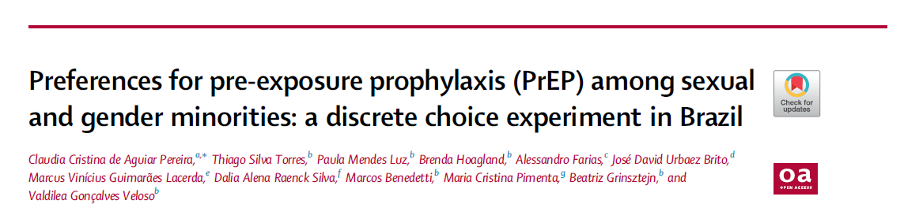
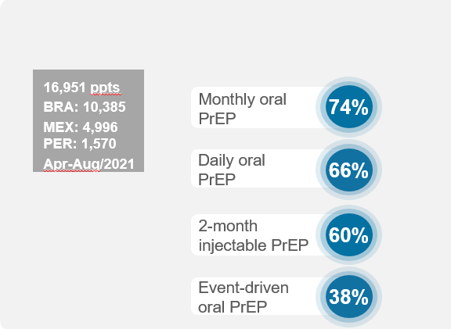
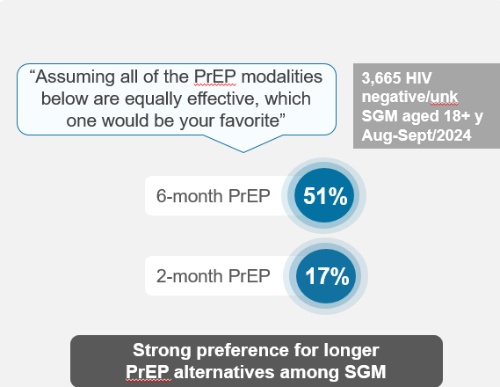
PrEP preferences on the ImPrEP oral study
Profiles of Willingness to Use Pre-Exposure Prophylaxis Modalities among Brazilian, Mexican and Peruvian Sexual and Gender Minorities: A Cross-Sectional Online Survey
Long-acting PrEP Preference Among Brazilian Sexual and Gender Minorities: Key Influencing Factors
3,924 participants
All Brazilian regions
Sept-Dec/2020
LEVEL OF PROTECTION
NO SIDE EFFECTS
MONTHLY
FREQUENCY OF USE
EVERY 2 MONTHS
YEARLY
PRESENTATION
INJECTABLE
IMPLANT
Most important attribute levels
Pereira et al, 2023. Qquellon et al. JMIR Public Health and Surveillance; 2025; Torres et al. CROI 2025.
Notes:
Increasing PrEP options may help to improve some of these outcomes.
In a discrete choice experiment conducted among Brazilian sexual and gender minorities, a longer duration between doses was identified as one of the most important attributes of an HIV prevention product.

Slide 5
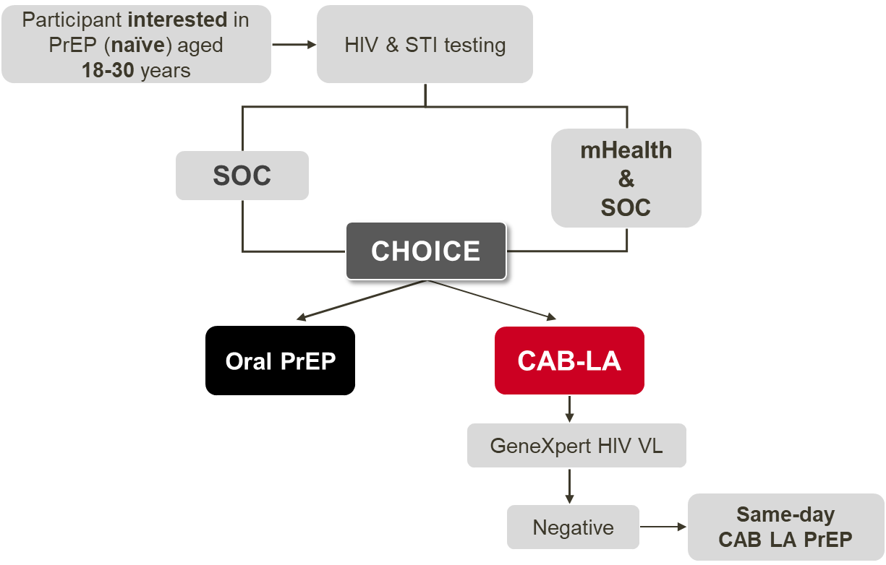
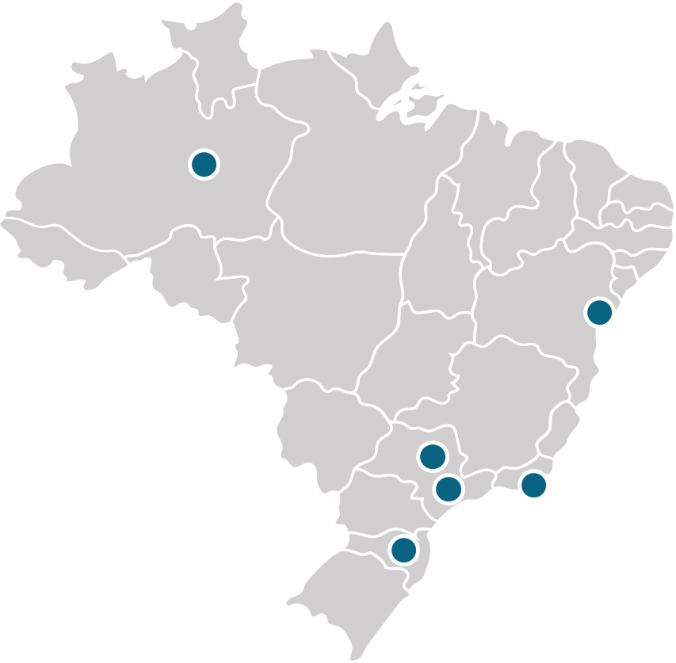
ImPrEP CAB Brasil Study
An Implementation study of CAB-LA for HIV PrEP among young MSM, non-binary and transgender persons
Goal
To generate critical evidence to inform national policies and program implementers about optimizing delivery of CAB-LA PrEP for MSM, non-binary and transgender individuals within public health PrEP services.
Study Population
MSM, non-binary or transgender persons with a negative HIV test result
Aged 18-30 years
PrEP naïve
Seeking PrEP or HIV testing
Location
6 Public PrEP services in 6 Brazilian cities
(Rio de Janeiro, São Paulo, Salvador, Campinas, Florianópolis and Manaus)
Grinsztejn B, et al. JMIR Public Health Surveill. 2023 Apr 19;9:e44961. Pimenta MC, et al. JMIR Public Health Surveill. 2024 Oct 24;10:e60961.
Notes:
To address this gap, we proposed the ImPrEP CAB Brasil study, which aimed to generate critical evidence to inform national policies and program implementers about optimizing delivery of CAB-LA PrEP for MSM, non-binary and transgender individuals within public health PrEP services across the country.
The study population was comprised of individuals with an HIV-negative test result, aged 18 to 30, who had never used PrEP but were seeking PrEP or HIV testing at one of six public PrEP services in six Brazilian cities as shown in this map.
After the formative phase, we initiated the study implementation phase, as shown in this slide. At enrollment, participants received either standard of care counselling or standard of care counselling plus an mHealth intervention to support PrEP choice.
HIV testing was performed using a 3rd generation HIV rapid test. In addition, only for the CAB-LA cohort, HIV viral load testing using the GeneXpert platform was performed prior to the first and reload injections.
Participants opting for CAB-LA received a same-day injection with no oral lead-in upon a negative quantitative GeneXpert HIV viral load result. Injections were 600mg, with the first 2 injections separated by 4 weeks and all subsequent injections at every 8 weeks.
Those opting for oral PrEP received same day TDF/FTC according to the Brazilian PrEP guidelines.

Slide 6
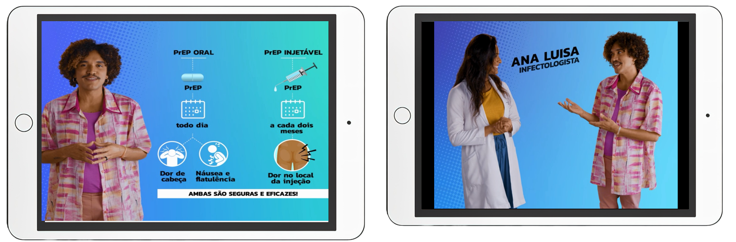

The mHealth intervention
In general, SGM persons participating in FGDs perceived the mHealth tool verbal and esthetic languages as appealing, accessible, direct, and relevant to reaching younger SGM groups.
Developed collaboratively with input from focus groups comprising young MSM, transgender individuals, and health professionals
Used at enrollment in ImPrEP CAB Brasil, when participants independently accessed the content on a tablet before choosing their PrEP option.
Comprised five short videos with 17 minutes of content in total.
Videos covered: oral and injectable PrEP, and other HIV and STI prevention strategies
People (including physicians) featured in the videos were SGM individuals
Pimenta MC, et al. JMIR Public Health Surveill. 2024 Oct 24
Notes:
Developed collaboratively with input from these focus groups, the mHealth was designed to enhance understanding and decision-making regarding PrEP options, including information on oral PrEP, CAB-LA, and combination HIV prevention strategies. The mHealth intervention was used at enrollment in ImPrEP CAB Brasil, when participants independently accessed the content on a tablet before choosing their PrEP option. The tool comprised five short videos with 17 minutes of content in total, which covered oral and injectable PrEP, and other HIV and STI prevention strategies.
People featured in the videos, including physicians, were members of sexual and gender minorities.

Slide 7

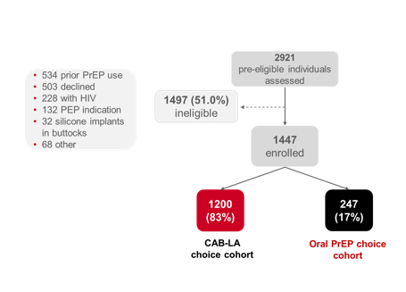
Person-centered choice and mHealth support for same-day delivery of long-acting injectable cabotegravir (ImPrEP CAB Brasil): a prospective, open-label, multicenter, quasi-experimental implementation study
Strong preference for CAB-LA among young sexual and gender diverse populations.
The mHealth intervention was highly acceptable and supported informed-decision, indicating its utility as a scalable strategy in real-world settings.
Most participants chose CAB-LA, with the main reason being the perceived difficulty of daily oral pill intake.
The proportion of participants of younger age (18–20 years) choosing CAB-LA was lower than that of those aged 25–30 Years. They might require more intensive peer-led counseling or tailored information to overcome potential barriers.
These findings underscore the critical importance of integrating diversified PrEP modalities with accessible decision-making support interventions within public health systems.
Enrollment period: Oct2023-Sept2024
Torres et al. 2026 Jun 12;59:101522
Notes:
For analyses of PrEP coverage, we compared three cohorts: the CAB-LA choice cohort, the oral PrEP choice cohort, and the oral PrEP comparison cohort, comprised of persons PrEP-naïve with the same demographics, who initiated oral PrEP in the same period through the Brazilian public health system.
From October 2023 to September 2024, we assessed twenty nine hundred twenty one pre-eligible individuals, of whom 51% were deemed ineligible due to reasons such as prior PrEP use, silicone implants, or HIV positive test results.
A total of fourteen hundred forty seven eligible individuals were enrolled, with twelve hundred (83%) choosing CAB-LA and two hundred forty seven (17%) choosing oral PrEP.
ENTER
The oral PrEP comparison cohort evaluated consisted of twenty four hundred eleven individuals using oral PrEP from 14 Brazilian PrEP public health services.
The formative phase of ImPrEP CAB Brasil involved intensive community mobilization, process mapping with providers experienced in CAB-LA, and focus group discussions with youth from sexual and gender minorities and health care providers. These activities helped identify initial barriers and facilitators to CAB-LA implementation, refine the mHealth educational tool, and assess the acceptability of using WhatsApp appointment reminders.

Slide 8
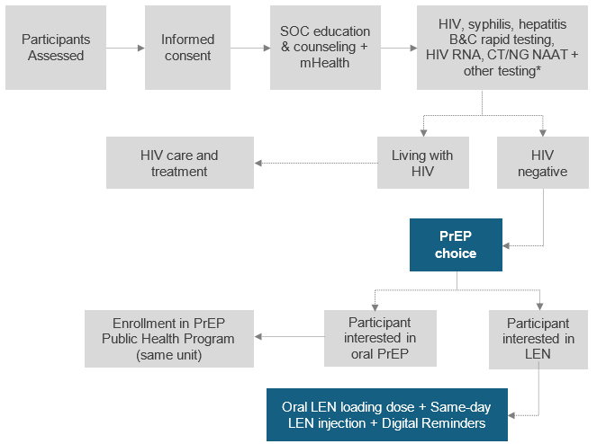
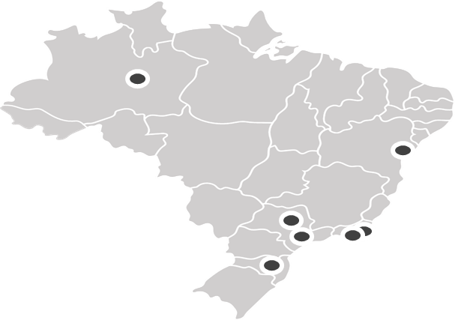


ImPrEP LEN Brasil
Expanding PrEP options among young MSM, transgender and non-binary persons in Brazil: incorporating twice-yearly lenacapavir for HIV prevention
GOAL
To evaluate the feasibility of implementing LEN for HIV prevention in real-world settings within the Brazilian Public Health System to generate critical evidence to inform national policies and program implementers.
PRIMARY OBJECTIVE
Assess LEN persistence among study participants in a context where they exercise choice of their PrEP methods.
STUDY POPULATION
Cisgender MSM, non-binary assigned as male at birth, or transgender persons with a negative HIV test result
Aged 16-30 years
PrEP naïve or PrEP-experienced remaining under vulnerability
Seeking PrEP or HIV testing spontaneously or through peer invitation
LOCATION
9 Public PrEP services in 7 Brazilian cities: Campinas, Florianopolis, Manaus, Salvador, São Paulo, Nova Iguaçu and Rio de Janeiro.

Slide 9








Intervention Package
Pharmacists generate reports to support outreach to ppts with delayed injections
Study team contacts participants to reschedule
LEN injections dispensed
Brazilian ARV Logistic System that records every ARV dispensation nationwide
Schedule feature integrated into the system to calculate the ideal window for the next injections
The system will automatically generate and send WhatsApp reminders
Last registered injections

Slide 10





Intervention Package
Loading dose
Report of drug leakage
Ppts with the indication of loading dose of oral LEN 600mg (enrollment and reloads)
Ppts with the indication of loading dose of oral LEN*
(enrollment and reloads)
Ppts with the indication of loading dose of oral LEN 600mg (enrollment and reloads)
Assessment of ppt reporting drug leakage
*Loading dose of oral LEN:
First dose (same day as initial injections): 2 tablets of 300 mg each
Second dose (24 hours later): 2 tablets of 300 mg each
Short survey to assess intake of the second oral loading dose
WhatsApp reminders
Short survey to assess intake of the second oral dose and eventual side events
WhatsApp reminders
Short survey to assess intake of the second oral dose and eventual side events
Short survey to assess drug leakage
Study team contact ppt to investigate what happenned
WhatsApp reminders

Slide 11
What new? LEN-specific questions on the drivers for uptake and delivery need to be answered
What are the optimal ways to deliver scalable LEN PrEP, assessing how to best integrate its provision into existing PrEP services settings and/or different health care delivery models?
How can we better reach highly vulnerable populations that remain underserved, and ensure their continued engagement in care?
How can we ensure that the loading dose is administered not only at initiation but also during re-initiation (reload) periods?
How can the intervention package be improved to support its automated, scalable use across the country?
*See poster numbered AS-AIDS-2026-12557 - "Implementing twice-yearly lenacapavir (LEN) within public health PrEP services in Brazil: the ImPrEP LEN-Brasil study
Notes:
As we move forward with the approval of new long-acting agents, such as LEN, several specific questions remain and must be addressed to guide broader implementation. We need to understand the most effective and scalable ways to deliver LEN PrEP, including how best to integrate its provision into existing PrEP services and other models of care. It's also critical to explore strategies for reaching highly vulnerable and underserved populations—and, importantly, ensuring their continued engagement in care over time.
In addition, operational questions remain: how can we ensure timely administration of the loading dose, not only at initiation but also during re-initiation periods? And how can we improve the intervention package so that it can be automated and scaled nationally, supporting effective and sustainable program delivery?
We hope to address some of these questions through our next implementation study — ImPrEP LEN Brasil. If you’re interested in learning more about this new initiative, we invite you to join us for the ImPrEP session tomorrow. Session details can be accessed via the QR code on the screen.

Slide 12


Acnowledgements
ImPrEP Brasil Study Group
Coordinating Site
Beatriz Grinsztejn
Valdiléa Veloso
Brenda Hoagland
Emilia M. Jalil
Carolina Coutinho
M. Cristina Pimenta
Thiago S. Torres
Ronaldo Ismério Moreira
luri Leite
Monica Derrico
Luana Marins
Larissa Villela
Débora Barreto
Sandro Nazer
Roberta Trefiglio
Marcos Benedetti
Júlio Moreira
Keila Simpson
Luciana Kamel
Gabrielle O'Malley
Raphael J. Landovitz
Claudio Gruber Mann
Renato Lima
AntonioCarvalho
Study Sites
Alessandro Farias (Salvador)
Maria Cristina Abbate (São Paulo)
Maria Paula G. Mourão (Manaus)
José Henrique Pilotto (Nova Iguaçu)
José Valdez Madruga (São Paulo)
Josué N. de Lima (Campinas)
Ronaldo Zonta (Florianópolis)
Beatriz Grinsztejn (Rio de Janeiro)
Support from:
UNITAID
Brazilian Ministry of Health
ViiV
Gilead
Notes:
I would like to thank our incredible study team, Unitaid for funding this study, the Brazilian Ministry of Health for the unrestricted support, ViiV for donating CAB-LA and Gilead for donating LEN, and, especially, all the participants for their invaluable contribution.

Slide 13

Obrigada!
Brenda Hoagland – brenda.Hoagland@ini.fiocruz.br
www.fiocruz.br

