Slide 1

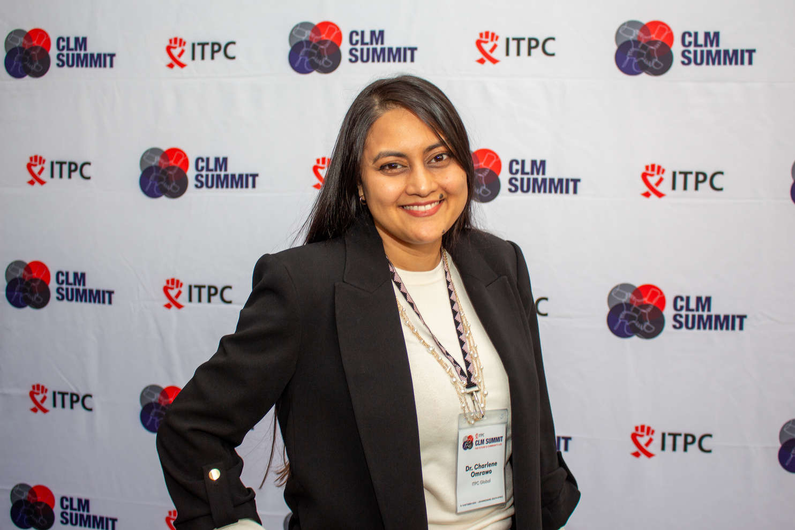
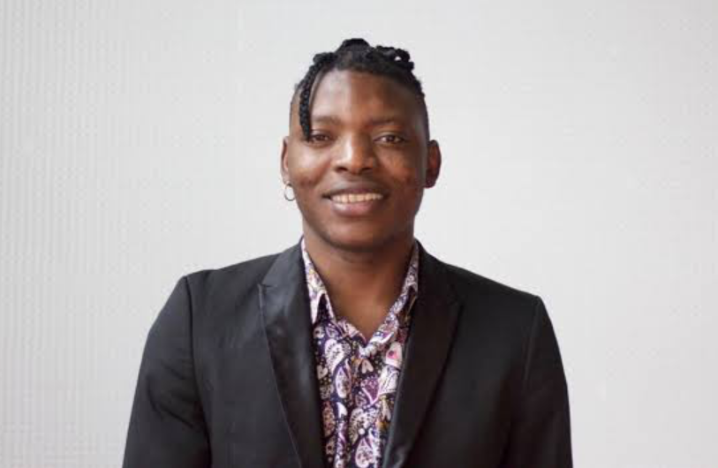
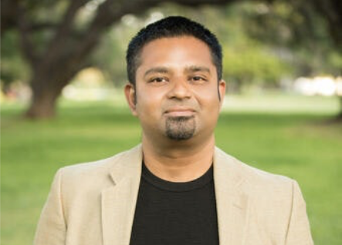
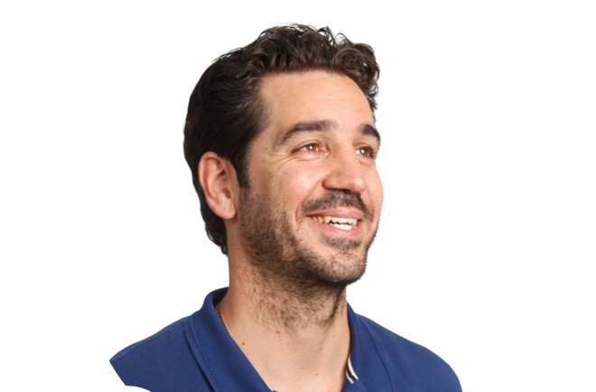
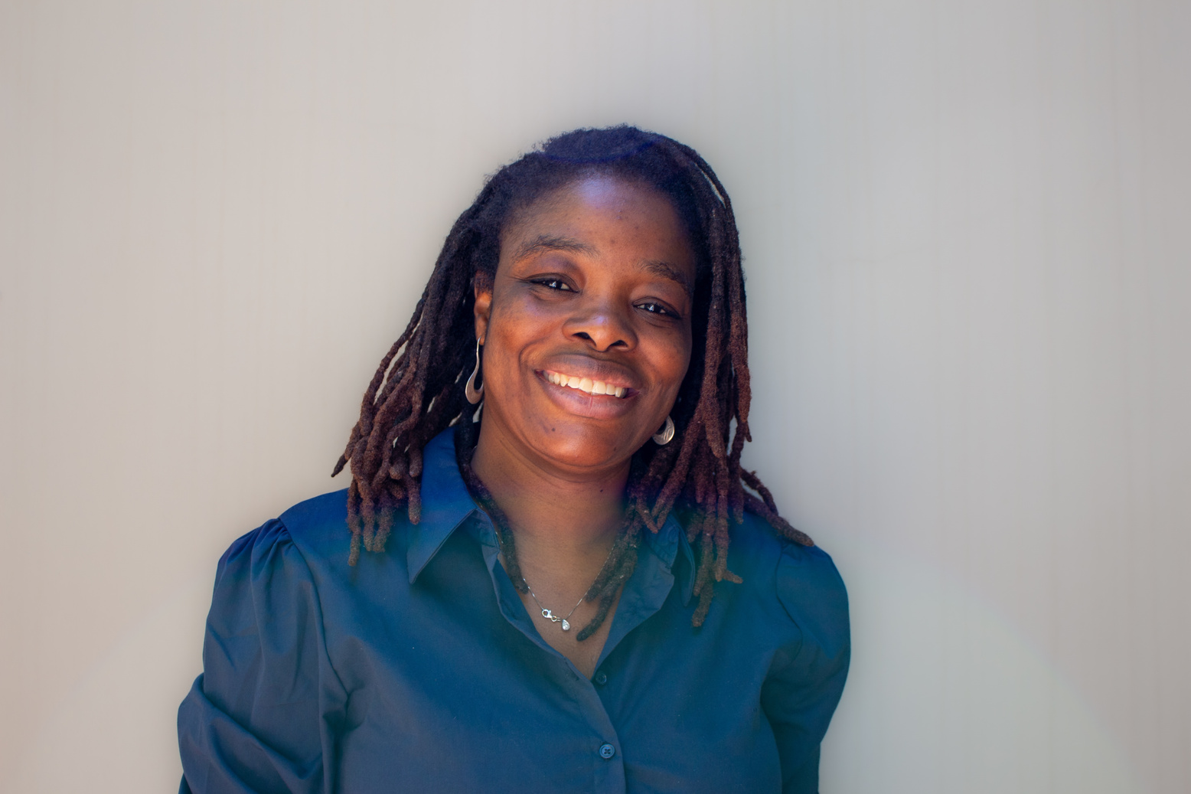

SPEAKERS
SESSION 3:
The Next Frontier – Technology, Power and the Future of HIV Activism
Voices from the Future
11:30-12:00
Charlene Omrawo
Micheal Ighodaro
ITPC Global - Program Lead
GBGMC - Executive Director
South Africa
USA
Mohan Sundararaj
Grindr for Equality - Managing Director
USA
Dino Rech
Wame Jallow
Audere - Chief Executive Officer
Shuga Global - Executive Director
Kenya
South Africa

