Slide 1
12th Symposium on Children and Adolescents with Perinatal HIV Exposure
Jorge Pinto
Professor of Paediatrics and Immunology
Federal University of Minas Gerias
Opening Remarks

Slide 2
Global population of children < 15 years of age living with HIV
(2000 – 2025)
UNAIDS Spectrum Data @ aidsinfo.unaids.org
Notes:
Number of children < 15 living with HIV dropped from and estimated 1.4 million in 2024 to 1.27 million in 2025, a decline of 9.3%.

Slide 3
Global population of children < 15 years of age with perinatal HIV exposure (2000 – 2025)
UNAIDS Spectrum Data @ aidsinfo.unaids.org
Notes:
The estimated number of children with in utero exposure to both HIV an ARVs did not change between 2024 and 2025, remaining at 14.6 million.

Slide 4
Global population of children < 15 years of age with perinatal HIV exposure (2000 – 2025)
UNAIDS Spectrum Data @ aidsinfo.unaids.org
Notes:
The estimated number of children with in utero exposure to both HIV an ARVs did not change between 2024 and 2025, remaining at 14.6 million.

Slide 5
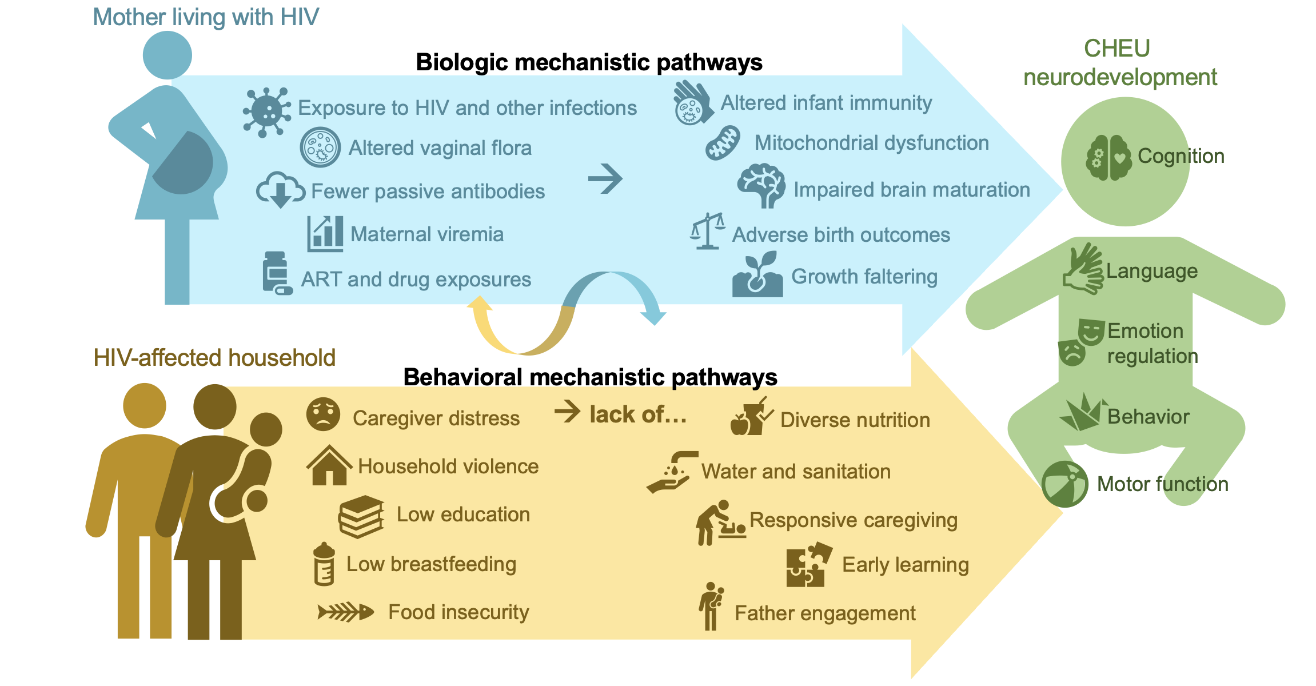

Slide 6
12th Symposium on Children and Adolescents with Perinatal HIV Exposure
Time | Session titles
14:00 - 15:00 | Session 1: Optimizing development after perinatal HIV exposure
15:00 - 15:30 | Break and refreshments
15:30 - 17:00 | Session 2: Identifying risk and supporting families: Lessons from other programmes
17:00 - 19:00 | Break
17:30 - 19:00 | Session 3: Long-term follow-up: From data to action

Slide 7

Please note that:
This event is being recorded
Participation signals your consent to have the recording posted on the conference portal and on the IAS+ website
We welcome our participants online. Those joining online are muted
For interpretation, scan the QR code, select your language, and tap Join
  Read captions or listen to audio using your phone and headphones
We welcome your questions
  For those joining online, please use the Q&A function
  And for those in the room please make use of the microphones along the aisles

Slide 8

12th Symposium on Children and Adolescents with Perinatal HIV Exposure

Slide 9


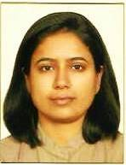
Session 1: Optimizing development after perinatal HIV exposure
Megan Kowalcyk
University of Maryland
Marguerite Marlow
Stellenbosch University
Himani Pandya
Stellenbosch University
Neurocognitive development in infants with perinatal HIV exposure: Evidence from Malawi
Supporting early child development through play-based and responsive caregiving interventions
Caregiving journeys for mothers of infants with perinatal HIV exposure: implications for policy and programmes

