Slide 1
Neurocognitive development in infants with perinatal HIV exposure: Evidence from Malawi
Megan Kowalcyk, PhD, MPH, University of Maryland School of Medicine
Session 1: Optimizing development after perinatal HIV exposure

Slide 2
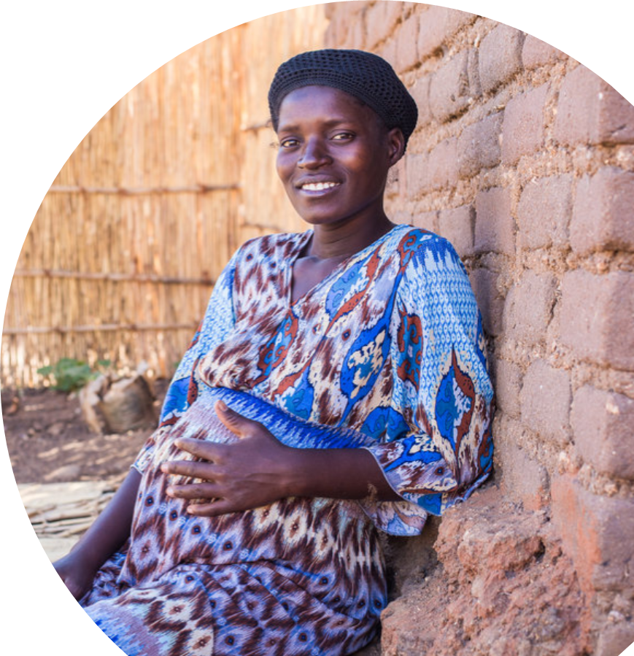
REFINE Study
Prospective cohort recruiting pregnant women from two health centers in Southern Malawi
Eligible women were enrolled into three cohorts
Diagnosed with HIV infection at the first ANC visit
  Viral load > 1,000 copies/mL at first visit (HIV high)
On ART for at least 6 months prior to conception
  Undetectable viral load at first visit (HIV low)
Without HIV
© Corrie Wingate
Notes:
Conflicting evidence on the impact of perinatal HIV exposure on neurocognitive development in children, particularly after widespread rollout of ART for PMTCT. Major challenges include locally validated neurocognitive assessments and confounding prenatal and postnatal factors.

Slide 3
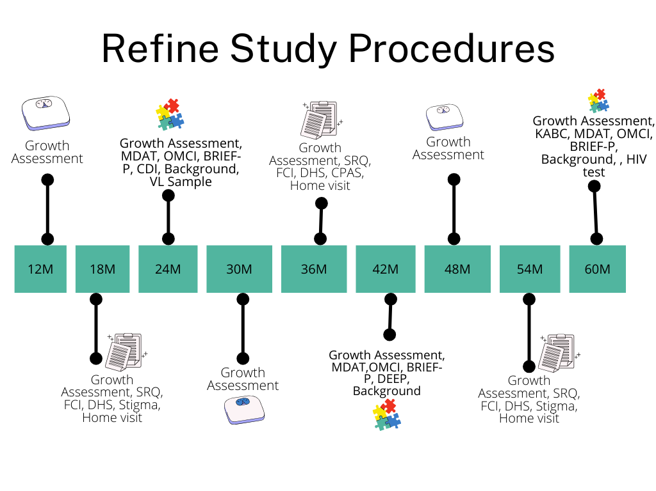
REFINE Study Procedures
Notes:
SRQ is measuring maternal mental health
In our study we looked at SRQ, MDAT, OMCI, BRIEF-P. CDI

Slide 4
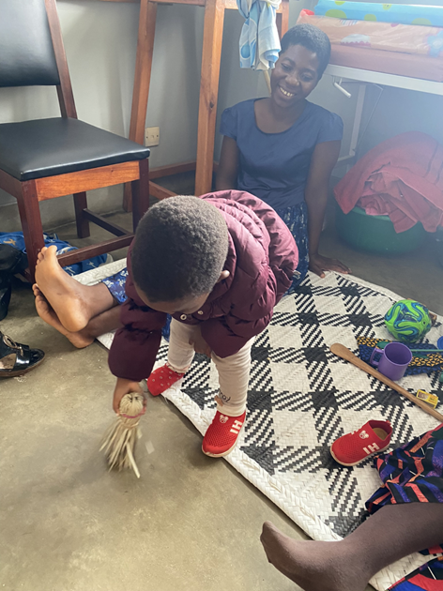
Child Neurodevelopment
Malawi Development Assessment Tool (MDAT)
Assesses neurodevelopment for children up to 6 years of age across four domains: gross motor, fine motor, language and social.
Items are scored as a pass/fail through caregiver report and direct observation.
Validated tool in Malawi and other sub-Saharan African settings
Notes:
Ngina thinks IRR will be important to this crowd: we assessed IRR and found consistent MDAT measurements

Slide 5
Child Neurodevelopment
MacArthur Bates Communication Development Inventory (CDI)
Standardized parent-report form to determine language development in children 8-37 months of age
Malawian adaptation is a 100-word vocabulary checklist

Slide 6
Child Neurodevelopment
Behavioural Rating Inventory of Executive Functions – Preschool (BRIEF – P)
Parent-report tool to evaluate behavioural, attention and cognitive problems disrupting executive function in children 2 – 5 years old
Culturally adapted for use in Malawi

Slide 7
Perinatal HIV Exposure and Postnatal Environment Impacts Neurodevelopment
Maternal Biological Exposures
HIV and other infections
Microbiota
Antibody transfer
ART, antibiotics, other drugs
Mechanistic Pathways
Altered infant immunity
Mitochondrial dysfunction
Impaired brain maturation
Adverse birth outcomes
Child Neurodevelopment
Cognition
Language
Emotional regulation
Behavior
Motor function
Environmental Exposures
Caregiver mental health (SRQ)
Low household income
Household violence (CPAS)
Low maternal education
Food insecurity
Mechanistic Pathways
Less responsive caregiving (OMCI)
Poor water and sanitation
Poor parental engagement
Fewer learning opportunities
Lack of nutrition

Slide 8

Perinatal HIV Impacts Mild Delay
 | Total Observations (N=1403) |  | 24 Months Observations (N= 669) |  | 42 Months Observations (N = 734)
 | Mild Delay N (%) | OR (95%CI) | Mild Delay N (%) | OR (95%CI) | Mild Delay N (%) | OR (95%CI)
CHEU | 63(8.9) | 1.88** (1.19, 2.96) | 22(6.9) | 1.97. (0.93,4.16) | 41(10.4) | 1.61. (0.98,2.64)
CHEU-Hi | 12(12.9) | 2.53** (1.36,4.74) | 1(2.4) | 0.86 (0.12,6.29) | 11(21.2) | 2.5** (1.33,4.72)
CHEU-Lo | 51(8.3) | 1.72* (1.06,2.80) | 21(7.6) | 2.17* (1.00,4.70) | 30(8.8) | 1.37 (0.79,2.38)
CHUU | 38(5.5) | Ref | 11(3.1) | Ref | 27(7.9) | Ref
Significance level: .0.1 * 0.05 **0.01 ***0.001 Mild Delay – MDAT total age adjusted z score < -1
Mild delay is more prevalent among children who are perinatally exposed to HIV
Prevalence of mild delay decreases as children age
Amanuel Wolde, MD, MS
Notes:
Delay is defined as age and standardized population adjusted z score <-1
N = 804 total children

Slide 9
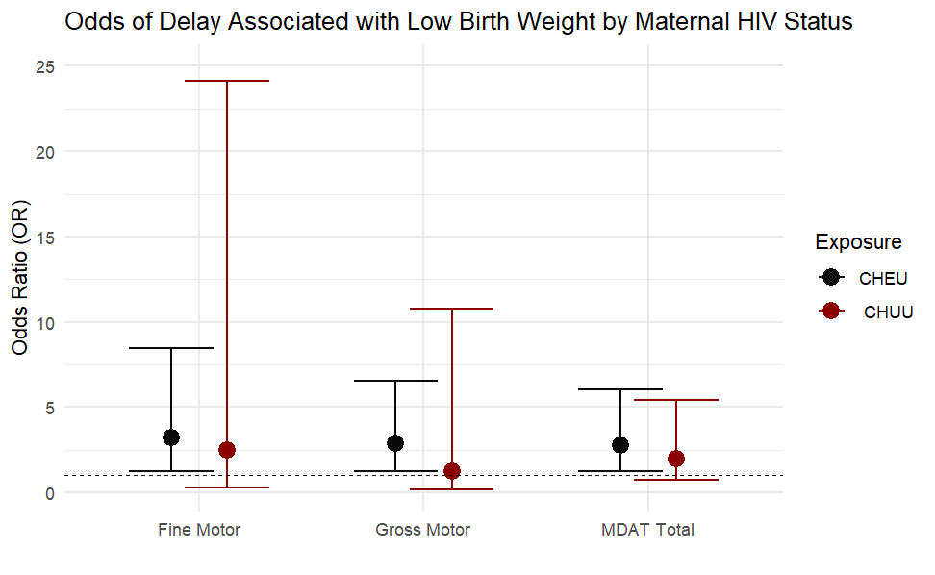
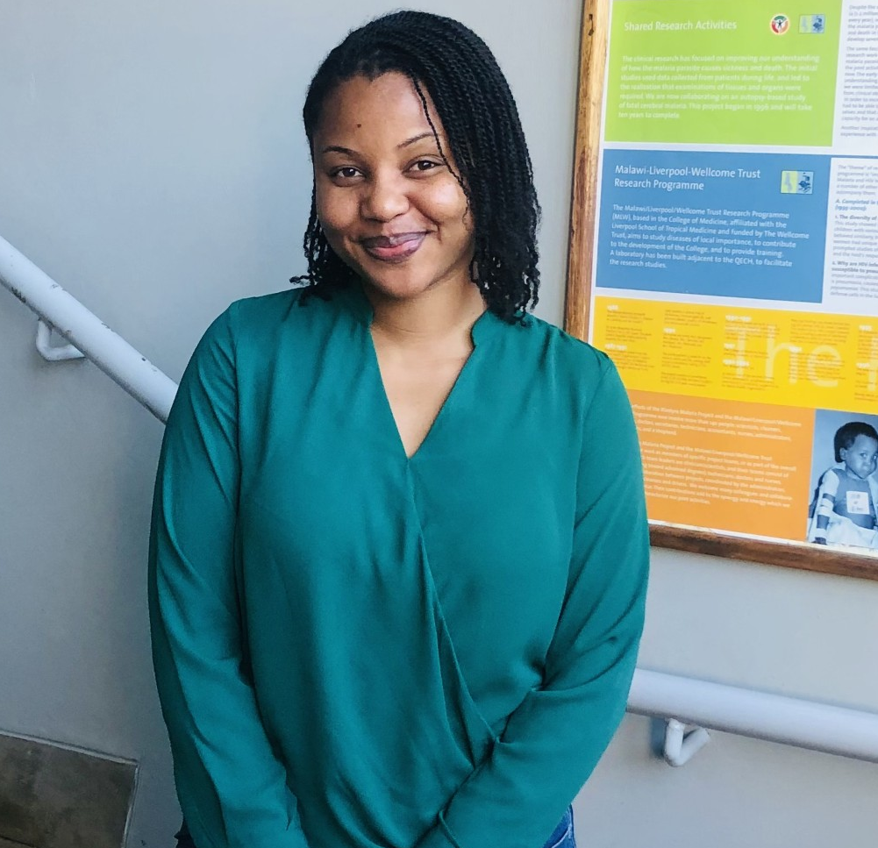

Low Birth Weight Predicts Poor Neurodevelopment among CHEU
Low birth weight increased odds of developmental delay overall and in the motor domains among those perinatally exposed to HIV.
Christabell Mdhluli & Harrison Msuku

Slide 10

Postnatal Environment Impacts Neurodevelopment
BRIEF – P Measure | High Distress Mothers (SRQ ≥ 8) | Low Distress Mothers (SRQ < 8) | Wilcoxon P-Value
Inhibitory Self Control | 16 (8, 24) | 11 (6, 17) | <0.001
Working Memory | 15 (8, 22) | 12(6, 18) | 0.016
Flexibility | 10 (5, 17) | 7 (3, 11) | <0.001
Global EF Score | 34 (19, 55) | 26 (15, 39) | 0.001
Median (LL, UL) Higher score = worse executive function
Worse executive function among children whose mother's self-reported experiencing psychological distress.
Gabriella Cabrera

Slide 11
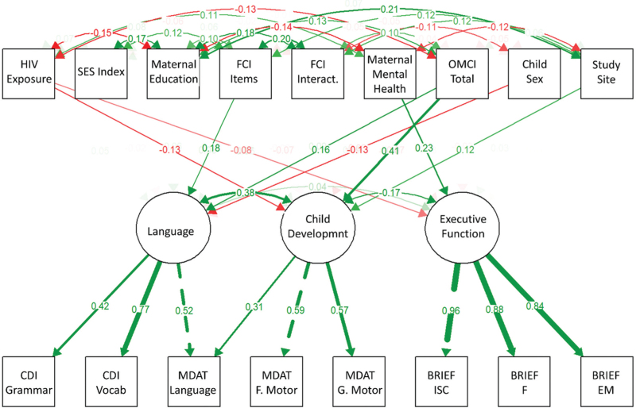

Environment Outweighs Impact of HIV on Neurodevelopment at 24 Months
Perinatal HIV exposure is associated with worse development and executive function.
However, improving OMCI scores had far greater positive impact.
Andrea Buchwald, PhD
Positive significant association Negative significant association
Notes:
We used a structural equations model which allows us to combine maternal and post natal environmental factors

Slide 12
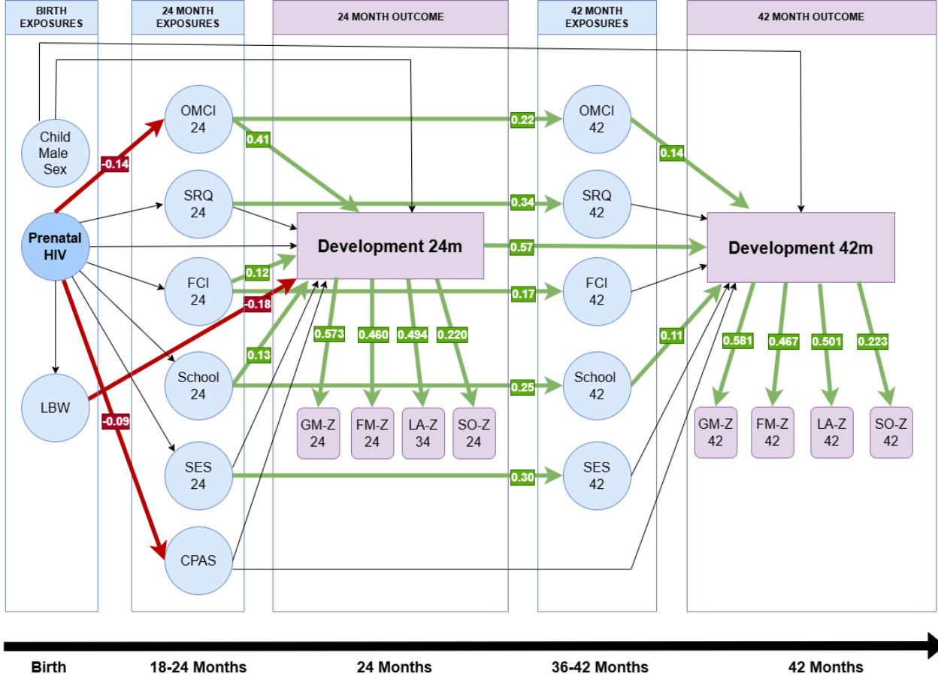

Longitudinal Neurodevelopment
Low birth weight mediates the association between perinatal HIV exposure and neurodevelopment at 24 months of age.
Nginache Nampota, MD
Notes:
Output of longitudinal structural equation model showing standardized estimates. Significant paths are shown in green for positive association and red for negative association. Maternal age, gravidity, study site, education, and marital status were included as predictors of exposures. CPAS: Childhood Psychosocial Adversity Scale; SRQ: Self-Reporting Questionnaire; OMCI: Observation of Mother–Child Interaction; FCI: Family Care Indicators; GM-Z: Malawi developmental assessment tool (MDAT) Gross-Motor Z score, FM-Z: MDAT Fine Motor Z score, LA-Z: MDAT Language Z score, SO-Z: MDAT Social Z score.

Slide 13
Longitudinal Neurodevelopment
CPAS mediates the association between perinatal HIV exposure and neurodevelopment at 24 months of age.
Nginache Nampota, MD
Notes:
Output of longitudinal structural equation model showing standardized estimates. Significant paths are shown in green for positive association and red for negative association. Maternal age, gravidity, study site, education, and marital status were included as predictors of exposures. CPAS: Childhood Psychosocial Adversity Scale; SRQ: Self-Reporting Questionnaire; OMCI: Observation of Mother–Child Interaction; FCI: Family Care Indicators; GM-Z: Malawi developmental assessment tool (MDAT) Gross-Motor Z score, FM-Z: MDAT Fine Motor Z score, LA-Z: MDAT Language Z score, SO-Z: MDAT Social Z score.

Slide 14
Longitudinal Neurodevelopment
OMCI is the largest driver of the association between perinatal HIV exposure and neurodevelopment at 24 and 42 months of age.
Nginache Nampota, MD
Notes:
Output of longitudinal structural equation model showing standardized estimates. Significant paths are shown in green for positive association and red for negative association. Maternal age, gravidity, study site, education, and marital status were included as predictors of exposures. CPAS: Childhood Psychosocial Adversity Scale; SRQ: Self-Reporting Questionnaire; OMCI: Observation of Mother–Child Interaction; FCI: Family Care Indicators; GM-Z: Malawi developmental assessment tool (MDAT) Gross-Motor Z score, FM-Z: MDAT Fine Motor Z score, LA-Z: MDAT Language Z score, SO-Z: MDAT Social Z score.

Slide 15
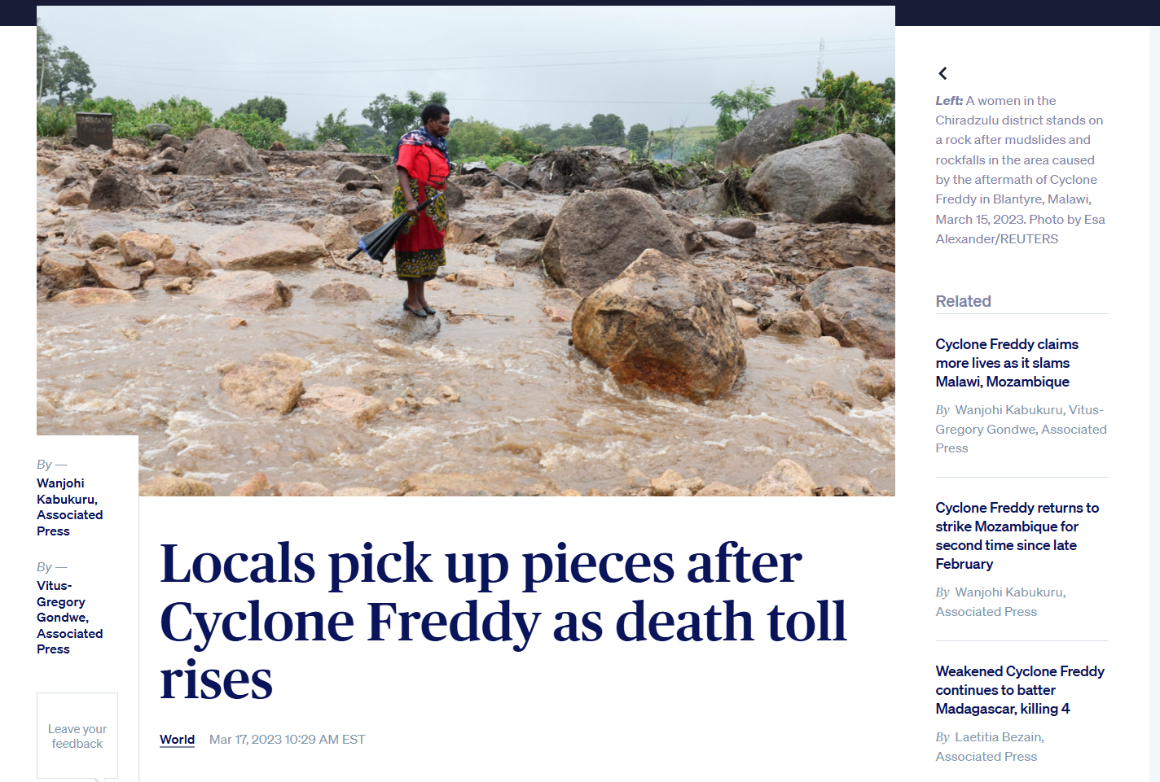
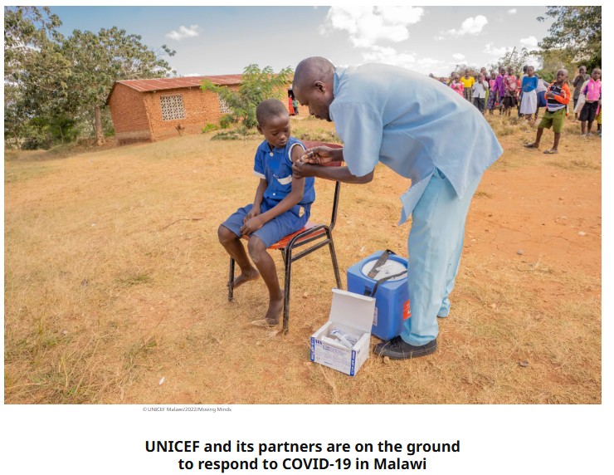
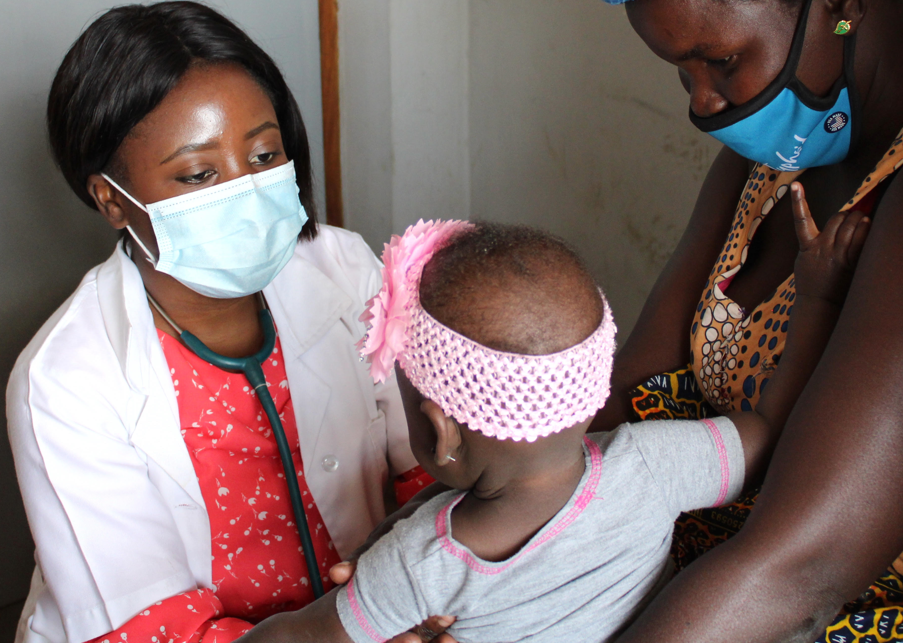
Compounding Vulnerability
We additionally aimed to examine various compound exposures, both biological and environmental, and found no additional effect of SARS-CoV-2, congenital cytomegalovirus, or Cyclone exposure on development among those who were exposed to perinatal HIV.
Nginache Nampota, MD & Amanuel Wolde, MD, MS

Slide 16
Conclusions
Continued effect of HIV observed on neurodevelopment out to 42 months of age despite healthy population on ART before conception
Environmental factors appear to drive impaired development among CHEU
Quality of mother – child interaction and maternal mental health emerge as key intervention points

Slide 17
Future Directions
Follow up continuing until 7 years of age
Assessing autism, school performance, other assessments of neurodevelopment (KABC-II, DEEP, SDQ)
Examining in utero immunological drivers of neurodevelopment
Assessing gut-brain axis – examining microbiome

Slide 18

Acknowledgements
The study participants
Blantyre Malaria Project:
Osward Nyirenda, Felix Mkandawire, Christabell Mdhluli, Chilungamo Mchakama, Stella Chifumbi, Ndege, Meraby Funsani, Chimwemwe Kalengo, Cynthia Manyozo, Victoria Mapemba, Jean Maloya,Kingsley Zuze, Newton Slemani, Rhoda Masonga, Charles Chilimbiri, Michael Matululu, Christopher Chiotcha, Goodson Thwala, and Margaret Banda.
University of Malawi:
Limbika Maliwichi
Malaria Alert Center:
Harrison Msuku, Samson Gowa, Alfred Matengeni
University of Liverpool
Melissa Gladstone, Malen Crespo-Llado
University of Maryland School of Medicine:
Miriam Laufer, Andrea Buchwald, Nginache Nampota, Cristiana Cairo, Gabriella Meshesha, Madison Beale, Sophie Moeller, Rachida Koudjra, Lauryn Butler, Amanuel Wolde, Gabriela Cabrera, Winter Okoth
Notes:
Borders on the letters

