Slide 1
Session 2: Identifying risk and supporting families: Lessons from other programmes
Session Chair: Renata Sanders, Children’s Hospital of Philadelphia/University of Pennsylvania School of Medicine

Slide 2
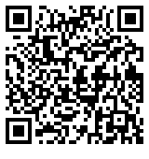
Please note that:
This event is being recorded
Participation signals your consent to have the recording posted on the conference portal and on the IAS+ website
We welcome our participants online. Those joining online are muted
For interpretation, scan the QR code, select your language, and tap Join
  Read captions or listen to audio using your phone and headphones
We welcome your questions
  For those joining online, please use the Q&A function
  And for those in the room please make use of the microphones along the aisles

Slide 3
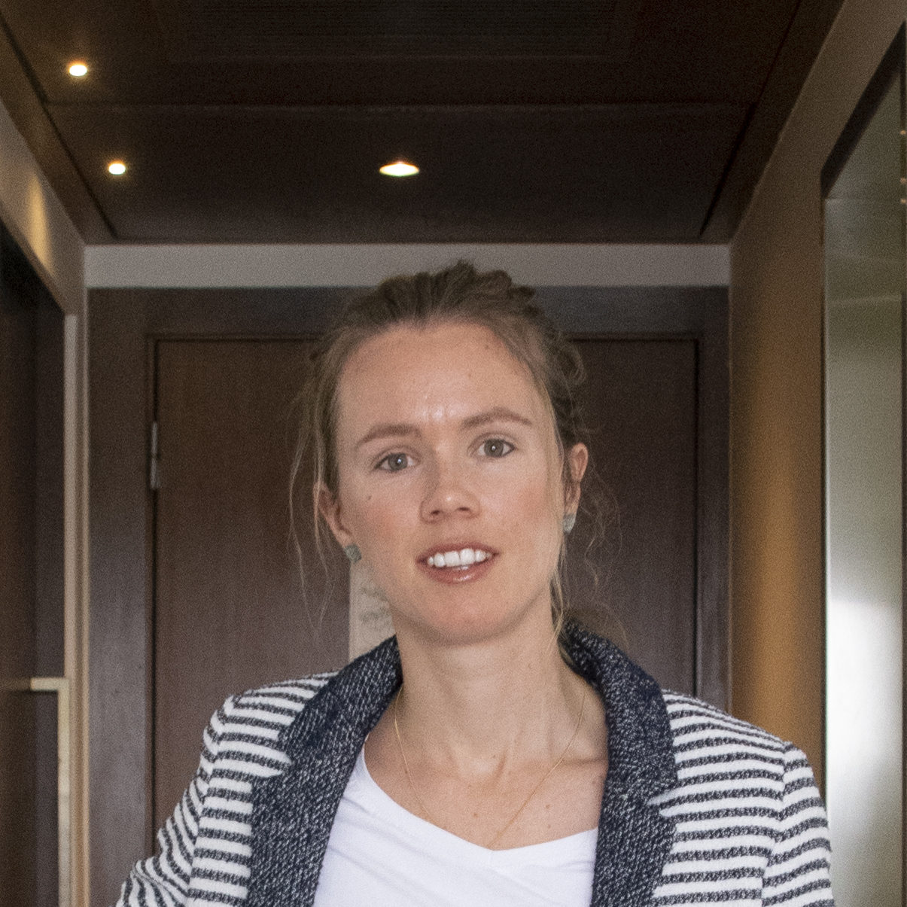

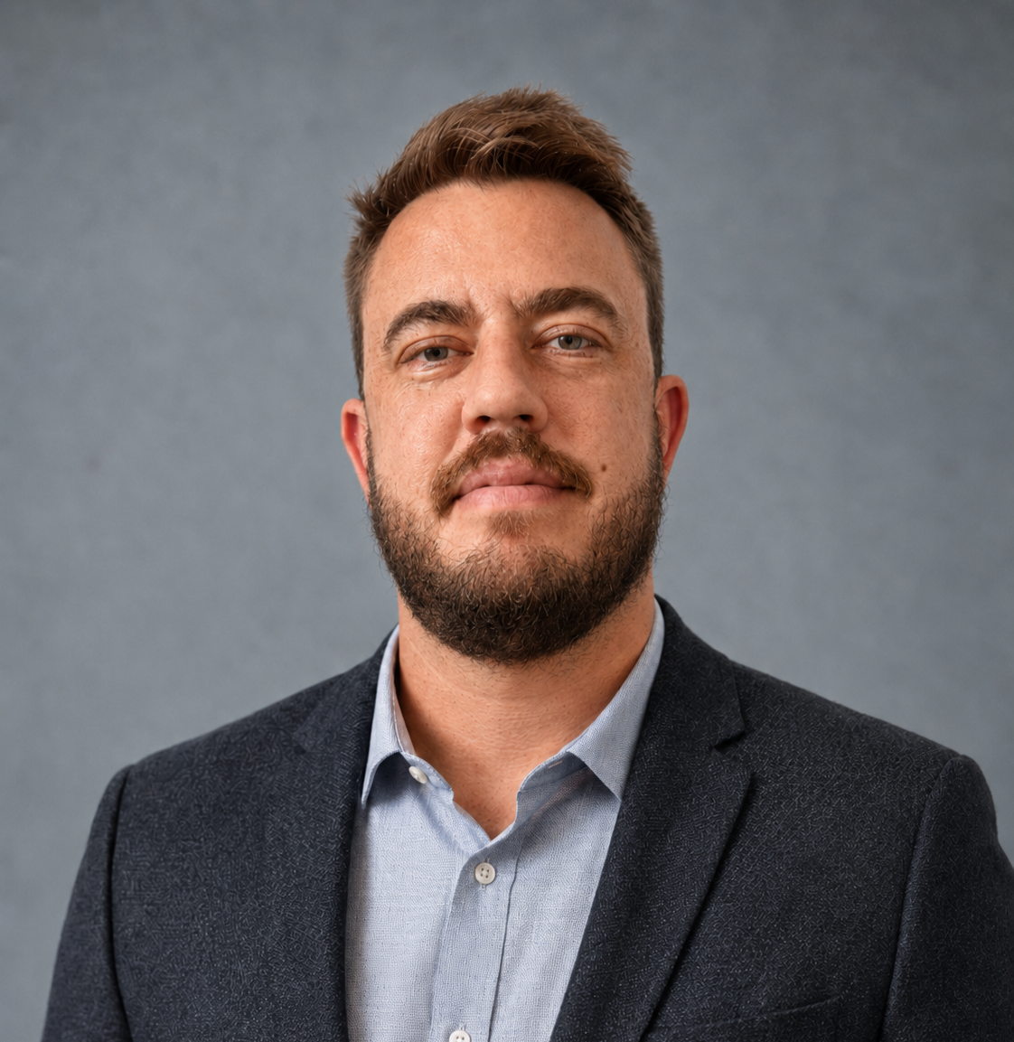
Shani de Beer
University of Cape Town
Lena Serghides
University of Toronto
Nathanael Leo van Blydenstein
Leo Advisory
Infectious-cause hospitalisation in a province-wide cohort of children HIV-exposed and HIV-unexposed during the dolutegravir era in the Western Cape, South Africa
Behavioural difficulties in school-aged children who are HIV-exposed uninfected and associations with intellectual performance; findings from the KIND Study
How to see children clearly without marking them socially: Transferable lessons from the imagine school-health intervention for children with perinatal HIV exposure screening in ECD and primary school settings

Slide 4
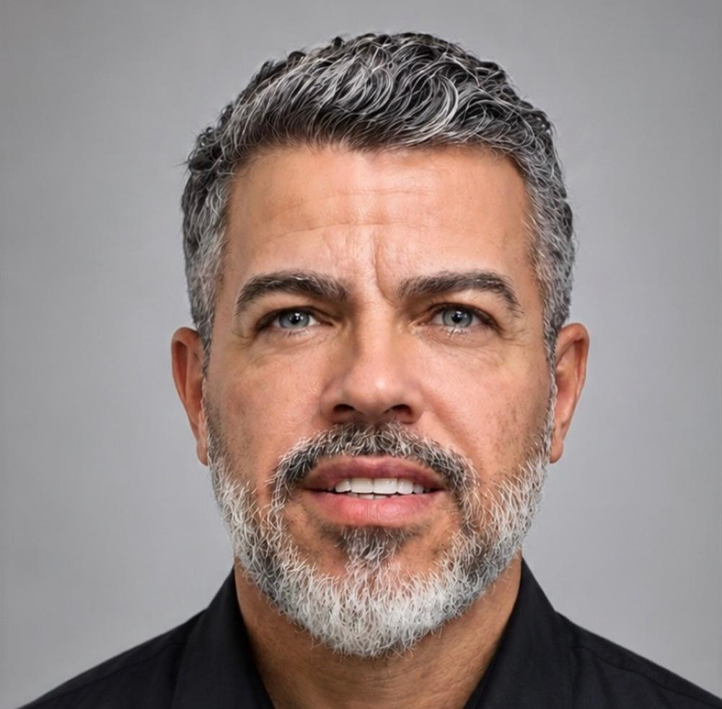
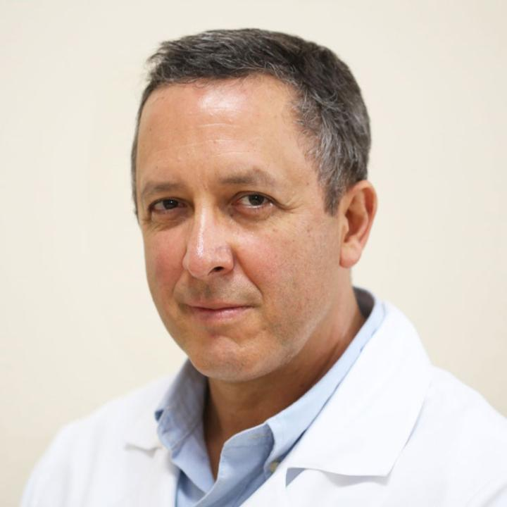

Jeferson Fonseca
Família Positiva BH
Jorge Pinto
University of Minas Gerais
Luana Uchôa Guimarães
Community Advocate
Community platforms that can be leveraged for long-term follow-up of children with perinatal HIV Exposure
Panellist
Panel chair
Panellist

