Slide 1




Infectious-cause hospitalisation in a province-wide cohort of children with and without HIV exposure during the dolutegravir era in the Western Cape, South Africa
S. de Beer, F. Phelanyane, K. Anderson, M. Tomlinson,
A. Bovu, A. Boulle, J. Euvrard, J-P Hynek, P. Dane, H. Rabie, J. Nuttall, K. Powis, P. Williams, M-A. Davies, E. Kalk
26–31 July • Rio de Janeiro, Brazil

Slide 2
Conflict of interest
K.A and M.A.D receive funding from ViiV Healthcare for an unrelated project.

Slide 3
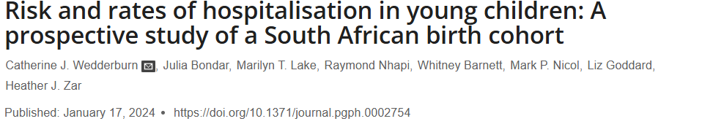
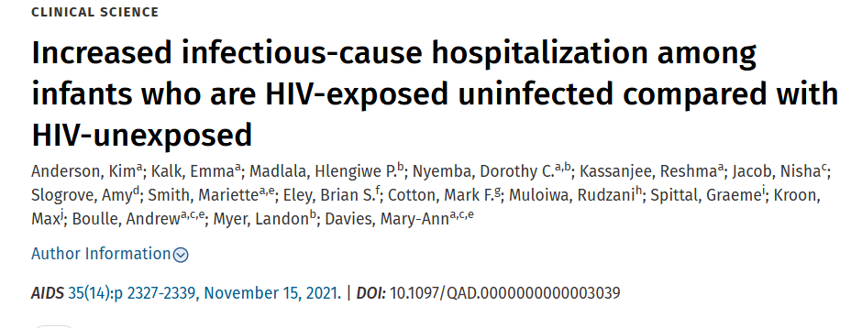
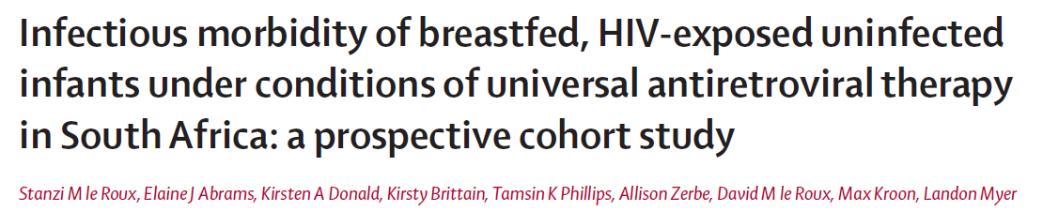
Years: 2012 – 2015
N = 1,136
Years: 2017 – 2018
N = 913
Years: 2013 – 2015
N = 869
Notes:
Previous studies have reported that children with HIV exposure are at an increased risk for infectious cause hospitalisation compared to children HIV-unexposed (referred to as HU), particularly in the first year of life.

Slide 4
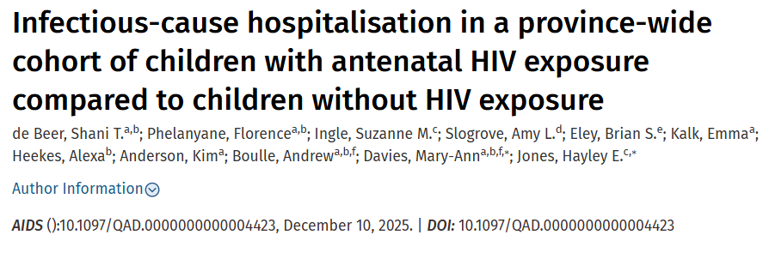
Years: 2013 – 2018
Pre dolutegravir (DTG) rollout
N = 394,334
Notes:
Last year, we published a paper on a province-wide study showing that despite greater access to maternal and pre-pregnancy ART, children HE vs. HU, born in the WC between 2013 and 2018 (pre dolutegravir rollout) had higher rates of infectious-cause hospitalisation during the first year of life.

Slide 5
Question
Do we see the same increased risk in infectious-cause hospitalisation among children with in utero HIV exposure now that we have a more mature ART programme and mothers on dolutegravir-based regimens?
We evaluated rates of infectious-cause hospitalisation from 2018 to 2024:
By gestational HIV and ART exposure
Up to age three years
Factors associated with hospitalisation
Data from WCPHDC
Notes:
This lead us to the question…

Slide 6
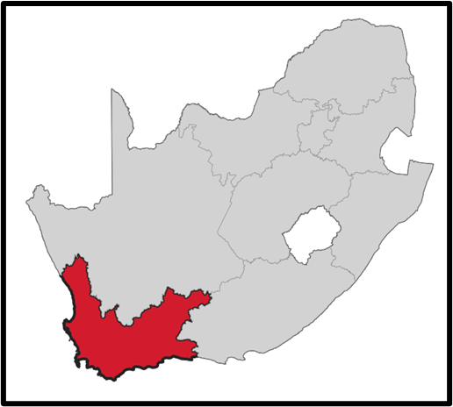
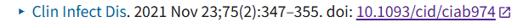
Methods
Children born in the Western Cape:
2018 - 2024
Child HIV diagnosis
Postpartum HIV diagnosis
No Linkage
HIV-unexposed
(HU)
In utero HIV exposure
(HE)
ART before pregnancy, start <2016
ART before pregnancy, start ≥2016
ART restart during pregnancy
ART start during pregnancy
No ART during pregnancy
No ART evidence ever
Unknown ART
Participants
Exclusion criteria
Exposure groups
*Children diagnosed with HIV during follow-up were censored at their last negative test
Further stratification
Notes:
We excluded children with an HIV diagnosis by age 10 weeks or an HIV diagnosis at any point with no prior negative HIV test result. Thereafter, children diagnosed with HIV during follow-up were censored at their last negative test.
Other exclusion criteria were Maternal HIV diagnosis during the postpartum period and no maternal and child linkage
We used a simplified version of globally agreed DECIPHER Project definitions to classify children as with in utero HIV-exposure (HE) and HIV-unexposed (HU).
For regression models, we stratified children with HE by timing of maternal ART start relative to pregnancy start. Mothers who started ART before pregnancy were further stratified by ART start before or after universal ART availability from 2016 onwards.

Slide 7
Methods
Outcome:
Infectious-cause hospitalisations: lower respiratory tract infections, diarrhoea, and meningitis
Classified using ICD10 codes
Statistical analyses:
Mixed-effects Poisson regression to assess rates of hospitalisation, and factors associated with hospitalisation, by gestational HIV-ART exposure status separately for three different periods:
  neonatal (0–28 days)
  post-neonatal (>28 days–≤12 months)
  1–3-year age periods

Slide 8
Results
Table 1. Characteristics of children and mothers, by child HIV exposure status at the start of follow-up
Variable | Total N=647,005 (100%) | Children HE N=100,256 (15.5%) | Children HU N=546,749 (84.5%)
Maternal age at delivery: mean (SD) | 27.4 (6.4) | 30.4 (6.0) | 26.8 (6.3)
Maternal death by child age 3 years: n (%) | 1,755 (0.3) | 746 (0.7) | 1,009 (0.2)
Child sex – male: n (%) | 327,295 (50.6) | 50,462 (50.3) | 276,833 (50.6)
Child low birthweight (< 2500g): n (%) | 96,328 (14.9) | 17,231 (17.2) | 79,097 (14.5)
Children with HIV at the end of follow-up | 343 (0.1) | 321 (0.3) | 22 (0.0)
Child death by age 3 years | 9,168 (1.4) | 1,868 (1.9) | 7,300 (1.3)
Notes:
Looking at the results of our analysis. Table 1 shows……We included 647,000 children in our dataset, 16% of which had HIV exposure. The mean maternal age among children HE was 30 years, compared to 27 among children HU. 17% of children HE were born low birth weight compared to 14% of children HU.

Slide 9
Maternal HIV-related characteristics among children HE (N= 100,256)
* Mothers who initiated ART prior to pregnancy, had no ART in hand during the first trimester, and had documented ART dispensing in the second or third trimester of pregnancy
† Maternal ART start date at delivery or postpartum
‡ Maternal ART start before or during pregnancy, but no electronic evidence of ART dispensing during pregnancy
Notes:
Here we have maternal HIV related characteristics among children HE. The donut chart on your left shows timing of ART initiation relative to pregnancy, and we see that 53% of mothers started ART before pregnancy, while another 13% had started ART before pregnancy, but interrupted and restarted during pregnancy.
The chart on the right shows the ART regimen anchor drug at delivery. Overall, 36% of mothers were on a DTG-based regimen at delivery and this proportion did increase progressively each year.

Slide 10
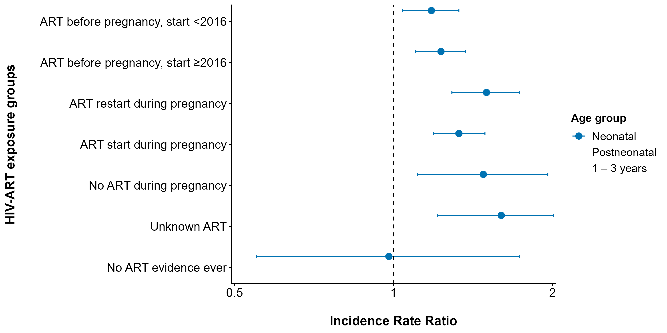
Increased rate of infectious-cause hospitalisation in the neonatal period
(reference group: children HU)
Models were adjusted for maternal age, suburb of residence, and birth year.
Notes:
This slide shows the outputs for regression models assessing the association between HIV-ART exposure and infectious-cause hospitalisation. The reference group is children HU. When stratifying HIV exposure status by timing of maternal ART as displayed on the y axis of this plot, children with HIV exposure had an increased risk of infectious-cause hospitalisation in the neonatal period compared to children HIV-unexposed, for all ART groups excepting those whose mothers had no ART evidence.

Slide 11
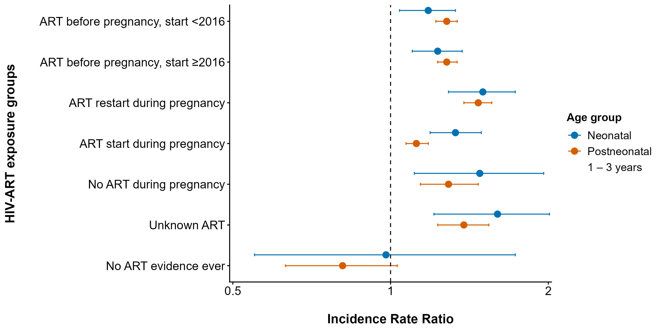
Increased rate of infectious-cause hospitalisation in the neonatal and postneonatal periods
(reference group: children HU)
Models were adjusted for maternal age, suburb of residence, and birth year.
Notes:
Similar associations were observed in the postneonatal period shown in orange.
Notably, among children of mothers on ART, the highest incidence rate ratios across the neonatal and post-neonatal periods were observed in those whose mothers restarted ART during pregnancy relative to children HIV-unexposed.

Slide 12
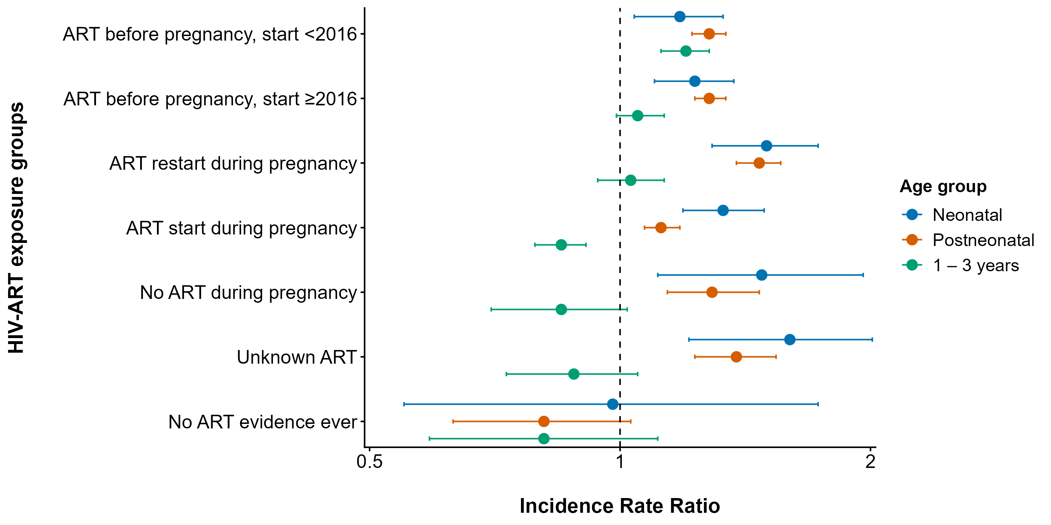
Compared rates of infectious-cause hospitalisation in all age periods
(reference group: children HU)
Models were adjusted for maternal age, suburb of residence, and birth year.
Notes:
In the 1 – 3 year age period shown in green, The only group that had an increased risk of hospitalisation where children whose mothers started ART before pregnancy and before 2016. These mothers started ART before the period of universal access and may have a background of very poor illness.
While children whose mothers started ART during pregnancy had a reduced association with hospitalisation.

Slide 13
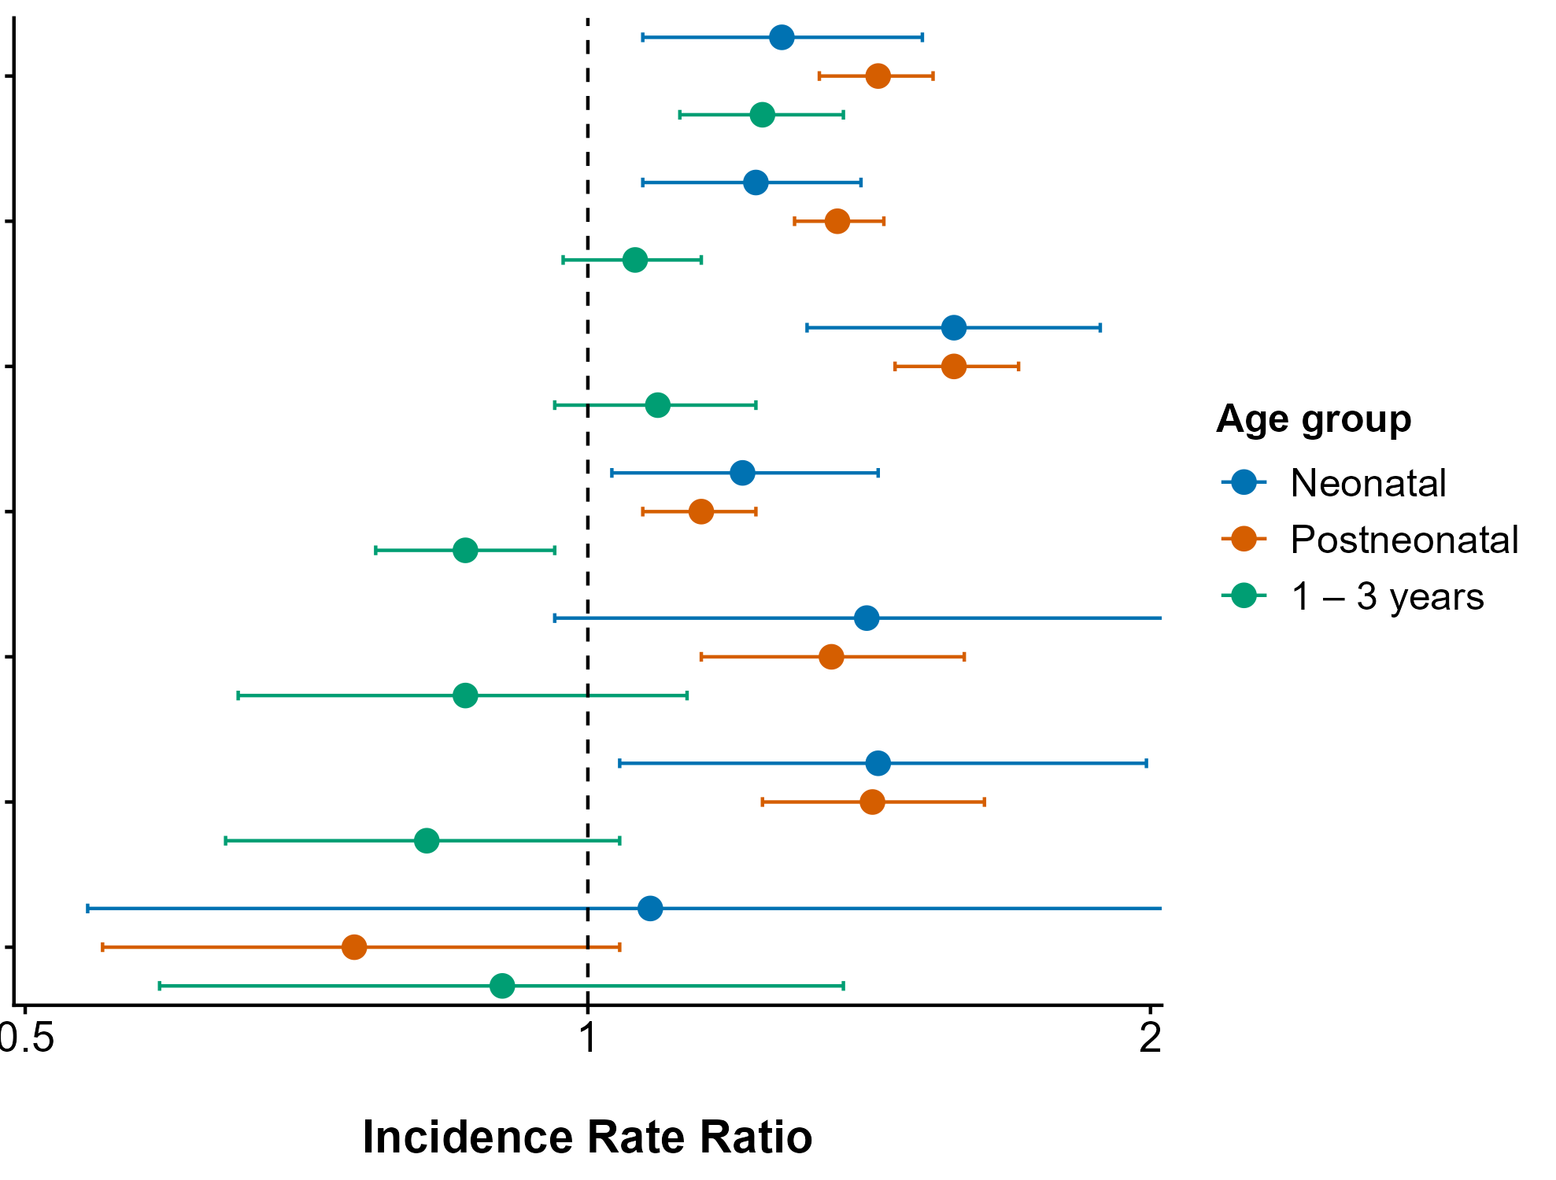
Sensitivity analysis: Compared rates of infectious-cause hospitalisation in all age periods
(reference group: children HU)
Birth year: 2018 - 2024
Birth year: 2021 - 2024
36% of mothers on DTG
62% of mothers on DTG
Models were adjusted for maternal age, suburb of residence, and birth year.
Notes:
This slide shows In a sensitivity analysis including only children born from 2021 onwards (after DTG implementation), (as shown in the figure on the right), we observed the same trends in the association between HIV-ART exposure and infectious cause hospitalisation across the three age periods.

Slide 14
Factors associated with infectious-cause hospitalisation
Child factors
Male sex (all age periods; HE, HU)
Low birth weight (all age periods; HE, HU)
Maternal factors
Inferred TB at delivery/postpartum (postneonatal and >12 months – 36 months; HU)
ART restart during pregnancy (neonatal and postneonatal; HE)
Viral Load ≥1000 copies/mL (neonatal and postneonatal; HE)
Factors included in the models: Maternal age, child sex, birthweight, multiple pregnancy, hypertensive disorders of pregnancy, maternal diabetes, maternal TB, parity, season of birth, maternal ART regimen, time of maternal ART initiation, viral load at delivery
Notes:
From models exploring the association of other maternal, child and HIV-related factors with hospitalisation, I have chosen to highlight the results of a few factors.

Slide 15
Conclusions
During periods of expanded maternal ART access and increasing dolutegravir use, children HE and without HIV had modestly higher infectious-cause hospitalisation rates than children HU in the first year of life.
Children whose mothers restarted ART during pregnancy had the highest risk of hospitalisation compared to children HU – vulnerability of people who interrupt care.
Early and sustained maternal ART uptake is important but will need to be complemented by multifaceted interventions to address the persistent health disparities experienced by children HE.
Notes:
Check if first point aligns with old slides or updated wording

Slide 16
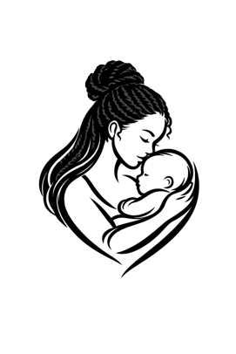
Acknowledgements
Western Cape Provincial Health Data Centre
Mothers, infants and caregivers
Funders:
  The Eunice Kennedy Shriver National Institute of Child Health and Human Development of the National Institutes of Health CHERISH study
  The WCPHDC is supported by:
    Western Cape Government Health and Wellness
    The US National Institutes for Health [B positive, IeDEA-SA, CHERISH]
    The Bill and Melinda Gates Foundation
    The United States Agency for International Development
    The Wellcome Trust

