Slide 1

Behavioural difficulties in school-aged children who are HIV-exposed uninfected and associations with intellectual performance; findings from the KIND Study.
Lena Serghides, Julia Young, Tharaniya Kumarathasan, Jennifer Bowes, John Sled, Jason Brophy, Ari Bitnun, Mary Lou Smith, on behalf of the KIND study team.
University Health Network,
The Hospital for Sick Children, Children’s Hospital of Eastern Ontario
A BIG THANK YOU! to the children and their families without whom this study would not be possible.

Slide 2
No conflict of interest to declare

Slide 3
Children HIV exposed uninfected but not unaffected
One of the fastest growing HIV affected populations
16 million children globally
  6,000 in Canada
1 million born each year
  ~200 born in Canada each year
Face disproportionate risks of infection, growth faltering, and neurodevelopmental delays despite never acquiring HIV

Slide 4
The KIND study
To compare neurocognition, behaviour, and neuroimaging measures between children who are HEU and HUU.
Recruitment at Sick Kids in Toronto and CHEO in Ottawa, and through community and school networks
Target recruitment 245 children age 6-12 years (180 CHEU and 65 CHUU)
Recruitment ongoing

Slide 5
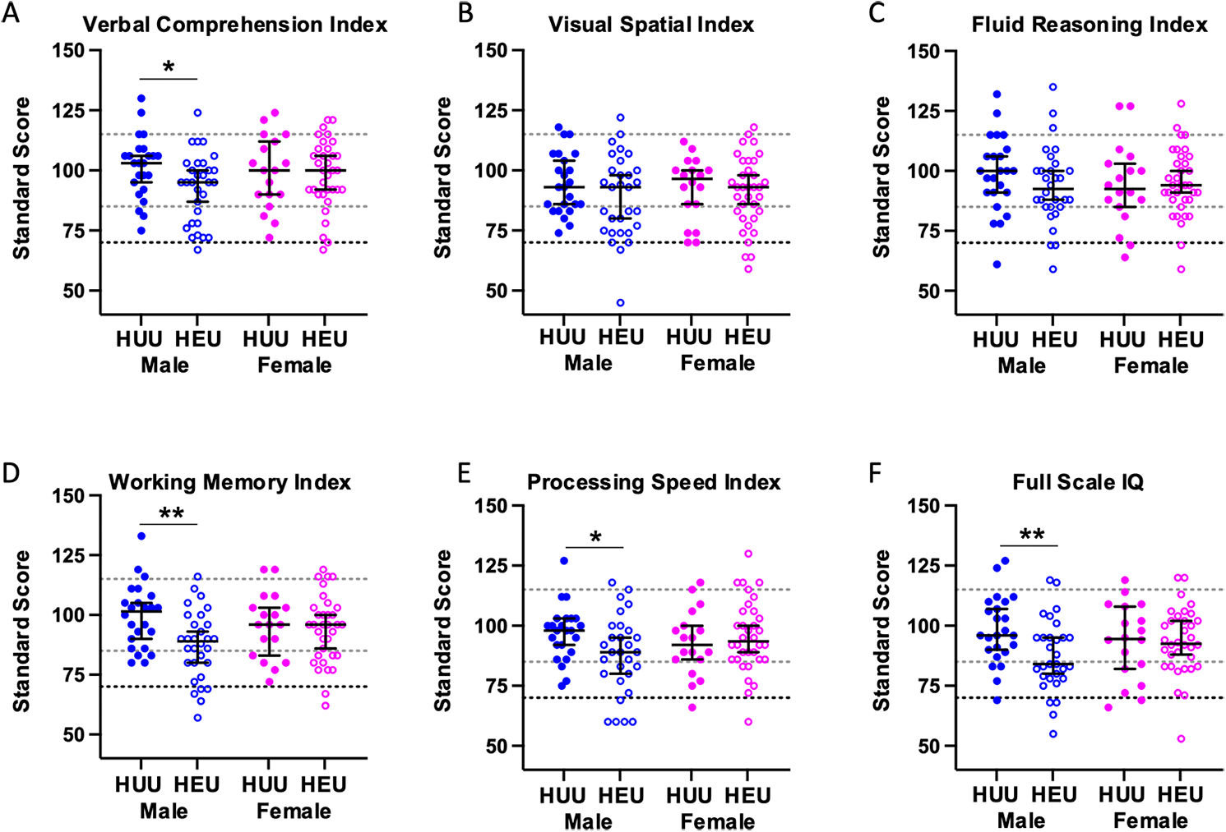
The KIND study findings – lower intellectual performance in boys HEU
Kahnami L et al. Front Pediatr 2025, 13:1540420

Slide 6
Aim: Investigate behavioural difficulties in the KIND study participants
Study population: 142 children (99 HEU, 43 HUU) included

Slide 7
Strengths and Difficulties Questionnaire (SDQ)
Administered to caregiver
Assesses emotional and behavioural difficulties
Total difficulties score = “Does the child have difficulties?”
  Combined score of 4 scales: Emotional symptoms, Conduct problems, Hyperactivity/inattention, Peer relationship problems
  Score of 17 or greater → clinically significant problems
Impact supplement score = “Is the child impaired by those difficulties?”
  Score of 2 or more clinically significant

Slide 8
 |  | Children HEU N=99 | Children HUU N=43 | p-value
Age at testing (years) |  | 8.75 (7.1 – 9.9) | 8.83 (7.2 – 10.1) | 0.38
Sex | Female Male | 51 (51%) 48 (48%) | 18 (42%) 25 (58%) | 0.29
Maternal race | ACB Caucasian Other | 66 (67%) 15 (15%) 13 (13%) | 20 (46%) 14 (33%) 9 (21%) | 0.10
Caregiver education | High school or less College University Post-graduate | 30 (30%) 34 (35%) 22 (22%) 12 (12%) | 8 (19%) 20 (47%) 8 (19%) 7 (16%) | 0.51
Household income | Less than $50,000 $50,000 or greater | 54 (55%) 45 (45%) | 16 (37%) 27 (63%) | 0.07
Birth weight (kg) |  | 2.9 (2.4 – 3.5) | 3.4 (2.9 – 3.8) | 0.002
Preterm (<37 weeks) |  | 20 (20%) | 3 (7%) | 0.03

Slide 9
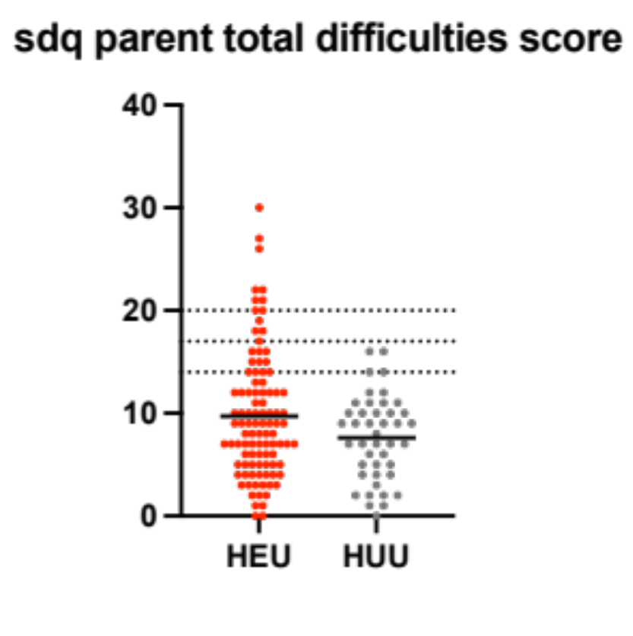
Does the child have difficulties?
HEU status associated with high total difficulties scores
Children HEU vs. HUU
Slight: 23% (23) vs. 9% (4), p=0.052
High: 13% (13) vs. 0% (0), p=0.013
Very high: 9% (9) vs. 0% (0), p=0.041
Total difficulties score
Very high
High
Slightly raised
Close to average
CHEU
CHUU

Slide 10
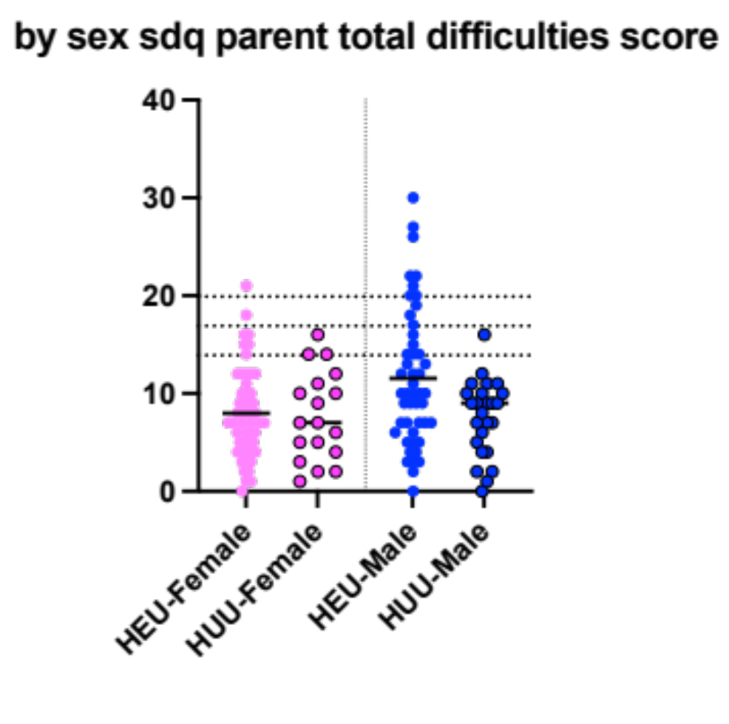
More boys HEU have high total difficulties scores
Girls HEU vs HUU
Slight: 14% (7) vs. 17% (3), p=0.76
High: 4% (2) vs. 0% (0), p=0.39
Very high: 2% (1) vs. 0% (0), p=0.55
Boys HEU vs HUU
Slight: 33% (16) vs. 4% (1), p=0.005
High: 23% (11) vs. 0% (0), p=0.009
Very high: 17% (8) vs. 0% (0), p=0.031
Girls
Boys
Total difficulties score
Very high
High
Slightly raised
Close to average
CHEU
CHUU
CHEU
CHUU

Slide 11
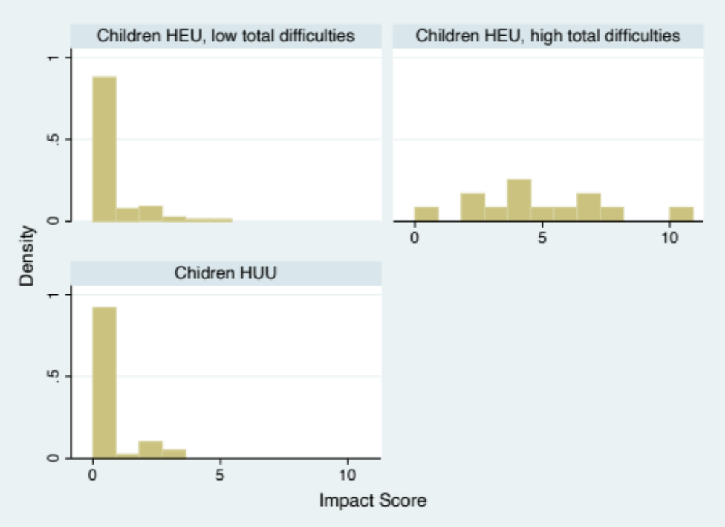
Impact score - Is the child impaired by those difficulties?
Children HEU
low total difficulties
Children HEU
high total difficulties
Impact score 2 or greater:
  Children HEU vs. HUU:
  23% (23) vs. 14% (6), p=0.2
Impact score high in those with high difficulties scores
Children HUU

Slide 12
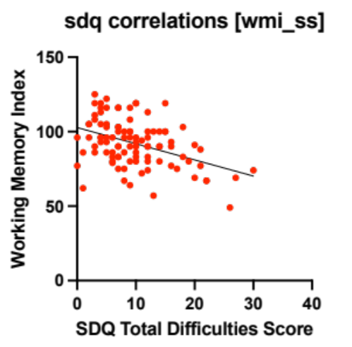
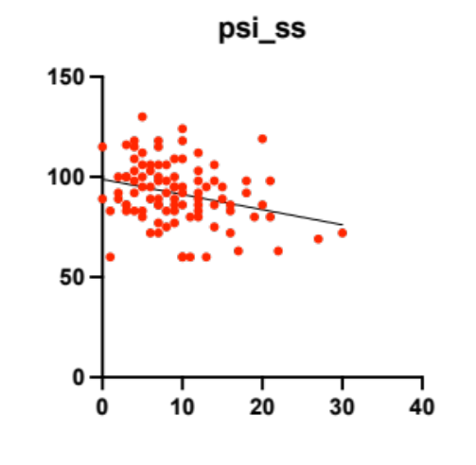
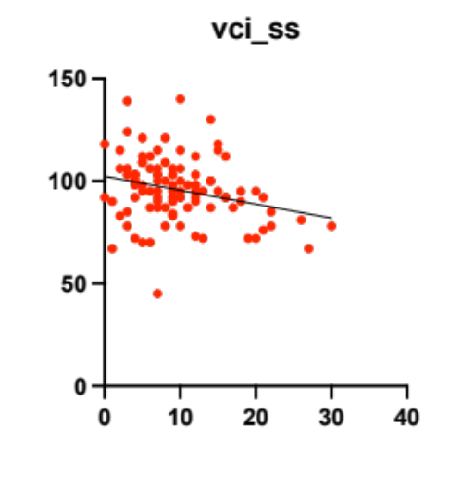
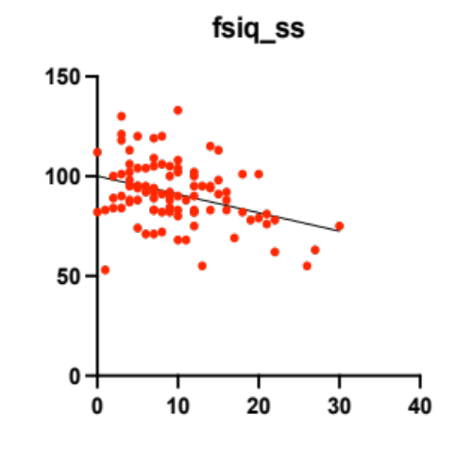
Total difficulties score correlates with intellectual performance metrics
Working Memory Index
Processing Speed Index
R= -0.42
p<0.001
R= -0.29
p=0.005
Cognitive deficits associated with behavioural difficulties
SDQ Total Difficulties Score
SDQ Total Difficulties Score
Verbal Comprehesion Index
Full Scale IQ
R= -0.26
p=0.008
R= -0.36
P<0.001
SDQ Total Difficulties Score
SDQ Total Difficulties Score
Notes:
The literature in general (across clinical populations) suggests a higher rate of behaviour problems in children with cognitive deficits

Slide 13
Summary
In the KIND study, boys HEU more likely to have behavioural difficulties (caregiver assessed)
  More likely to be impacted by those difficulties
  Cognitive deficits associated with behavioural difficulties
Small sample size
With full enrollment
  assess associations with perinatal ART exposure
  control for other factors

Slide 14
More information about the KIND study
lena.serghides@utoronto.ca

