Slide 1



Nathanael (Nate) Leo van Blydenstein
12th Symposium on Children and Adolescents with Perinatal HIV Exposure
How to see children clearly without marking them socially​
Transferable learnings from a gamified approach to ‘risk screening’ developed for adolescent girls and young women in South Africa.
26–31 July • Rio de Janeiro, Brazil
aids2026.org
Notes:
Good afternoon. My name is Nate van Blydenstein, I'm from sunny South Africa, I want to ask you all to hold some space for me this afternoon as I am new to this problem an have some developmental delays ;)
A bit about myself: for the last decade I have been implementing, evaluating, dismantling and re-imagining data-collection tools and programmes for adolescents and young people in South Africa.
I am hoping to share some interesting things I have learned about the risk screenings in this time. That being said, I still don't know how to see children clearly, but I hope I am becoming better at not marking them socially.
And I think there is some transferability in that endeavour. So, lets get stuck in.

Slide 2
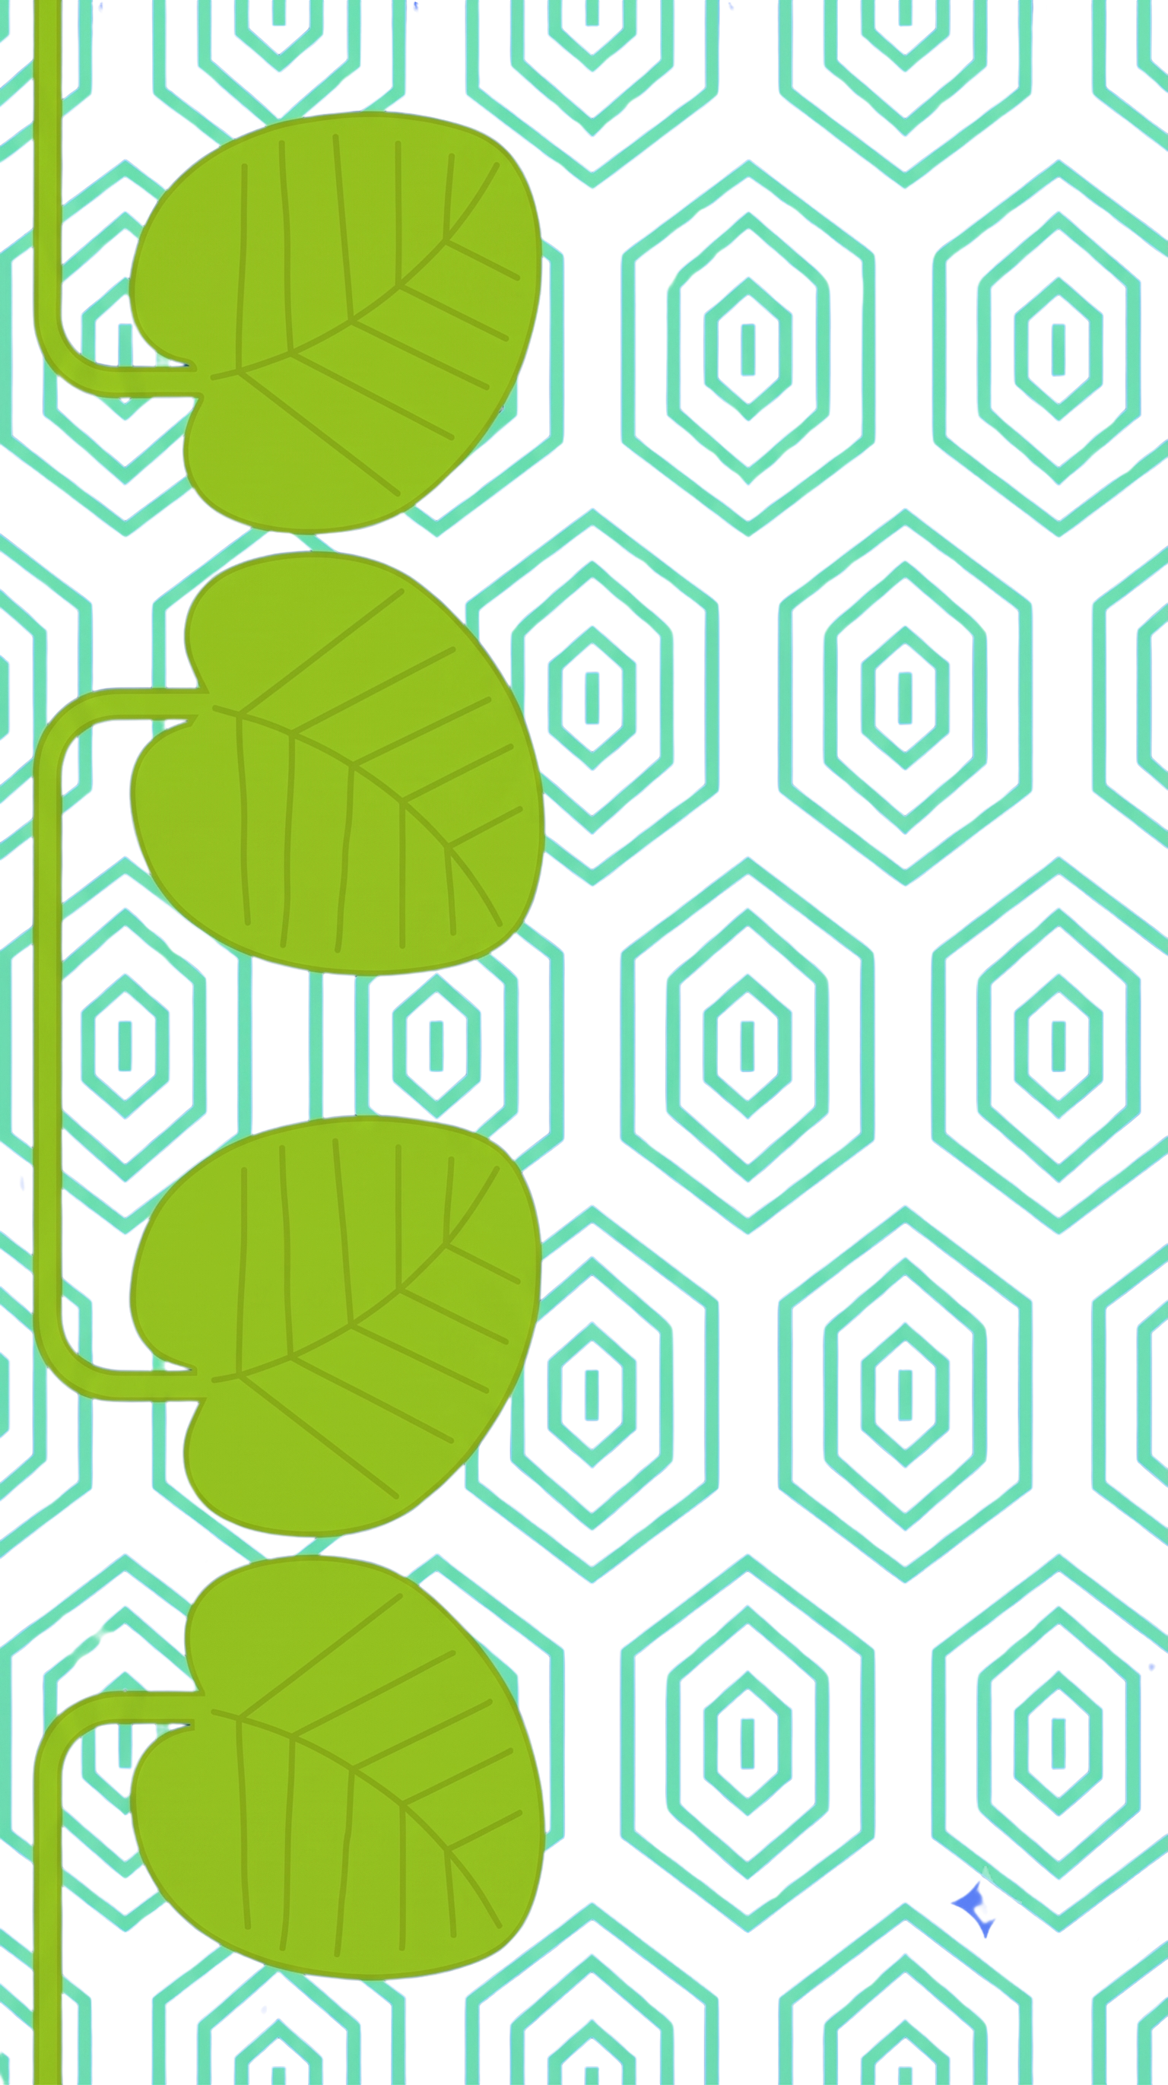

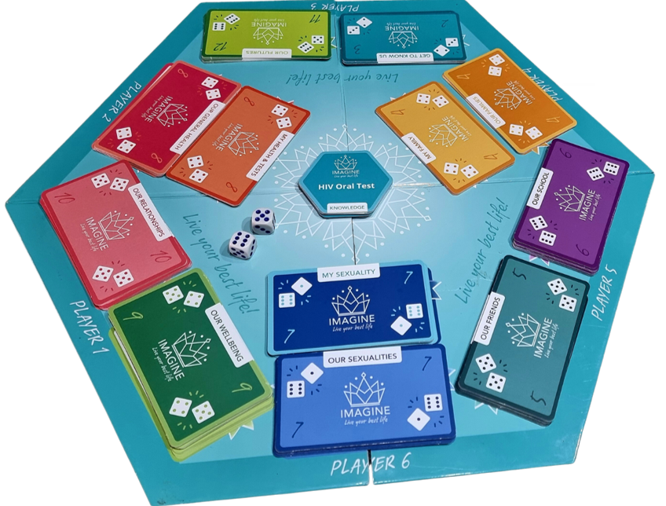
Redesigning risk screening for adolescents revealed a helpful design consideration
BefoRe wE aSk
whetheR wE caN cLasSify children Better....
FiRst AsK whaT
Classi FicAti0n d0eS iN
the eNcoUnter beTwEen
childREn, 0r cAreGiverS
aNd @/yOuR HeALth sYsTem??
26–31 July • Rio de Janeiro, Brazil
aids2026.org
Notes:
Humourlessly I can say that, risk screening has been my arch nemesis for about a decade. It is a more formidable opponent than you'd think, both in terms youth-friendliness, and 'better data' that leads to improved health outcomes.
This is not to say that they don't have administrative function though, in this regard one can argue that they have been highly successful.
I would like to draw your attention to the problems of CLASSIFICATION logic as it moves from scientific modelling into programmatic administration that may be a shared problem to think about in adolescent and pediatric programming.
Advanced epidemiological modelling and classification of important risk factors can be precise enough to decide where resources and expertise should go but there is a huge amount that happens between the science, programme design and what a particular young woman needs in a particular encounter.
The difficulty arises when that population-level classification of risk factors hardens into individual eligibility rules that become embedded in target settings, denominator calculations, staff training, M&E system validations, practical implementation strategies, practitioner realities and street level bureaucracies. Any contradictions in those classifications must be absorbed through the institutional disciplinary apparatus so that what returns is flattened evidence that the programme has reached the right people.
By the time a practitioner and a young woman or child with perinatal exposure to HIV meet, their encounter is already crowded with decisions made elsewhere: what kind of person the programme expects to find, what she must disclose, which answers will count as evidence, what can be offered, and what must be recorded.
So, yes, better classification can bring expertise, continuity, resources and contribute to improved health outcomes. But we should judge those gains together with what the resulting encounter requires people to do, what this requirement could mean for young women or families and is a commensurate institutional response available?
So this is the challenge I want to hold across the talk: do not ask whether we can classify children better until we ask what classification will do to the encounters between children, caregivers and the system.

Slide 3

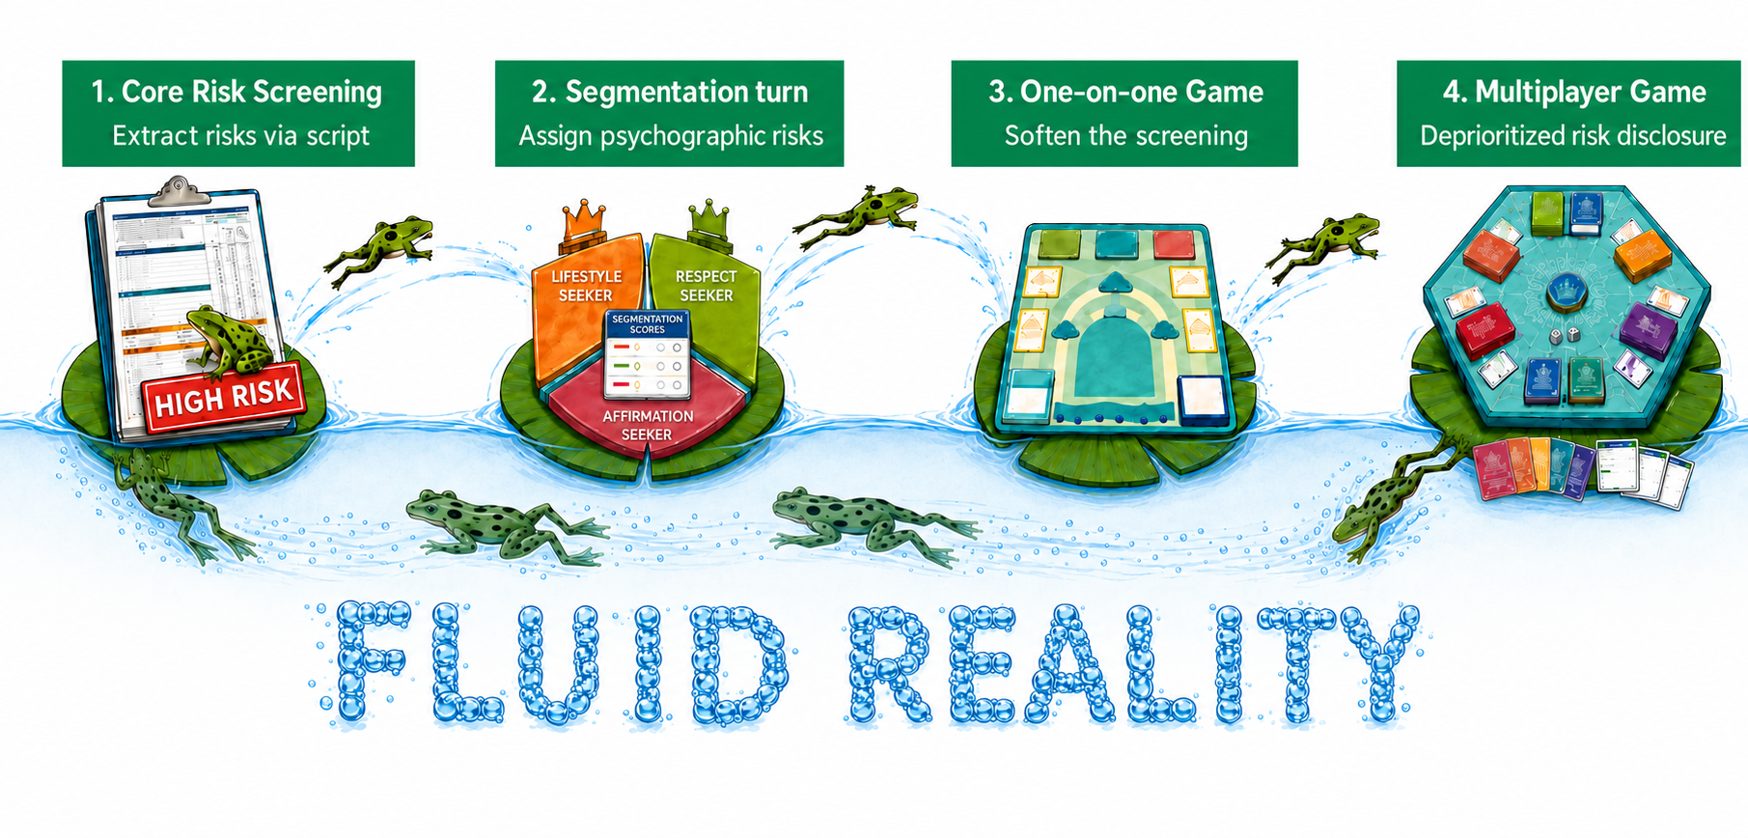
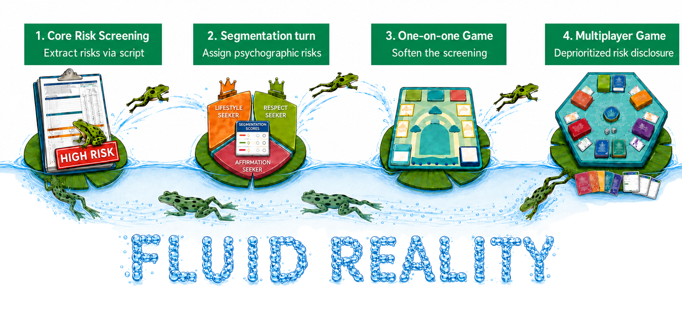

Screening evolved but classifiable ‘High Risk’ subjects remains
Tool redesigns and continuous improvements are important, but the institutional demand to satisfy a risk classification may be the primary contradiction we must attend to first.
26–31 July • Rio de Janeiro, Brazil
aids2026.org
Notes:
The history of risk screening tools I have observed being used in adolescent HIV programming hasn't been a linear progression, and it can't be simplified into a simple move from bad questionnaires to a good game. Each tool responds to real problem and should builds onto the gains from the last, for example:
The early 'Core Risk Screening' forms on Lily pad 1 sought to created a stable record of more than 100 risks and then weight them to come up with a 'High Risk' client identity.
Then there was a turn to 'Segmentation' where there was a recognition that young women have different hopes and relationship motivations and that these behavioural dimensions would influence their risk profiles, the assigning of persona segments was still organised around disclosure of the same risk classifications used in the prior tool.
The one-to-one game attempted a more playful encounter and tested about 200 extra interesting questions alongside the 100 legacy ones in an attempt to be more relational. We asked small groups of young women to debate the questions and decide which should remain in the game and which shouldn't. This brought down the number of risk related questions to a handful that young women were OK with answering.
The social dynamic that emerged in this process was more important than the screening questions themselves, and so we changed the format entirely into a multiplayer game changed the social encounter more substantially. When the final multiplayer game was deployed, girls would enter together and 80% of the questions were fun and interesting, pathways to services were explained and their uptake incentivized in a clever game mechanism and a handful of private risk related questions could be answered in a private booklet which was separate to the booklet were girls could self select their service interests regardless of their self disclosed 'risk questions'.
But the institutional demand for a high risk subject who could be counted, followed and reported as 'high risk' for improved targeting kept returning.

Slide 4
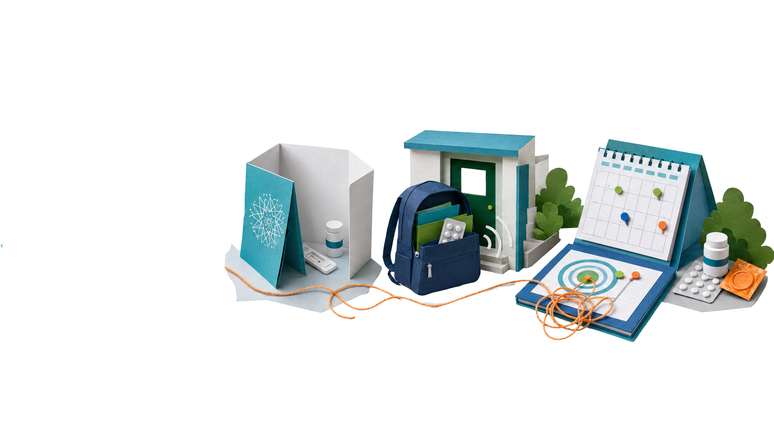
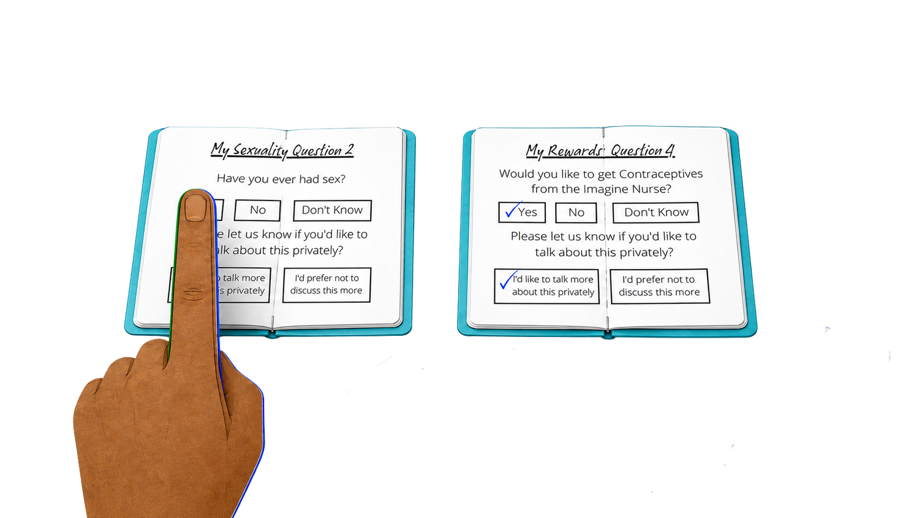
When follow-up is experienced as surveillance
  Prevention uptake normalised faster than treatment and maternal care
  Limited first-contact data was repurposed into individual targeting lists
  Surveillance could change practitioners from accessible support into pursuers
  The same learners who once ran toward the Safe Space began hiding from staff
  The psychosocial character of follow-up needs more design consideration
26–31 July • Rio de Janeiro, Brazil
aids2026.org
Notes:
The game was a great entry-point and the separation between disclosure and service eligibility meant that a learner could protect herself without first producing a perfectly coherent account of her sexuality or disclosing other vulnerabilities like orphanhood or exposure to violence if she didn't want to.
The low social risk at programme entry-point enabled near universal programme exposure in the cohort. And repeated engagements were enabled by having full-time school-based services in dedicated 'Safe Spaces'. The programme was able to quickly destigmatize the uptake of health testing and prevention based services, but ART coverage and Antenatal care coverage targets slower to reach.
When we couldn't meet these rigorously modelled but ambitious treatment and care targets, we tried to use the purposefully limited risk screening data points that we had recorded at first contact to try and find those who were 'most at risk' but who had not yet engaged the services.
We methodically worked through every single learner's risk data and produced weekly targeting lists on a school-by-school and-grade-by-grade basis which were then used by school based practitioners to find learners who should be considered 'At Risk' and convince them to do HIV and Pregnancy testing.
This surveillance approach was quite different to the way that the programme started and we began to hear accounts of learners actively running away and hiding from staff whom they had ran towards a few months earlier.
Even if this is a hyperbolic example it is worth stating that for treatment and maternal related programming, the psychosocial character of those encounters should be the top design priority.

Slide 5

Transferability possibilities
These are potential areas of overlap that may help
  When a programme asks someone to disclose a concern, it also asks them to risk being negatively interpreted socially.
  If the screening can potentially negatively mark a child or their caregiver socially, then don’t expect it to be the only eligibility gate into care.
  Caregivers proximity and interest in holding detailed knowledge of visits, medicines, transport, family support and a child’s changes over time are probably the greatest joy asset.
  Measure the programmes side of the encounter on its ability to elicit joy and create confidence and competence with caregivers.
  Ensure that programmes have adequate capacity and obligation to respond to disclosed vulnerability signals.
26–31 July • Rio de Janeiro, Brazil
aids2026.org

Slide 6

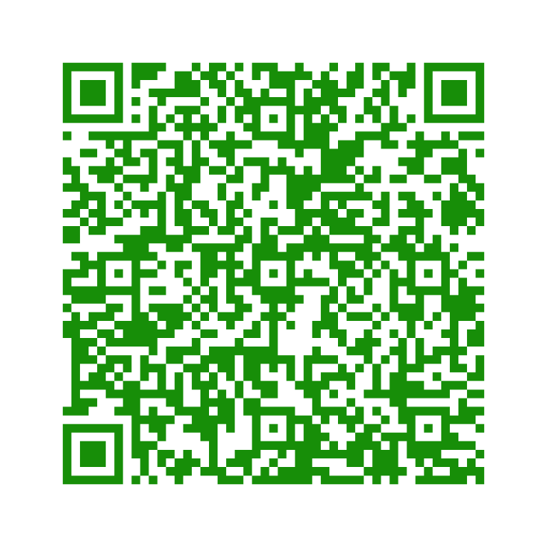
Read more here
26–31 July • Rio de Janeiro, Brazil
aids2026.org

