Slide 1
Community platforms that can be leveraged for long-term follow-up of children with perinatal HIV exposure
Jeferson Carvalho
Família Positiva, Belo Horizonte, Brazil

Slide 2
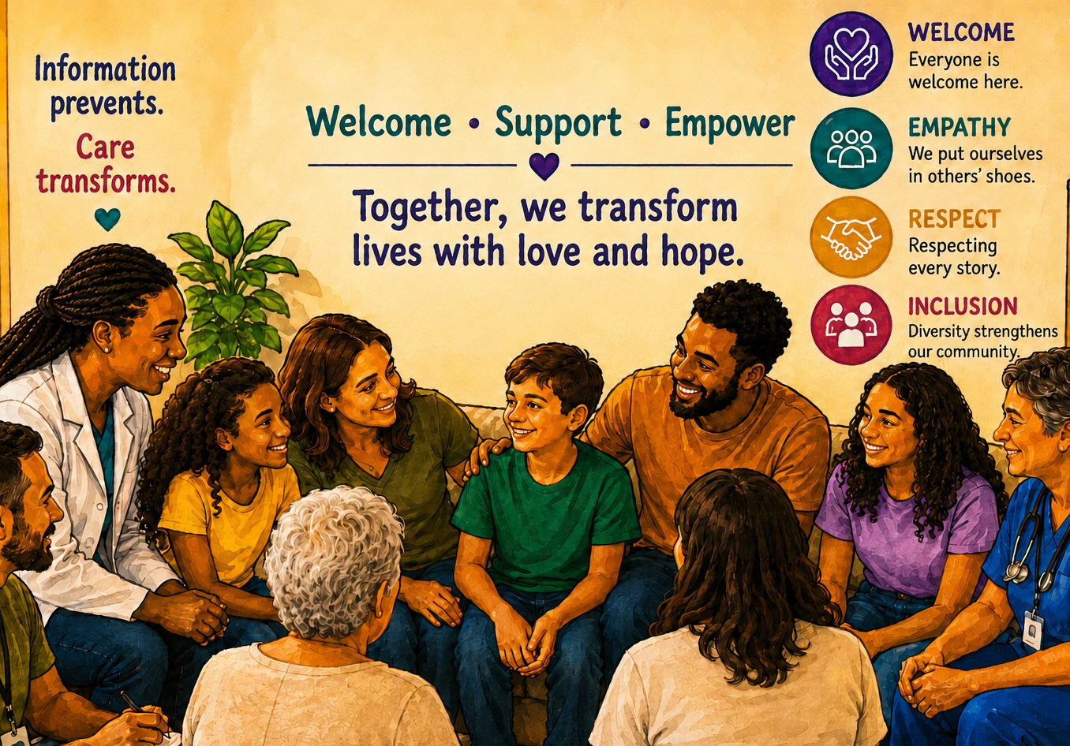
FAMÍLIA POSITIVA
WHAT IS GRUPO FAMÍLIA POSITIVA?
WHO MAKES THIS GROUP HAPPEN?
HOW DO WE SUPPORT FAMILIES?
WHY DOES IT MATTER?

Slide 3
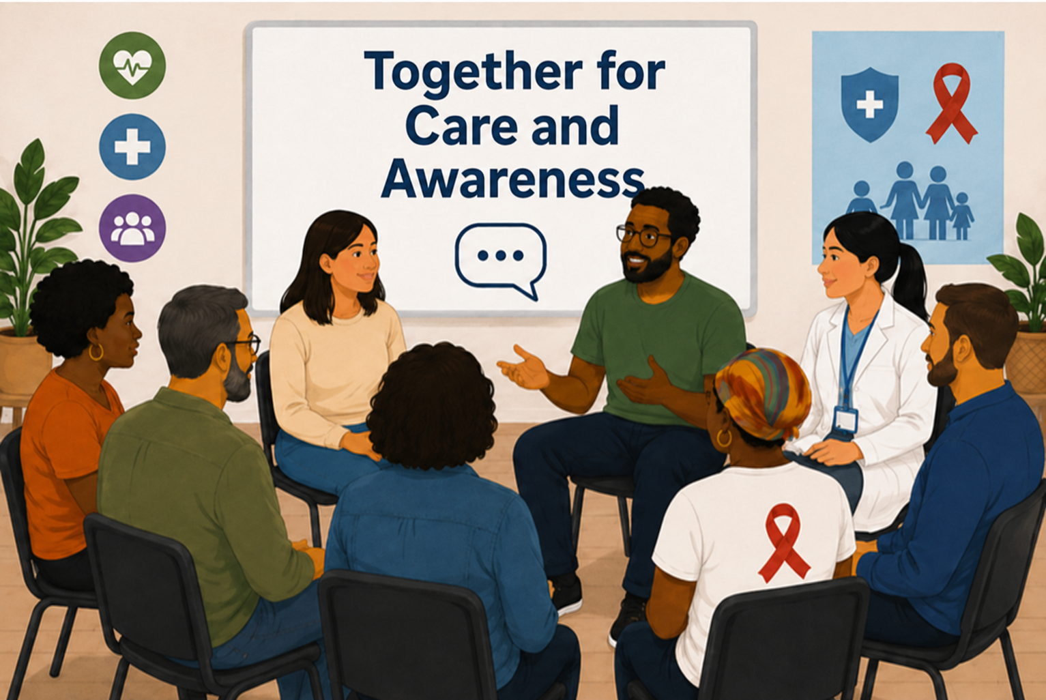
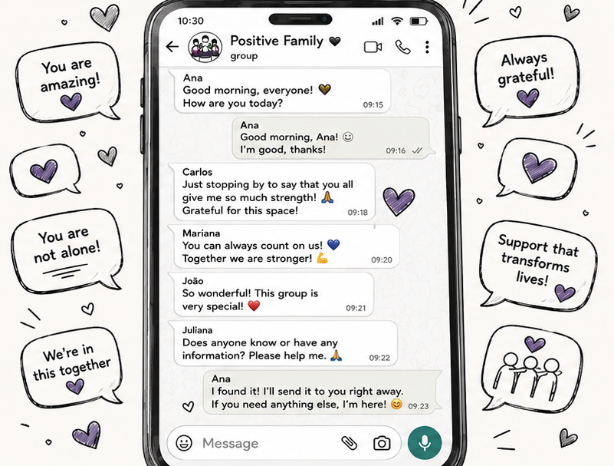
THE IMPORTANCE OF COMMUNITY PLATFORMS

Slide 4
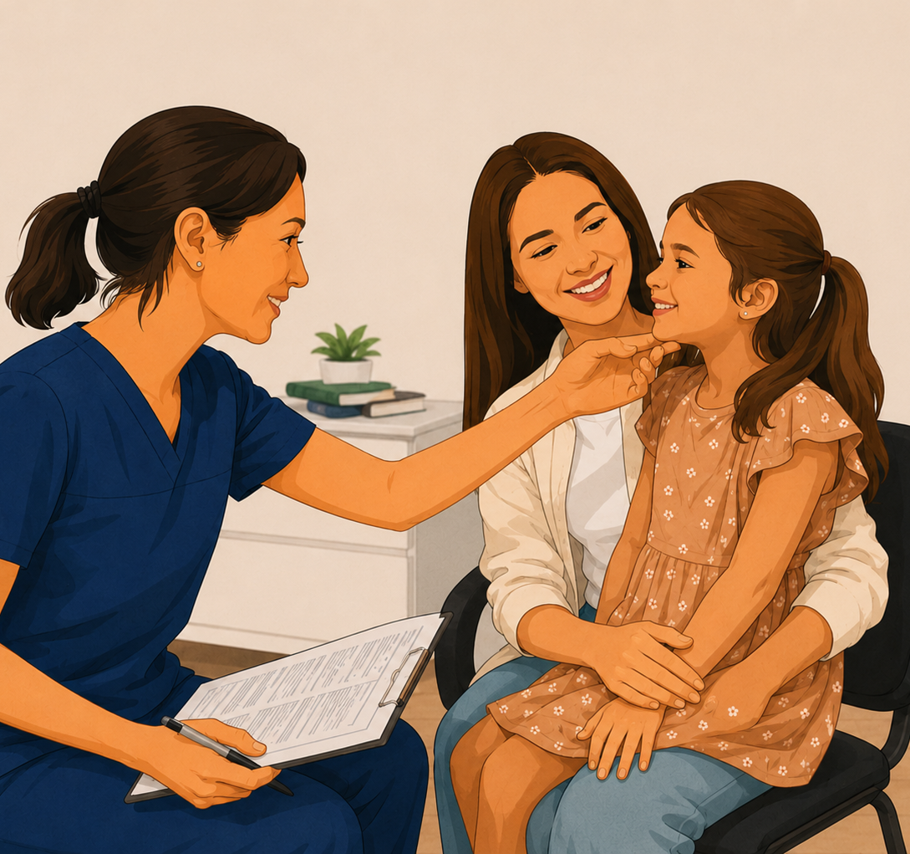
CHALLENGES
Stigma and discrimination;
The impact of HIV on family dynamics;
Effects on mental health and child development;
Lack of continuous psychosocial support;
Weak coordination within the care network;
Limited public policies for children and adolescents affected by HIV.

Slide 5



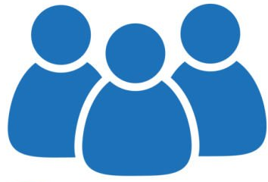
IMPROVEMENTS, PROPOSALS AND IMPACTS
Discussion
circles
Safe spaces for listening, sharing experiences, and strengthening bonds.
Emotional
support
Support and emotional guidance to promote well-being and overcome challenges.
Guidance on
rights and services
Clear information to facilitate access to rights and services that transform lives.
Coordination with
the healthcare
network
Connection with healthcare professionals and services for comprehensive care.

Slide 6
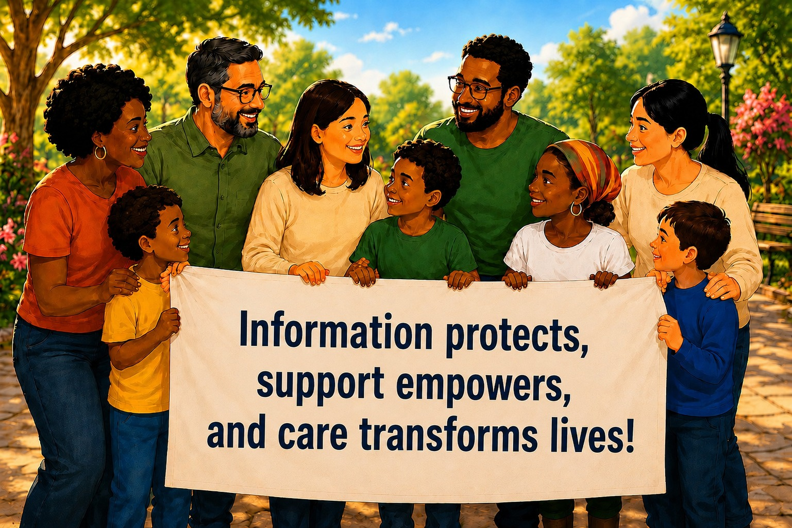




THANKS
Email: familiapositiva.bh.2014@gmail.com
Instagram: @familiapositivabh

