Slide 1
Session 3: Long-term follow-up: From data to action
Session Chair: Catherine Wedderburn, University of Cape Town

Slide 2

Please note that:
This event is being recorded
Participation signals your consent to have the recording posted on the conference portal and on the IAS+ website
We welcome our participants online. Those joining online are muted
For interpretation, scan the QR code, select your language, and tap Join
  Read captions or listen to audio using your phone and headphones
We welcome your questions
  For those joining online, please use the Q&A function
  And for those in the room please make use of the microphones along the aisles

Slide 3

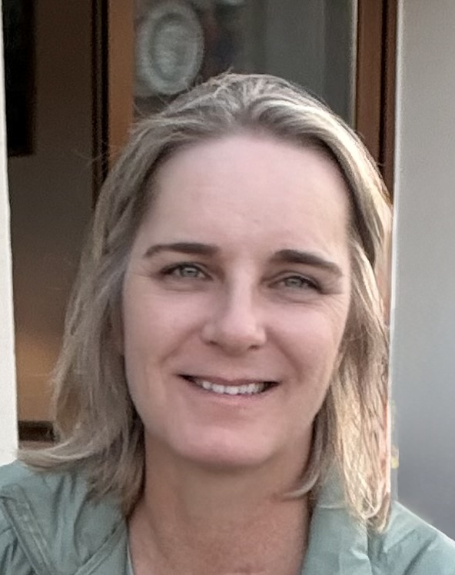

Debate: Health systems should systematically document perinatal HIV and ARV exposure in health records to enable long-term follow up of health outcomes of persons with perinatal HIV exposure
Agnes Ronan
Paediatric Adolescent Treatment Africa (PATA)
Kim Anderson
University of Cape Town
Maria Leticia Cruz
Hospital Federal dos Servidores do Estado
Facilitator
For the proposition
Against the proposition

Slide 4



Irene Njuguna
Emory University
Anurita Bains
UNICEF
Florence Anam
GNP+
The BONDS Study: – A multi-country study with planned interventions to understand and improve long-term outcomes for children and adolescents with perinatal HIV exposure
Reassessing priorities: aligning research and programming to support lifelong outcomes

Slide 5

Sonia Lee
NIH
Closing Remarks

