Slide 1
Health systems should systematically document perinatal HIV and ARV exposure in health records, to enable long-term follow-up of health outcomes
Kim Anderson, University of Cape Town, South Africa
& responsibly!
COI: My institution has received funding from ViiV Healthcare for research projects unrelated to this topic

Slide 2

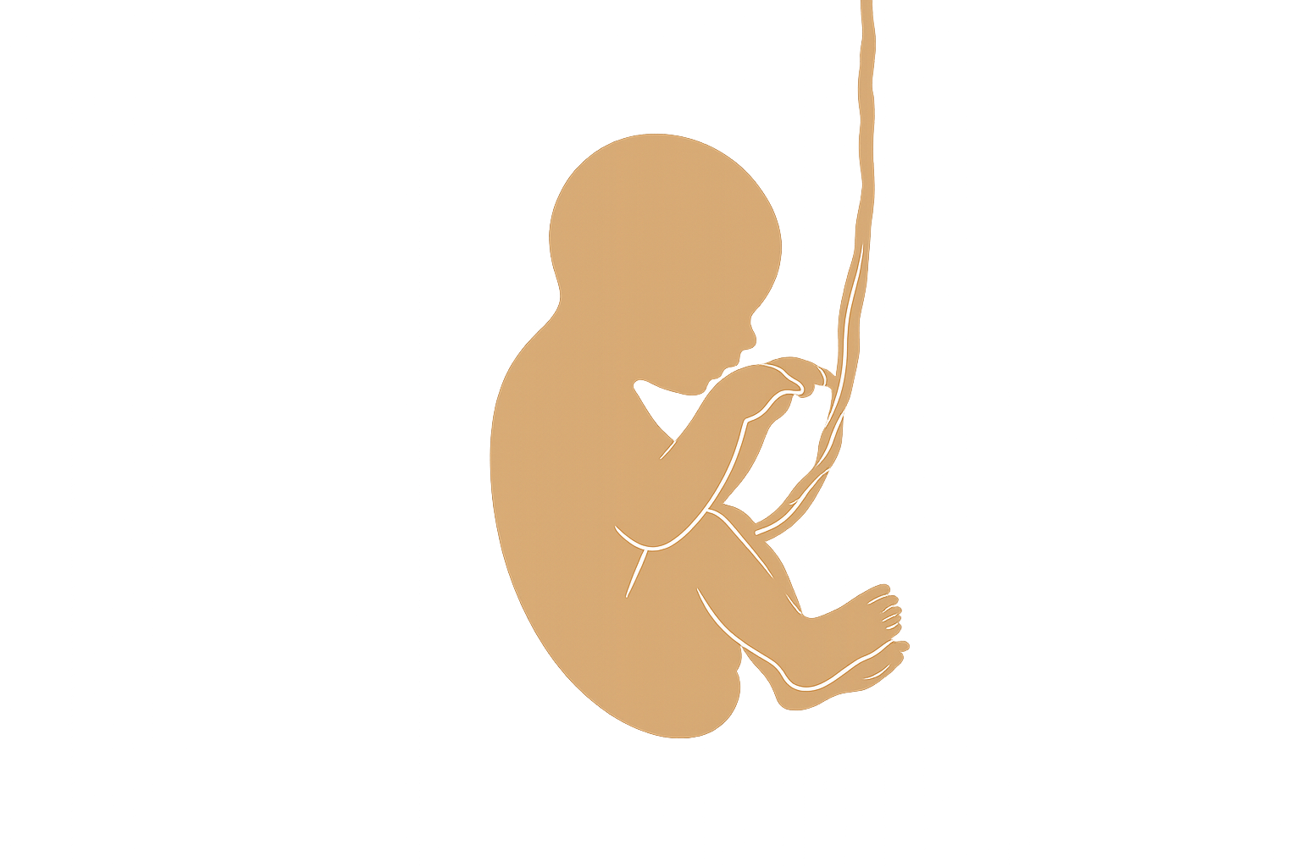


Pregnancy → Birth → Breastfeeding → Childhood → Adolescence → Adulthood
HIV exposure
ARV exposure
~16 million children globally with perinatal HIV exposure
What happens if exposure information disappears after breastfeeding ends?
Why should documentation stop here?
What we do not document, we cannot understand, monitor, or respond to

Slide 3

Exposure history matters
🫁 Infections
🧠 Neurodevelopment
❤️ Long-term health
👨‍⚕️ Clinical decision-making
Exposure history is part of person-centred care

Slide 4
We need lifelong surveillance
The Knowns
Infectious morbidity
Mortality
Growth
Neurodevelopment
Lower insulin sensitivity
The Unknowns
Mental health
Cognitive outcomes
Hearing loss
Cardiometabolic disease
Reproductive health
Cancer
Effects of newer ARVs, LAIs, bNAbs

Slide 5
History teaches us lessons
Exposure | Important outcomes recognised later
Valproate | Neurodevelopmental and cognitive effects
Zika virus | Delayed developmental impairment
New medicines | Rare or delayed safety signals
Important outcomes are often recognised years after exposure

Slide 6
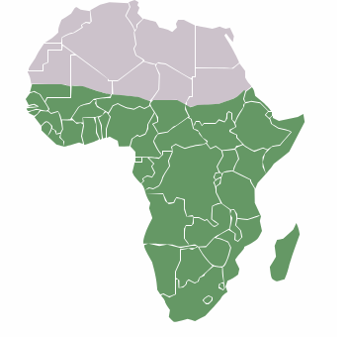
Without documentation, people become invisible
VT prevention programme
Child health services
Adolescent services
Adult care
No documentation
No surveillance
No evidence
No policy response
Research gap
Evidence gap
Equity gap

Slide 7

Responsible documentation
Legitimate concerns:
⚠️ Stigma
⚠️ Labelling
⚠️ Disclosure
Solutions:
🔒 Confidentiality safeguards
🔒 Access controls
🤝 Counselling
📋 Limited necessary data fields
🖥️ Digital records
i.e. EMR (Electronic Medical Records)
The answer to stigma is better protection of information, not erasure of information

Slide 8

Closing
Documentation improves clinical care
Better safety monitoring
Better long-term understanding of health outcomes
Documentation prevents an entire generation of HIV-exposed children from becoming
The greatest risk is not documentation
The greatest risk is losing the information
Health risks may not disappear when our records do
The answer to stigma is better protection of information, not erasure of information
INVISIBLE

Slide 9
Preserve clinically relevant information
No - we don’t have to choose!
Protect confidentiality
or
Preserve clinically relevant information
WE
CAN
DO
BOTH!!!
Protect confidentiality
RESPONSIBLE DOCUMENTATION

