Slide 1

Building Opportunities for Nurturing care to enhance child Development in Sub-Saharan Africa:
The BONDS Study
Irene Njuguna
Nell Hodgson Woodruff School of Nursing, Emory University
Kenyatta National Hospital
Notes:
Thank you for the opportunity to share with on the

Slide 2


RISE CONSORTIUM
PROJECT 1
Understand brain volume and structure and association with neurocognition
PROJECT 2
Determine the impact of a combination intervention package on neurodevelopment
PROJECT 3
Evaluate a risk score
BONDS implementation outcomes and cost-effectiveness
Grant: U19HD118601
Period: 2025-2030
Sites: Botswana, Kenya, Zimbabwe
Notes:
Before I jump into BONDS, I would like to highlight that BONDS is one of 3 projects funded by NIH – to study neurodevelopment among CHEU
The other 2 projects are – Image – that will use MRI to determine differences in brain volume and structures in school age children and adolescents exposed to HIV
And Implement – an IS study that steps into the real world settings – exploring how to identify the most at risk children and how an intervention package such as BONDS package would work

Slide 3
BONDS Study Rationale
Two thirds of children in Sub-Saharan Africa at risk of not reaching developmental potential (Lu 2016)
  Children exposed to HIV higher risk (Wedderburn 2019)
Priorities for child development (Dua 2019)
  Develop and assess WHO nurturing care packages
  Improve quality of care and education
  Assess if community workers can deliver interventions
“If we change the beginning of the story, we change the whole story”
UNICEF/WHO call to action to invest in early phases of human life
Notes:
Today we have heard clearly on the need to focus on CHEU, child development and to figure out effective interventions
BONDS attempts to do this – with strong emphasis to start early because …..

Slide 4
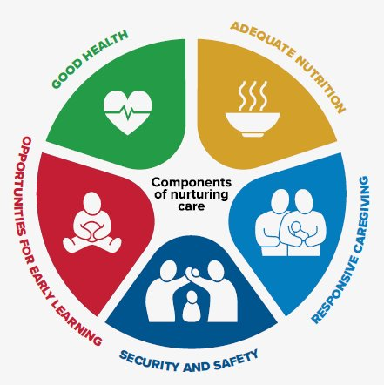
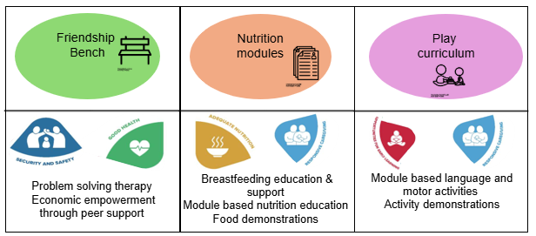
BONDS Intervention Package
Community health worker delivered
Notes:
What is the BONDS package?
The BONDS package is grounded in the NCF – it brings together 3 evidence-based interventions xxxx
Delivered by CHW/lay workers in a structured curriculum that incorporates …………

Slide 5
BONDS Intervention Package
Community health worker delivered
Optimized maternal child heath and HIV care
Notes:
And delivered in the setting of
Each of these intervention pieces is designed to address an important gap in current services

Slide 6

Friendship Bench
Evidence based mental health intervention (Chibanda 2016)
  Lay delivered problem-solving therapy
    6 1:1 sessions
  Circle Kubatana Tose (CKT) groups
    Peer support groups
BONDS adaptation
  CKT groups also emphasize nutrition and play messaging
Friendshipbench.org
Notes:
The FB, an evidence-based intervention – will address maternal mental health
It will be delivered as 6 1:1 problem solving therapy sessions BEGINNING IN PREGNANCY, followed by peer support groups called the CKT – In BONDS, CKT group sessions will also incorporate sessions for group nutrition and play messaging

Slide 7

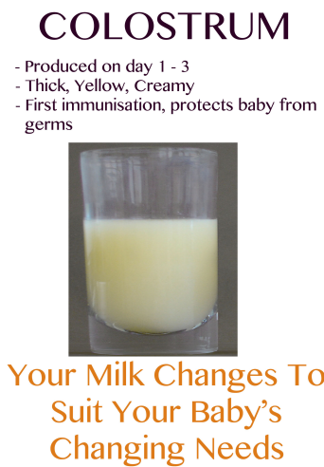
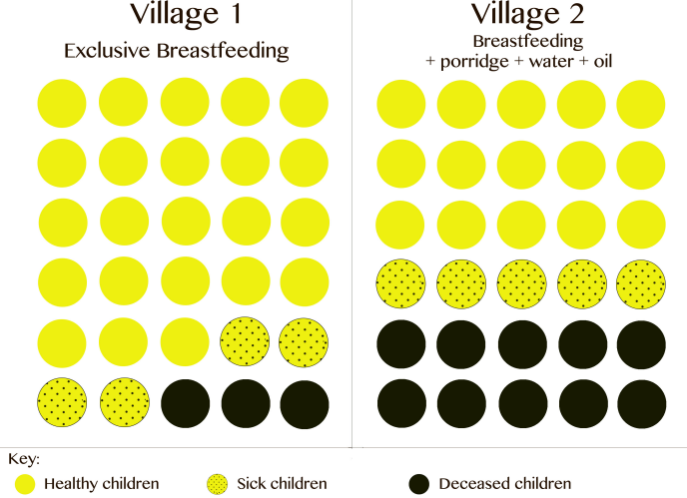
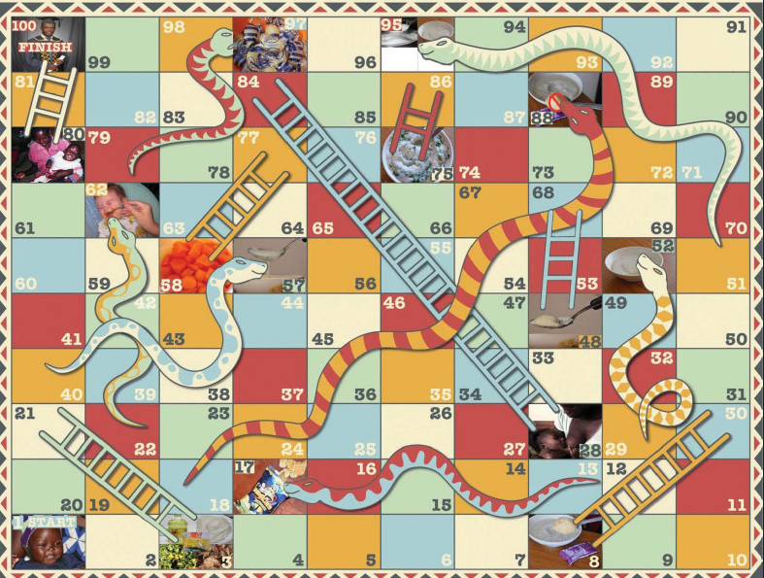
Nutrition Modules
Developed in Zimbabwe by Zvitambo
Community-based behavior change support package
Emphasis on breastfeeding
  Early initiation
  Exclusive breastfeeding
  Prolonged breastfeeding
Interactive practical and participatory activities
Group learning in CKT groups
Notes:
The nutrition package has special focus on early initiation, exclusive and prolonged breastfeeding as well as complementary feeding
It will be delivered through practical interactive activities and as we mentioned before through group learning in CKT groups
Some of the material includes visual cards like this one – showing colostrum
A mock clinical trial showing benefits of exclusive breastfeeding and benefits in terms of child outcomes
And fun games like this snakes and ladder rendition to emphasize key messages covered through out the curriculum

Slide 8
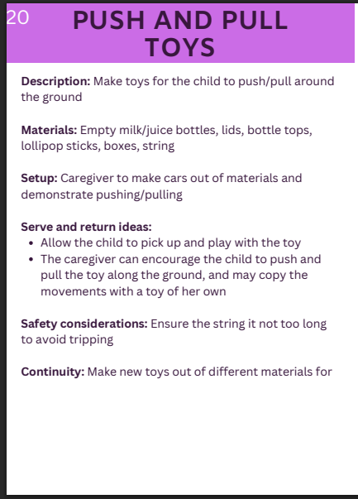
Play Curriculum
Developed in Zimbabwe by Zvitambo
Focus on play as a fundamental right for every child
Play for children with all abilities
Interactive practical and participatory activities
Group play in CKT groups
Notes:
The play package introduces play as a universal right, with emphasis on children with all abilities
As with nutrition, it is delivered through practical interactive activities and group learning in CKT groups
Here is an example of the “push and pull toys activities” card – the front of the card describes the activity, materials needed, safety considerations, what to do at home – and importantly serve and return ideas – which are critical for forming and strengthening neural connections in the brain

Slide 9
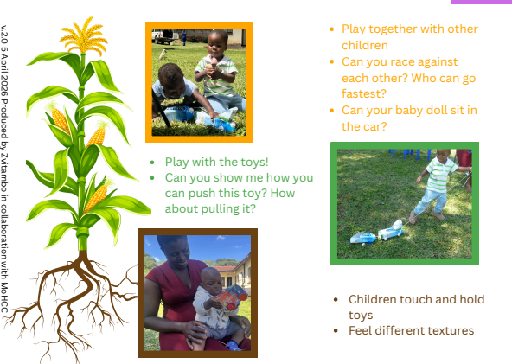
Play Curriculum
Developed in Zimbabwe by Zvitambo
Focus on play as a fundamental right for every child
Play for children with all abilities
Interactive practical and participatory activities
Group play in CKT groups
Notes:
The back of the card practically shows how children of different ages and abilities can do this SAME activity – for example, the youngest feeling textures and the oldest racing their toys against each other
– the maize plan here representing different stages of growth

Slide 10
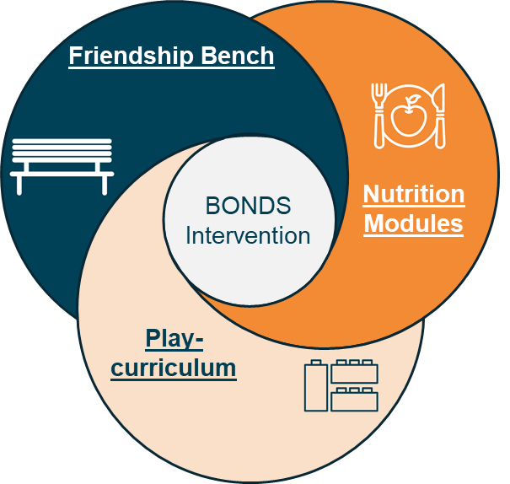
BONDS Study Aims
Botswana, Kenya, Zimbabwe
Aim 1: Adapt, refine, pilot the BONDS intervention package
Aim 2: Determine efficacy of BONDS intervention package
Aim 3: Understand intervention mechanism of action
Notes:
Our first goal is to make this package work in all 3 participating countries – Bot, Ken, Zim - through cultural adaptations, refinements and pilot testing the individual and the combined package
We will then move to the clinical trial phase – where we test efficacy in aim 2 and understand mechanism in aim 3

Slide 11
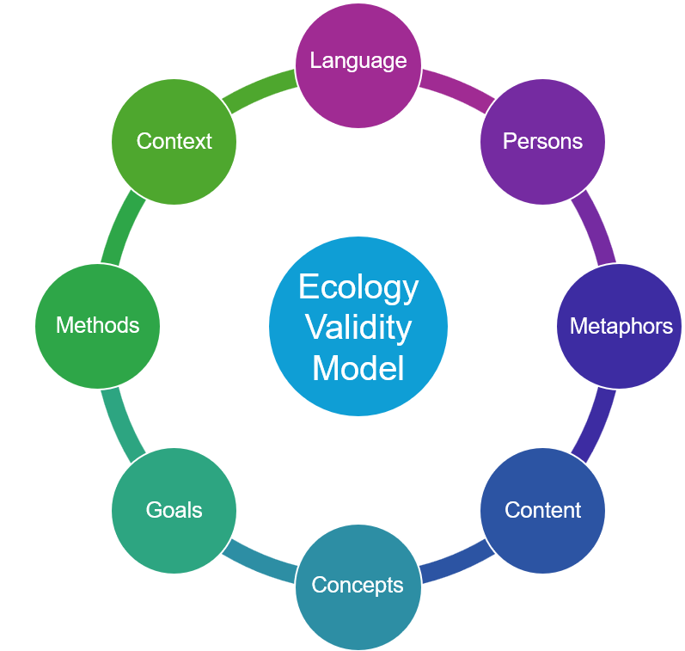
Aim 1: Adaptations
Language | Attuned to potential users of the BONDS intervention
Metaphors | Familiar symbols, concepts, stories, songs, myths
Content | Intervention alignment with local values and traditions
Goals | Communication of BONDS intervention objectives
Context | Location where services are delivered
Workshops with community partners
Pilot with target population
Notes:
We are currently in that first adaptation step where through workshops with community partners - we are looking at different aspect of the intervention pieces – like language, metaphors, content aligns with local values and identifying delivery locations and conducting pilot testing

Slide 12
Aim 2: Efficacy
Individual RCT, n=1260
Botswana, Kenya, Zimbabwe
Incorporate women living with and without HIV
Enrollment in pregnancy, follow-up 2 years postpartum​
Notes:
Once that is done, we will move to the clinical trial phase where we will randomize 1260 pregnant women with and without HIV in pregnancy, to BONDS package or standard of care
Mother-infant pairs followed up for 2 years postpartum

Slide 13
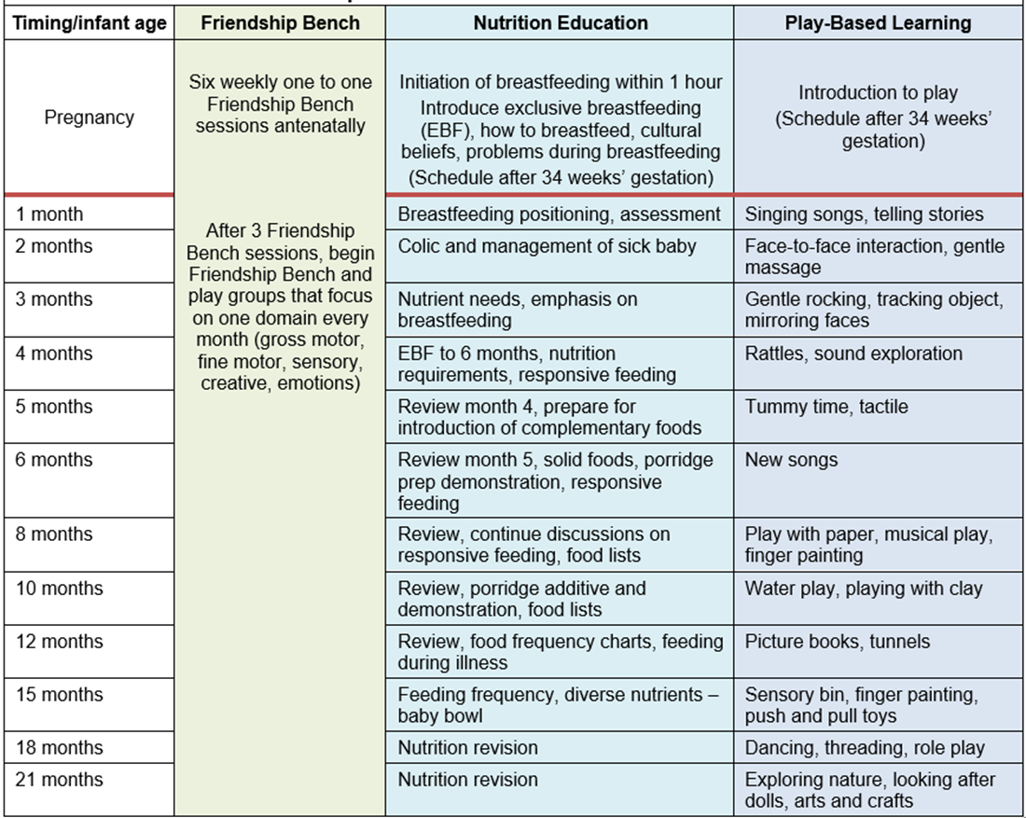
Intervention Delivery
Intensive intervention activities
Tailored to age
Notes:
The BONDS intervention is quite intensive – here we see the different pieces and activities that are tailored to age – that are supported through a well-structured curriculum, lay worker training and supervision support

Slide 14
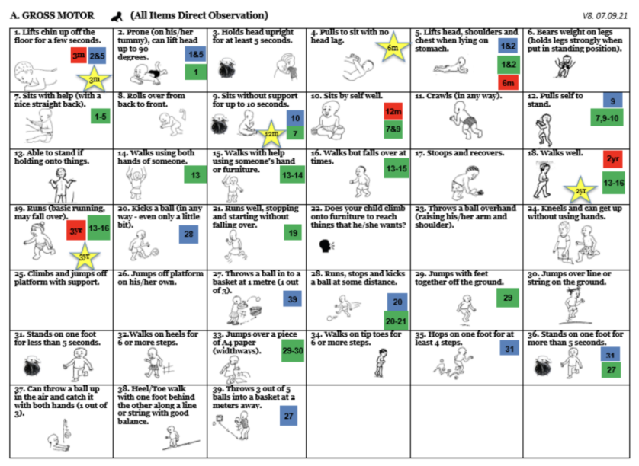
Study Outcomes
Primary outcome
  MDAT scores at 2 years
Secondary outcomes
  MDAT score at 1 year
  Domain specific MDAT scores
  Growth
Notes:
Our primary
The MDAT is a culturally adapted tool developed in and for sub-Saharan Africa settings – that has 136 standardized test items split across four key development domains – gross and fine motor, language and social – this is a picture showing the gross motor domains
Our secondary outcomes include

Slide 15
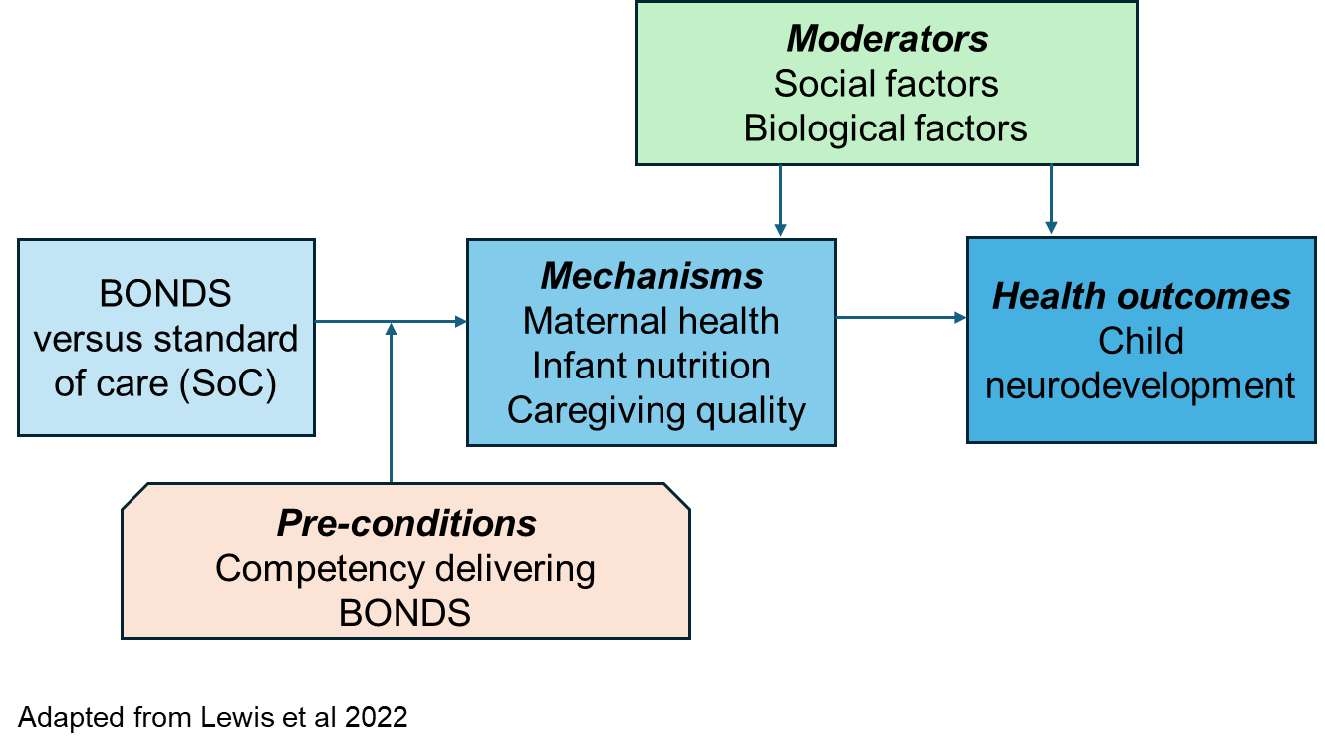
Aim 3: BONDS Mechanisms
Impact of BONDS on brain volume and structure
  Subgroup
  Low and high field MRIs at 6 weeks and 2 years
Notes:
In our third aim, we will explore why or why not and how the BONDS intervention package works - Hypothesized pathways include maternal health (including mental health), infant health and nutrition, caregiving quality
We also have a unique opportunity to study the impact of the intervention on brain volumes and structure – leveraging expertise from the IMAGE project I mentioned at the beginning

Slide 16
Study Progress
Intervention adaptation workshops and piloting
  June to September 2026
Enrollment to RCT
  October 2026 – May 2028
Study end May 2030

Slide 17
Summary
BONDS will determine whether a community health worker administered package:
Improves neurodevelopment for all children
Closes the developmental gap between CHEU and CHU
Large multi-country data repository for future studies on mechanisms of child development
Notes:
In summary

Slide 18
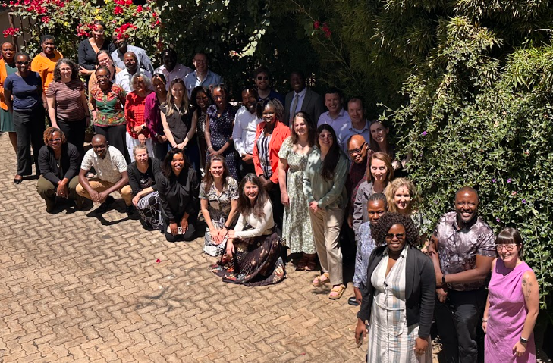
Acknowledgements
BONDS co-investigators, collaborators and study team
Funding from NICHD
Botswana, Kenya, Zimbabwe Ministry of Health and community partners
Families affected and not affected by HIV
Notes:
I would like to acknowledge the BONDS team, NICHD funding, our partners and families we will and have worked with over the years

Slide 19
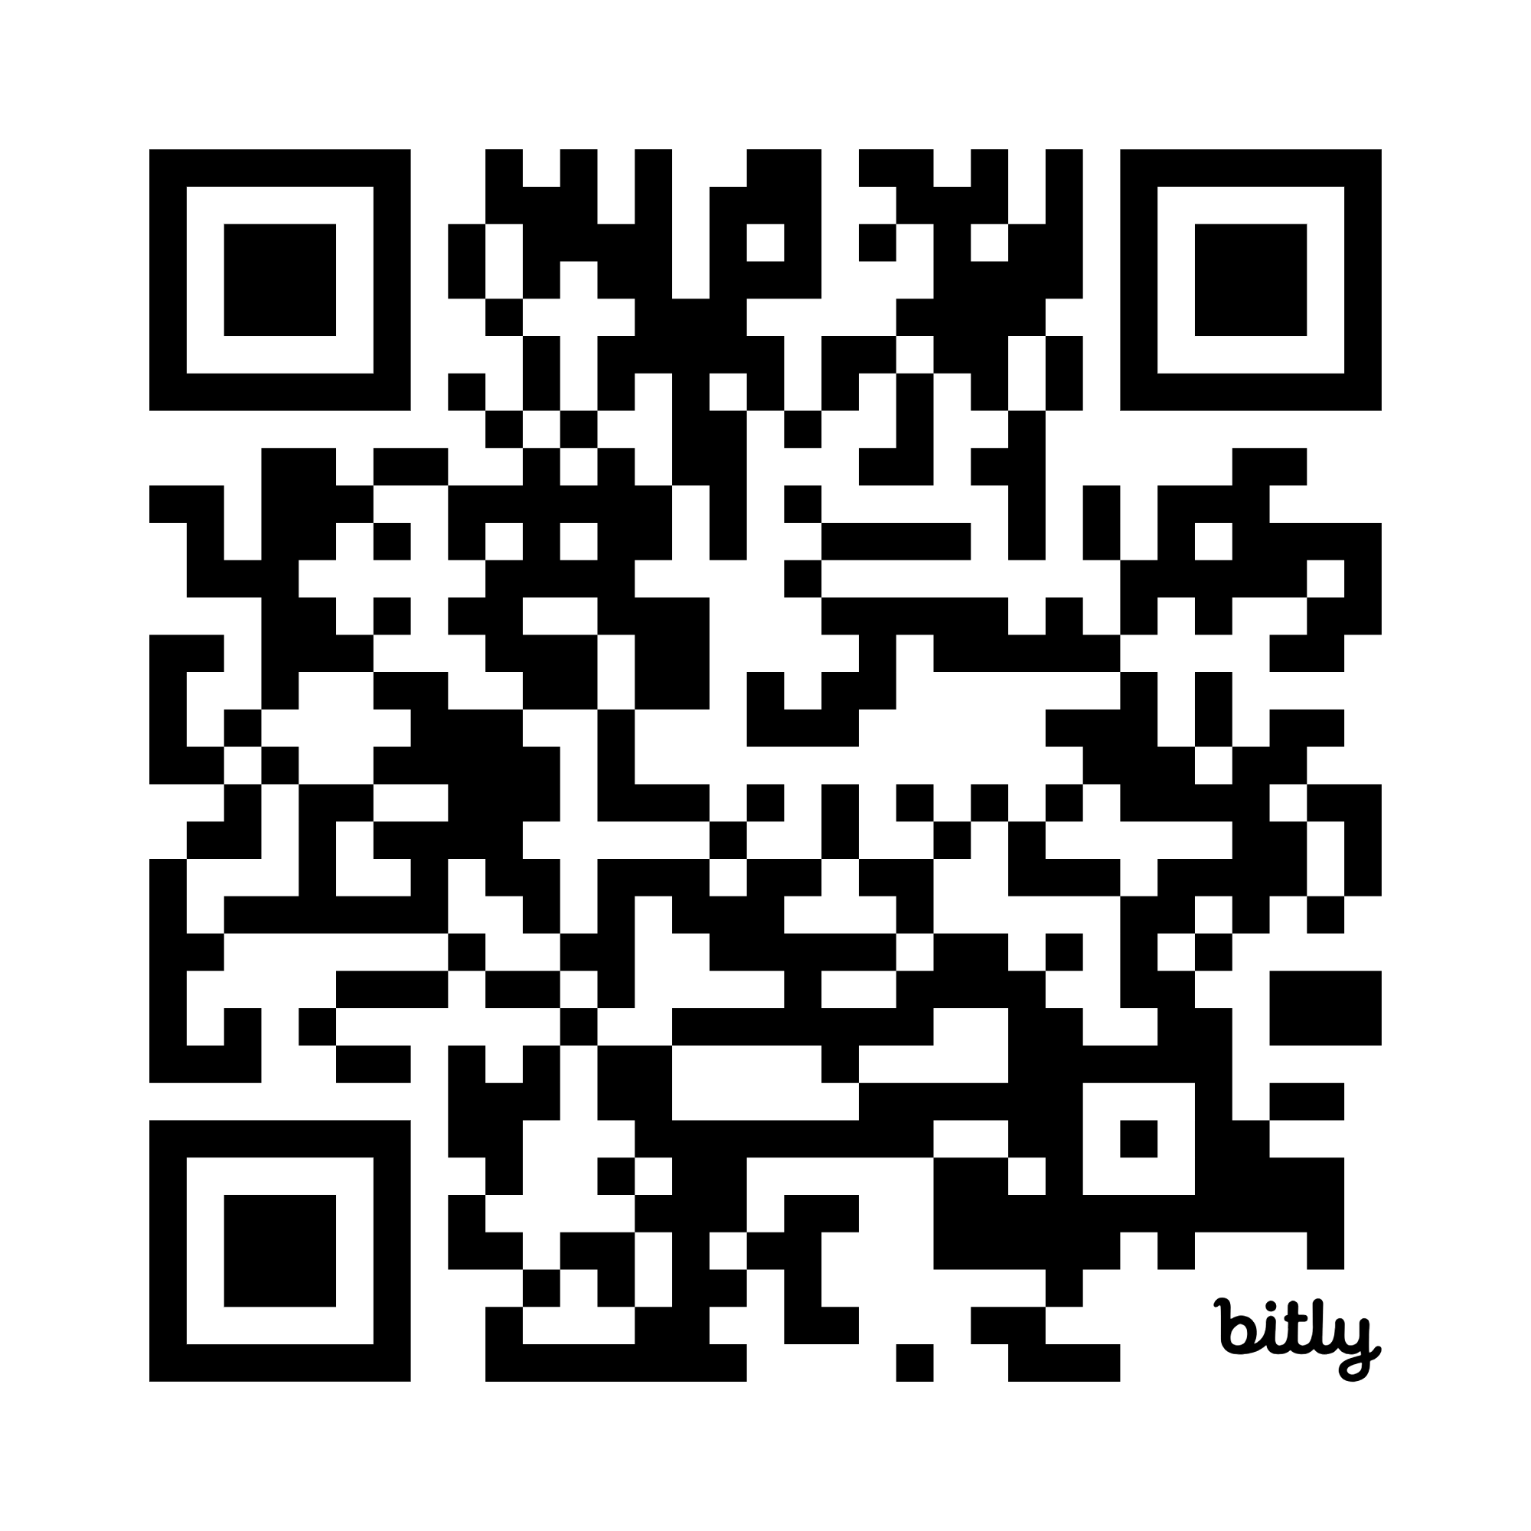
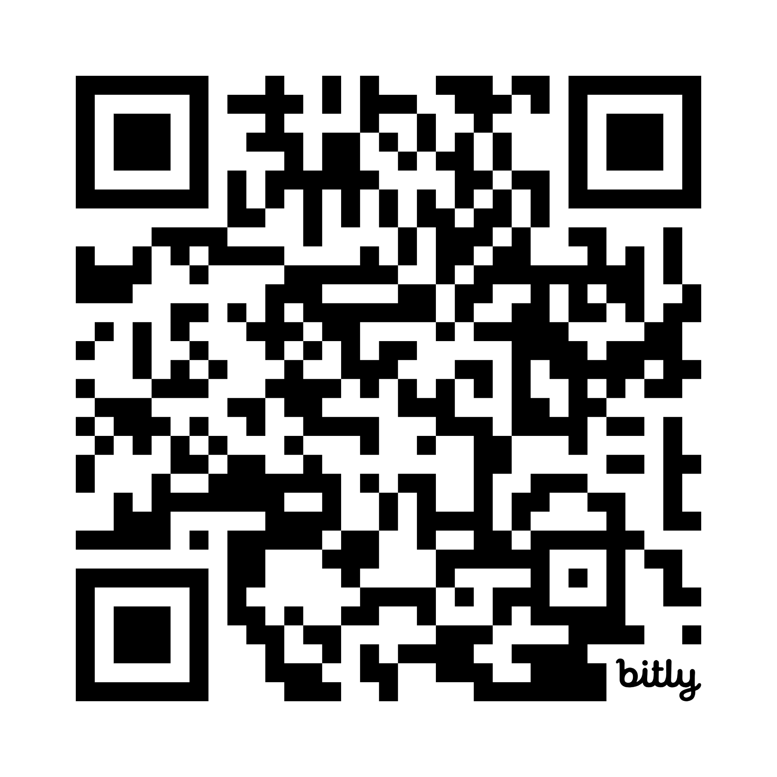
More Information on RISE Consortium
Notes:
I will leave this up as I take questions – if you would like more information on the other 2 studies – please scan this code to access the study information sheets

