Slide 1
Reassessing Priorities: Realigning Research with Programming to Support Lifelong Outcomes
Anurita Bains Florence Riako Anam
Associate Director HIV/AIDS Co-Executive Director
UNICEF GNP+
From Drug Safety Surveillance to a Life-Course Agenda

Slide 2
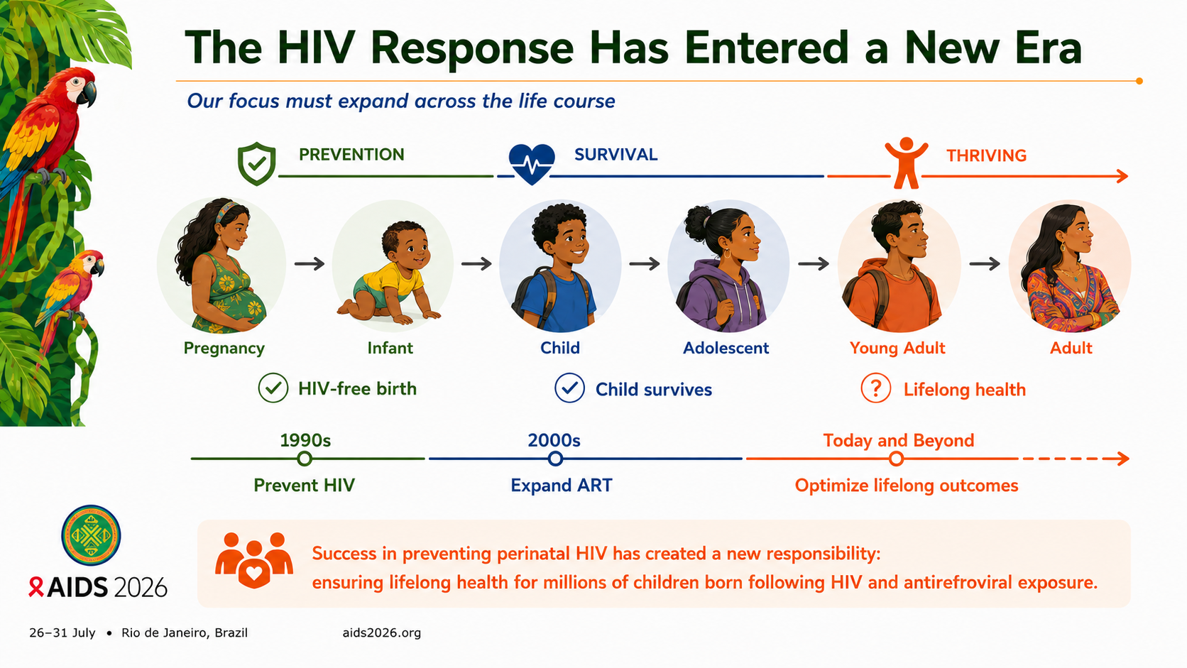
Notes:
Over the past three decades, the global HIV response has achieved one of public health's greatest successes. Millions of children who once would have acquired HIV now begin life HIV-free because their mothers had access to effective antiretroviral therapy.
But every major success creates new responsibilities.
Today, our challenge is no longer defined simply by preventing HIV transmission at birth or caring for children who do acquire HIV. It has expanded to ensuring that the growing population of children, adolescents, and adults born following HIV and antiretroviral exposure have every opportunity to thrive across the life course."

Slide 3
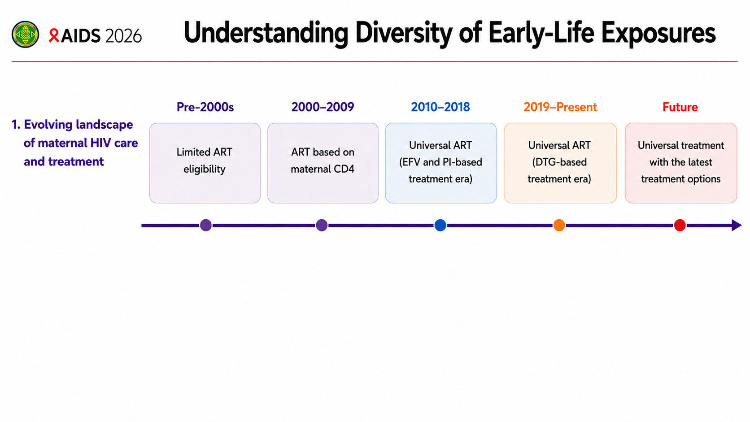
Notes:
As we think about the future of this field, it's important to recognize that there is no single population of children with perinatal HIV and antiretroviral exposure.
Every child, every adolescent, and every adult has a somewhat unique life-course exposure history—from biological exposures in utero to the clinical, social, and structural environments that continue to shape health and well-being.
That history is shaped not only by the antiretroviral regimen used during pregnancy, but also by the evolving landscape of maternal HIV care. Over time, we've moved from limited treatment eligibility, to treatment based on maternal health status, to universal treatment, and more recently to dolutegravir-based regimens. Looking ahead, we can anticipate that maternal treatment options will continue to evolve.
Move to next slide to continue the story

Slide 4
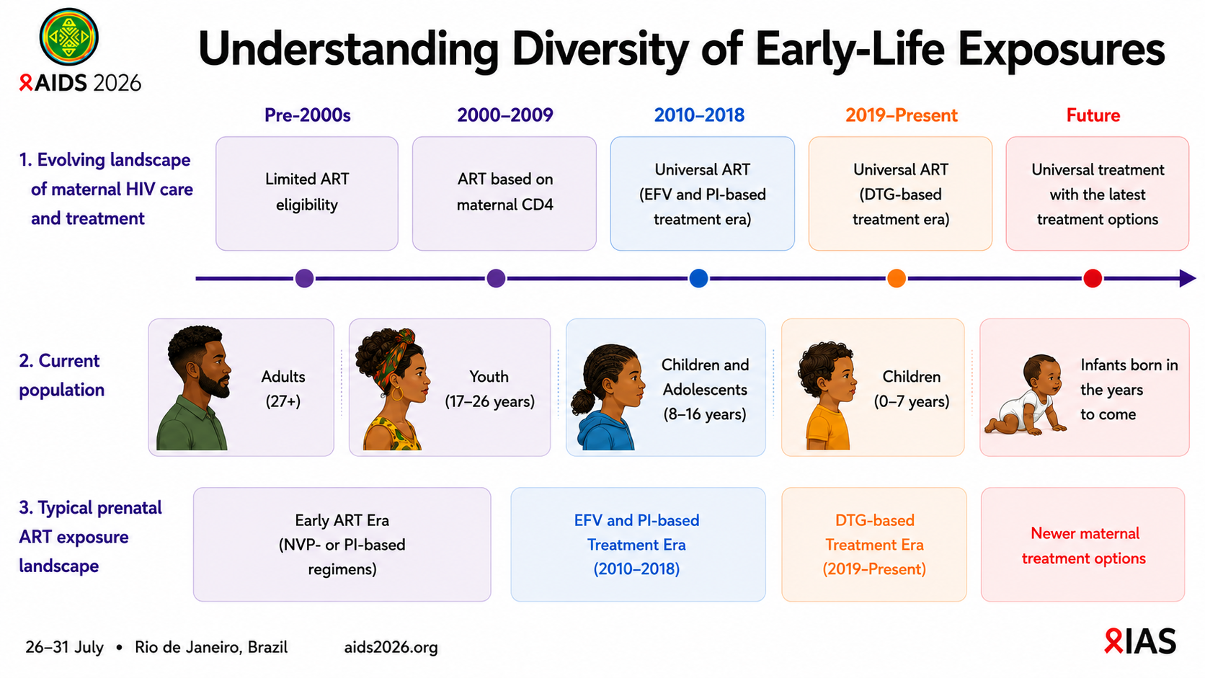
Notes:
But even within the same treatment era, prenatal exposures can be very different.
One child may have been conceived while their mother was receiving effective treatment and was virally suppressed before pregnancy. Another may have been born to a mother newly diagnosed during pregnancy, initiating treatment later in gestation. Others may have experienced treatment changes during pregnancy, interruptions in therapy, or ongoing maternal HIV disease.
These biological differences are only part of the story.
The social and structural environments in which children are born and raised—including poverty, nutrition, caregiver health, education, stigma, and access to care—also shape health and well-being across the life course.
Unfortunately, most health systems are not designed to capture these complex exposure histories. Once a child has a documented negative HIV test and is no longer considered at risk for HIV acquisition, information about maternal HIV disease, timing of diagnosis, treatment history, viral suppression, and many of the social and structural factors that influence lifelong outcomes is often no longer systematically linked to that child's health record.
As a result, we are often trying to understand lifelong health without having a complete picture of the biological, clinical, social and structural exposures that may have shaped it.
The question before us is not simply how to study this complexity. It is how to build research programs and health systems that are sufficiently flexible, participatory, and scalable to address it.
We've spent the last several minutes discussing research priorities, health systems, and policy. But perhaps the most important question isn't what researchers hope to discover. It's what families hope this research will make possible.

Slide 5
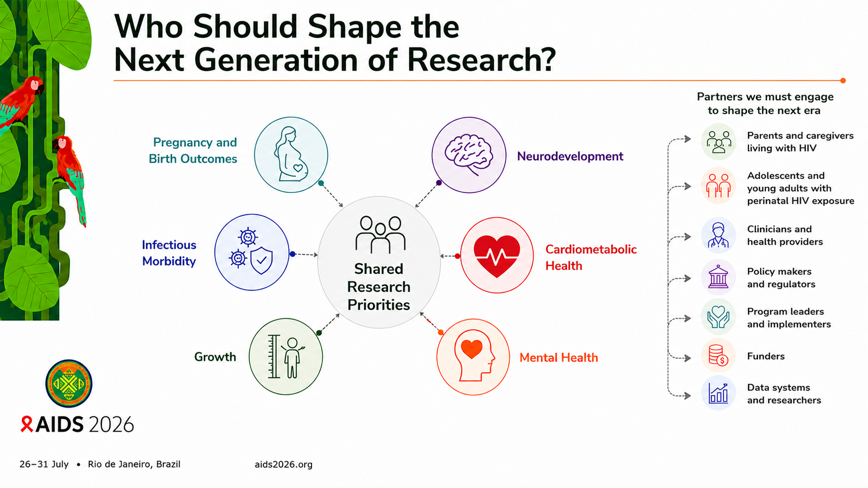
Notes:
In the past two decades, our understanding of children with perinatal HIV exposure has expanded tremendously. We began by asking whether antiretroviral therapy during pregnancy was safe, focusing appropriately on pregnancy and birth outcomes. As these children have grown, so too has our research. Today, we are studying infectious morbidity, growth, neurodevelopment, cardiometabolic health, and mental health across childhood and adolescence.
That progress is something this community should be proud of.
But I would argue that the next challenge is not simply identifying new research questions. It is ensuring that the right people help define them.
Traditionally, research priorities have largely been shaped by investigators, funders, and regulatory agencies. Those perspectives remain essential. But they are no longer sufficient if our goal is to improve lifelong outcomes.
Parents and caregivers living with HIV bring lived experience that researchers cannot replicate. Adolescents and young adults who were born following HIV exposure can tell us which health concerns matter most to them as they transition through school, employment, relationships, and parenthood. Clinicians understand the questions that arise in everyday care. National HIV programs and policy makers need evidence that is actionable, scalable, and relevant in real-world settings.
When these voices come together, we move beyond simply conducting research. We build a shared research agenda—one that is more relevant, more equitable, and ultimately more likely to improve the lives of children, adolescents, and adults with perinatal HIV exposure.
Its about taking the research that we have and engaging communities to understand the implementation opportunities and challenges.
Florence, as a mother raising children who were born HIV-exposed and HIV-free, what does success look like for your family?

Slide 6
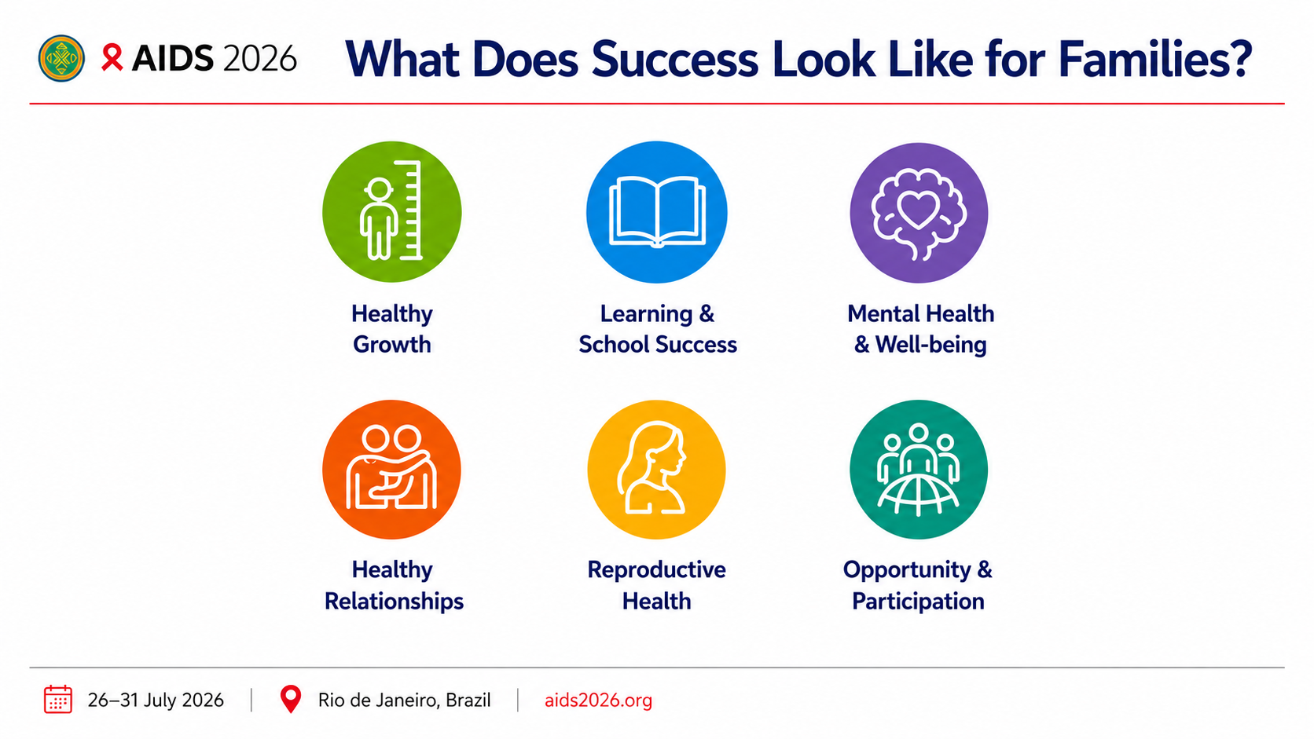

Slide 7
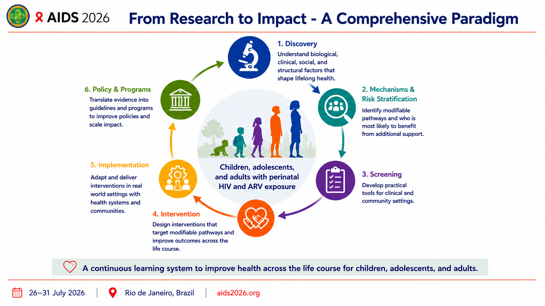
Notes:
Florence reminded us what success looks like from the perspective of families. The question now becomes: how do we ensure that research delivers those outcomes?
I would advocate for thinking differently about the research enterprise itself.
Discovery remains essential. We need to understand the biological, clinical, social, and structural factors that shape lifelong health. But discovery is only the beginning.
Our science must increasingly identify the modifiable biological, clinical, social, and structural pathways that influence health and well-being. It must also identify who is most likely to benefit from additional support, develop practical screening approaches, design effective interventions, and work with communities, clinicians, health systems, and policy makers to ensure those interventions reach the people who need them.
Importantly, this is not a linear process. Each stage informs the next. Implementation identifies new questions. Programs reveal new priorities. Communities highlight outcomes that matter most. Together, they create a continuous learning system capable of improving health across the life course.
While this approach has tremendous potential to improve the lives of children, adolescents, and adults with perinatal HIV and antiretroviral exposure, I believe its impact extends far beyond HIV. It offers a model for building the next generation of life-course science—one that integrates biology, clinical care, lived experience, implementation, health systems, and policy to help all children reach their full potential.

Slide 8






A Call to Action
Risk Informed Screening
Develop and deliver practical tools for early identification and ongoing monitoring
Targeted Interventions
Design and adapt interventions that address modifiable pathways to improve health across the life course
Responsive Health Policy
Partnering on dissemination of research findings to inform health policy with streamlined approaches to health policy adaptation and adoption.
Adaptive Health Systems
Use real-world data and feedback loops to continuously improve care and outcomes
Sustained Funding
Secure and align investments to ensure equity and long-term impact

Slide 9
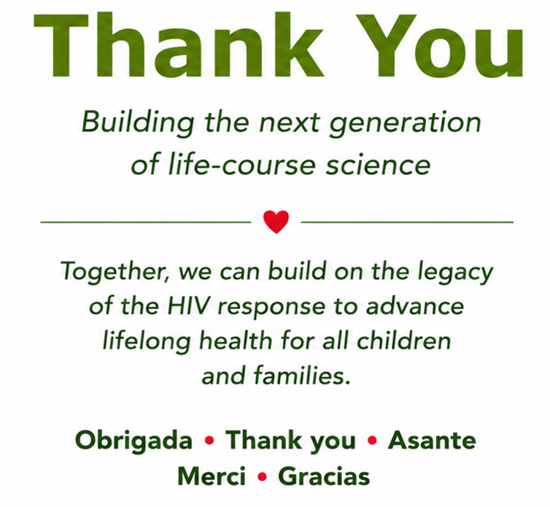
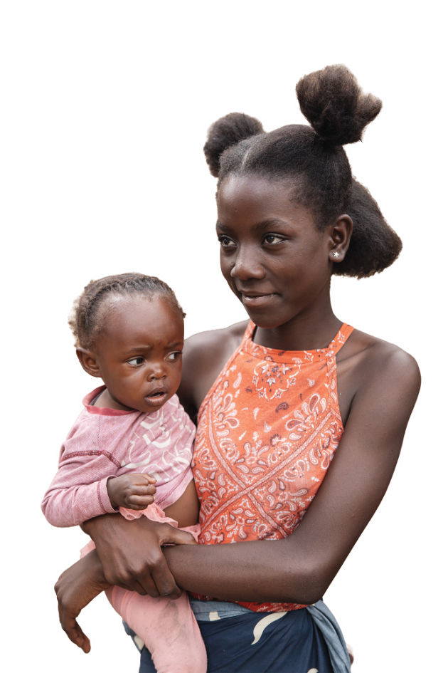
Mercy Phiri (16 years old) with her child Blessing (18 months old) outside Chainda Urban Health Centre in Zambia. The centre provides free HIV testing, counselling, and maternal health services, supporting young mothers like Mercy to stay healthy and protect their children.
Notes:
Florence and I wish to thank you for your attention and we look forward to seeing this ecosystem evolve as we gather next year at the 13th Symposium for Children and Adolescents with Perinatal HIV Exposure.

