Slide 1
Closing remarks
Sonia Lee
Eunice Kennedy Shriver National Institute of Child Health and Human Development

Slide 2


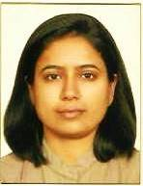
Optimizing development after perinatal HIV exposure
Megan Kowalcyk
University of Maryland
Marguerite Marlow
Stellenbosch University
Himani Pandya
Stellenbosch University

Slide 3
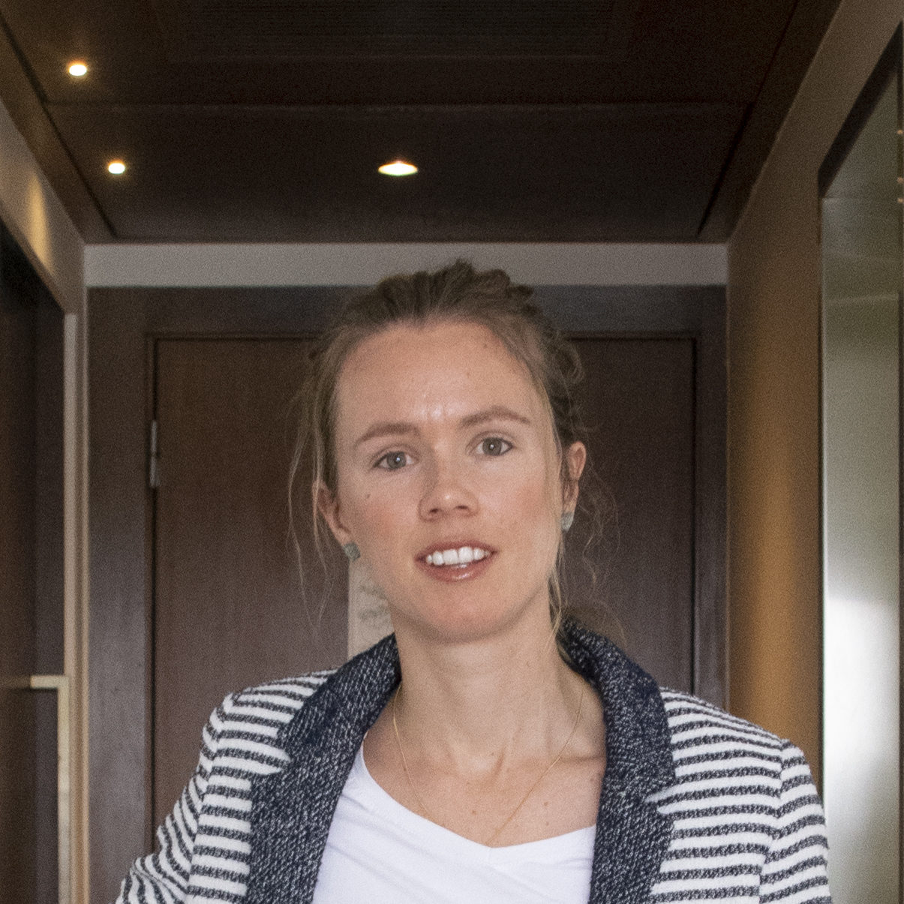

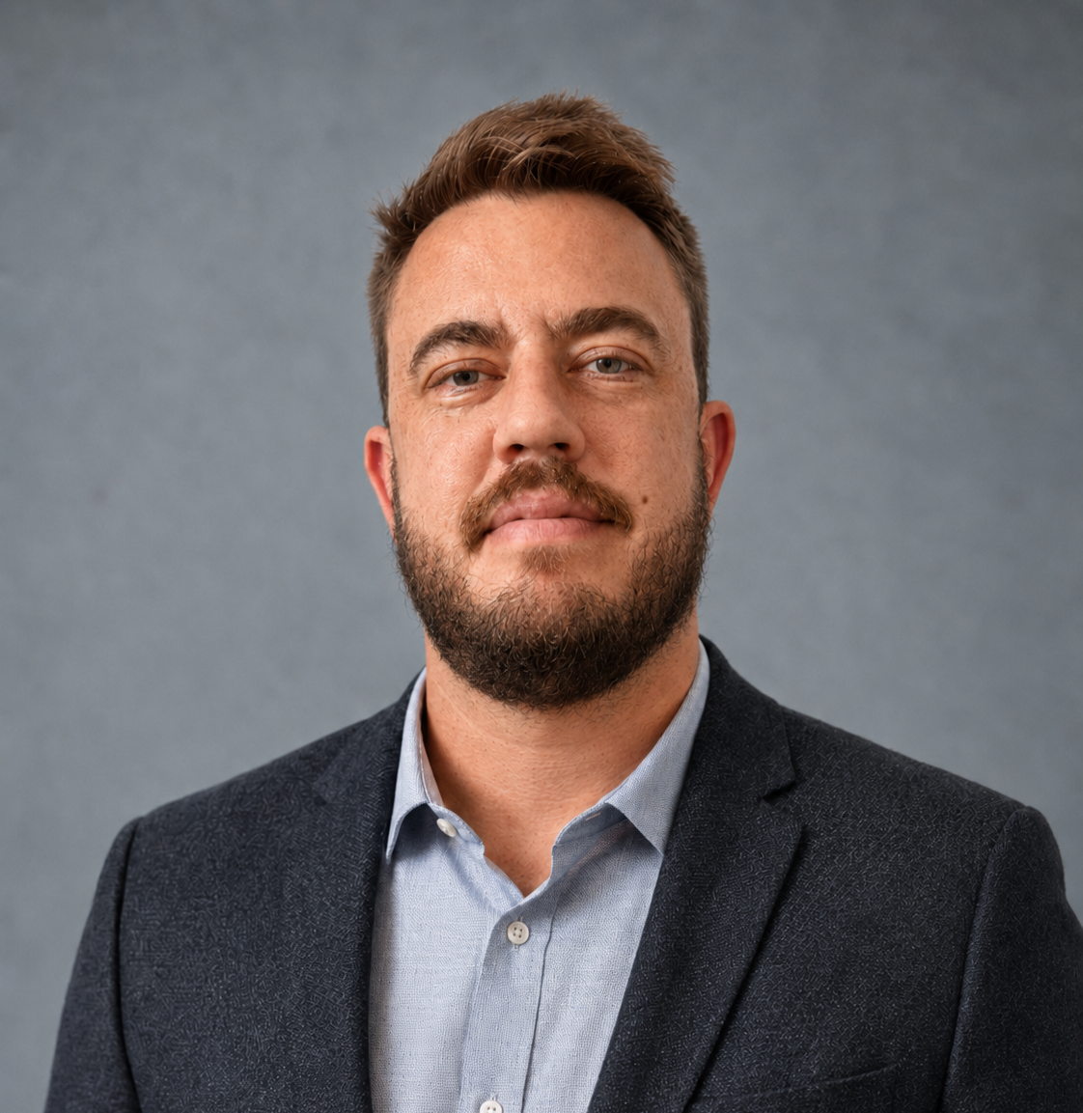
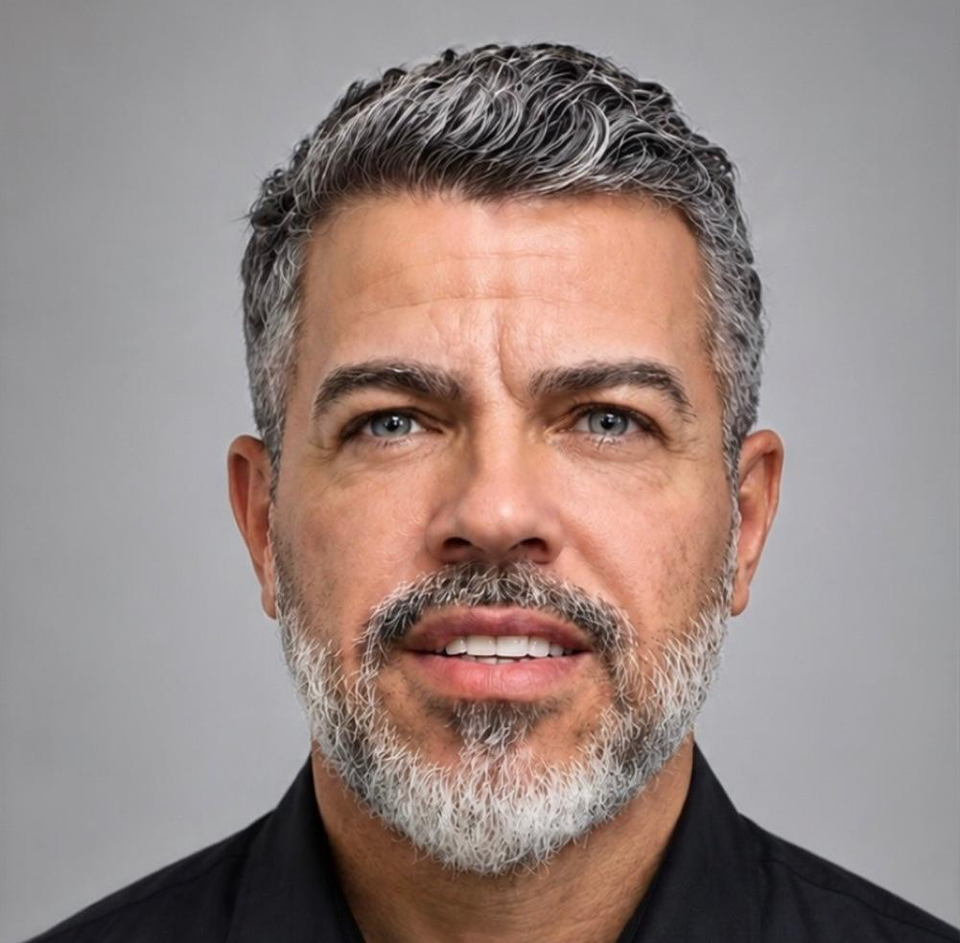

Identifying Risk and Supporting Families: Lessons from Other Programmes
Shani de Beer
University of Cape Town
Lena Serghides
University of Toronto
Nathanael Leo van Blydenstein
Leo Advisory
Jeferson Fonseca
Família Positiva BH
Luana Uchôa Guimarães
Community Advocate

Slide 4
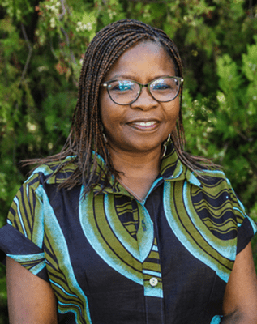
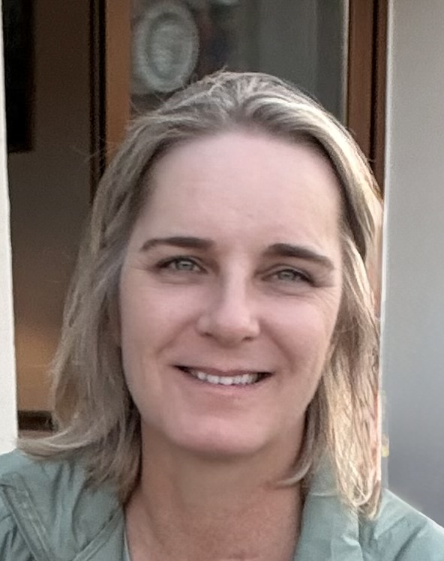
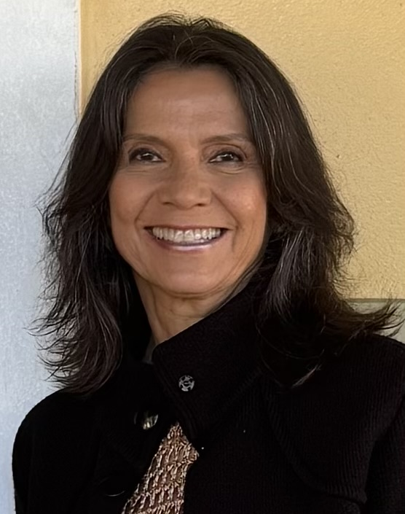
Learning through debate
Agnes Ronan
Paediatric Adolescent Treatment Africa (PATA)
Kim Anderson
University of Cape Town
Maria Leticia Cruz
Hospital Federal dos Servidores do Estado
Facilitator
For the proposition
Against the proposition

Slide 5
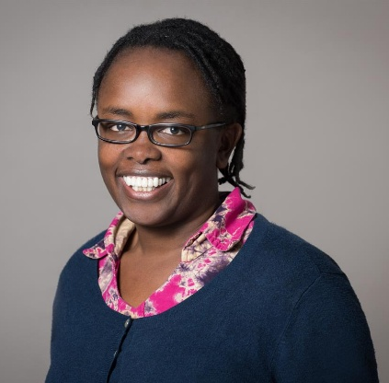
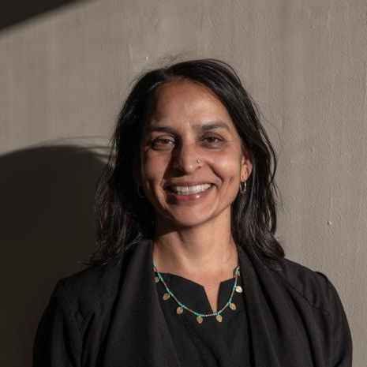

Long-term follow-up: From Data to Action
Irene Njuguna
Emory University
Anurita Bains
UNICEF
Florence Anam
GNP+

Slide 6

Feedback survey

Slide 7


13th Symposium on Children and Adolescents with Perinatal HIV Exposure
Join us in Geneva

Slide 8

Sponsors

