Slide 1


HIV Cure in 2026: State of the field
Prof. Dr. Christian Gaebler
Berlin Center for HIV Cure
Charité – Universitätsmedizin Berlin / Berlin Institute of Health
AIDS 2026 HIV cure pre-conference

Slide 2

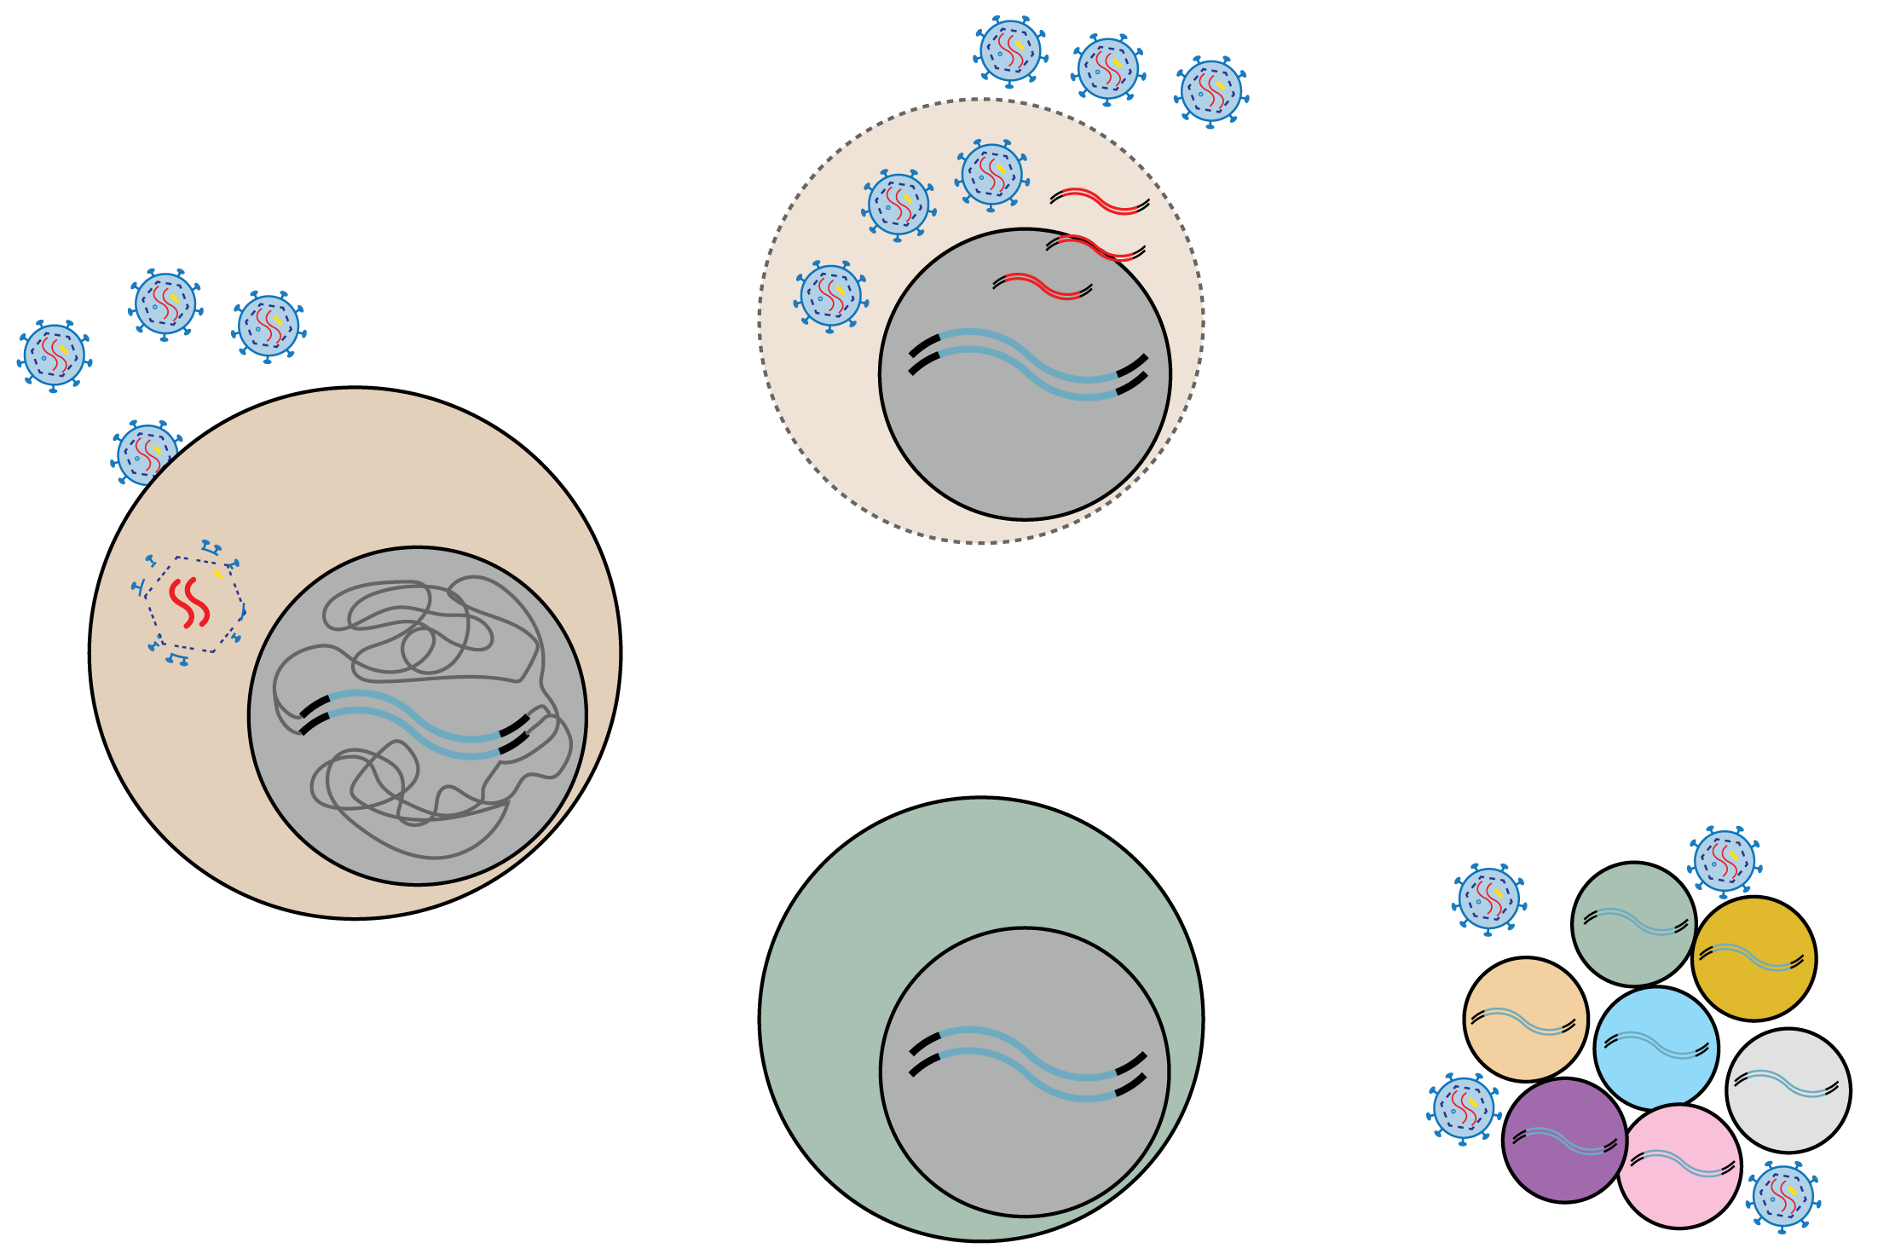
HIV Biology
HIV
Viral Replication
CD4+ T cell
Latent CD4+ T cell
HIV RESERVOIR

Slide 3
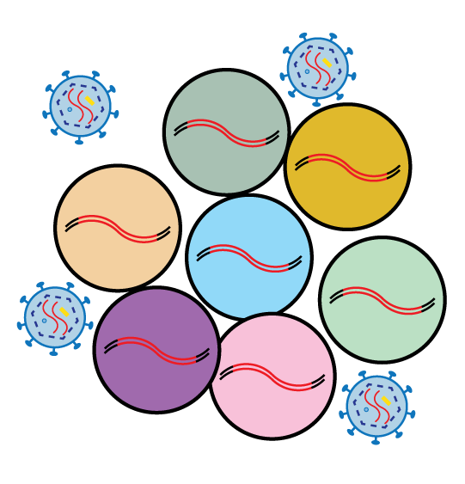
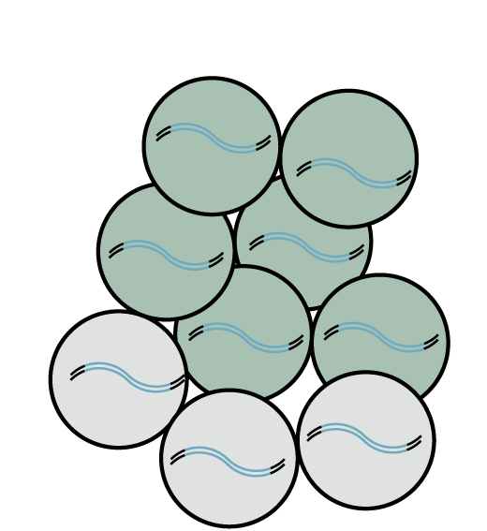
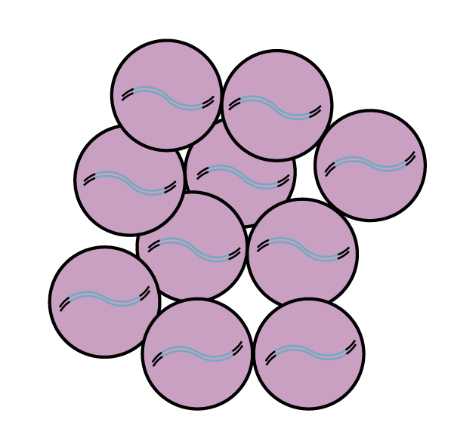
HIV Reservoir
Antiretroviral Therapy (ART)
HIV reservoir is the primary obstacle to an HIV cure
ART inhibits active viral replication but has little impact on the HIV reservoir
Reservoir is established early in infection
Reservoir is a dynamic viral archive (“wax and wane”)
Reservoir formation, maintenance, and reactivation are poorly understood
Viral Load
Viral
Rebound
Time
Today: Session 3
Friday, 31 July 12:00 - 13:00
Reservoir dynamics and latency disruption (OAA38)
Reservoir
Formation
Reservoir
Maintenance
Reservoir
Reactivation

Slide 4
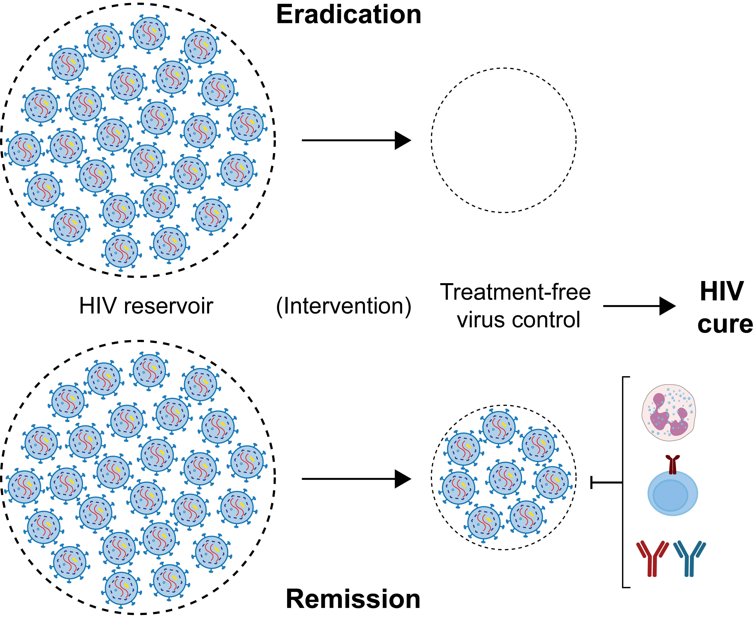
HIV Cure
Eradication
Remission

Slide 5
HIV Cure
Eradication
Remission

Slide 6
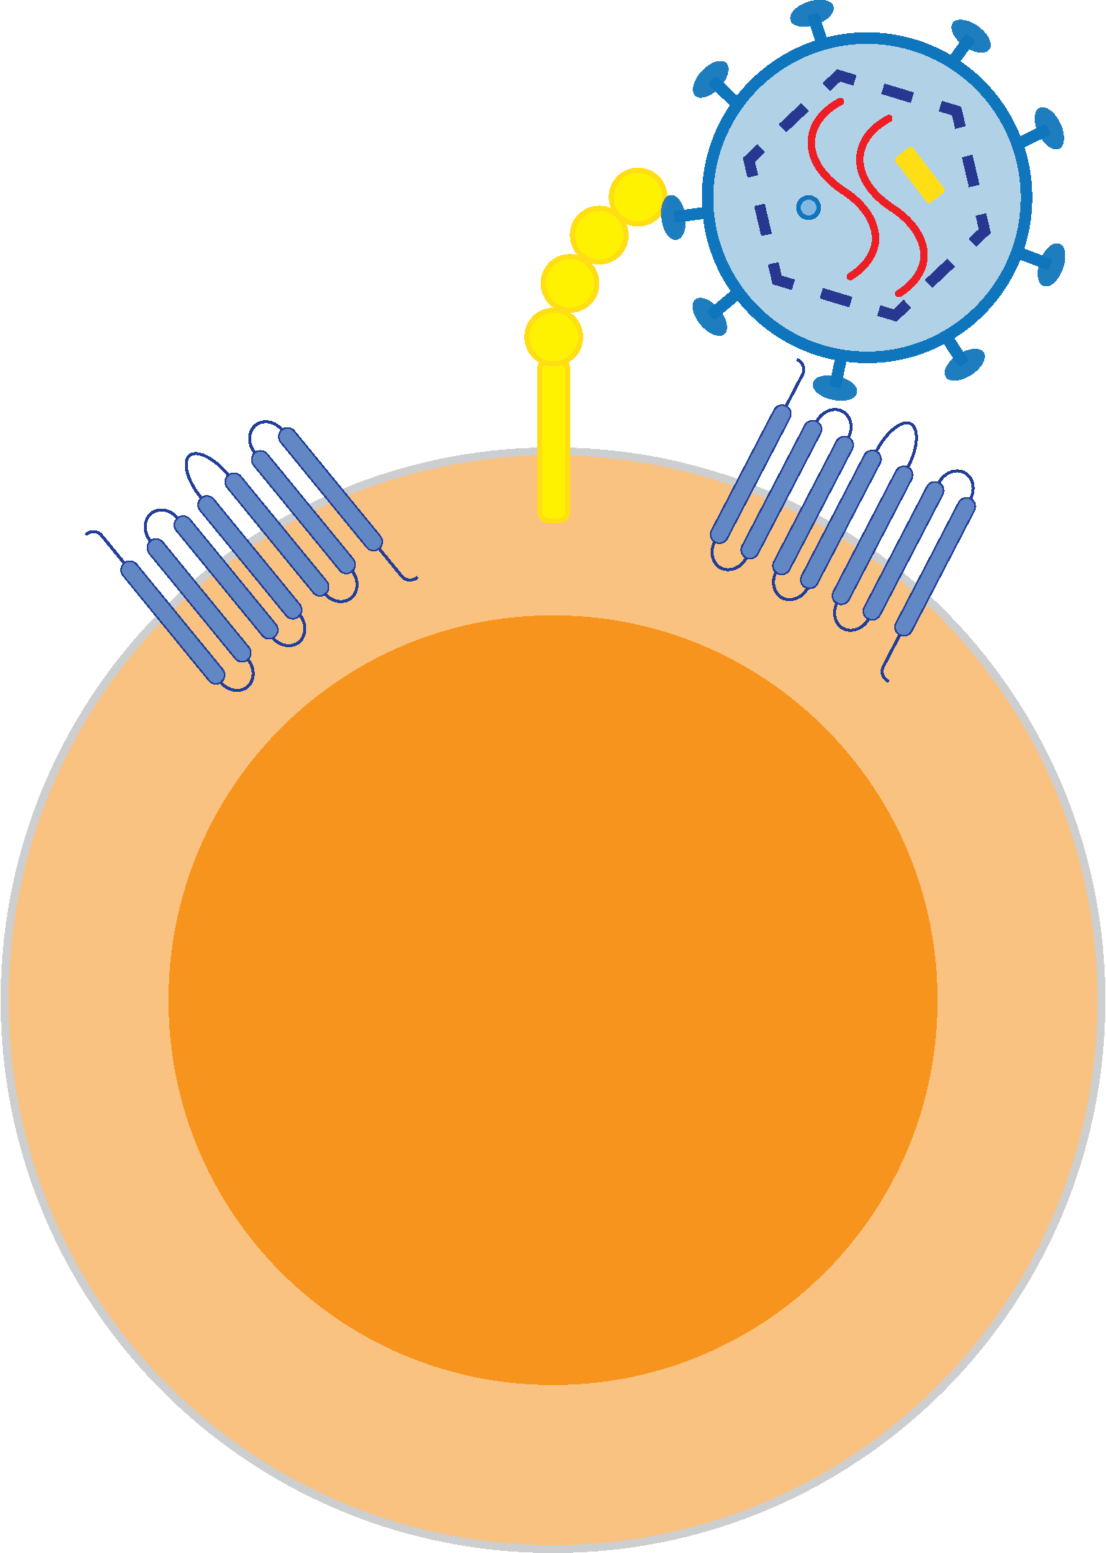
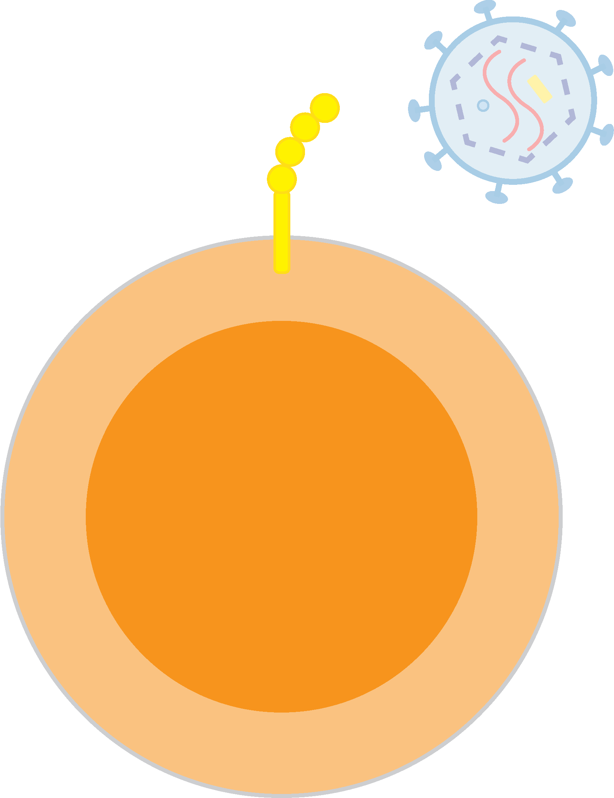
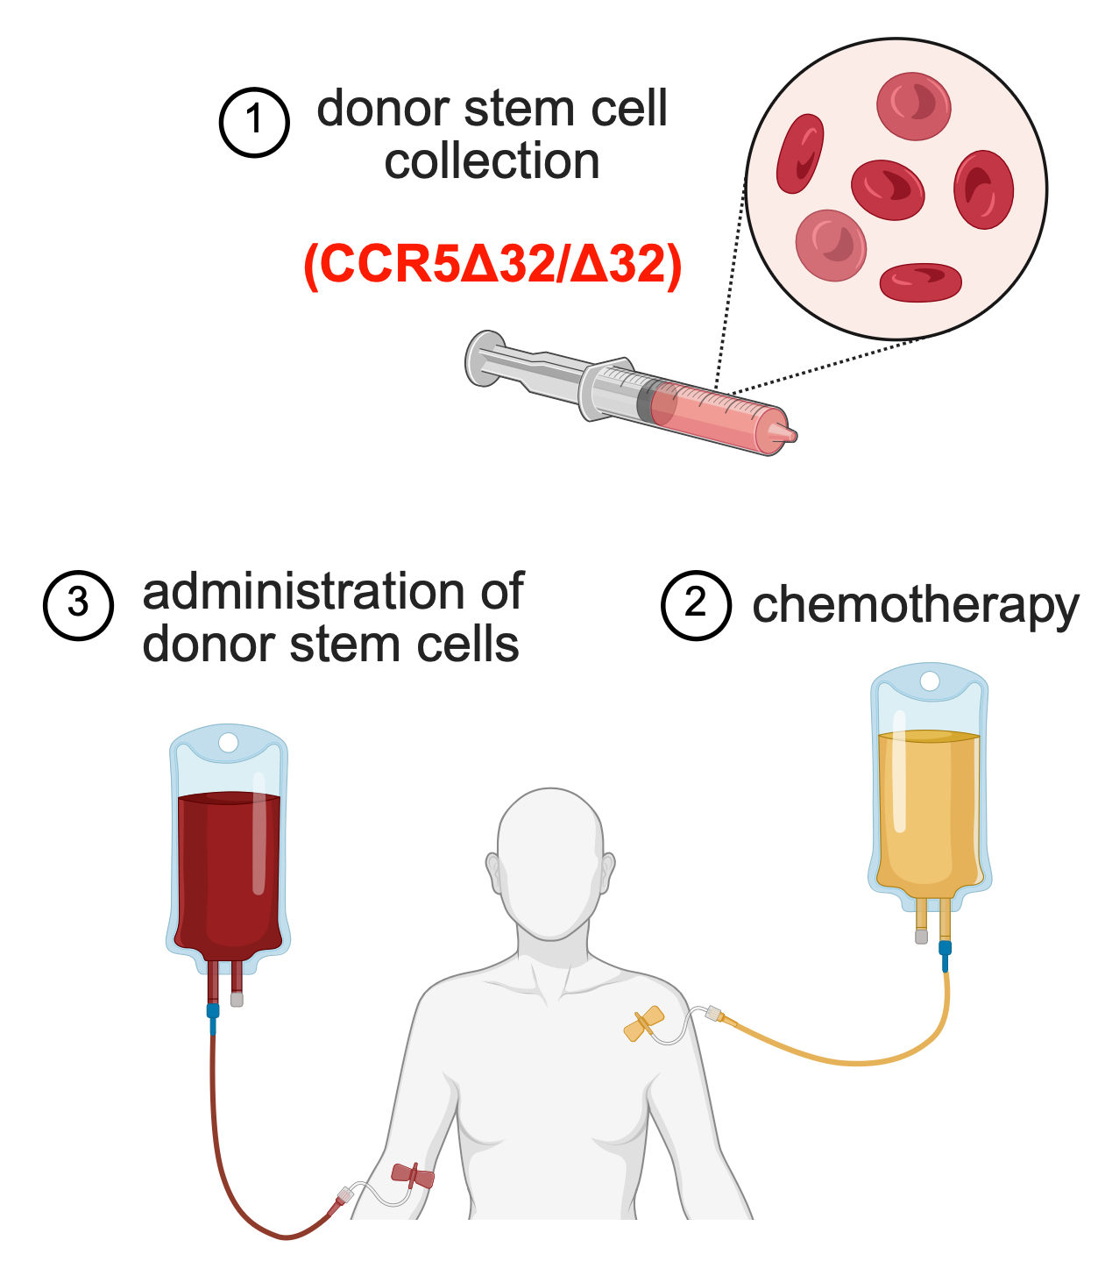
HIV Cure – Stem Cell Transplantation
CCR5
WT/WT
CCR5
Δ32/Δ32
HIV Infection
Protection against HIV Infection

Slide 7
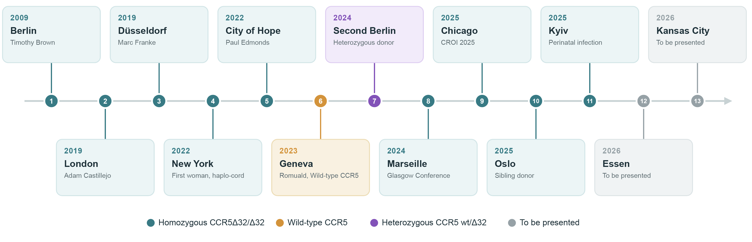
HIV Cure – Stem Cell Transplantation
Wednesday, 29 July 10:30 - 11:30
Cure and control (OAA15 )
1 Hütter, NEJM 2009 · 2 Gupta, Nature 2019 · 3 Jensen, Nat Med 2023 · 4 Hsu, Cell 2023 · 05 Dickter, NEJM 2024 · 6 Sáez-Cirión, Nat Med 2024 · 7 Gaebler, Nature 2026 · 8 Marseille pt (HIV Glasgow 2024) · 9 Rubinstein, CROI 2025 · 10 Myhre, Nat Microbiol 2026 · 11 Korenkova, Blood 2025 (ASH) · 12 Essen pt (AIDS 2026) · 13 Kansas City pt (AIDS 2026)

Slide 8

HIV Cure – Stem Cell Transplantation
91.4 million
[73.4 million–116.4 million] people have been or are living with HIV since the start of the epidemic
13 individuals have been cured of HIV

Slide 9
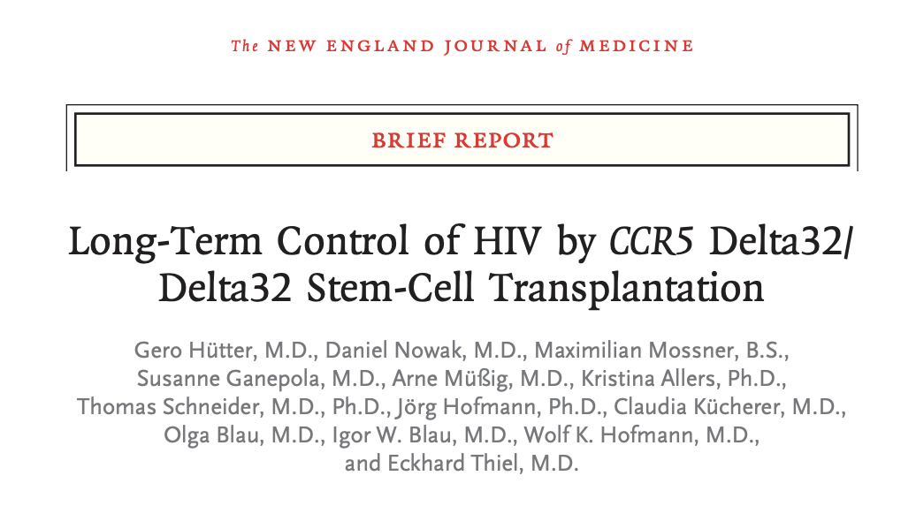
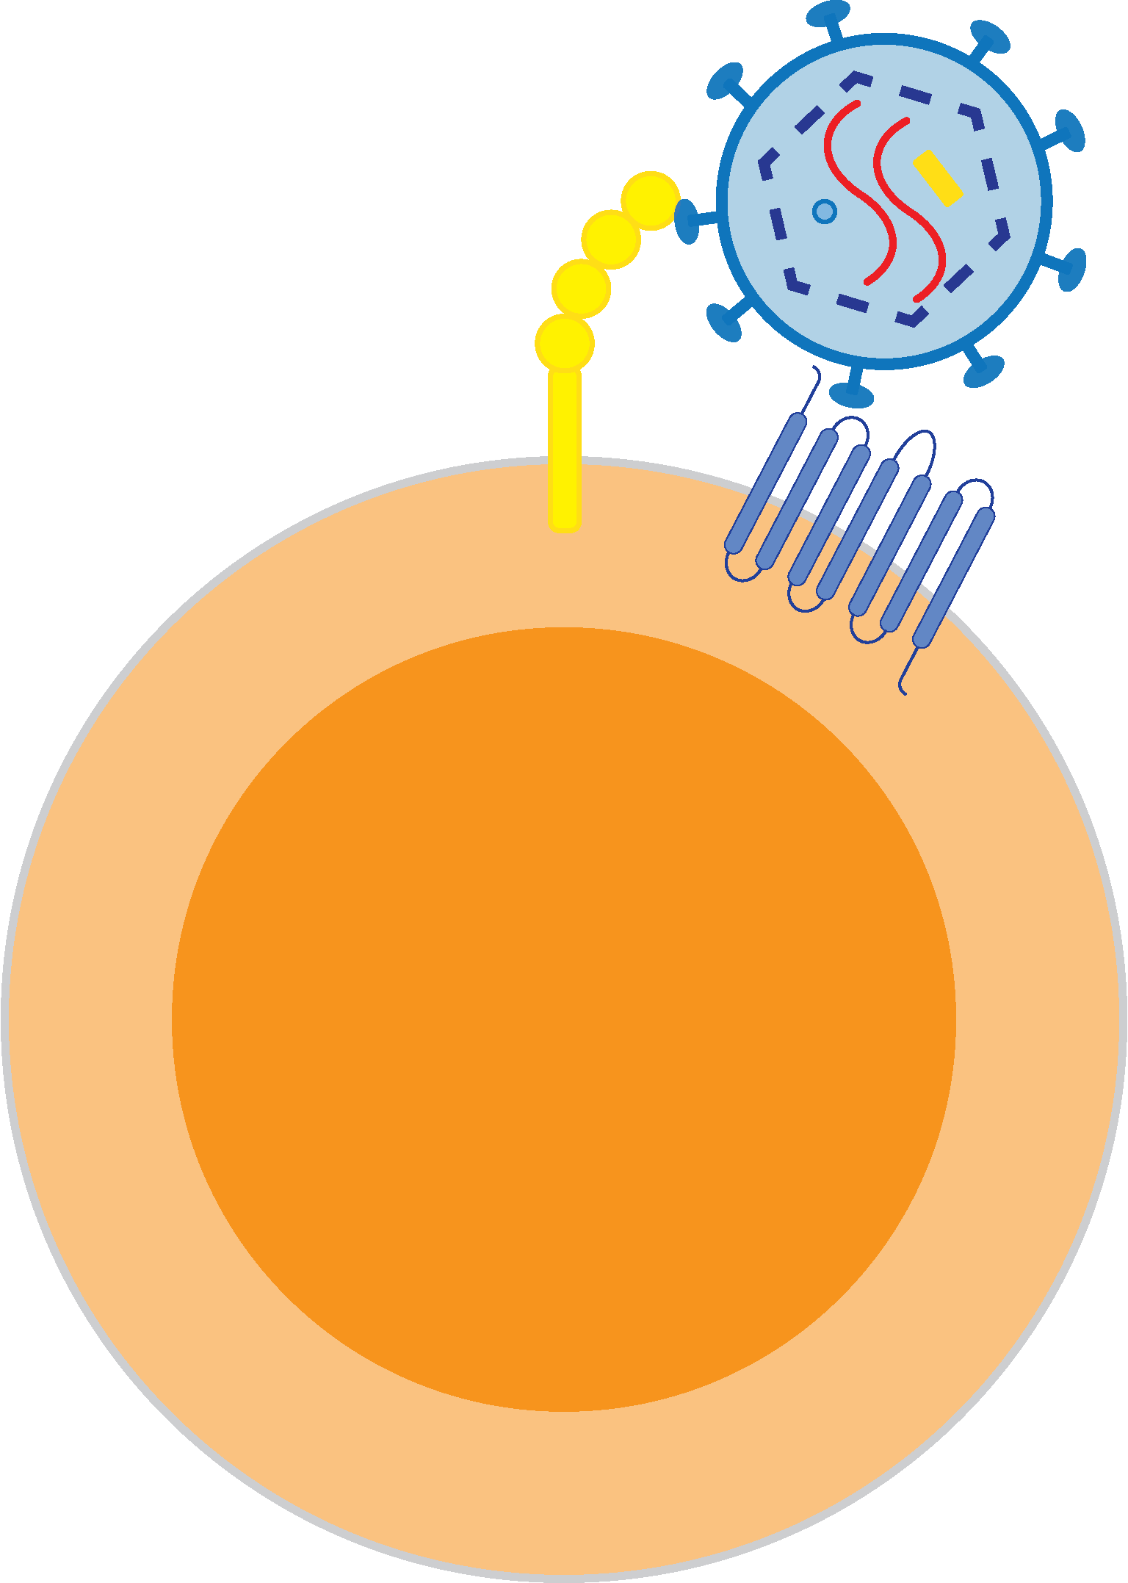
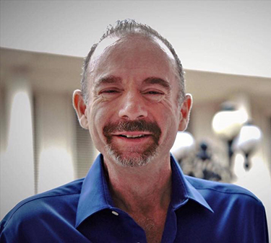

HIV Cure – Stem Cell Transplantation
Geneva Patient
Sixth person cured of HIV
Second Berlin Patient Seventh person cured of HIV
CCR5
WT/WT
CCR5
WT/Δ32
Sáez-Cirión, Nat Med 2024
Gaebler, Nature 2026
2009
Timothy Ray Brown First person cured of HIV
HIV cure independent of CCR5 status

Slide 10
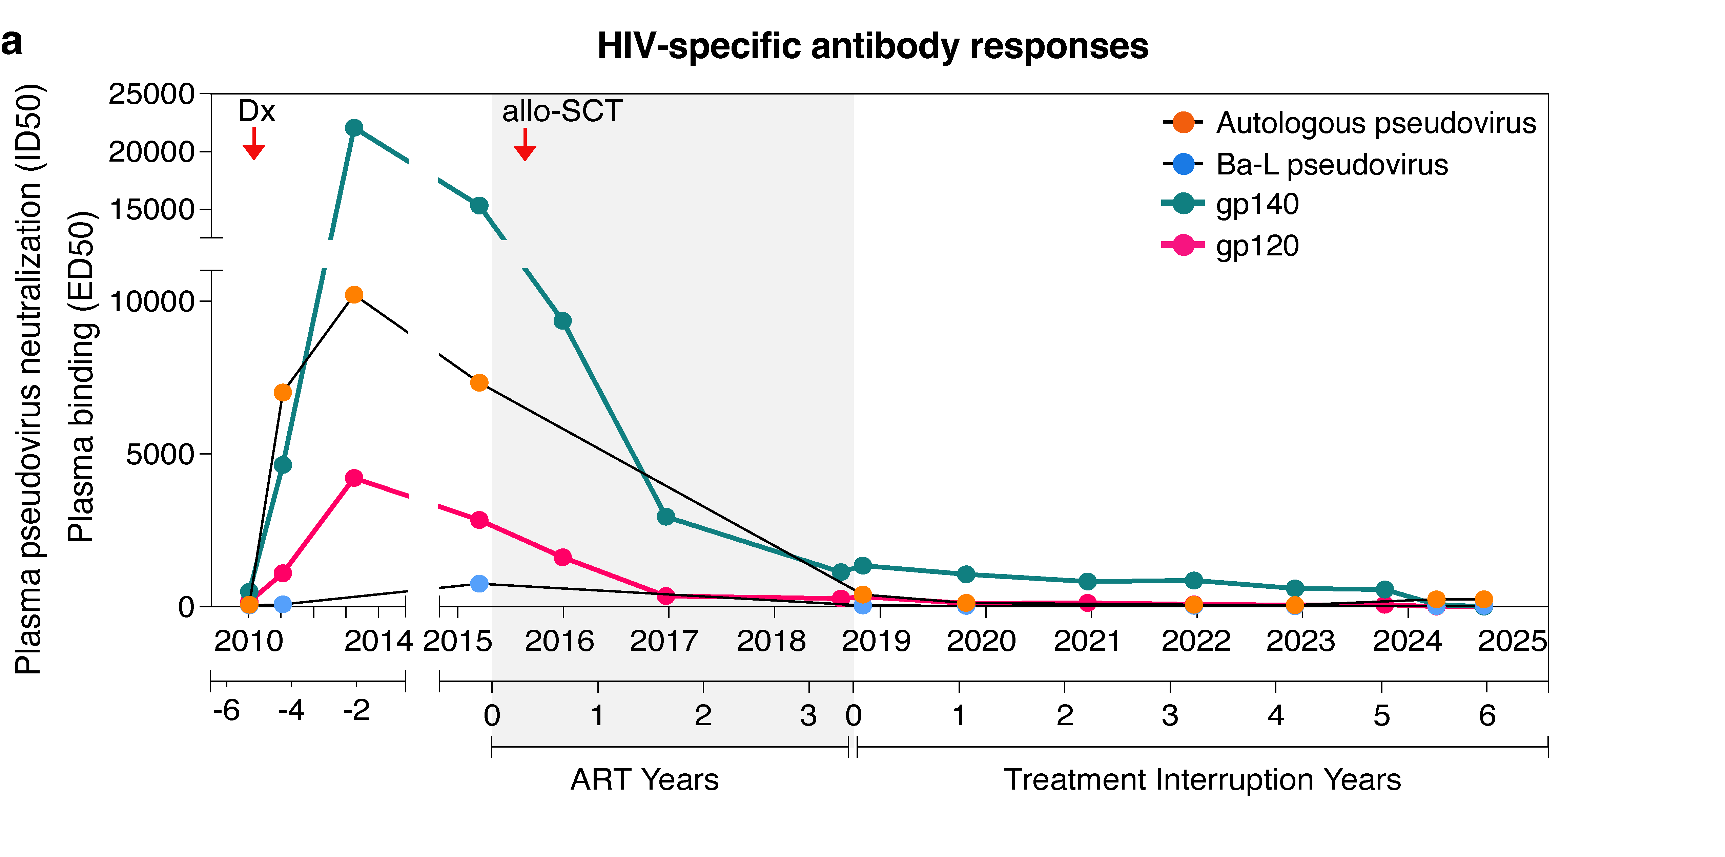
HIV-specific Antibodies
Gaebler, Nature 2026

Slide 11
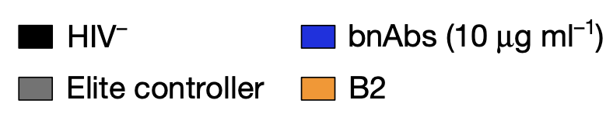
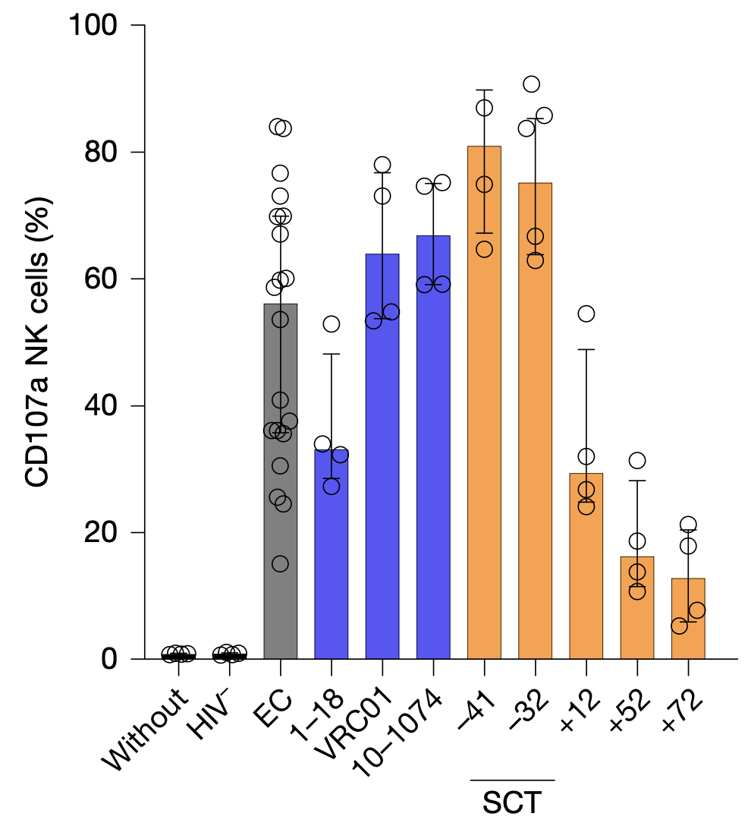
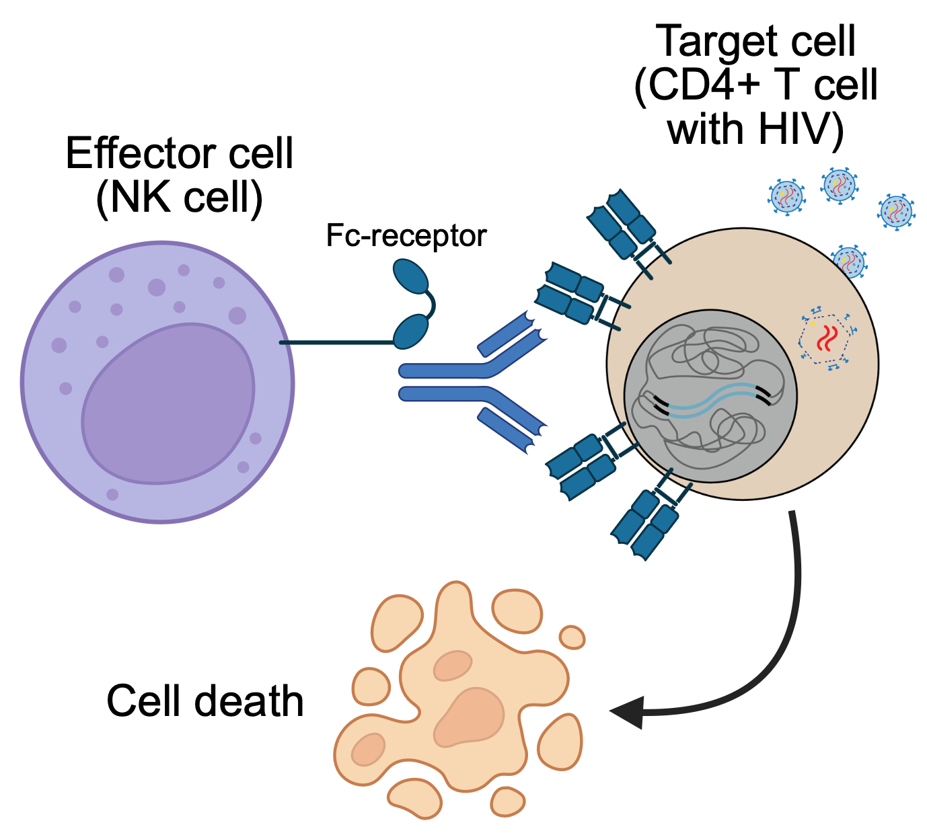
Antibody-dependent Cellular Cytotoxicity (ADCC)
High ADCC activity
→ HIV Reservoir depletion

Slide 12
HIV Cure
Eradication
Remission

Slide 13
HIV Cure
Eradication
Remission

Slide 14
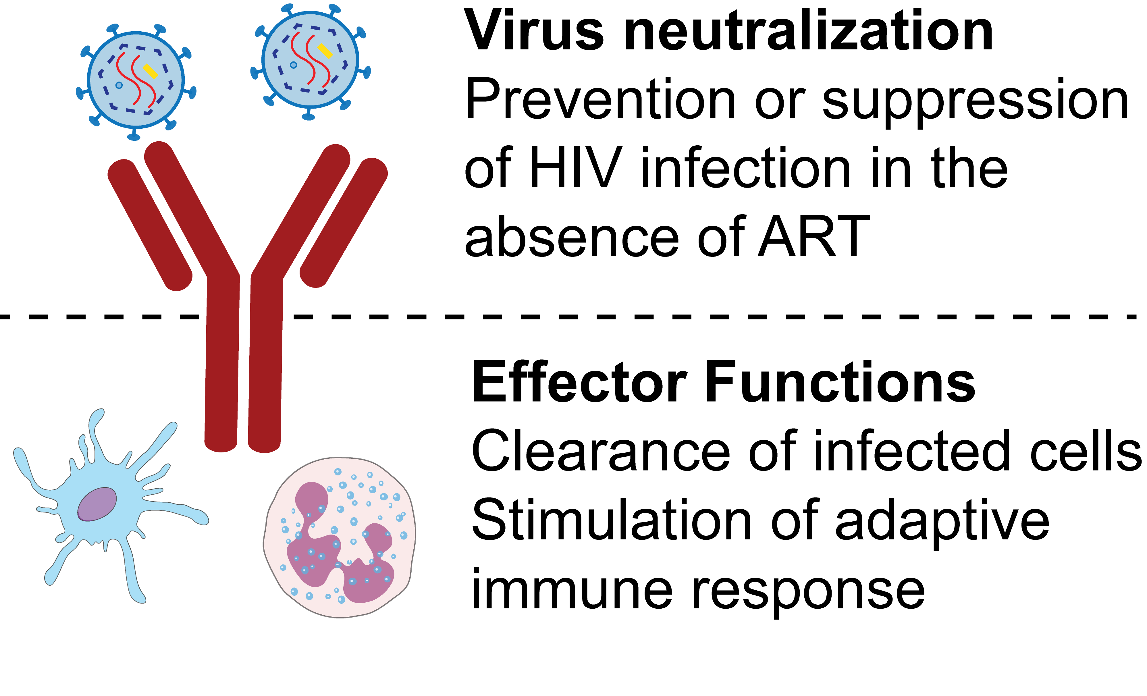
HIV-specific Antibodies

Slide 15
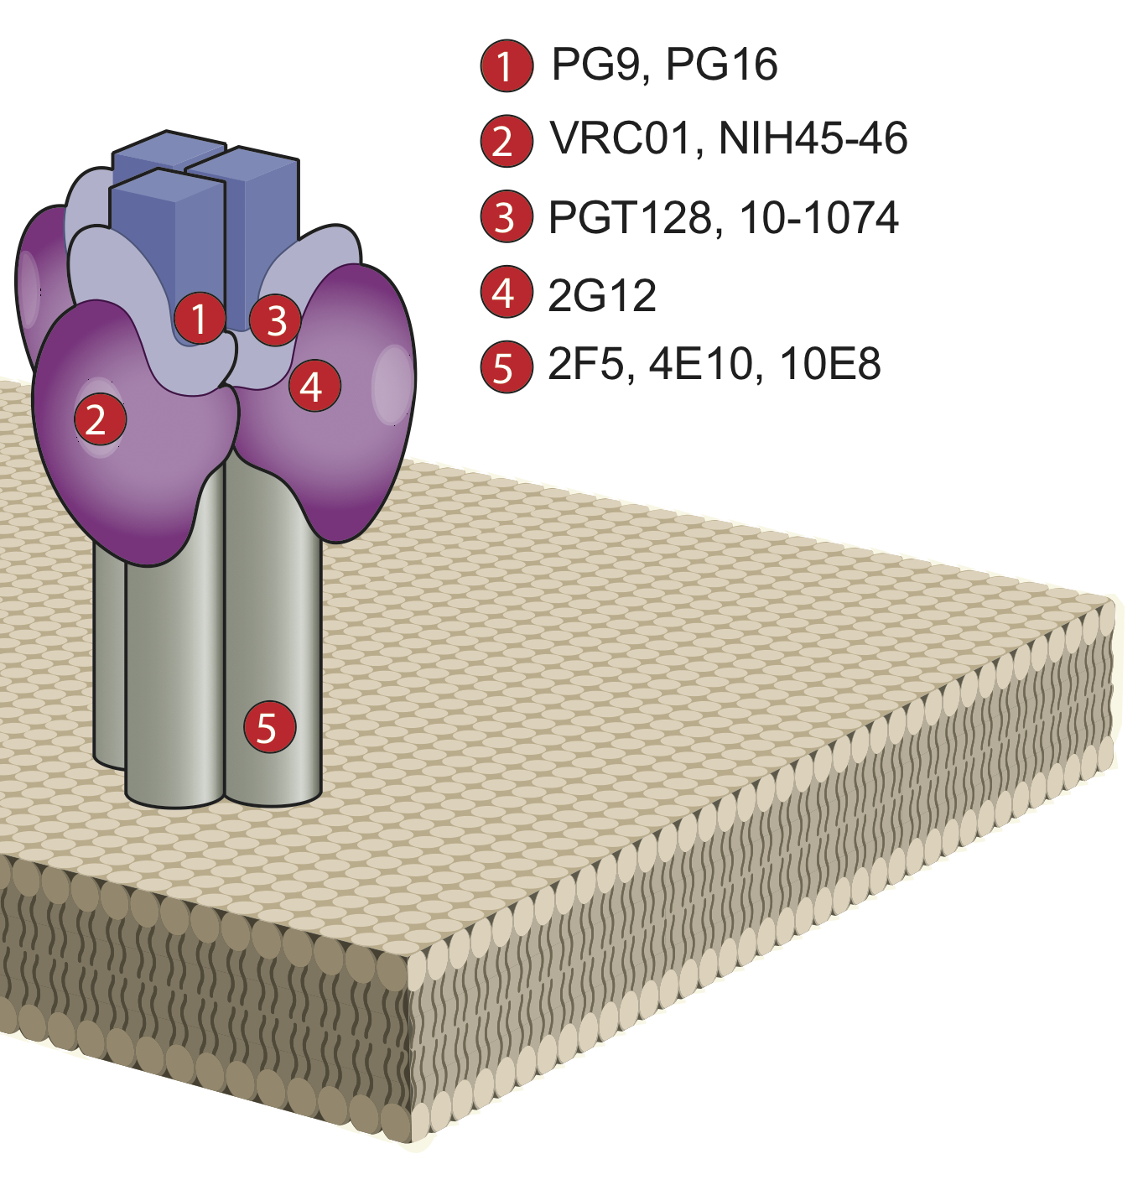
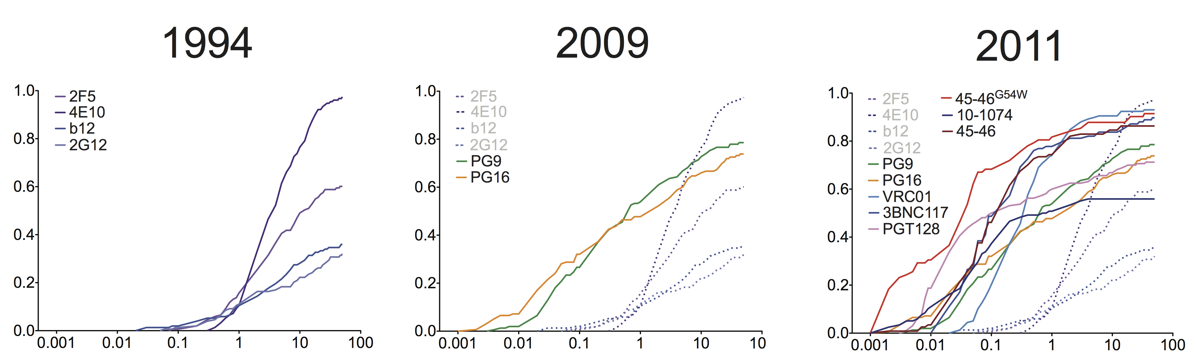
HIV-specific Antibodies
Broadly neutralizing antibodies (bNAbs)
IC50(µg/ml)
IC50(µg/ml)
IC50(µg/ml)
Wu, Science 2010
Scheid, Science 2011
Diskin, Science 2011
Walker, Nature 2011
Mouquet, PNAS 2012
Muster, J Virol 1993
Burton, Science 1994
Trkola, J Virol 1996
Walker, Science 2009

Slide 16


Broadly neutralizing antibodies (bNAbs)
2017
2018
2012
2013
2015
2019-2021
2025
Tuesday, 28 July 08:30 – 10:00
Plenary Talk: Michel Nussenzweig
Tuesday, 28 July 10:30 - 11:30
bNAbs for cure: Hope or hype? (SY19)
Wednesday, 29 July 10:30 - 11:30
Cure and control (OAA15)

Slide 17
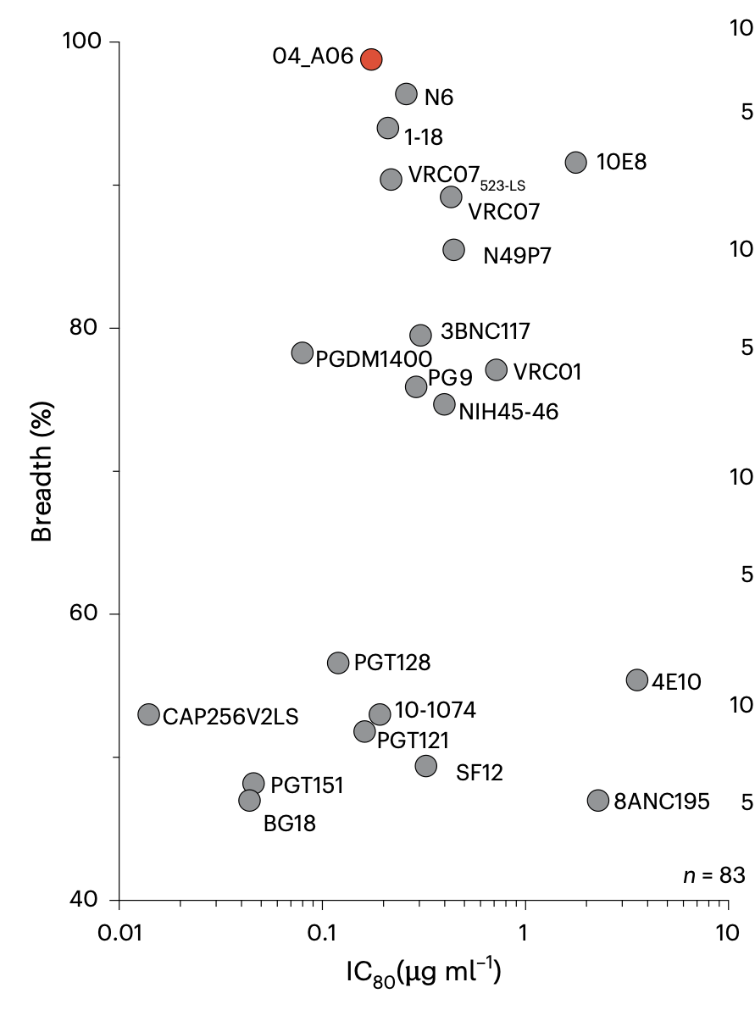
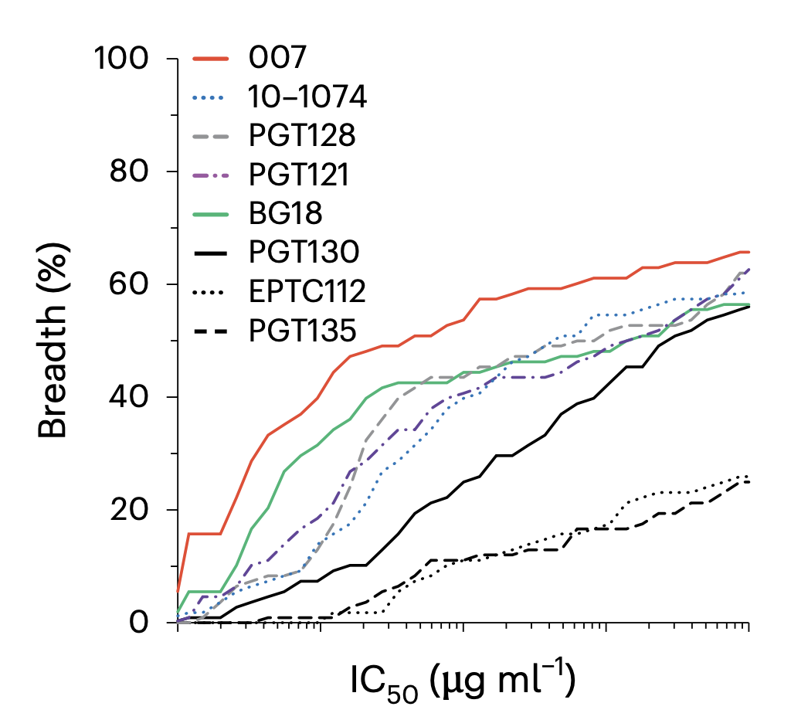

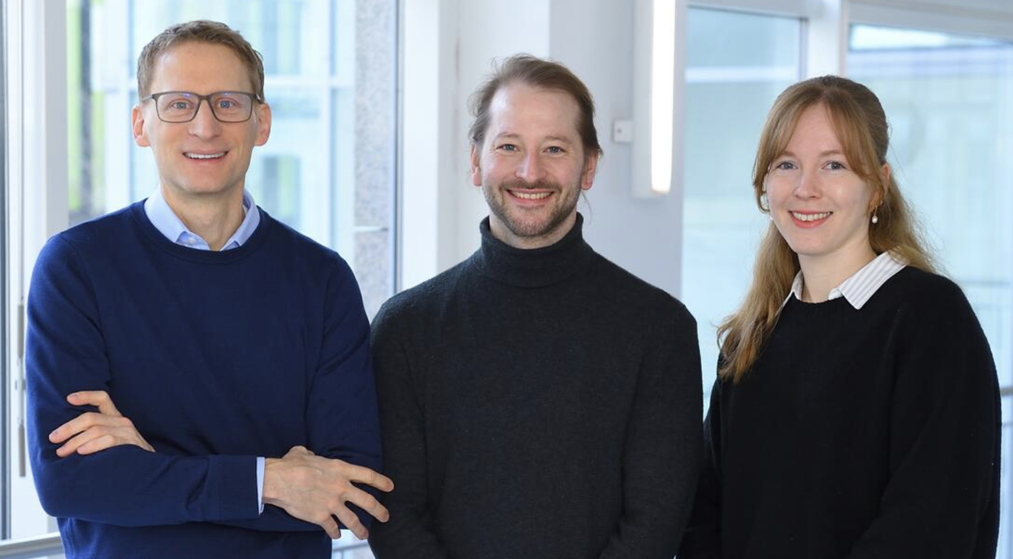
Next-Gen bNAbs
2025
2026
Gieselmann, Nature Immunology 2025
Gieselmann, Nature Immunology 2026

Slide 18
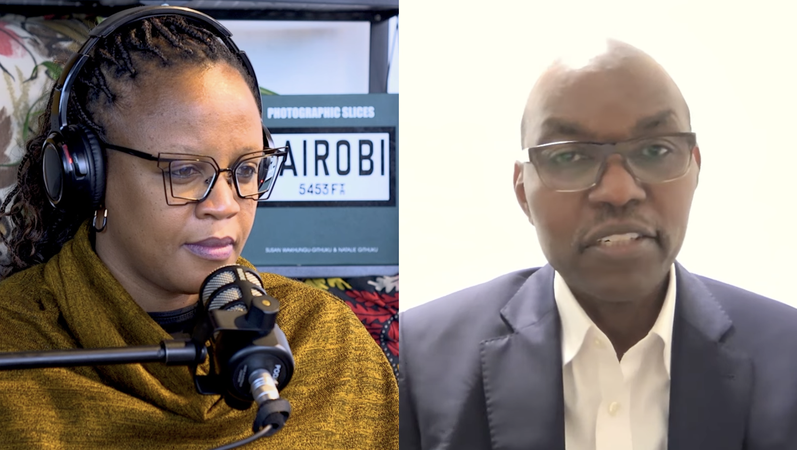

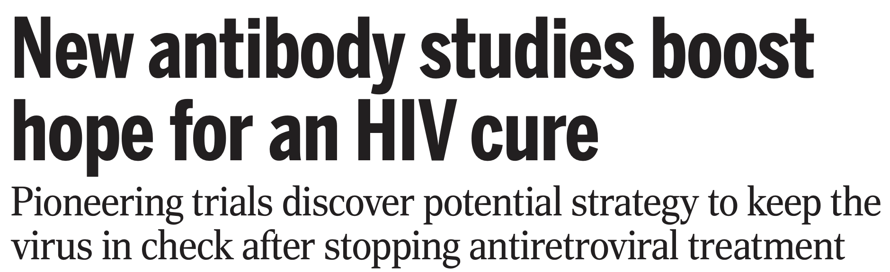
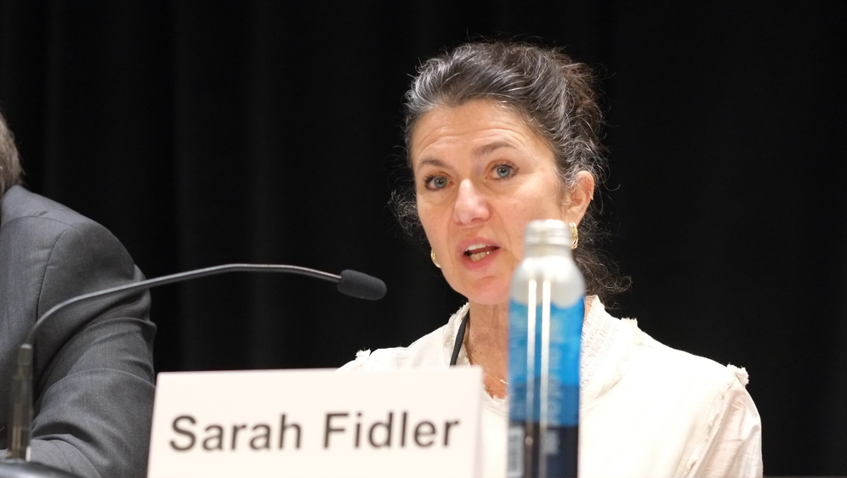
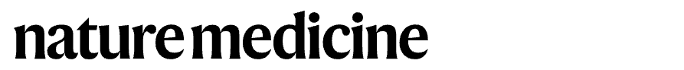
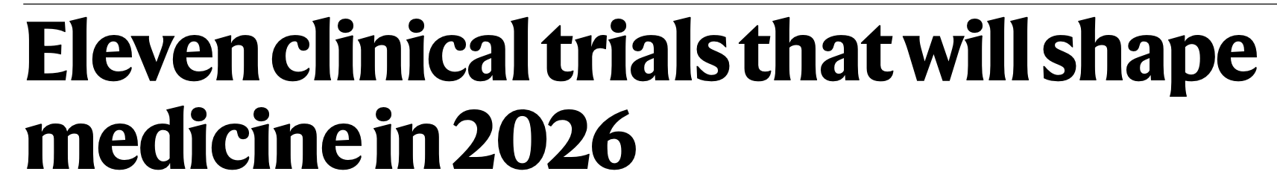
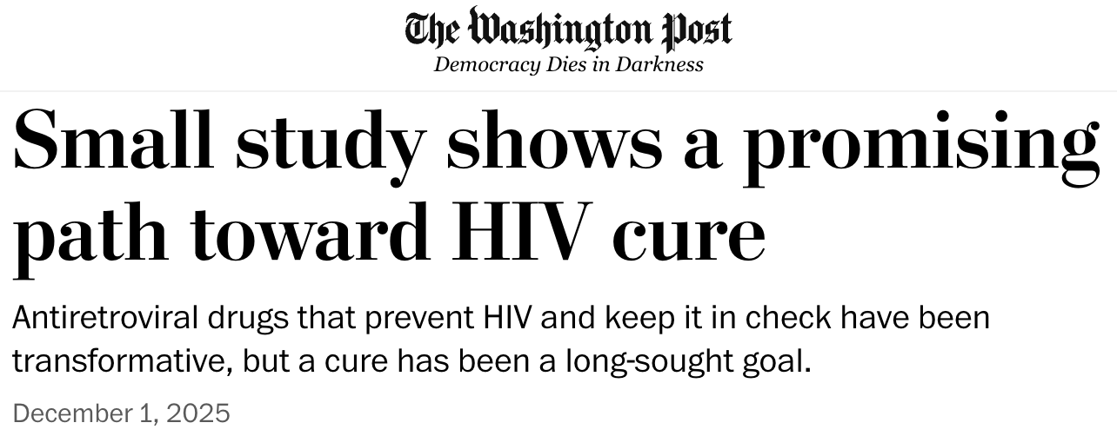
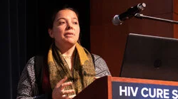
Antibody-based HIV immunotherapy
FRESH
Trial
RIO
Trial
UCSF-amfAR
Trial

Slide 19
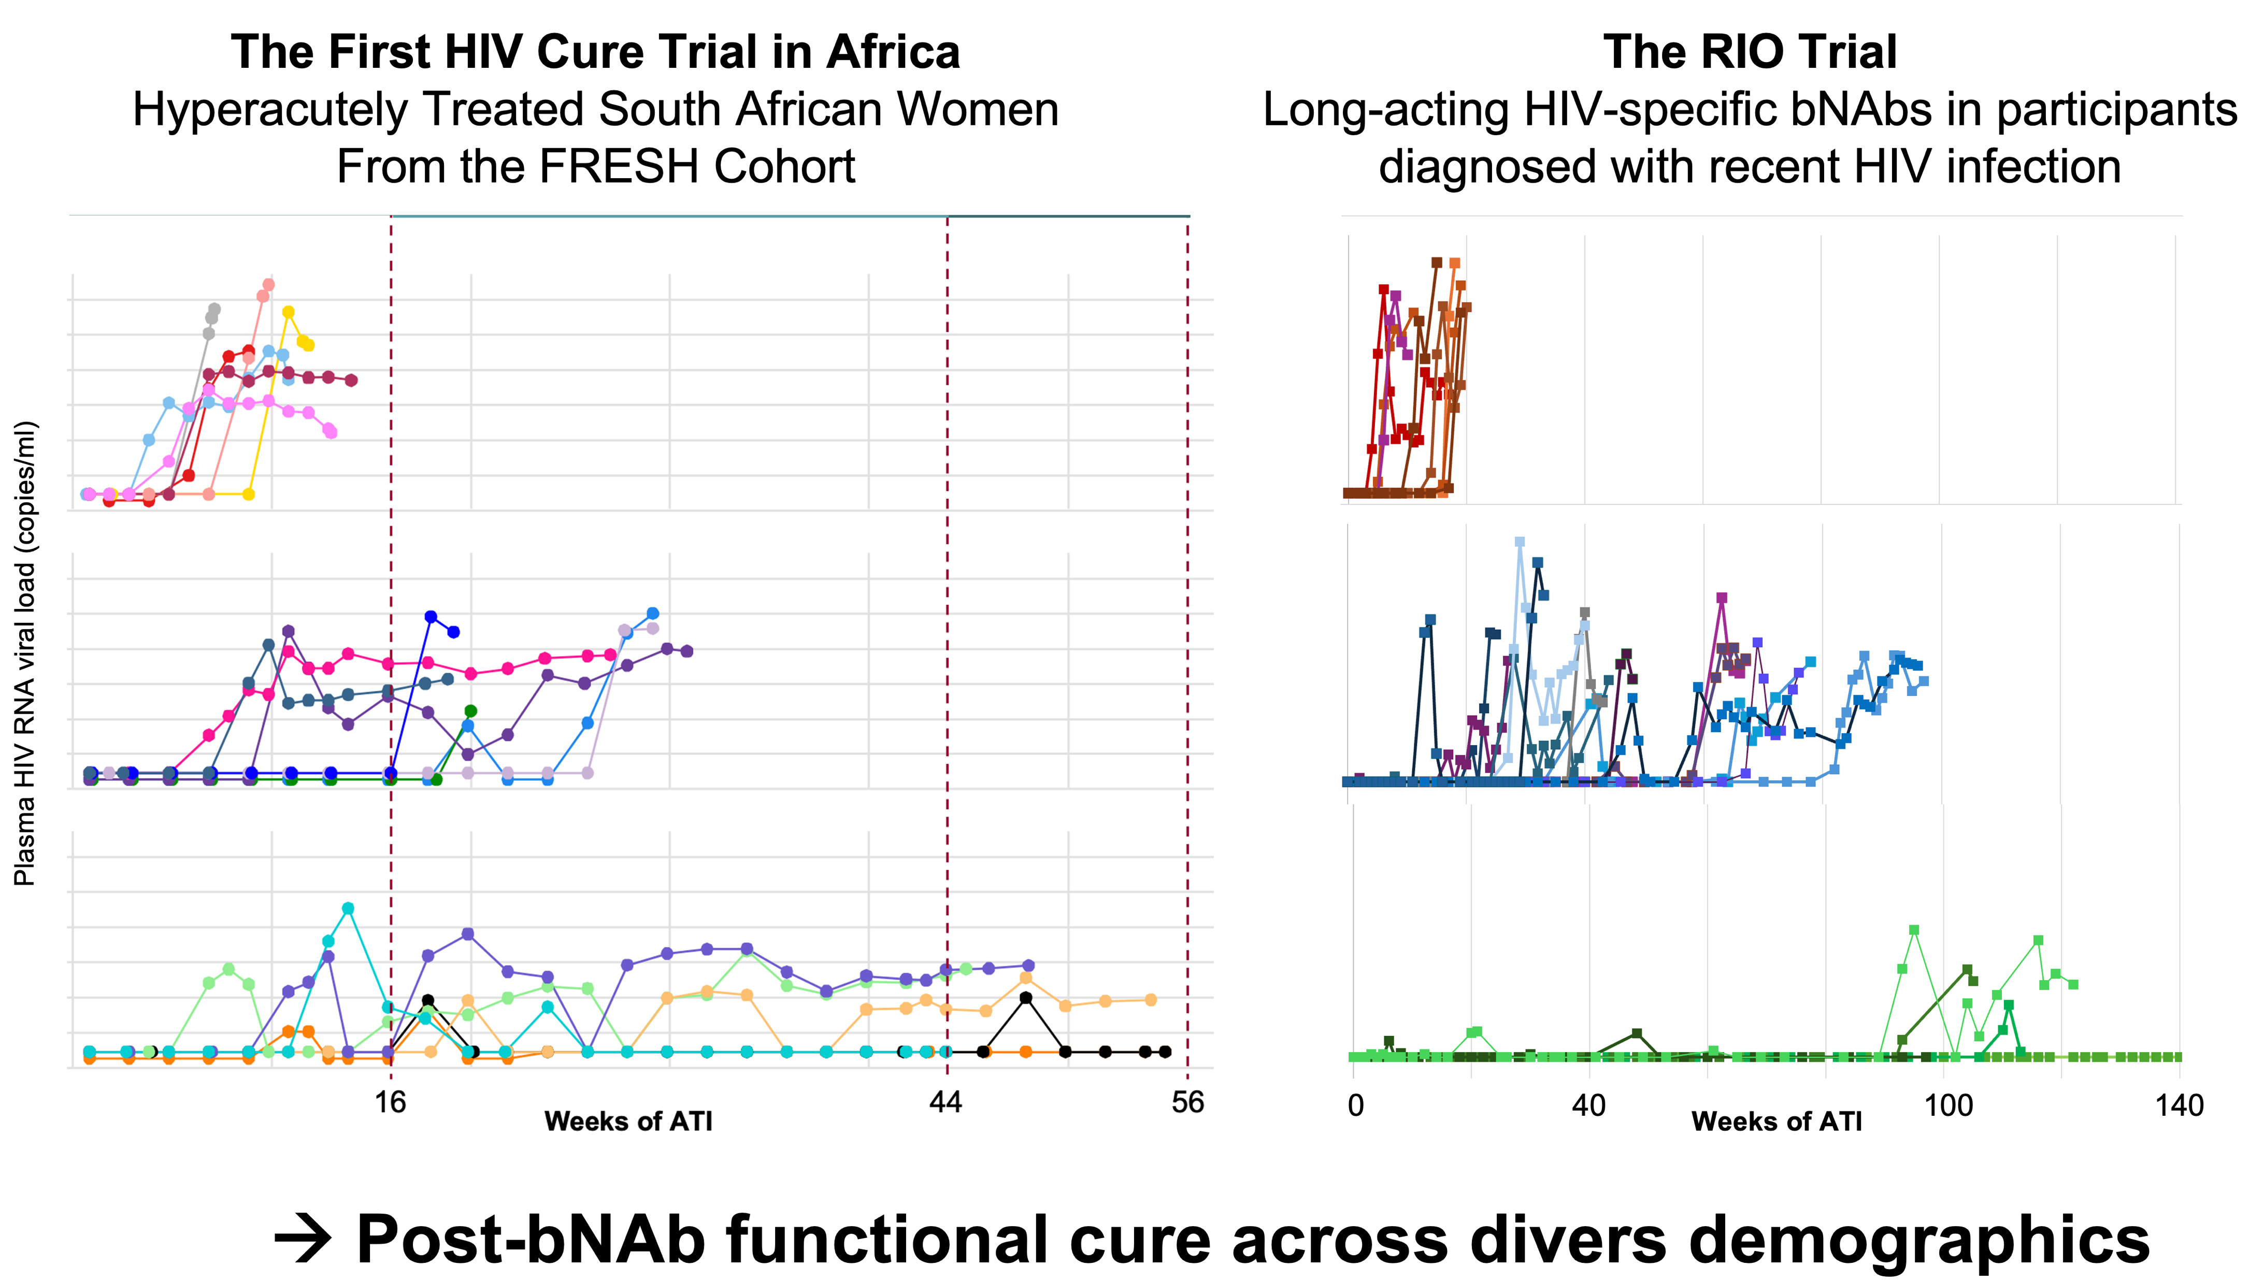
Antibody-based HIV immunotherapy

Slide 20
Antibody-based HIV immunotherapy
UCSF-amfAR study
Combination immunotherapy trial
Peluso, Nature 2025

Slide 21
Antibody-based HIV immunotherapy
Magdalena Schwarzmüller, Ole Soogard
→ Post-intervention control in 10-20% of individuals across diverse demographics

Slide 22
HIV Cure
Eradication
Remission

Slide 23
HIV Cure
Eradication
Who gets to control?
Remission

Slide 24
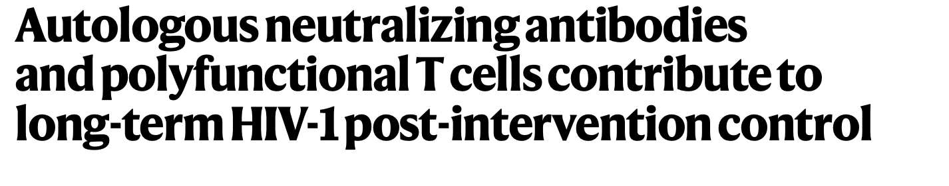
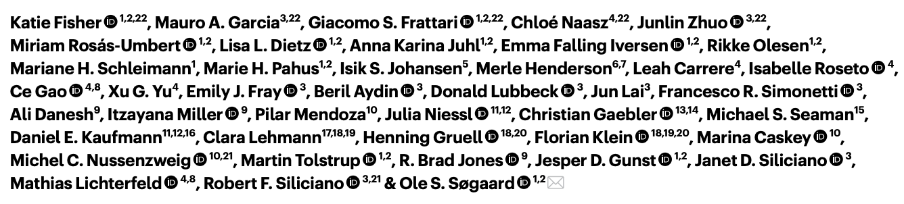
Correlates of post-intervention control
Notes:
There has been a wealth of new insights on biological correlates on who gets to control and who not.

Slide 25
Correlates of post-bNAb remission
Li, Nature, 2025
Thursday, 30 July 10:30 - 11:30
Advances in HIV immunology (OAA27)
Friday, 31 July 10:30 - 11:30
Unlocking HIV control: Host-virus genetics, immunity and the path to a cure (SY28)
Notes:
Two features that separates controllers from the outset are stem-like CD8 memory cells and potent autologous neutralizing antibodies to begin with. Upon bNAb intervention the stem-like populations can expand into effector cells with high proliferative potential, antigen sensitivity and robust cytolytic activity, contributing to post-intervention control.

Slide 26
Antibody-based HIV immunotherapy

Slide 27

Antibody-based HIV immunotherapy
Other Interventions
→ How to achieve higher levels of of post-treatment control?

Slide 28
HIV Cure
Eradication
Intervention
Non-controllers
Today: Session 3 & 5 & 6
Wed, 29 July 16:30 - 17:30
Bioengineering our way to a cure (SY02 )
Remission

Slide 29
Cell-based HIV immunotherapy
May 11, 2026

Slide 30
Cell-based HIV immunotherapy
Deeks at al, ASGCT 2026

Slide 31
Cell-based HIV immunotherapy
CCR5 edited, HIV-specific CAR-T
Viral control for 90 wks
Riley et al., Preprint 2026
NCT03617198
Notes:
The construct combines two modifications. A CD4-based chimeric receptor directs the T cells to HIV envelope on infected cells while zinc finger nucleases disrupt CCR5 so the cells resist infection themselves.
In this clinical trial one out of ten participant maintained viral control for 90 weeks after rebound.

Slide 32
Novel Interventions
Today: Session 3 & 5 & 6
Wed, 29 July 16:30 - 17:30
Bioengineering our way to a cure (SY02 )

Slide 33
Global HIV Cure Initiatives
Notes:
Mexico, Argentina, Chile, Brasil, Peru, Uruguay

Slide 34
Global HIV Cure Initiatives
Notes:
13 countries, 20 institutions

Slide 35
Berlin Center for HIV Cure
Notes:
13 countries, 20 institutions

Slide 36
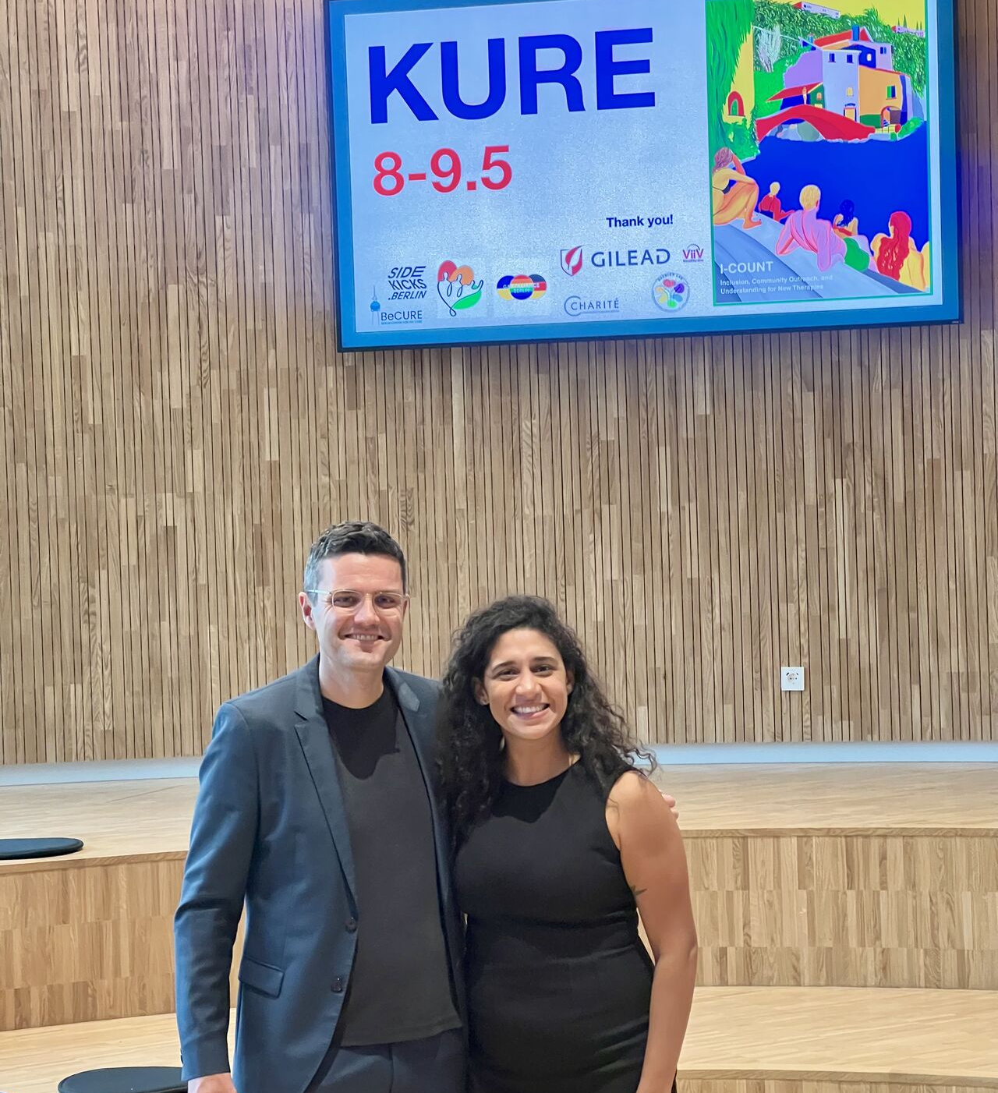
Berlin Center for HIV Cure
Tomer Einav: Today, Session 4 and Poster Session
Vanessa Igbokwe/Marion Pardons: Poster Session
Sherazaan Ismail: 31 July 10:30-11:30 SY28
Notes:
13 countries, 20 institutions

Slide 37
HIV Cure in 2026: State of the field
Prof. Dr. Christian Gaebler
Berlin Center for HIV Cure
Charité – Universitätsmedizin Berlin / Berlin Institute of Health
AIDS 2026 – pre-conference

