Slide 1
Introduction to community aspects of HIV Cure
Pisci Bruja Garcia de Oliveira
University of São Paulo Medical School (FMUSP), Brazil
HIV cure without borders: Science, community and Latin America and Caribbean perspectives
community and Latin America and Caribbean perspectives

Slide 2
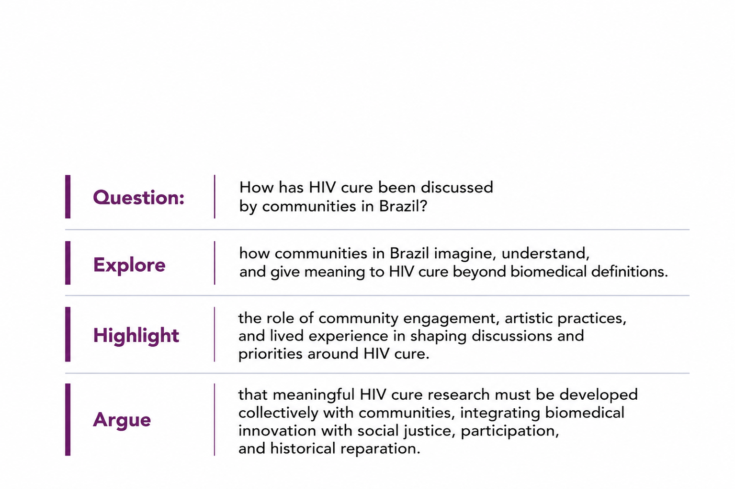
Summary Slide

Slide 3
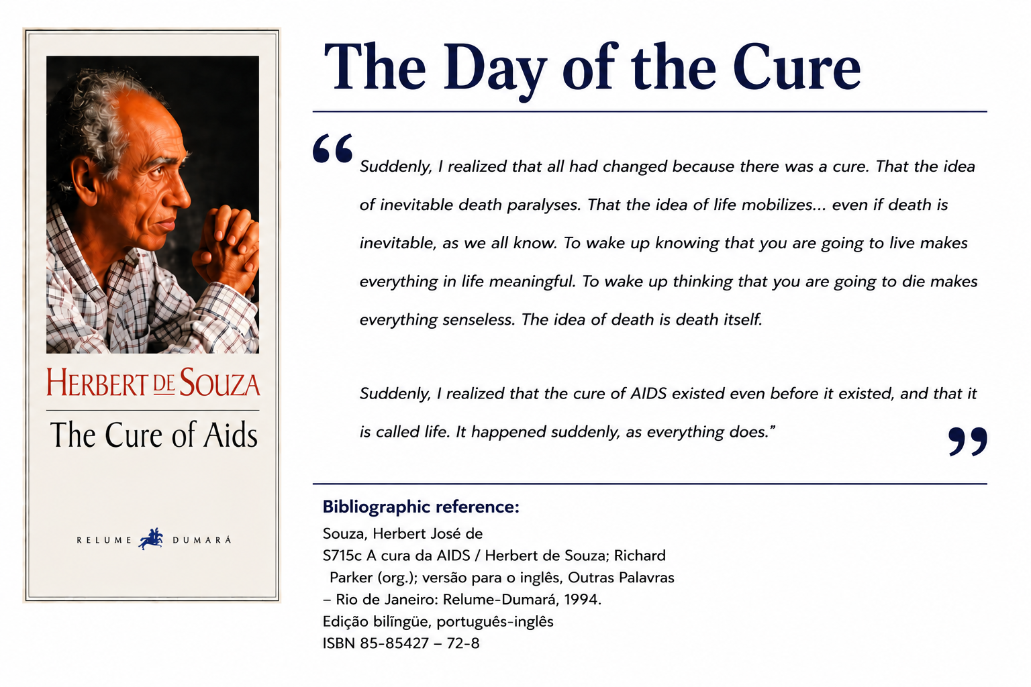

Slide 4
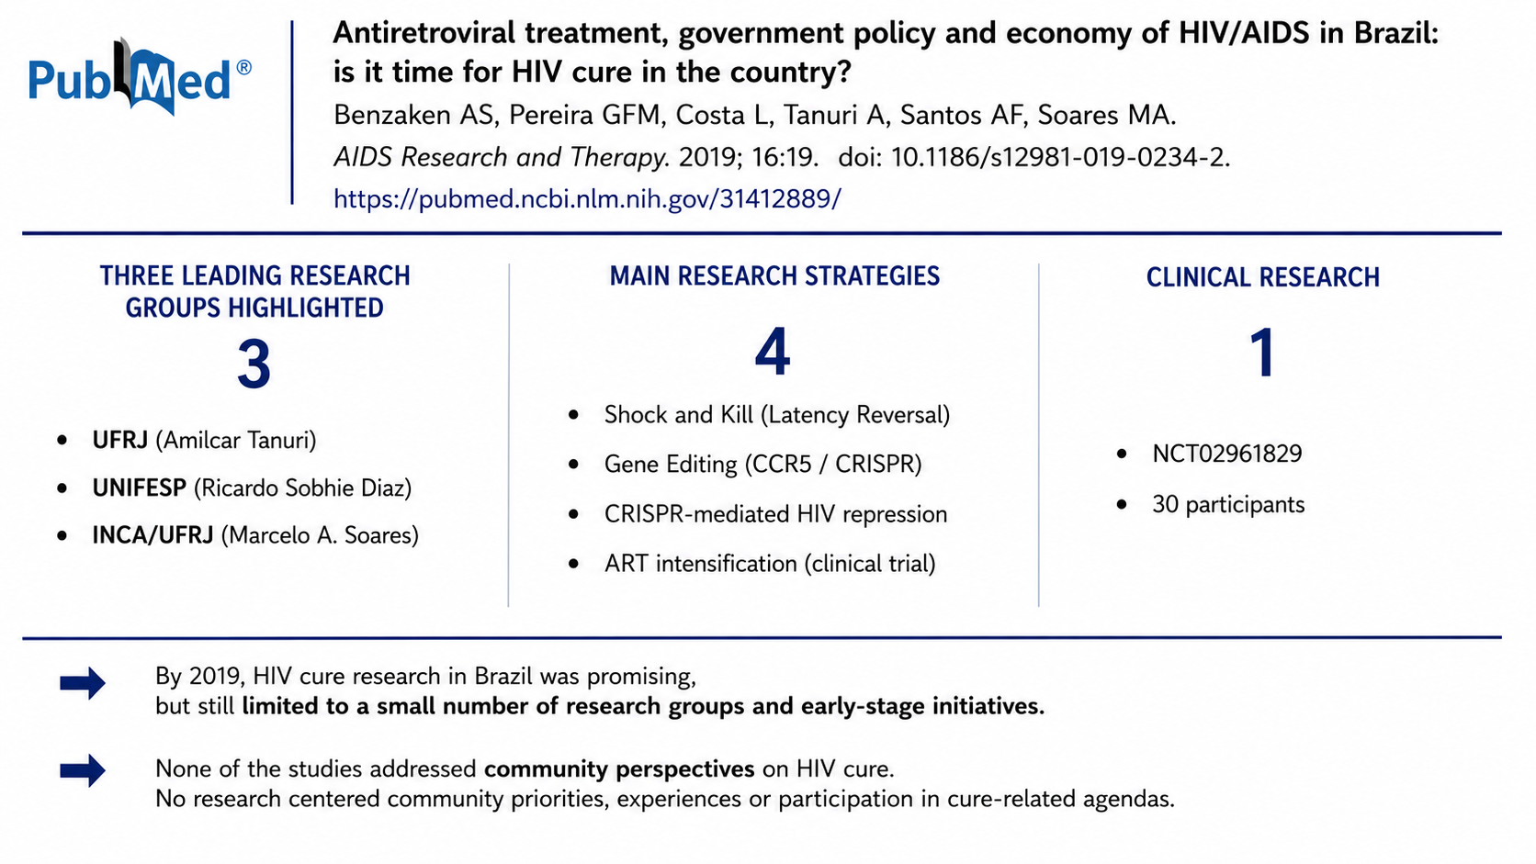
HIV cure research in Brasil up to 2019

Slide 5
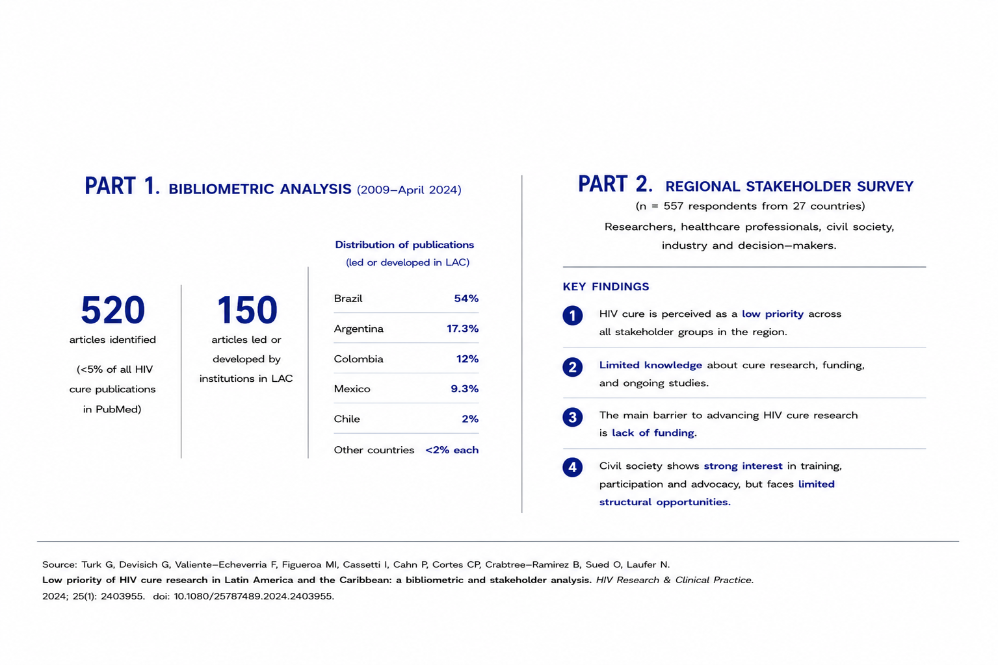
Why is HIV cure not a priority in Latin America and the Caribbean?

Slide 6
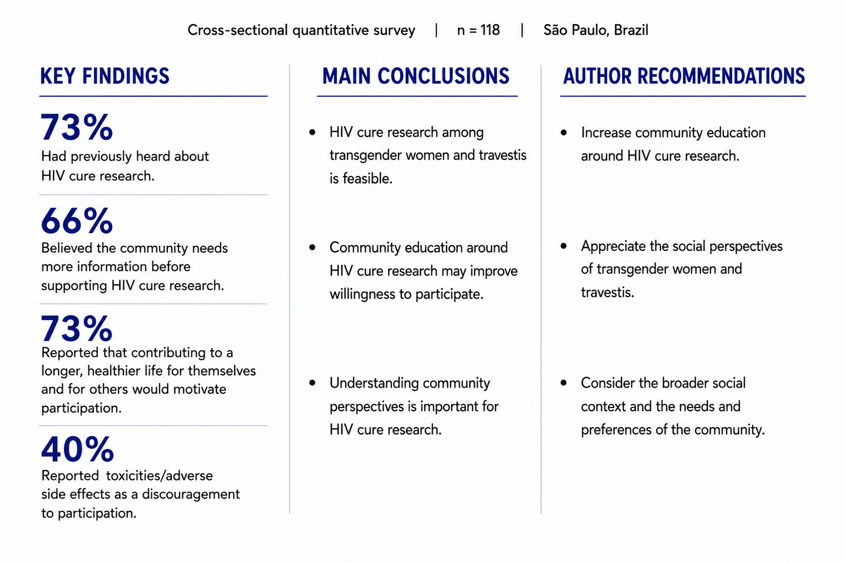
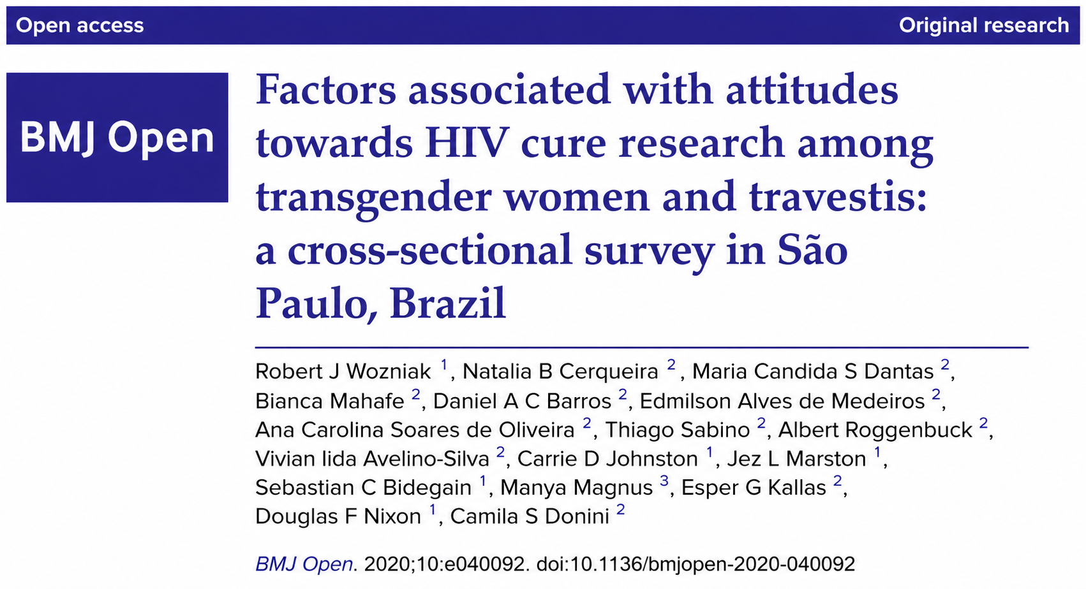

Slide 7
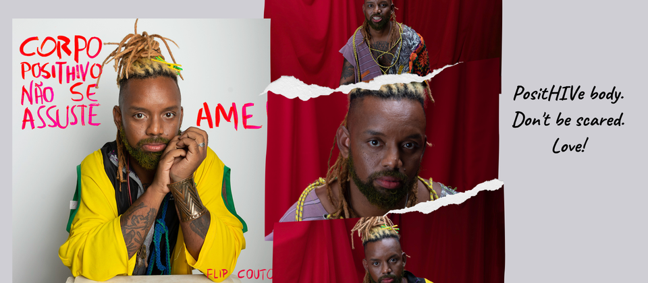
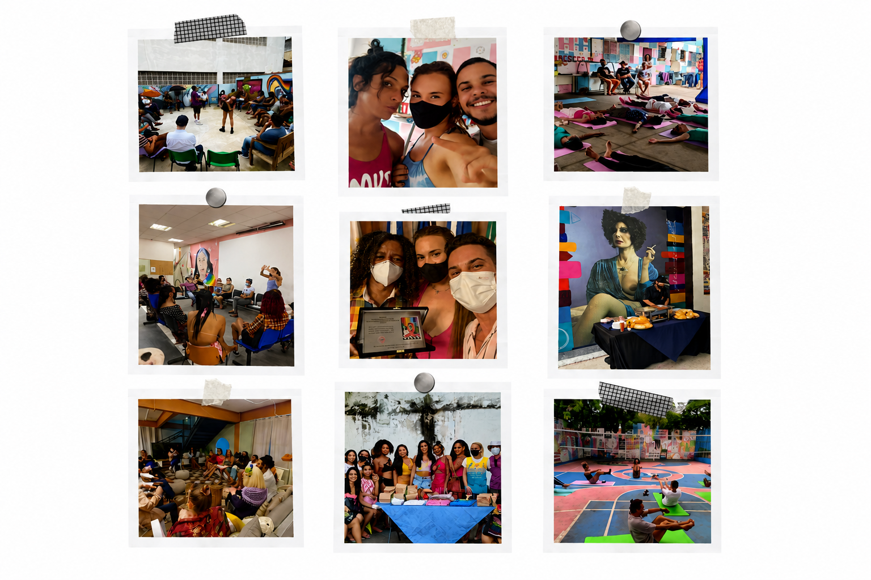
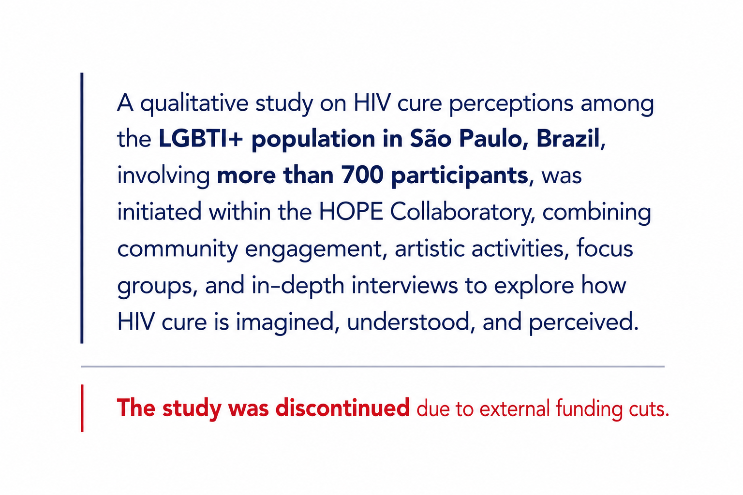
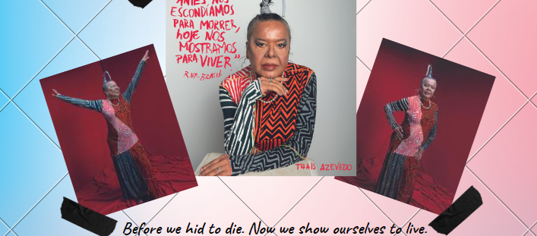
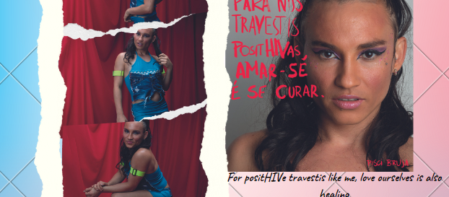

Community engagement on HIV perception of cure
Research Literacy
Community-led artistic production

Slide 8
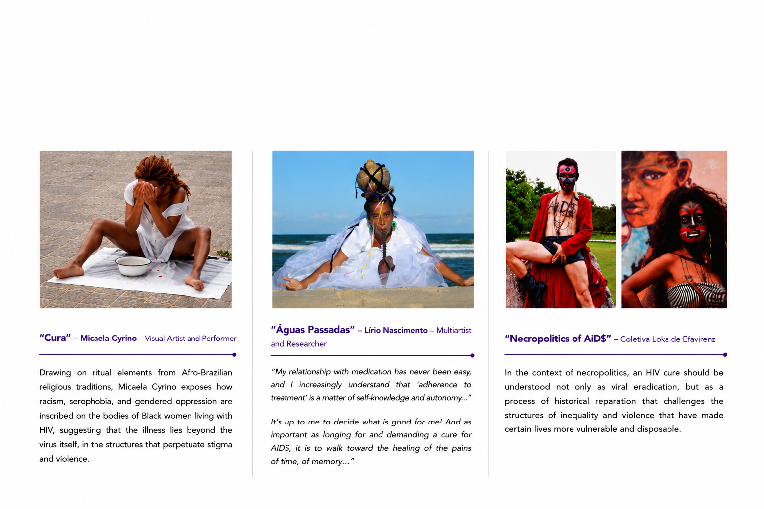
Beyond Biomedical Cure:
Art as a Technology of Healing

Slide 9
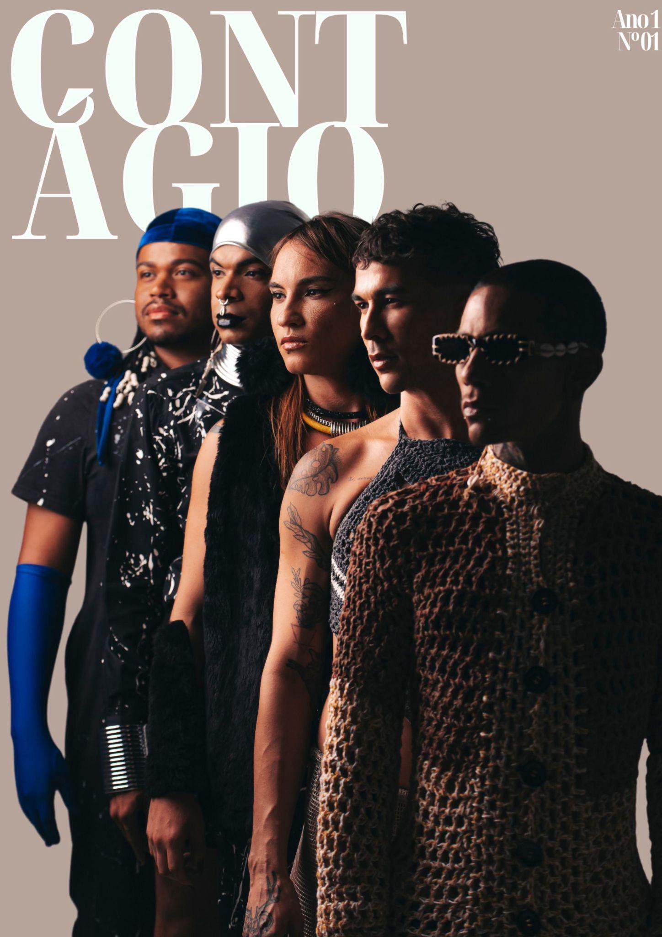
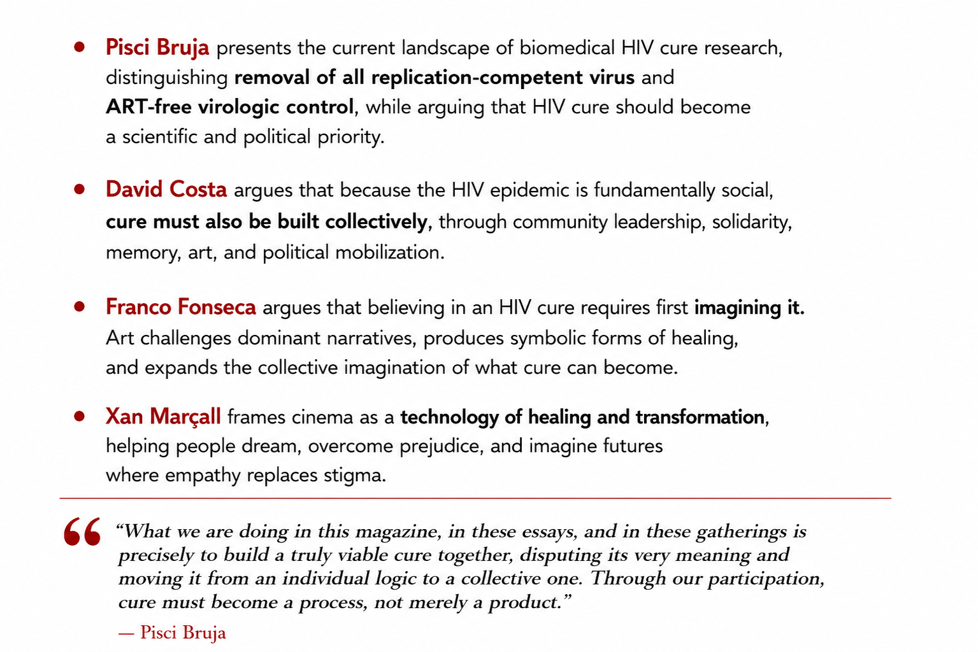
“Cure must become a process, not merely a product”
https://coletivocontagio.com.br/

Slide 10
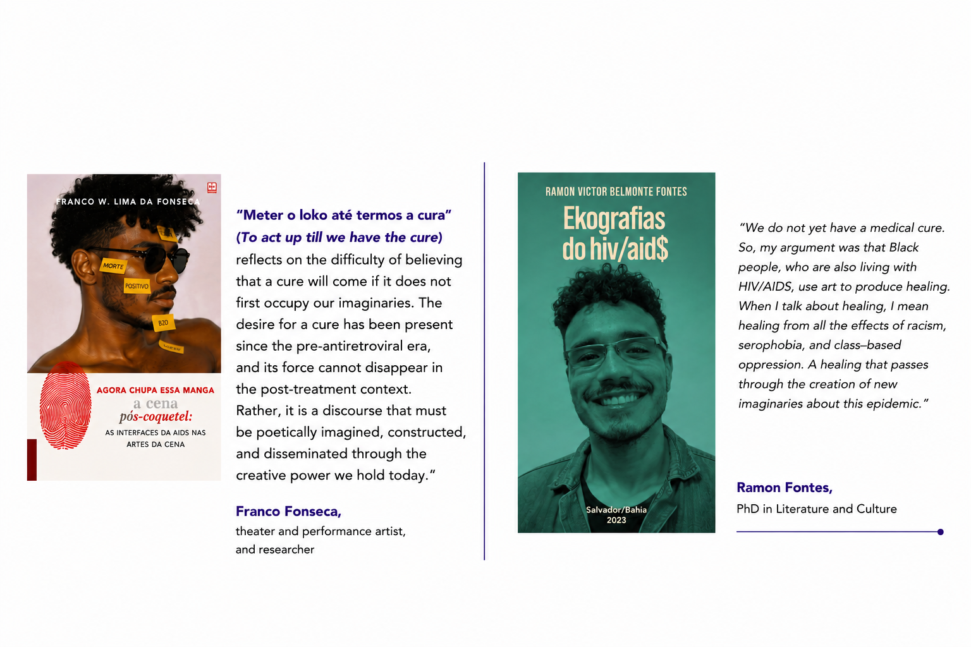
Imagining HIV Cure

Slide 11
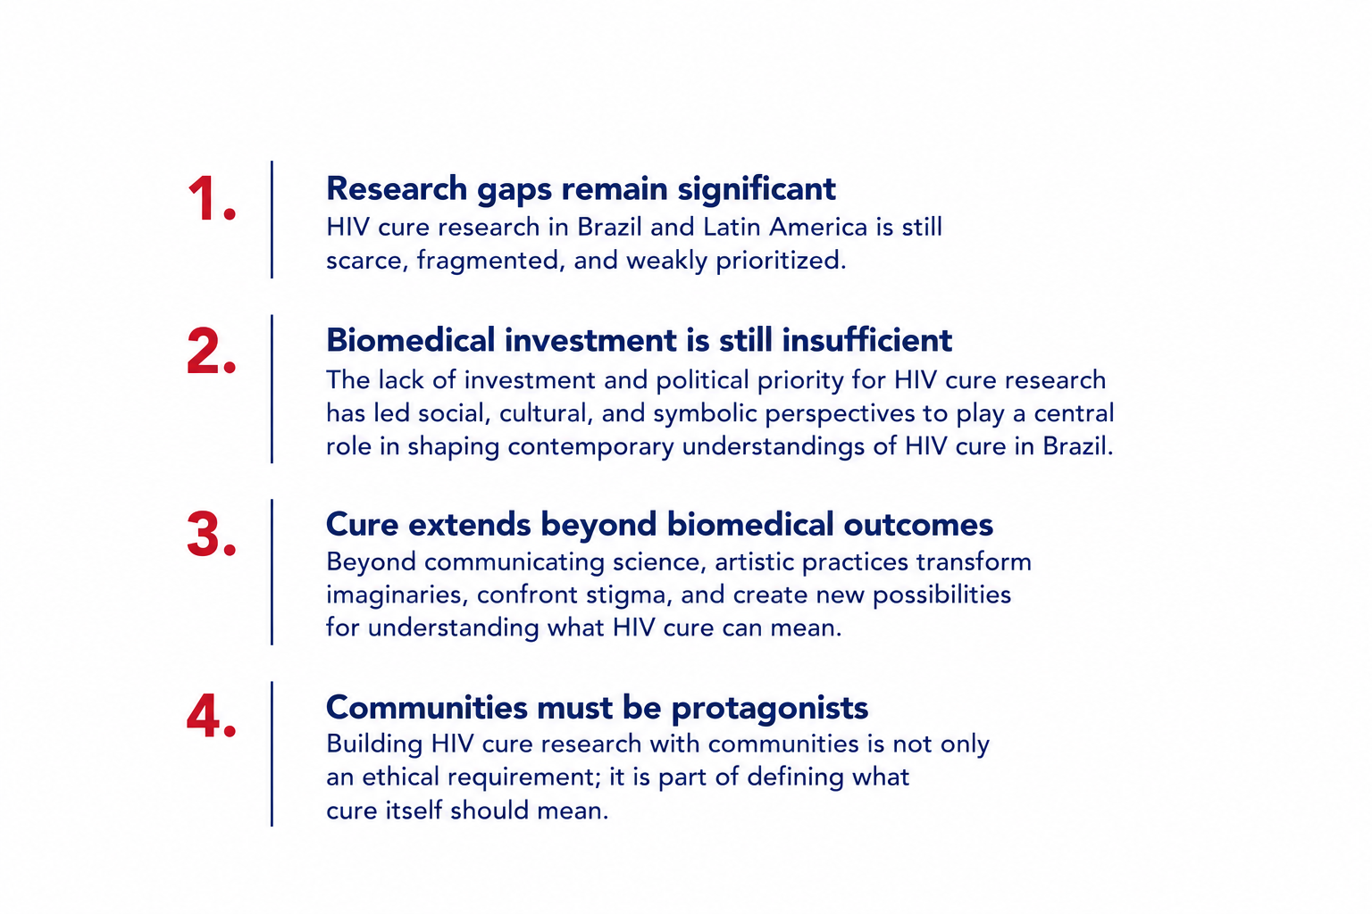
Key Takeaways

Slide 12
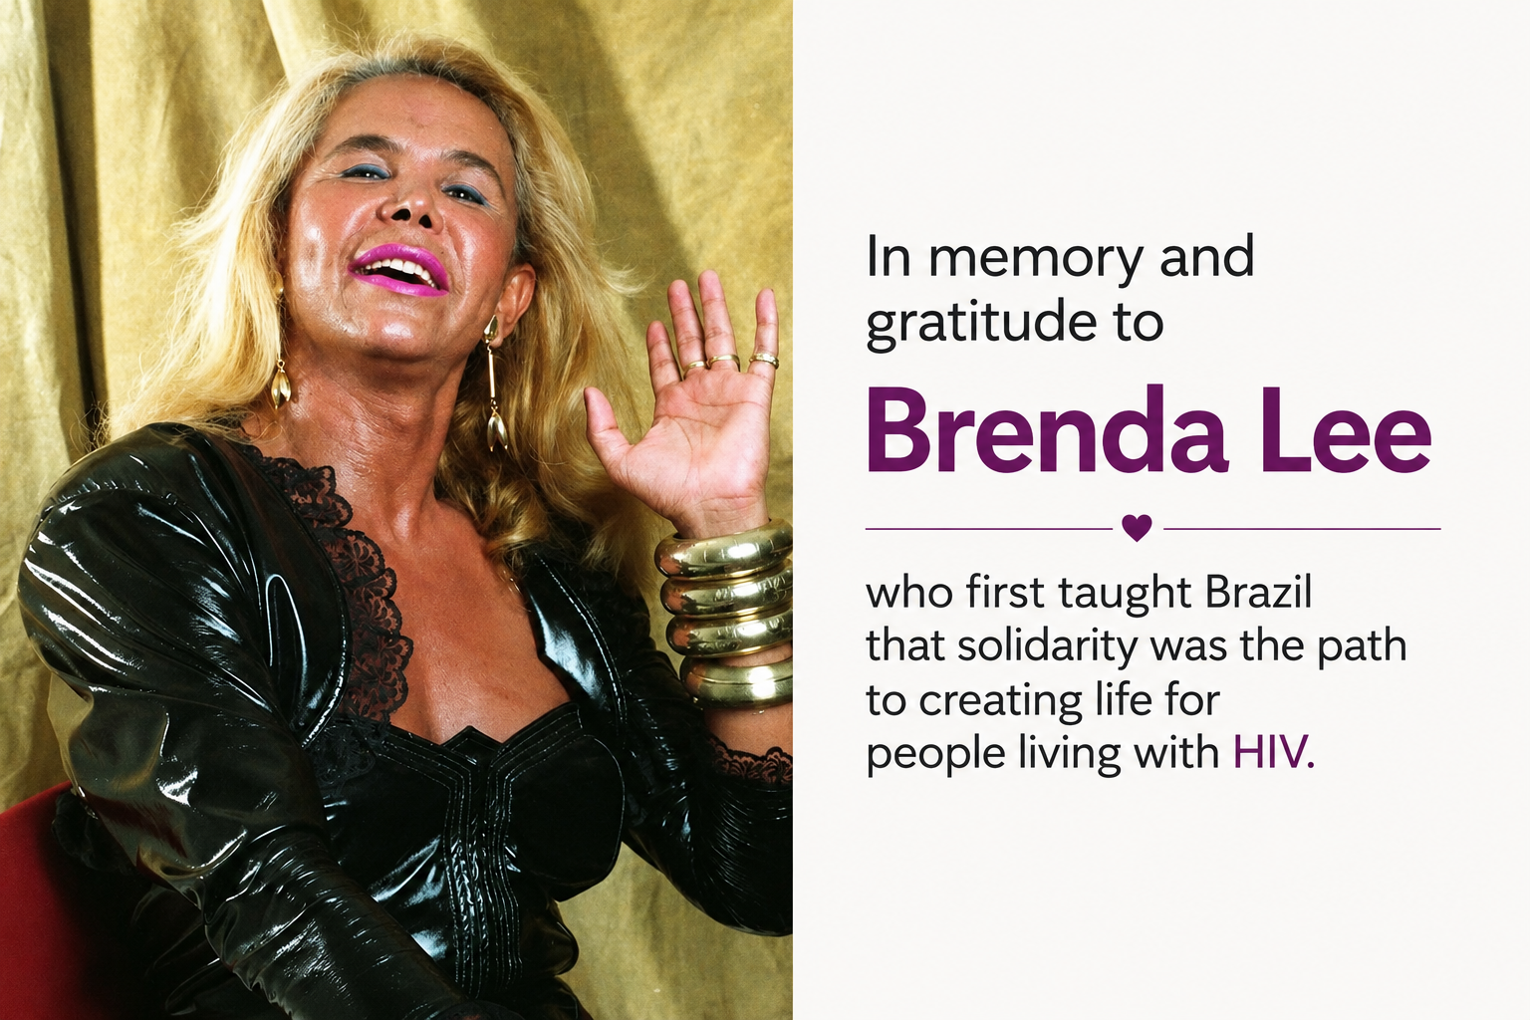
Quote citation

Slide 13
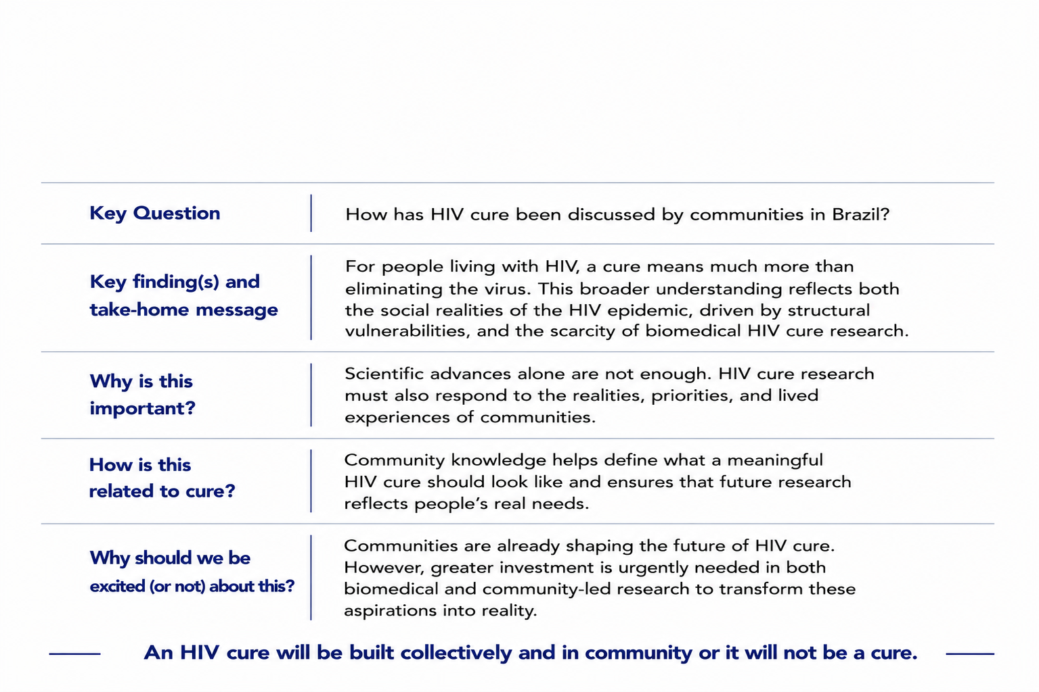
Summary FOR COMMUNITY

