Slide 1
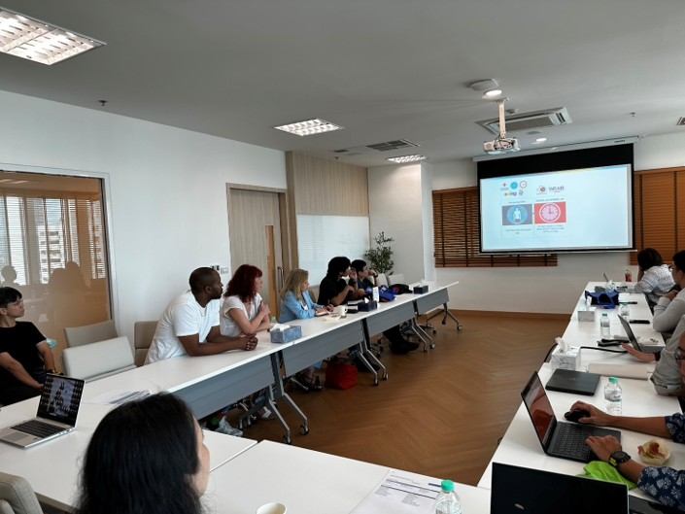
Building capabilities in clinical trials in different settings
Lydie Trautmann, PhD, EngD
Director Translational Research | HJF
Military HIV Research Program

Slide 2
Summary
Why should we build clinical trial capacities worldwide?
Therapies to induce an HIV cure need to address HIV diversity, different populations, and need to be tested globally
What are the current HIV cure strategies?
Combination immunotherapies tested mainly in early-treated people
How is MHRP contributing to building capacities and conducting HIV cure clinical research in different settings?
The DELIVER initiative provides the opportunity to test interventions in areas most affected by HIV in a collaborative and integrated network

Slide 3
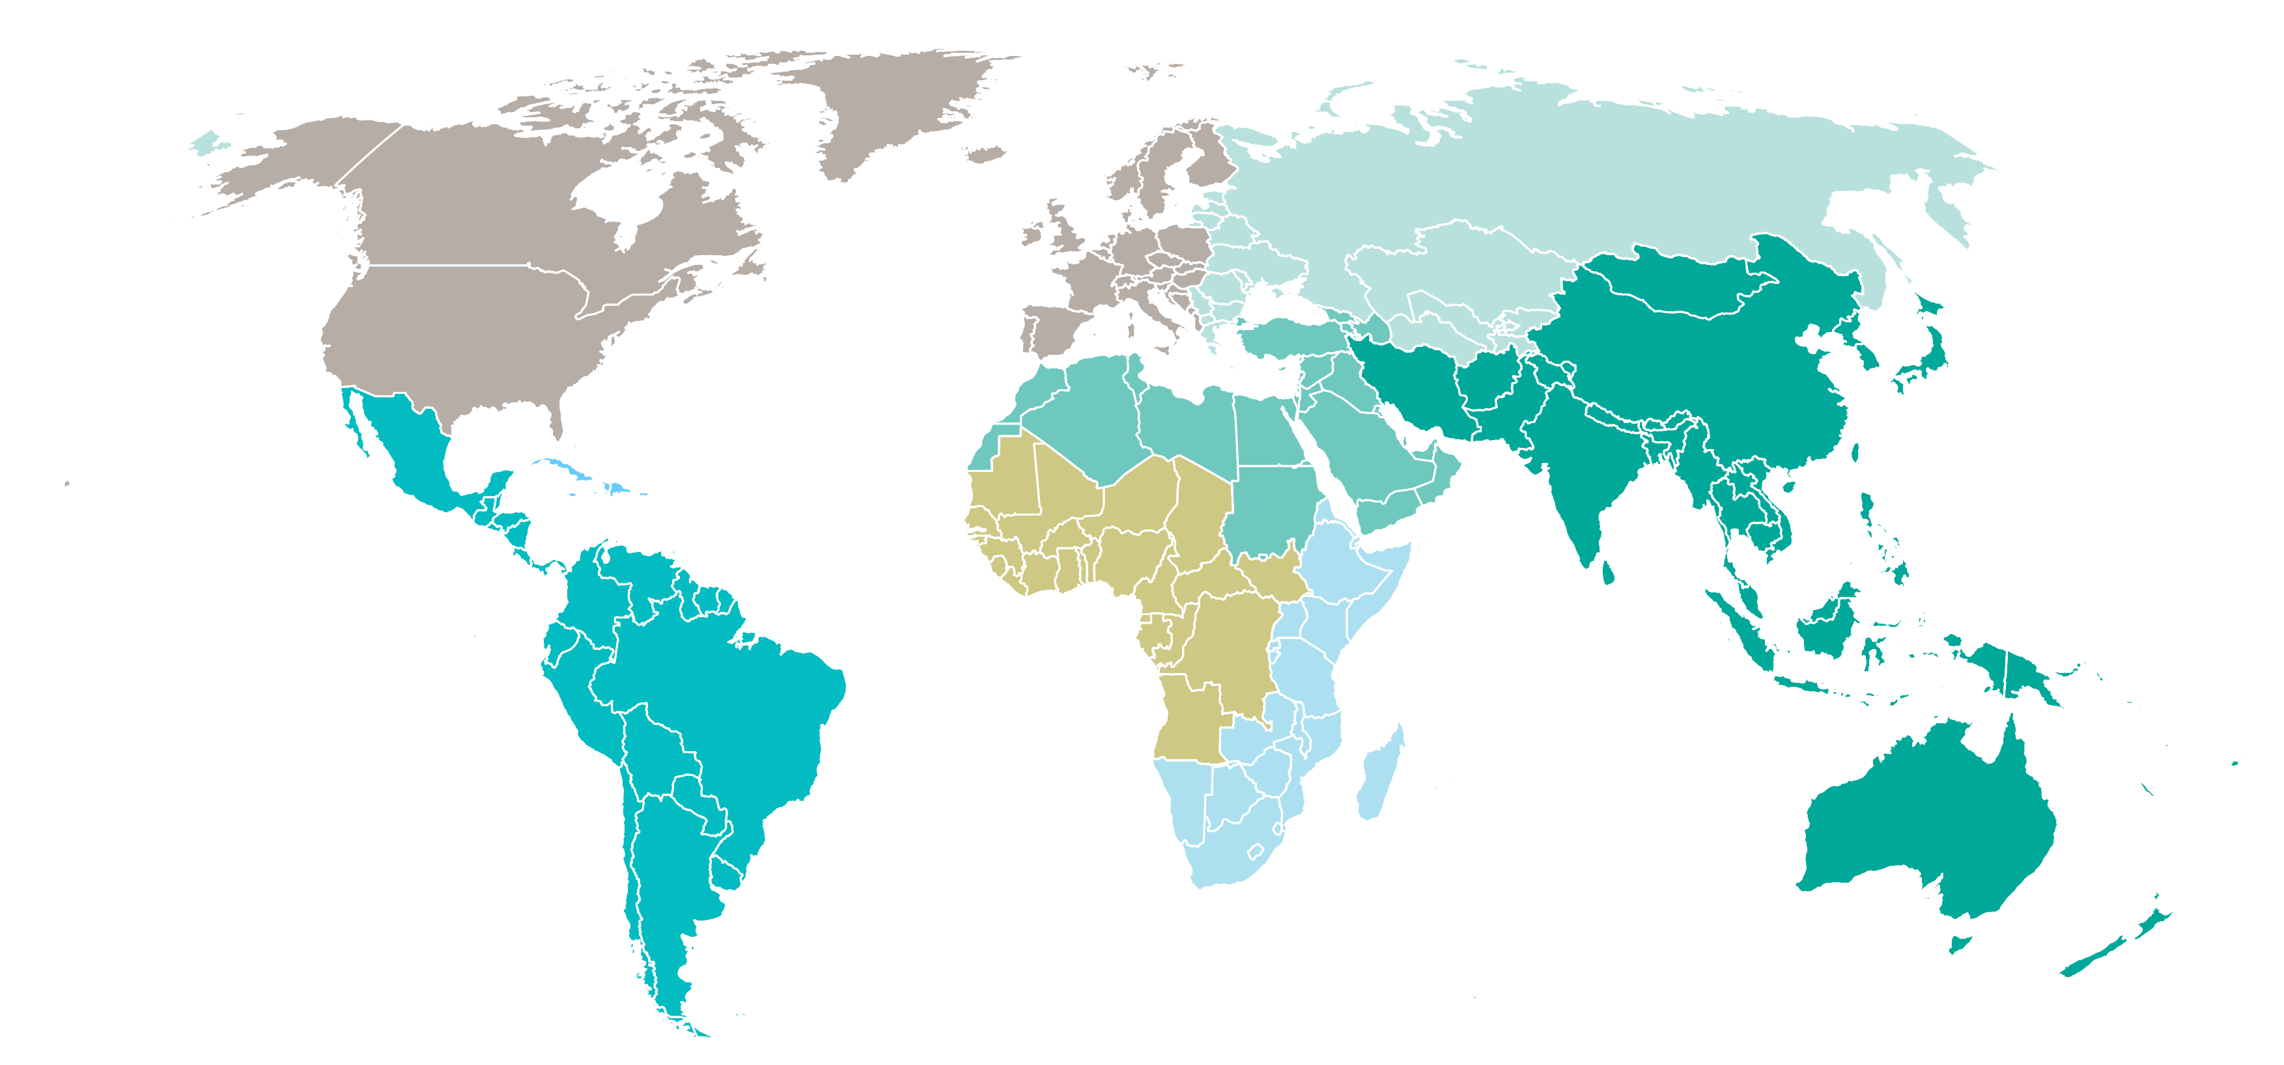
Epidemiology (obviously)
Adults and children estimated to be living with HIV  2025
Western and central Europe and North America
2.4 million
[2.1 million–2.6 million]
Eastern Europe
and central Asia
2 million
[1.8 million–2.1 million]
Total: 40.9 million
[37.1 million–45.7 million]
Middle East and North Africa
240 000
[200 000–320 000]
Caribbean
340 000
[290 000–400 000]
Western and central Africa
5.2 million
[4.6 million–6.0 million]
Asia and the Pacific
7.1 million
[6.4 million–8 million]
Latin America
2.6 million
[2.3 million–2.9 million]
Eastern and southern Africa
21.1 million
[19.4 million–23.4 million]
If cure strategies are developed only in high-income countries, they may be less applicable to the populations most affected by HIV

Slide 4
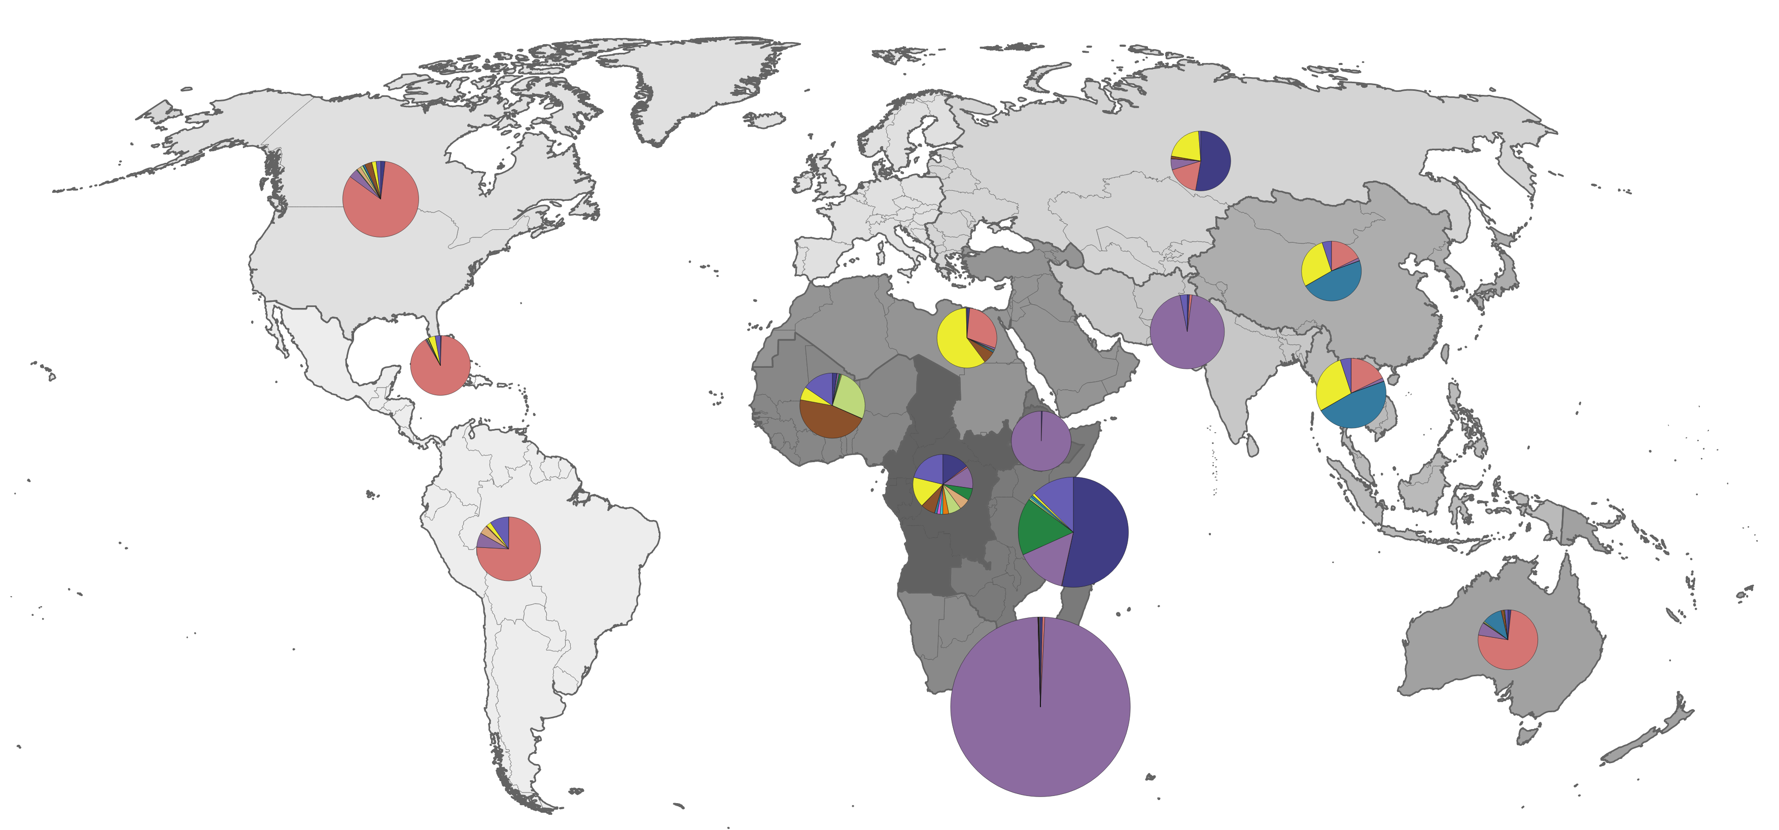
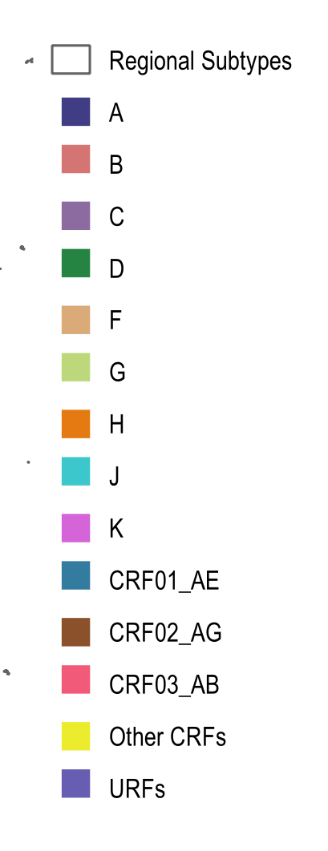
HIV Diversity
Global map of HIV-1 subtype distributions
1,352,271 HIV-1 sequences available in GenBank as of July 7, 2026, but:
Extreme pathogen variability
Limited data from specific regions
9 HIV-1 subtypes, 205 HIV-1 circulating recombinant forms (CRF) and countless unique recombinant forms (URF)

Slide 5
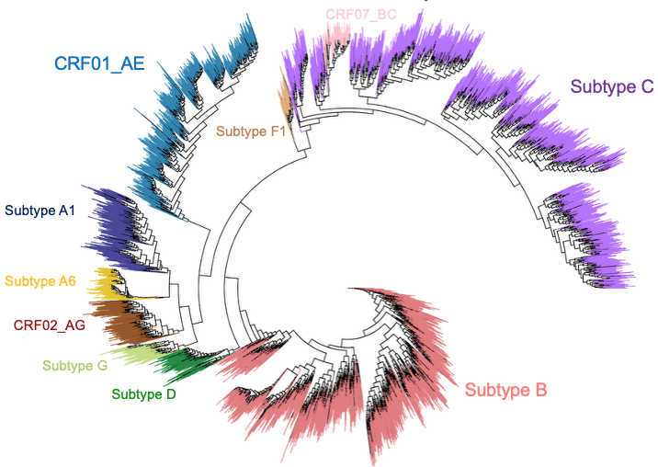
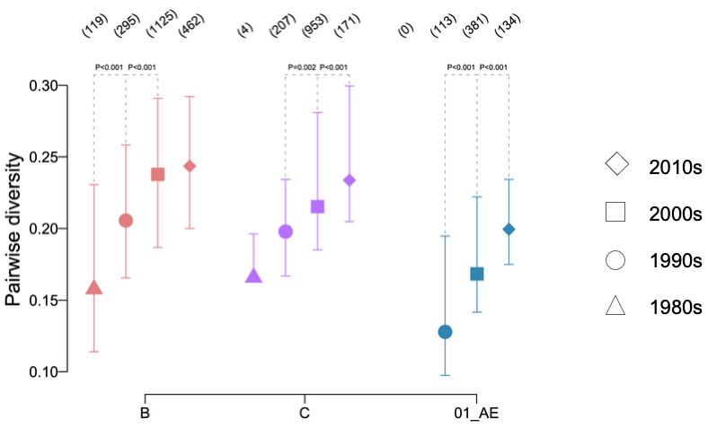
HIV Diversity
HIV diversity continues to increase at the pandemic level
Recombinant HIV strains account for approximately 20% to nearly 30% of global HIV-1 infections
Lewitus, Li, Rolland, mBio, 2024

Slide 6
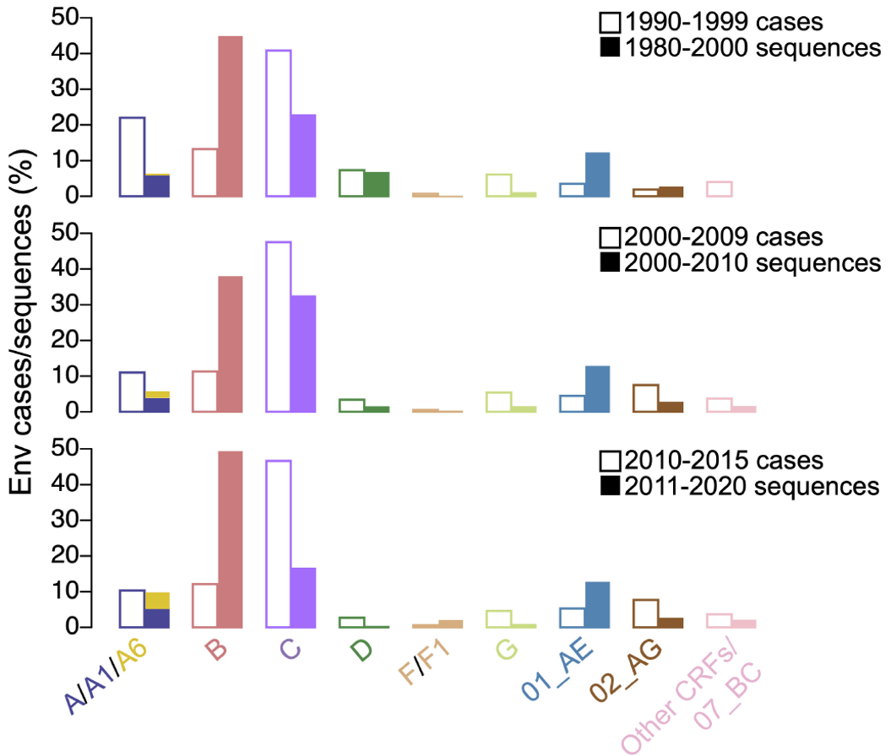
HIV Diversity
Analysis of 4,830 Env sequences sampled since 1980
Most clades are under-represented among published sequences compared to the frequency of that clade among people living with HIV-1 (while HIV-1 subtype B is over-represented)
Lewitus et al., mBio, 2004

Slide 7
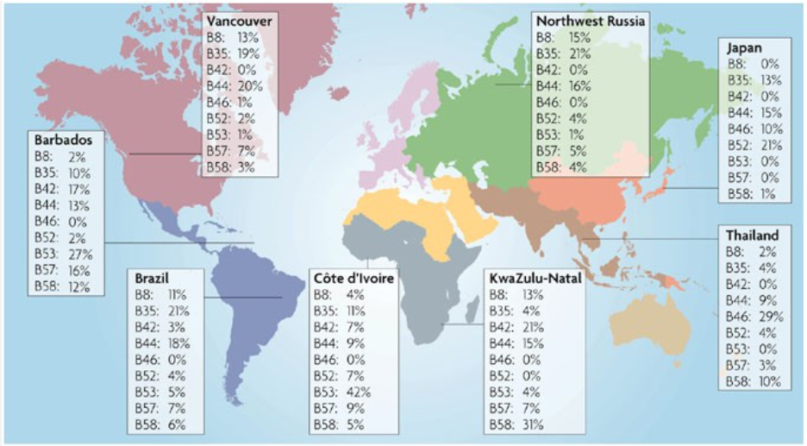
Host Diversity
HIV cure trials will be conducted in people:
With diverse genetic backgrounds
Across sexes
Across all stages of life
Across all major HIV subtypes
Notes:
Biologic sex has had the most consistent effect on cure outcomes (reservoirs, set-point). Most of trials in the North are in older men, Most of the epdemic in the south is in younger women. The best story here is the lack of any real insights into the Africal population most likely to enroll in clinical trials.

Slide 8
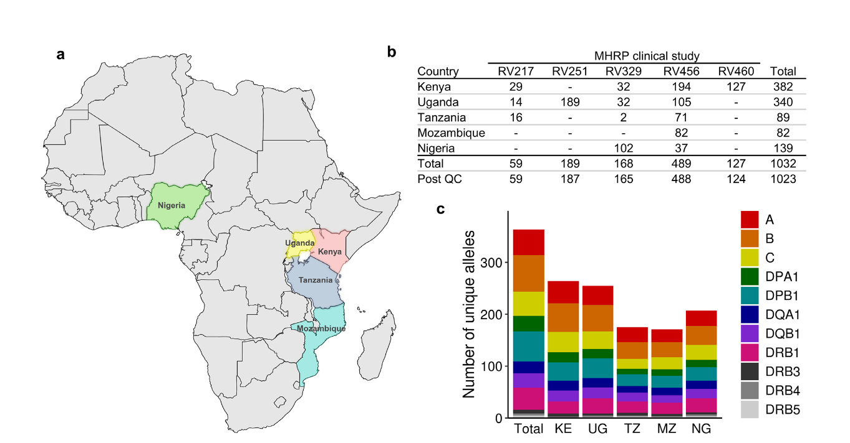
HLA Diversity in Africa
Distinct intra-continental variation across five African countries, including 24 novel alleles
Rosario et al. HLA, 2026
Notes:
Full-length HLA sequencing of 1,023 individuals from five African countries revealed extensive population-specific diversity across 11 loci and identified 24 novel alleles, including variants encoding amino acid changes within peptide-binding regions.

Slide 9
Additional Differences
Different populations may respond differently to HIV cure strategies due to variations in:
Viral reservoirs and immune responses
Co-infection profiles (e.g., TB, malaria, and CMV)
Timing of ART initiation and treatment duration
Antiretroviral (ARV) regimens and treatment histories
Prime example of multisite cure trial is IMPAACT P1115:
Argentina, Brazil, Haiti, Kenya, Malawi, Puerto Rico, South Africa, Tanzania, Thailand, Uganda, United States, Zambia, Zimbabwe
Age at study entry: few hours to 8 days of birth, Gender: 61% female, 39% male

Slide 10

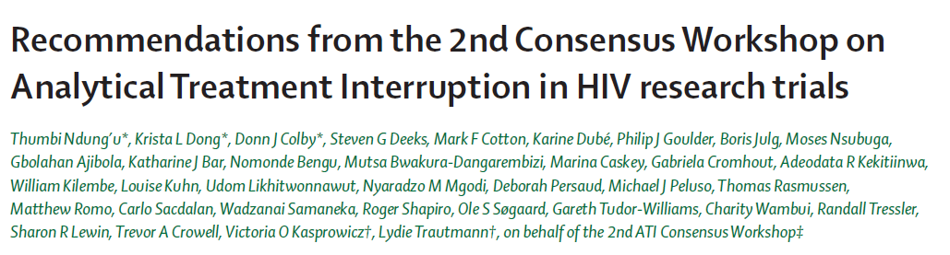


New Recommendations for ATI Trials
2nd Consensus Workshop on ATI in HIV Cure Trials (2024)
More regional considerations, including guidance on ATI studies in LMICs
Less restrictive recommendations in some areas based on current knowledge but may also depend on product being tested. In such cases more conservative monitoring is needed
Inclusion of new recommendations e.g., TB co-infection, pediatrics and adolescents; more participant protection considerations

Slide 11
Summary
Why should we build clinical trial capacities worldwide?
Therapies to induce an HIV cure need to address HIV diversity, different populations, and need to be tested globally
What are the current HIV cure strategies?
Combination immunotherapies tested mainly in early-treated people with HIV in cure trials with viral set-point ATI
How is MHRP contributing to building capacities and conducting HIV cure clinical research in different settings?
The DELIVER initiative provides the opportunity to test interventions in areas most affected by HIV in a collaborative and integrated network

Slide 12

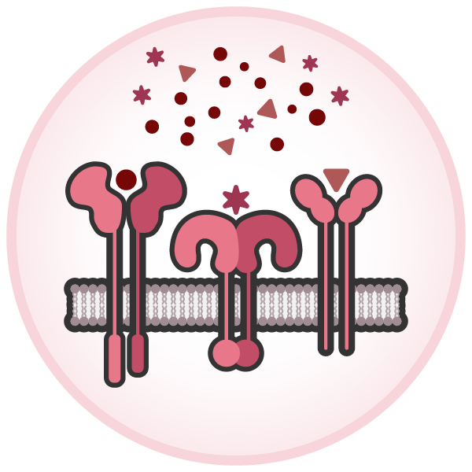





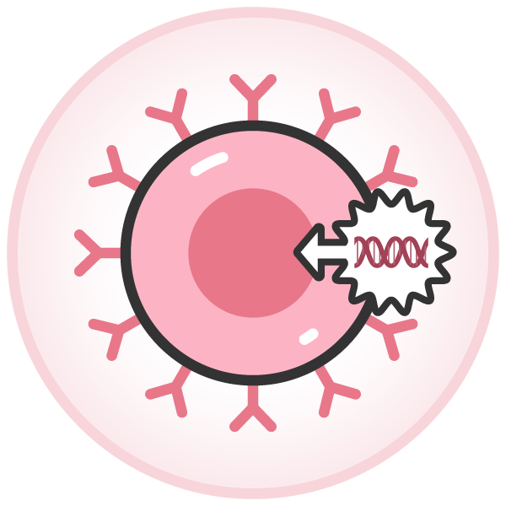
HIV Cure Research Strategies
Early ART
Immunotherapy
(Cytokines, TLR agonists, PD-1 blockade)
Targeting the HIV reservoir
Enhancing Immune Defenses
Latency-reversal
“shock & kill”
Vaccines
Combination
Latency silencing
“block & lock”
Antibodies
Gene editing
Engineered T & B cells

Slide 13
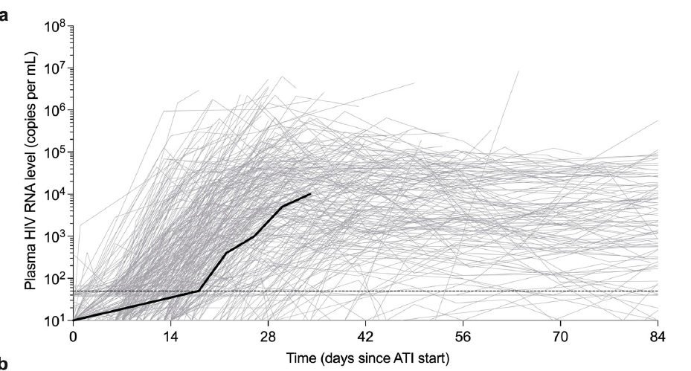
Early ART Initiation
Is associated with faster decay of the HIV reservoir
(Massanella ….Chomont, Lancet Microbes 2021; Janssens… Yulk, Poster 560, CROI2025)
Is associated with higher frequency of post-treatment control (Gunst … Sogaard, Nat Comm 2025)
Most studies focus on people who initiated ART early after infection
Early ART 6%
4%
Late ART 1%

Slide 14
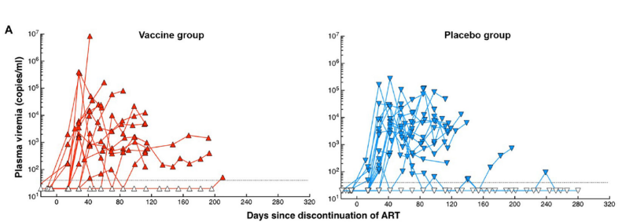
Previous Therapeutic Vaccine Trials
Therapeutic vaccines have not shown efficacy in decreasing the viral reservoir
RIVER trial (ChadV63/MVA) Fidler Lancet 2020
Therapeutic vaccines have not shown efficacy in impacting viral load set-point after ATI
Vacc-4x trial Carlsen et al. Lancet Inf Dis 2014
DNA vaccine Sneller et al. Sci Transl Med 2017
BNC01 trial Mothe et al. EclinicalMedicine 2019
BNC02 trial Mother et al. Frontiers in Immunol 2020
RV405 trial (MosaicAd26MVA)Colby et al. Nat Med 2020
AELIX-002 trial (HTI vaccine) Bailon et al. Nat Med 2022
Sneller Sci Transl Med 2017
Studies performed mainly in the global North on early treated MSM
Limited available data from Brazilians or other people living with HIV

Slide 15

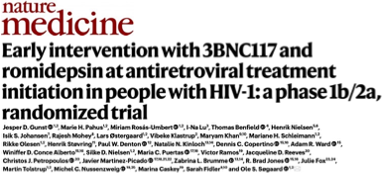
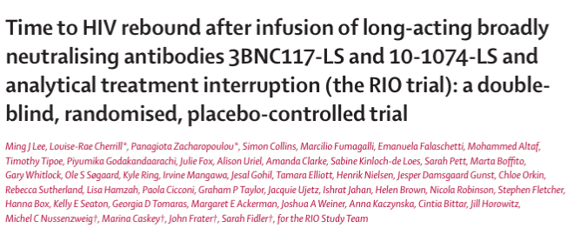
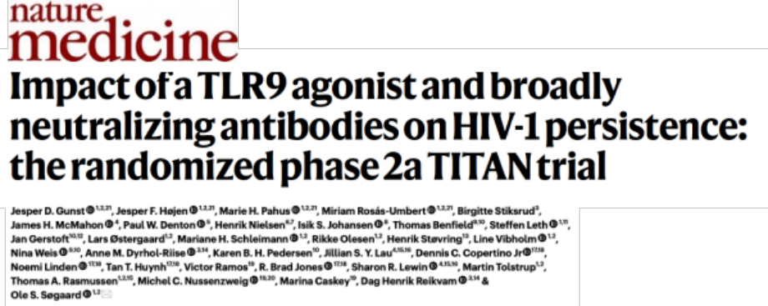
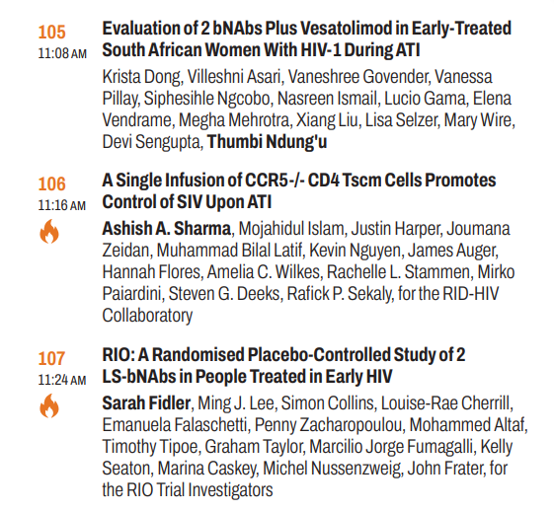

Broadly Neutralizing Antibodies in ATI Trials
Broadly neutralizing antibodies during states of antigenemia (early ART, post-ART) alter the time-to-rebound, first phase rate of increase, peak viral load and in some cases the set-point

Slide 16
Broadly Neutralizing Antibodies in ATI Trials
Studies performed mainly in the global North on early treated MSM
Limited available data from Brazilians or other people living with HIV

Slide 17
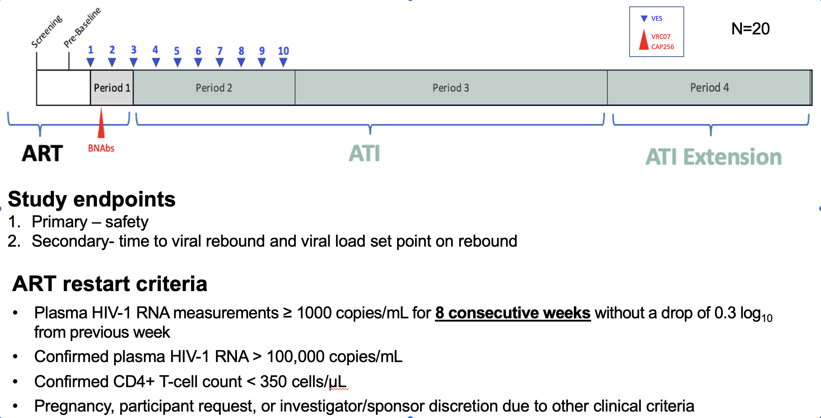
FRESH Study
Young females, started ART in acute infection

Slide 18
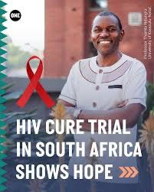
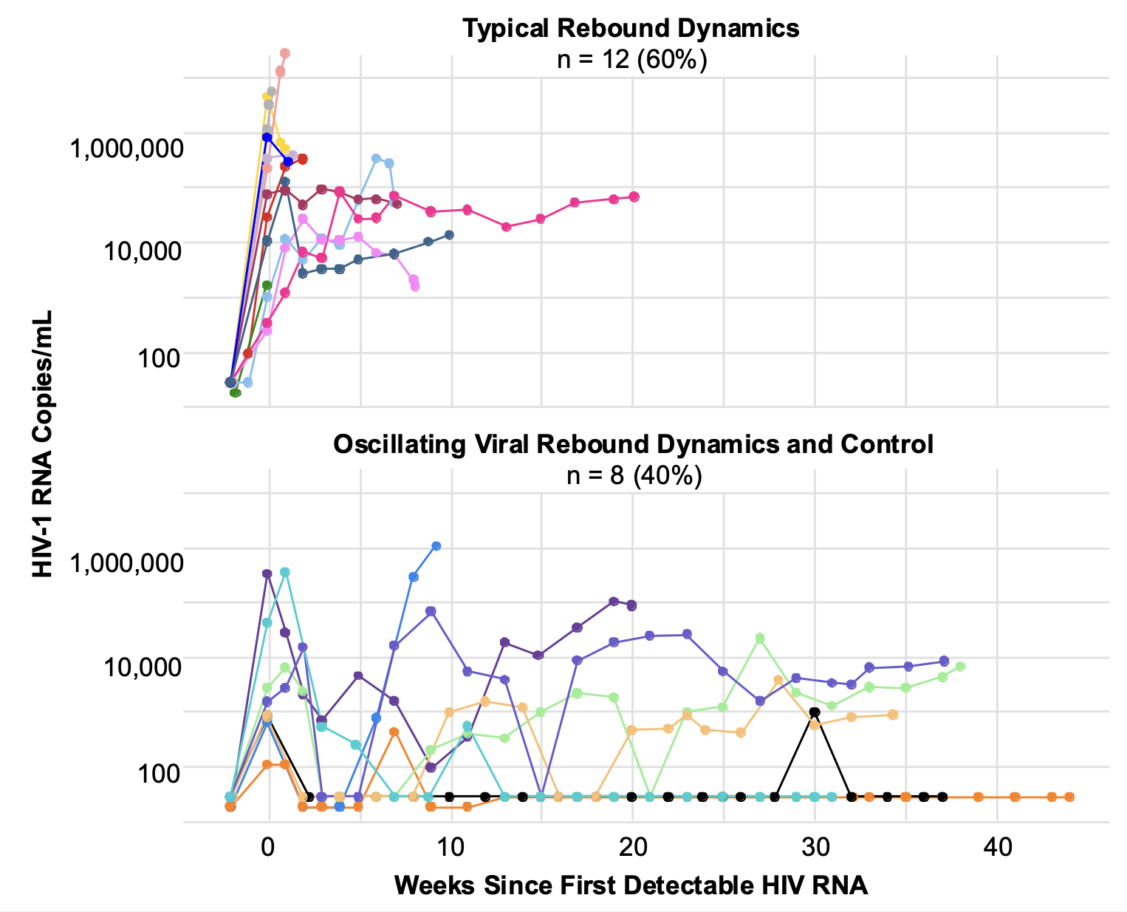
~40% of young women who started ART early and who received bNAbs and a TLR agonist had partial control
FRESH Study
Krista Dong, Thumbi Ndung’u, others

Slide 19
Summary from ATI Trials 1.0
Initiating ART as early as possible alone does not induce post-ART viral control in a consistent and predictable manner
Therapeutic vaccination alone does not work
bNAbs alone can induce control is some, but the effect is not consistent, may not be sustained, and is typically associated with levels of viremia that are associated with excess transmission
  None of these single interventions have yielded sustained, stringent control

Slide 20
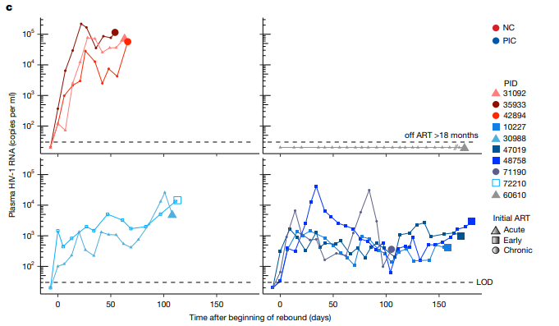
First Combination ATI Trial
NCT04357821
Therapeutic vaccine:
IL-12 adjuvanted p24CE DNA prime (p24CE/IL-12) at Weeks 0 and 4
IL-12 adjuvanted DNA boost (p24CE plus p55gag) at Week 12
MVA/HIV62B (MVA62B) boost at Week 20
Altered viral kinetics and viral load set point in 7 out of 10 participants

Slide 21
Current Combination Trials
A5374: Combination regimen with a therapeutic vaccine (ChAdOx1-MVA/HIVconsvX), TLR agonist (vesatolimod) and bNAbs 3BNC117LS + 101074LS
  45 ppts (30 experimental, 15 placebo) who initiated ART within 28 days of acute HIV diagnosis
NCT04983030: Safety, Immunogenicity, Efficacy of Ad26.Mos4.HIV, MVA-BN-HIV and PGT121, PGDM1400, and VRC07-523LS in HIV-1-Infected Adults
  36 ppts randomized in a 1:1:1 ratio to 3 groups (vaccines+ bnAbs, vaccine+placebo, placebo+bnAbs)
NCT07054931: Combination Vaccination (ChAdOx1.tHIVconsv1 and ChAdOx2.HIVconsv62/MVA.tHIVconsv4) and Broadly Neutralizing Antibody Therapy (GS-5423 and GS-2872)
  48 ppts randomized 1:1:1 to 3 groups (TI + bnAbs, vaccine + bnAbs, TI + vaccine + bnAbs)
DELIVER-01/RV630: Safety and Efficacy of Broadly Neutralizing Antibodies Combined with Therapeutic Vaccination (PGDM1400LS and VRC07-523LS) Combined with Therapeutic Vaccination (ChAdOx1.tHIVconsv1 and ChAdOx2.HIVconsv62/MVA.tHIVconsv4, A244/ALF-Q)
  48 ppts, 40 ppts randomized to 2 groups (TI + bnAbs+ vaccine, TI + bnAbs + placebo), 8 ptts in acute infection (bnAbs+ vaccine)

Slide 22
Current Combination Trials
A5374: Combination regimen with a therapeutic vaccine (ChAdOx1-MVA/HIVconsvX), TLR agonist (vesatolimod) and bNAbs 3BNC117LS + 101074LS
  45 ppts (30 experimental, 15 placebo) who initiated ART within 28 days of acute HIV diagnosis
NCT04983030: Safety, Immunogenicity, Efficacy of Ad26.Mos4.HIV, MVA-BN-HIV and PGT121, PGDM1400, and VRC07-523LS in HIV-1-Infected Adults
  36 ppts randomized in a 1:1:1 ratio to 3 groups (vaccines+ bnAbs, vaccine+placebo, placebo+bnAbs)
NCT07054931: Combination Vaccination (ChAdOx1.tHIVconsv1 and ChAdOx2.HIVconsv62/MVA.tHIVconsv4) and Broadly Neutralizing Antibody Therapy (GS-5423 and GS-2872)
  48 ppts randomized 1:1:1 to 3 groups (TI + bnAbs, vaccine + bnAbs, TI + vaccine + bnAbs)
DELIVER-01/RV630: Safety and Efficacy of Broadly Neutralizing Antibodies Combined with Therapeutic Vaccination (PGDM1400LS and VRC07-523LS) Combined with Therapeutic Vaccination (ChAdOx1.tHIVconsv1 and ChAdOx2.HIVconsv62/MVA.tHIVconsv4, A244/ALF-Q)
  48 ppts, 40 ppts randomized to 2 groups (TI + bnAbs+ vaccine, TI + bnAbs + placebo), 8 ptts in acute infection (bnAbs+ vaccine)

Slide 23
Ongoing or planned clinical trials in sub-Saharan Africa
NIAID/NIH
  A5417 (Acacia; Gates): RCT of 2 bNABs at ART initiation with an ATI
  A5416: RCT of bNAbs at interruption
  P1115: Early ART in infants
  DELIVER 02: DART with an LRA (three arm trial, n=24)
  HVNT germline targeting (e.g. 426c.Mod.Core-C4b CD4 binding site)
Brilliant Consortium
  bNAb induction (BG505 SOSIP.GT1.1 gp140 trimer), no ATI
Gates Foundation: Networked epitope therapeutic vaccine (Gahia, Ragon)
  GRAdHIVNE1 vector: Enrolling
  mRNA (Biontech): Enrolling

Slide 24
Summary
Why should we build clinical trial capacities worldwide?
Therapies to induce an HIV cure need to address HIV diversity, different populations, and need to be tested globally
What are the current HIV cure strategies?
Combination immunotherapies tested mainly in early-treated people with HIV in cure trials with viral set-point ATI
How is MHRP contributing to building capacities and conducting HIV cure clinical research in different settings?
The DELIVER initiative provides the opportunity to test interventions in areas most affected by HIV in a collaborative and integrated network

Slide 25

The DELIVER Initiative
Deliver an HIV cure to people living with HIV in the USA and globally
Notes:
The Deliver initiative stands for developing leadership and innovation in viral eradication research and spans the global sites shown here . A major goal of the deliver initiative is to tech transfer different assay platforms to these sites.
FUNDED BY NIH

Slide 26
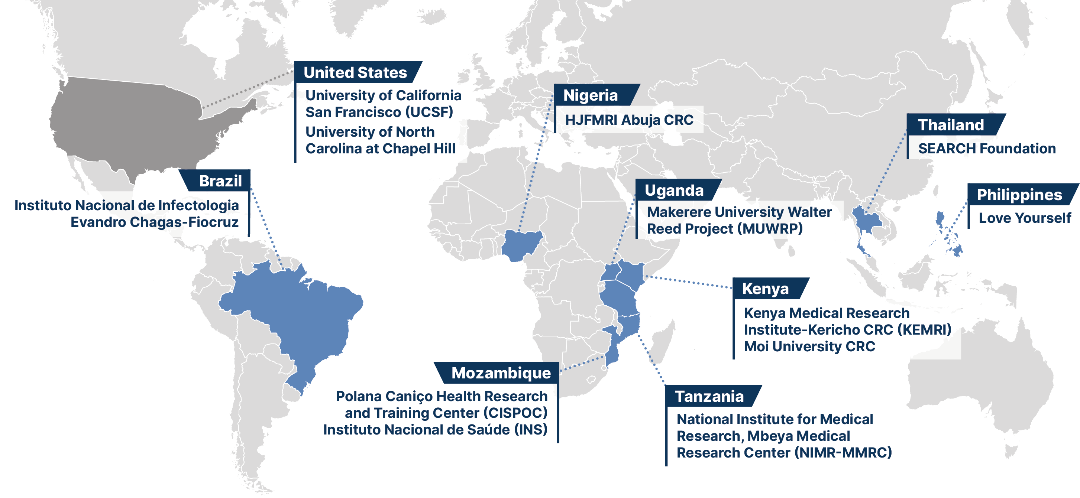
The DELIVER Initiative

Slide 27

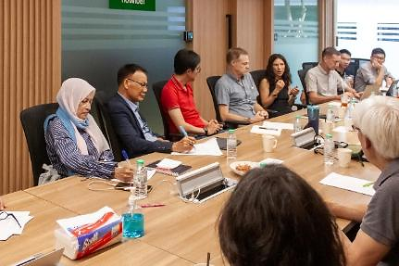
DELIVER-01/RV630
Approach to Control HIV with Immune Enhancement and Vaccination (ACHIEV):
Safety and Efficacy of Broadly Neutralizing Antibodies Combined with Therapeutic Vaccination for the Induction of HIV Remission
The RV630 team
SEARCH CAB

Slide 28
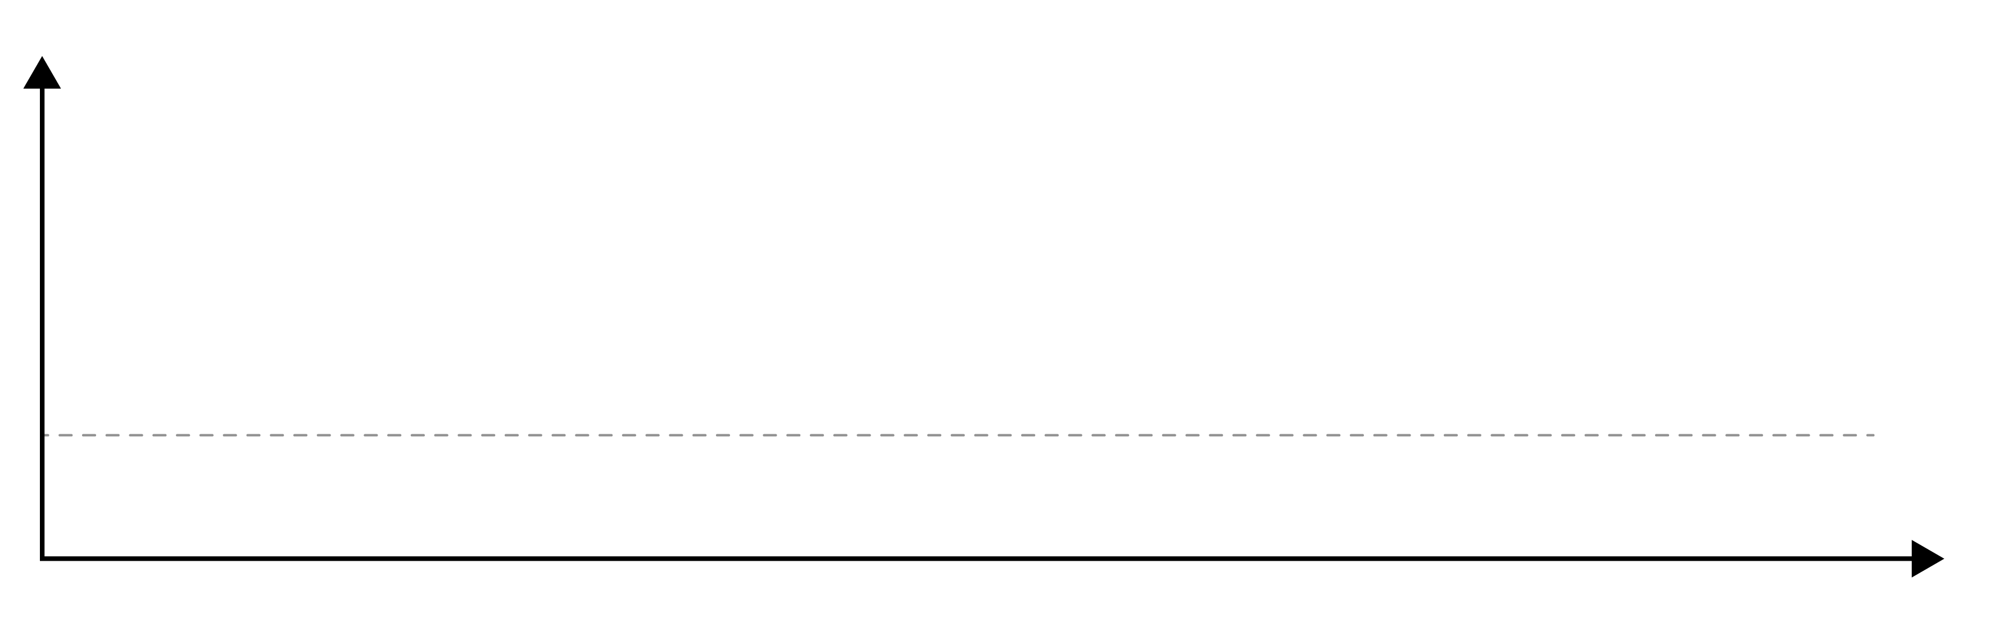



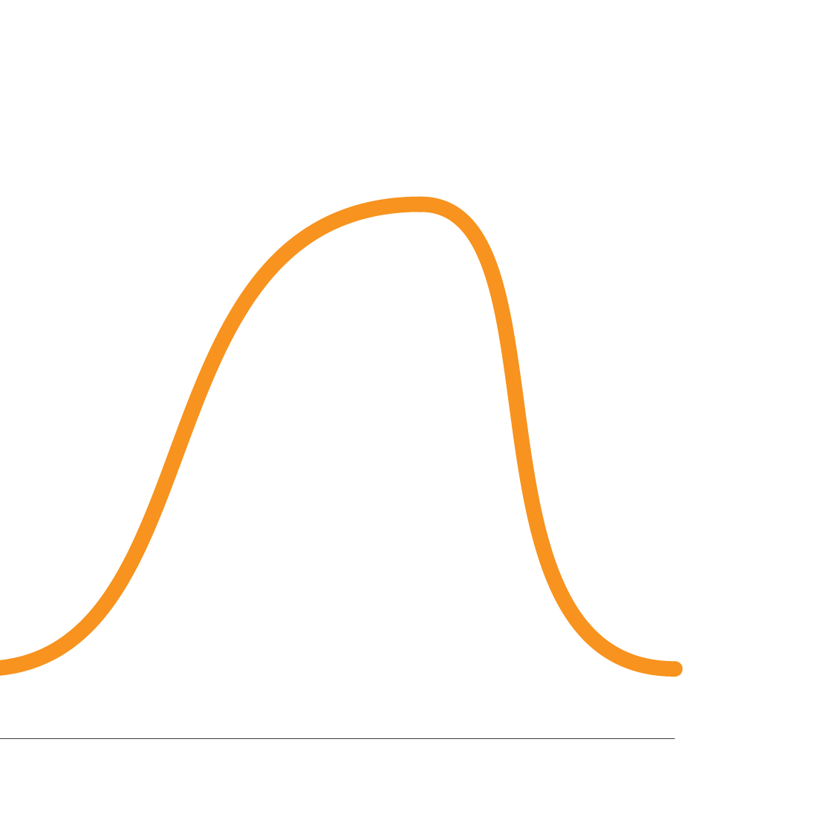
DELIVER-01/RV630: ACHIEV Trial
T and B cell Vaccines
bnAbs
bnAbs
Thai acute infection cohort RV254
TTI
ATI
Rebound
Enrollment in DELIVER-01
Viral Load
Lower setpoint
Rebound then suppression
Time
TTI: Temporary Treatment Interruption
ATI: Analytical Treatment Interruption

Slide 29
DELIVER-01 Trial Design
First enrollment:
September 1st 2025
ChAdOx1
C1 C62
MVA M4
A244 + ALF-Q
Mental Health Program
VRC07-523LS
PGDM1400LS
VRC07-523LS
PGDM1400LS
Every 4 weeks through week 12
then every 12 weeks
Wk 50/end study
Study Week
#
1
Wk 12
Every 4 weeks
Wk 50/0
50
0
Wk 8/0
0
22/30
0
Wk 0
Wk 0
0
50*
Viral Rebound
*ART resumption may occur earlier than wk50
20
TTI
bnAbs
Resume ART and vaccinate
RV254
Viral Rebound
Randomization
TTI
bnAbs
Resume ART and placebo
ATI
Resume ART
RV254
20
Exploratory Arm 8
AHI
Start bNAbs + ART and vaccinate
No Viral Rebound
Step 1
Step 2
Step 3
Step 4
RV412
CNS investigations
LP / MRI
Step 2 Week 1
LP / MRI
Step 3 Week 12 (If still suppressed)
LP / MRI
Step 3
(2 weeks after first rebound)
LP / MRI
Step 4 Week 0
TTI: Temporary Treatment Interruption
ART resumption at confirmed VL>1,000c/ml
ATI: Analytical Treatment interruption
ART resumption at VL>1,000c/ml for 8 weeks

Slide 30
Current/Pending DELIVER Cure Trials
DELIVER-03
DELIVER-02
DELIVER-01
DELIVER-03
DELIVER-02
Future DELIVER combination trials will be multisite trials

Slide 31
Developing Laboratory Capabilities to Support Cure Research
 | Assay | DELIVER Site
HIV reservoir quantification | Quantitative realtime PCR, digital realtimePCR, SIPIA | Uganda, Kenya
Rebounding virus characterization | Viral sequencing | Kenya, Mozambique
HLA typing | Multilocus NGS-based typing | Mozambique
Sensitivity to bnAbs | Pseudovirus neutralization assay | Tanzania
bnAbs PK and ADA | PK/ADA assays | Multiple Sites
Analysis of immune interventions | Multiparametric flow cytometry, ICS | Uganda, Thailand
Tissue analysis | RNA/DNA scope, Immunohistochemistry | Thailand

Slide 32
The DELIVER Initiative
Shared resources and experiences within DELIVER CE group
Common assay platforms to analyze clinical trials
Mentoring of clinicians and scientists across sites
Standard ATI protocol template to conduct clinical trials
Shared resources to ship and manage IPs for trials
Notes:
The Deliver initiative stands for developing leadership and innovation in viral eradication research and spans the global sites shown here . A major goal of the deliver initiative is to tech transfer different assay platforms to these sites.
FUNDED BY NIH

Slide 33
Conclusions
HIV cure trials are complex: ATI, frequent viral load monitoring, advanced reservoir and immunology analyses, intensive safety monitoring
A global network of experienced sites to conduct cure trials will make it easier to recruit participants with strict eligibility criteria, complete studies more quickly and obtain results that are broadly applicable
People in countries with the highest burden of HIV should participate in cutting-edge research, benefit from new therapies and help shape research priorities
Building capacity now to prepare for implementation:
  Trained investigators
  Regulatory expertise
  Laboratory infrastructure
  Community engagement programs

Slide 34
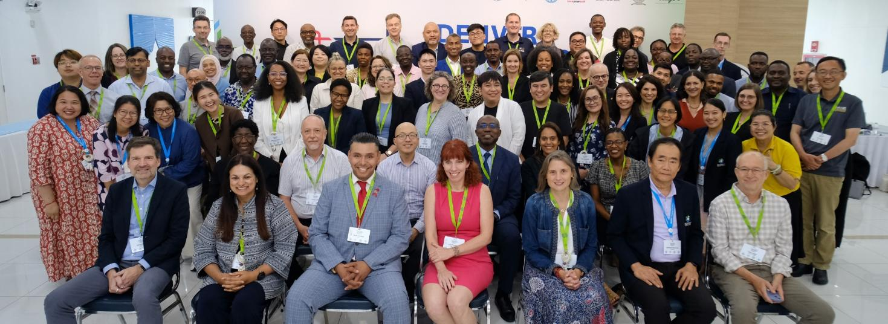

Many thanks to the DELIVER team!
DELIVER Team and Partner Sites
DELIVER-01, DELIVER-02 and DELIVER-03 protocol teams and sponsors
Study Participants
MHRP Leadership
and Staff
Division of AIDS, NIAID, NIH
This work was supported by the Assistant Secretary of Defense for Health Affairs endorsed by the Department of War, through the Walter Reed Army Institute of Research (WRAIR) under Award No. HT9425-24-3-0004. This research was funded, in part, by the U.S. National Institute of Allergy and Infectious Diseases, NIH.
Material has been reviewed by the Walter Reed Army Institute of Research. There is no objection to its presentation. The opinions or assertions contained herein are the private views of the author, and are not to be construed as official, or as reflecting true views of the Department of the Army, the Department of War or HJF.
Notes:
Col Ake, Peter Kim, Karl Salzwedel, Randy Tressler and Adriana Andala, Steve Deeks, Jason TikOy

