Slide 1
Measuring HIV reservoirs: the optimal or the feasible?
Lucía Baquero
CONICET-Universidad de Buenos Aires. Instituto de Investigaciones Biomédicas en Retrovirus y Sida (INBIRS), Argentina
Basic science and translational clinical studies on HIV cure

Slide 2
Measuring HIV reservoirs: the optimal or the feasible?
What reservoir are we measuring?
Innovations in single-cell and multiomic approaches
How can we track reservoir decay?
Current challenges

Slide 3
What reservoir are we measuring?

Slide 4
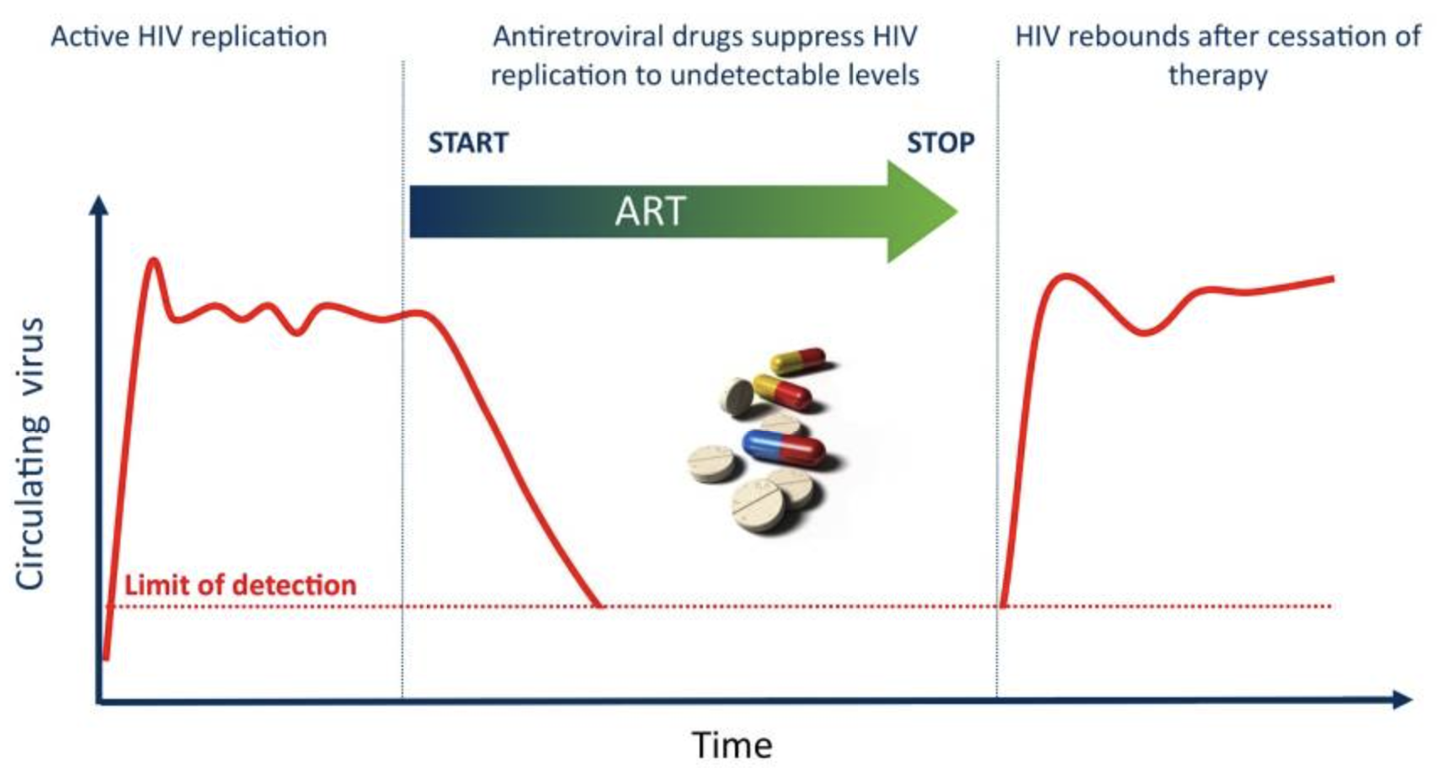




What reservoir are we measuring?
Replication-competent reservoir
Kulpa & Chomont. J Virus Erad. 2015.

Slide 5


What reservoir are we measuring?
Silent
reservoir
Transcription-competent reservoir
Translation-competent reservoir
Replication-competent reservoir
proviral DNA
viral RNA
viral proteins
infectious viral particles
Moar et al. mBio. 2023; Falcinelli et al. Front. Microbiol. 2019.; Tanaka et al. Pathog. Immun. 2025; Roux & Chomont. J Infect Dis. 2024.

Slide 6
Cell culture-based methods
QVOA: gold standard
Silent
reservoir
Transcription-competent reservoir
Translation-competent reservoir
Replication-competent reservoir
proviral DNA
viral RNA
viral proteins
infectious viral particles
X Usually labor-intensive, time-consuming, requires large cell inputs.
Underestimates the replication-competent reservoir (low reactivation rate).
Moar et al. mBio. 2023; Falcinelli et al. Front. Microbiol. 2019.; Tanaka et al. Pathog. Immun. 2025; Roux & Chomont. J Infect Dis. 2024.

Slide 7
Cell culture-based methods
QVOA*, TZA, p24-VOA, HIVE
Silent
reservoir
Transcription-competent reservoir
Translation-competent reservoir
Replication-competent reservoir
proviral DNA
viral RNA
viral proteins
infectious viral particles
X Usually labor-intensive, time-consuming, requires large cell inputs.
May still underestimate the replication-competent reservoir (low reactivation rate).
Moar et al. mBio. 2023; Falcinelli et al. Front. Microbiol. 2019.; Tanaka et al. Pathog. Immun. 2025; Roux & Chomont. J Infect Dis. 2024.

Slide 8
Cell culture-based methods
VIP-SPOT, HIV-Flow
Silent
reservoir
Transcription-competent reservoir
Translation-competent reservoir
Replication-competent reservoir
proviral DNA
viral RNA
viral proteins
infectious viral particles
X Still labor-intensive, time-consuming, require large cell inputs.
Tend to overestimate the replication-competent reservoir.
Moar et al. mBio. 2023; Falcinelli et al. Front. Microbiol. 2019.; Tanaka et al. Pathog. Immun. 2025; Roux & Chomont. J Infect Dis. 2024.

Slide 9
RNA PCR-based methods
CA-US/MS-RNA, smFISH, FISH Flow, TILDA*
Silent
reservoir
Transcription-competent reservoir
Translation-competent reservoir
Replication-competent reservoir
proviral DNA
viral RNA
viral proteins
infectious viral particles
X Tend to overestimate the replication-competent reservoir.
* Requires stimulation → also informs inducibility.
Moar et al. mBio. 2023; Falcinelli et al. Front. Microbiol. 2019.; Tanaka et al. Pathog. Immun. 2025; Roux & Chomont. J Infect Dis. 2024.

Slide 10
DNA PCR-based methods
Total HIV-DNA, Alu-gag PCR, ddPCR/dPCR-IPDA
Silent
reservoir
Transcription-competent reservoir
Translation-competent reservoir
Replication-competent reservoir
proviral DNA
viral RNA
viral proteins
infectious viral particles
X Tend to overestimate the replication-competent reservoir.
Most of them do not distinguish intact/defective.
Moar et al. mBio. 2023; Falcinelli et al. Front. Microbiol. 2019.; Tanaka et al. Pathog. Immun. 2025; Roux & Chomont. J Infect Dis. 2024.

Slide 11
NGS-based methods
NFL-seq, FLIPS, MIP-seq, PRIP-seq, Q4PCR, HIV Sort seq
Silent
reservoir
Transcription-competent reservoir
Translation-competent reservoir
Replication-competent reservoir
proviral DNA
viral RNA
viral proteins
infectious viral particles
More specificity, less sensitivity. Distinguish intact/defective proviruses.
X May overestimate replication-competent reservoir (not all intact proviruses are replication-competent). Limited amplification efficiency.
Moar et al. mBio. 2023; Falcinelli et al. Front. Microbiol. 2019.; Tanaka et al. Pathog. Immun. 2025; Roux & Chomont. J Infect Dis. 2024.

Slide 12
Innovations in single-cell and multiomic approaches

Slide 13
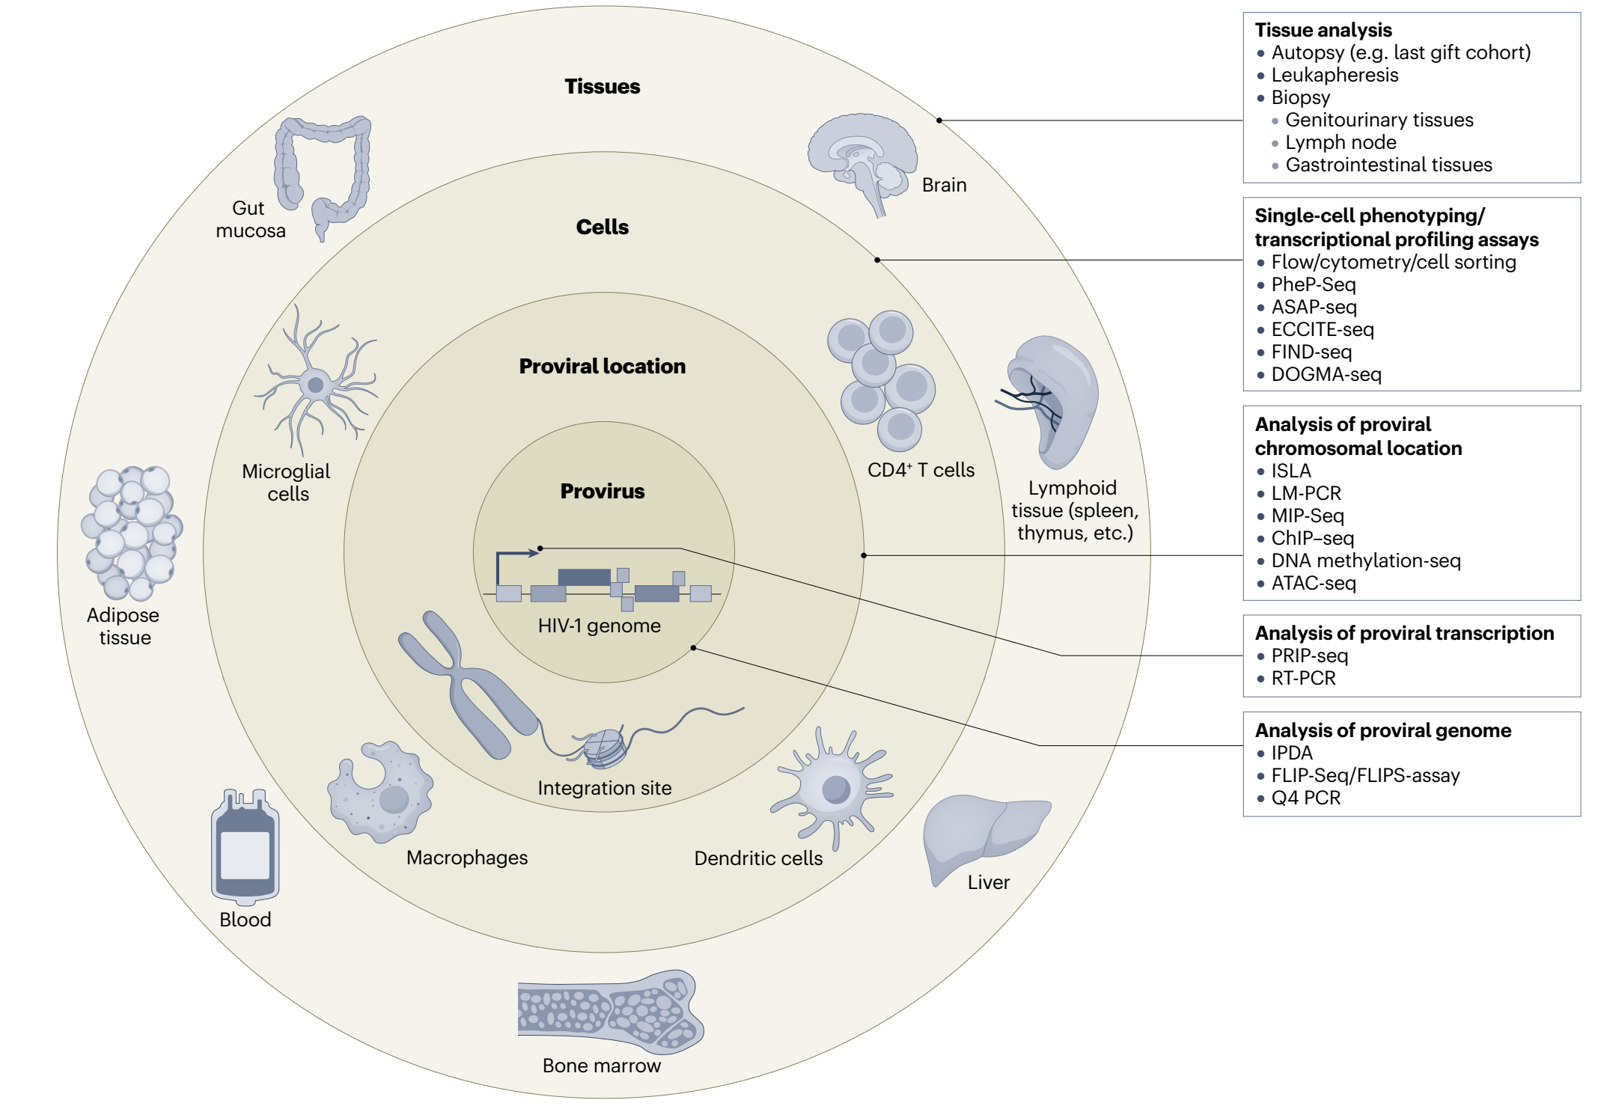
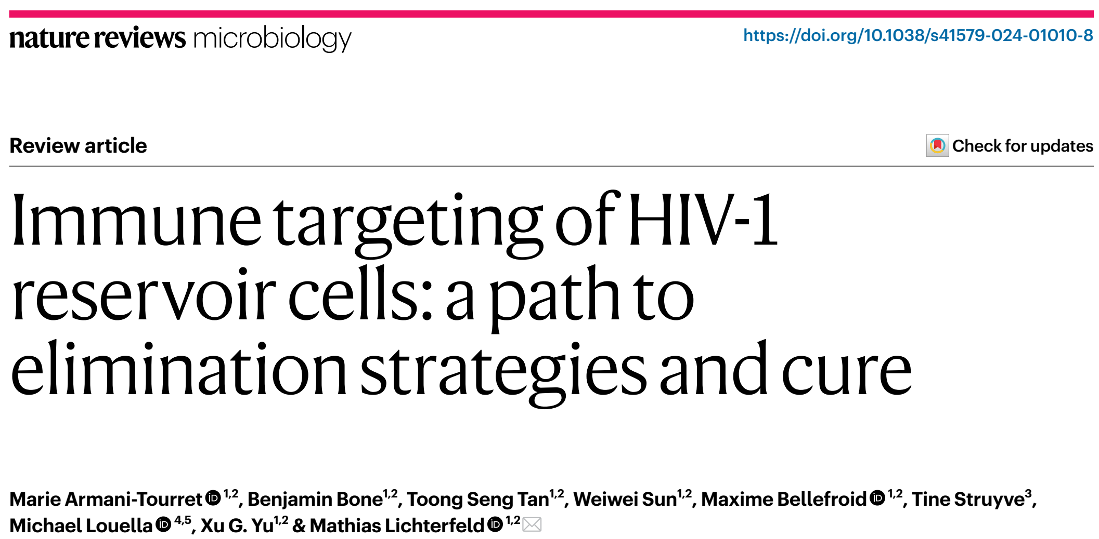
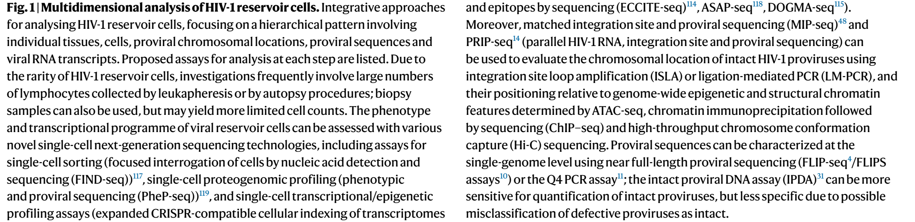
Innovations in single-cell and multiomic approaches
Armani-Tourret et al. Nat. Rev. 2024.

Slide 14
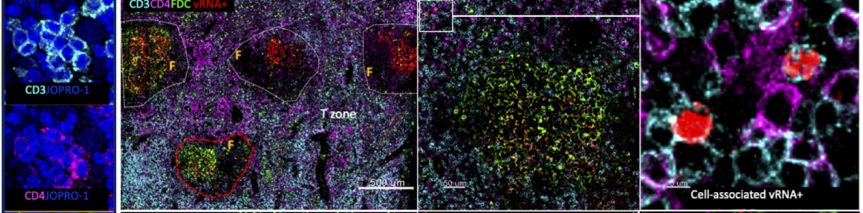
Microscopy-based methods
→ Immunephenotyping and spatial omic techniques.
→ Immunofluorescent in situ hybridization
(IF-FISH) for the visualization of actively transcribed HIV (vRNA+) in lymph nodes.
X Low throughput, not scalable.
Requirement of tissue samples.
Armani-Tourret et al. Nat. Rev. 2024.
Moysi et al. Front. Immunol. 2021.

Slide 15
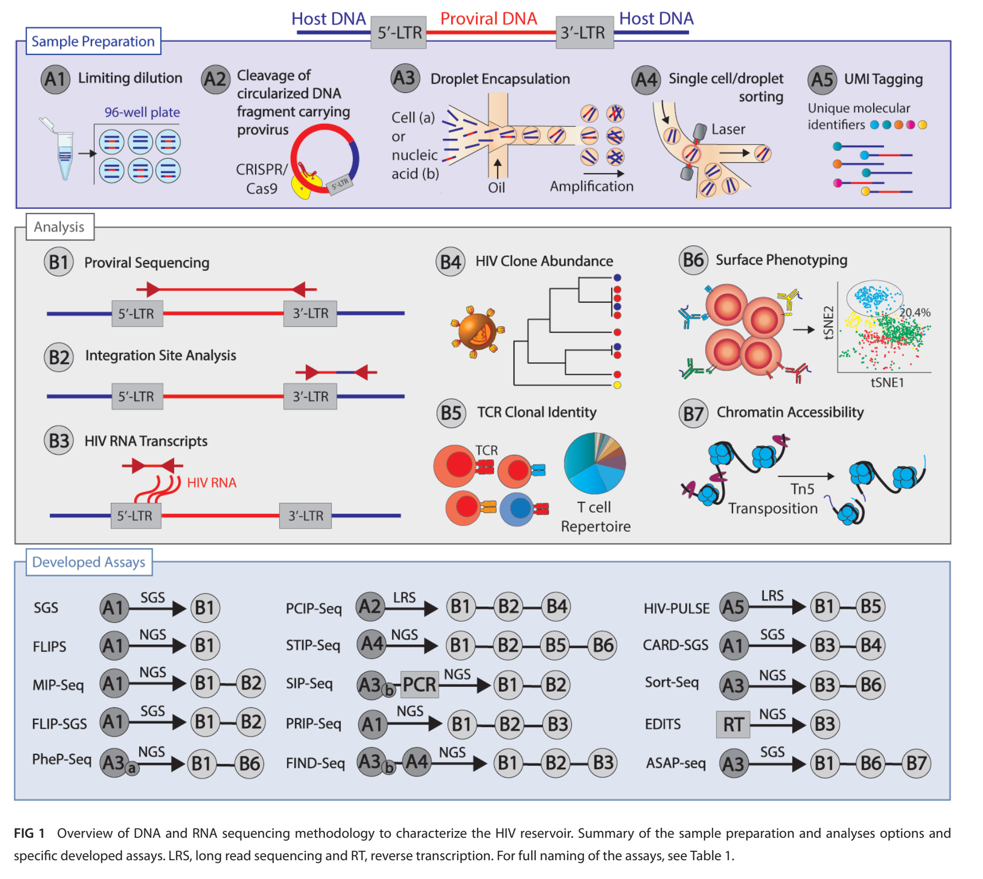
Sequencing methods for HIV reservoir
→ Sample preparation
→ Analysis
Moar et al. mBio. 2023.

Slide 16
Sequencing methods for HIV reservoir
Moar et al. mBio. 2023.

Slide 17
Sequencing methods for HIV reservoir
FLIPS
Full-length individual proviral sequencing
High specificity for distinguishing intact and defective proviruses.
X Limited amplification efficiency
→ possible underestimation.
Labor-intensive.
Does not estimate replication competence.
Hiener et al. Jove. 2018; Moar et al. mBio. 2023.

Slide 18
Single-cell analyses of the HIV reservoir
PRIP-seq
Parallel analysis of transcription, integration and seq. of single HIV-1 proviruses
HIV-provirus
Integration sites
Transcription
X Does not measure inducibility.
Labor-intensive, high costs.
Einkauf et al. Cell. 2022; Moar et al. mBio. 2023.

Slide 19
Single-cell analyses of the HIV reservoir
PheP-seq
Phenotypic and proviral seq
Phenotypic characterization of cells harbouring
HIV-proviruses.
X Does not measure inducibility.
Labor-intensive, high costs.
Sun et al. Nature. 2023; Moar et al. mBio. 2023.

Slide 20
Single-cell analyses of the HIV reservoir
FIND-seq
Focused interrogation of cells by nucleic acid detection and sequencing
Transcriptomic analysis of HIV-DNA+ cells
X Does not measure inducibility.
Labor-intensive, high costs.
Shin et al. Nat Protoc. 2024; Moar et al. mBio. 2023.

Slide 21
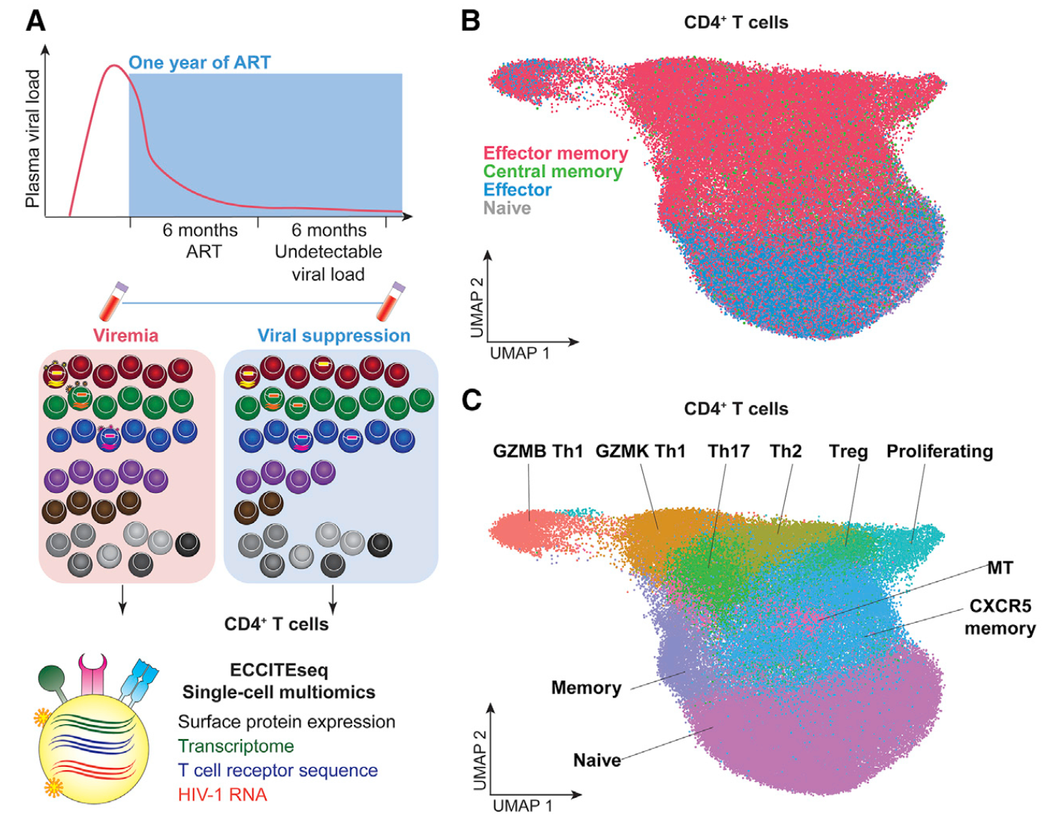
Single-cell analyses of the HIV reservoir
ECCITE-seq
sc-expanded CRISPR-compatible cellular indexing of transcriptomes and epitopes by seq.
﻿Surface protein expression,
Cellular transcriptome,
HIV-1 RNA,
TCR sequence,
On the same single-cell analysis.
X Relies on the presence of viral RNA;
Does not distinguish intact/defective harbouring cells.
Collora et al. Immunity. 2022.

Slide 22
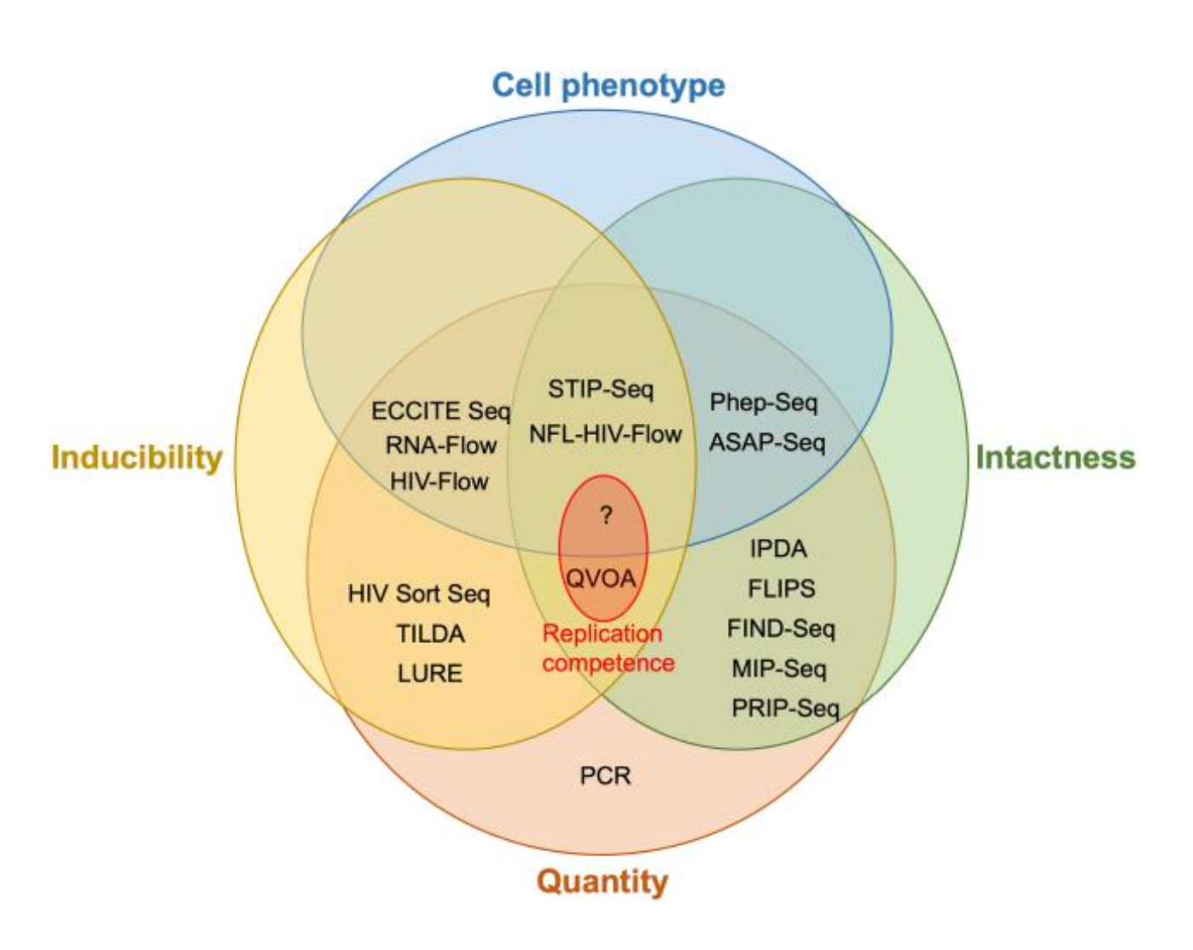
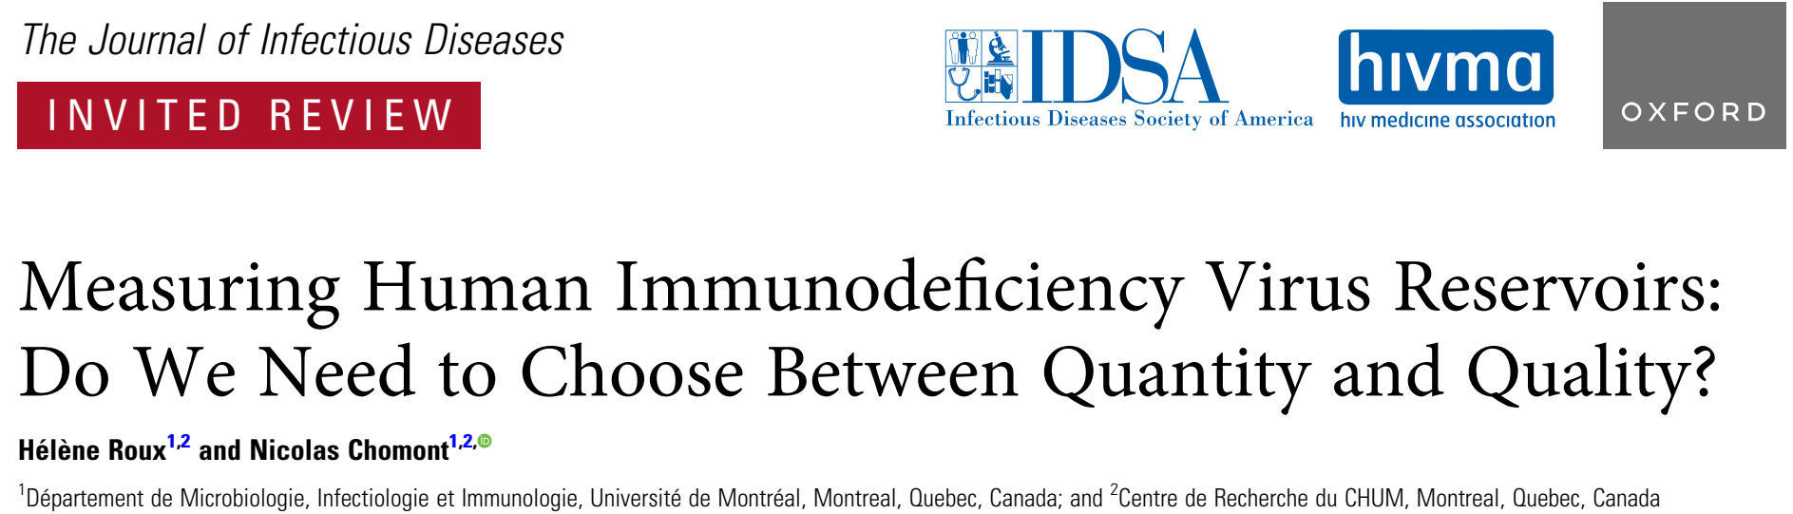
Innovations in single-cell and multiomic approaches
Inducibility?
Intactness?
Quantity?
Roux & Chomont. J Infect Dis. 2024.

Slide 23
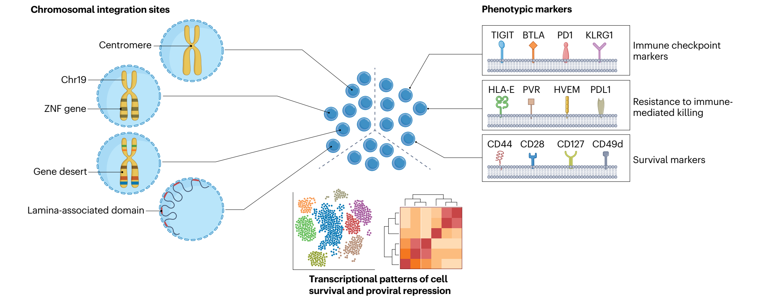
Innovations in single-cell and multiomic approaches
﻿These techniques provided genomic, phenotypic and transcriptional immune selection features of viral reservoir during long-term ART.
X High-cost techniques. Not scalable to clinical trials.
Armani-Tourret et al. Nat. Rev. 2024.

Slide 24
How can we accurately quantify intact proviruses to track reservoir decay?

Slide 25
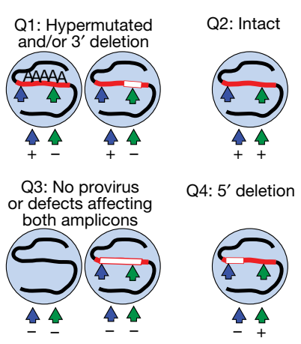
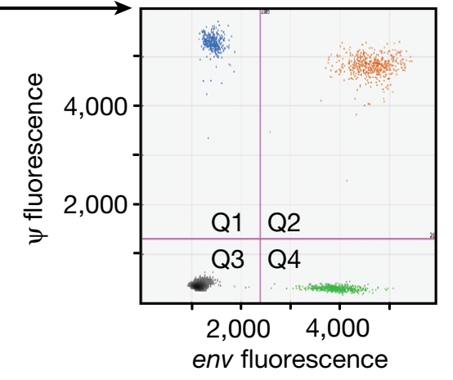
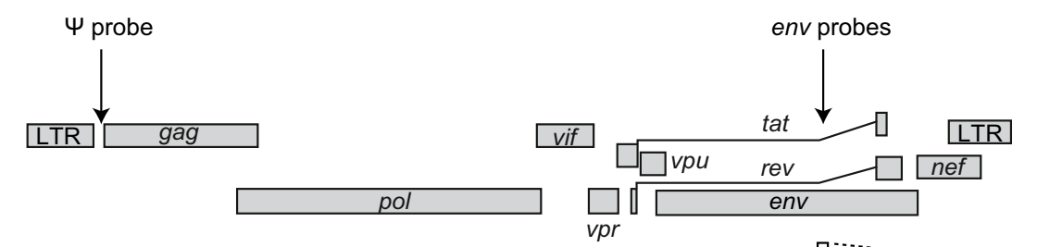
From IPDA to multiple-target detection
IPDA
﻿Intact proviral DNA assay
→ 2 targets
Distinguishes intact/defective proviruses.
High throughput, low cell input.
Cost-effective.
Bruner et al. Nature. 2019.

Slide 26
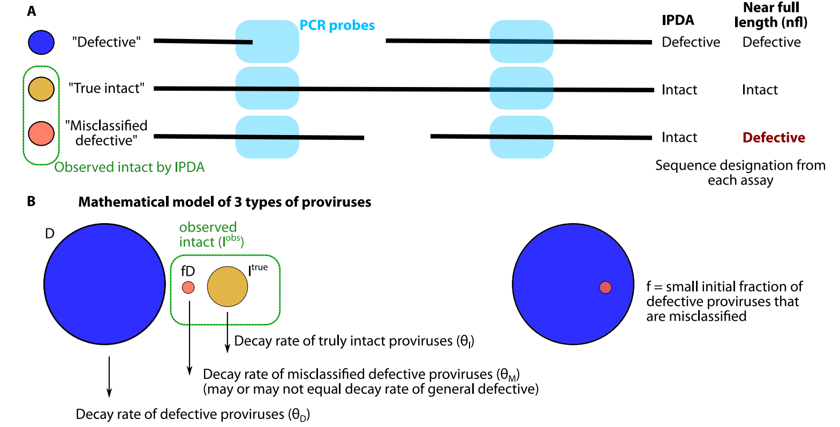
From IPDA to multiple-target detection
IPDA
﻿Intact proviral DNA assay
→ Impact of misclassification on decay-rate estimations:
→ 2 targets
Distinguishes intact/defective proviruses.
High throughput, low cell input.
Cost-effective.
X Misclassification of intact provirus.
Overestimation / Failure due to
primer/probes mismatches.
Bruner et al. Nature. 2019; Reeves. Nat Commun. 2023.

Slide 27
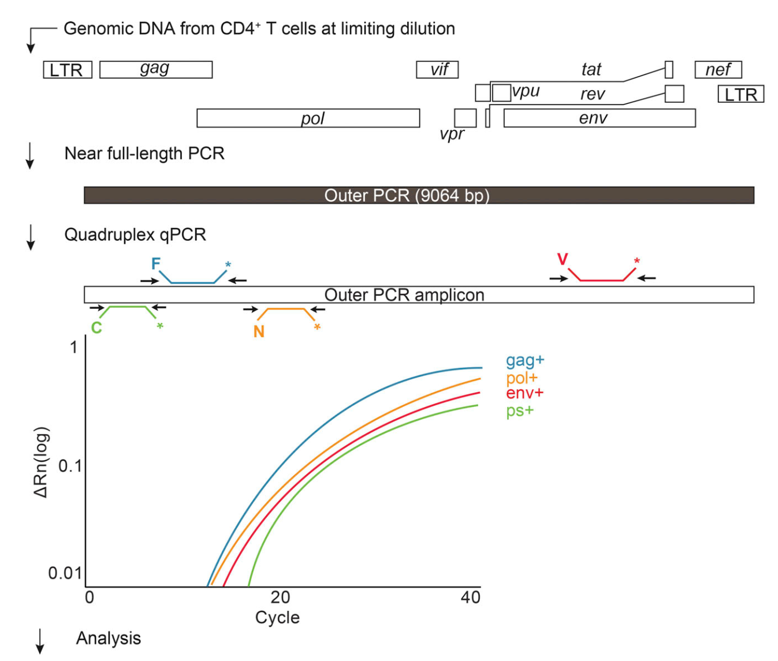
From IPDA to multiple-target detection
IPDA
Q4PCR
﻿Intact proviral DNA assay
Quadruplex qPCR + NGS
→ 2 targets
Distinguishes intact/defective proviruses.
High throughput, low cell input.
Cost-effective.
→ 4 targets
Sensitive, specific and “relatively high-throughput”.
X Misclassification of intact provirus.
Overestimation / Failure due to
primer/probes mismatches.
Gaebler et al. Jour of Vir. 2021; Bruner et al. Nature. 2019.
; Reeves. Nat Commun. 2023.

Slide 28
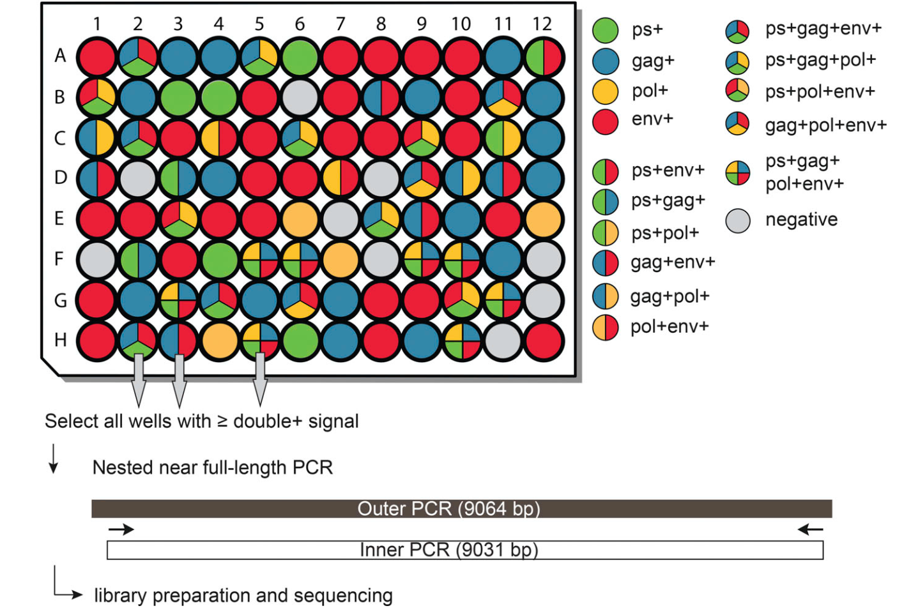
From IPDA to multiple-target detection
Q4PCR
Quadruplex qPCR + NGS
→ 4 targets
Gaebler et al. Jour of Vir. 2021.

Slide 29
From IPDA to multiple-target detection
Q4PCR
Quadruplex qPCR + NGS
X Labor-intensive, can underestimate the latent reservoir.
﻿→ Distinguishes intact/defective proviruses more accurately than IPDA due to polymorphisms
→ 4 targets
Gaebler et al. Jour of Vir. 2021.

Slide 30
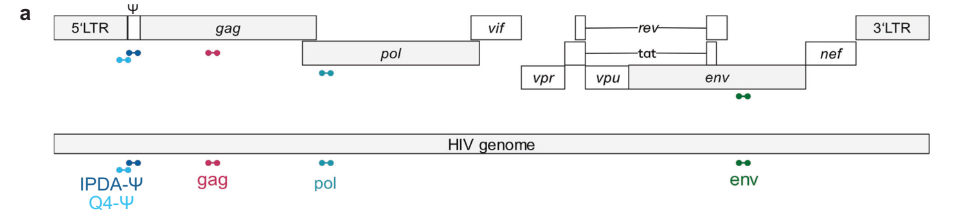
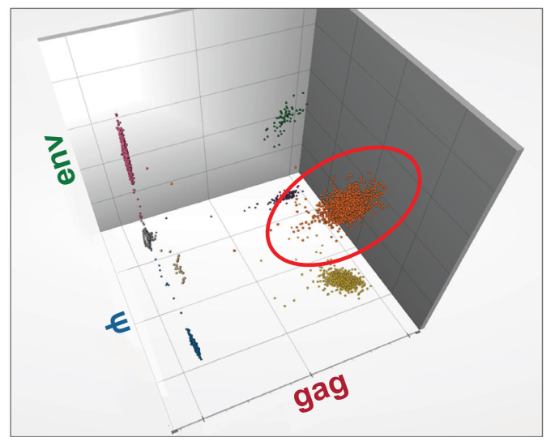
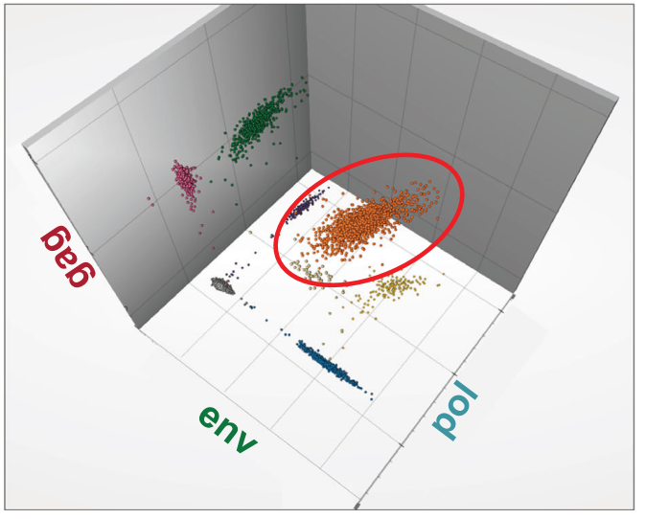
From IPDA to multiple-target detection
Q4ddPCR
4-target ddPCR
High sensitivity, low cell input, high throughput.
4 targets
Scheck et al. Nat Commun. 2026.

Slide 31
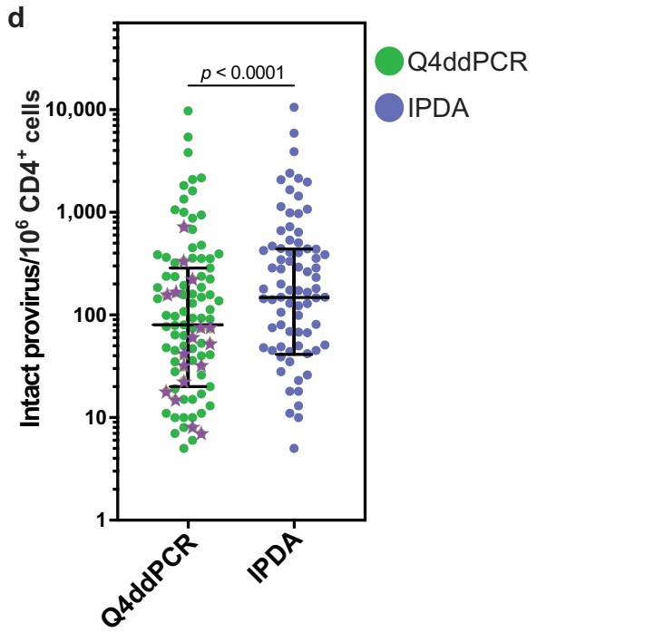
From IPDA to multiple-target detection
Q4ddPCR
4-target ddPCR
Closely matches sequence-confirmed reservoir measurement (still less specific).
Correlates with viral outgrowth.
Backup primers/probes.
High sensitivity, low cell input, high throughput.
4 targets
X Might need sequencing information to compare.
Validated in subtype B so far.
“offers a rapid, scalable, and cost-effective
alternative for quantifying intact proviruses.”
Guide prioritization of specific participants for single-cell
and phenotypic indepth analyses.
Scheck et al. Nat Commun. 2026.

Slide 32
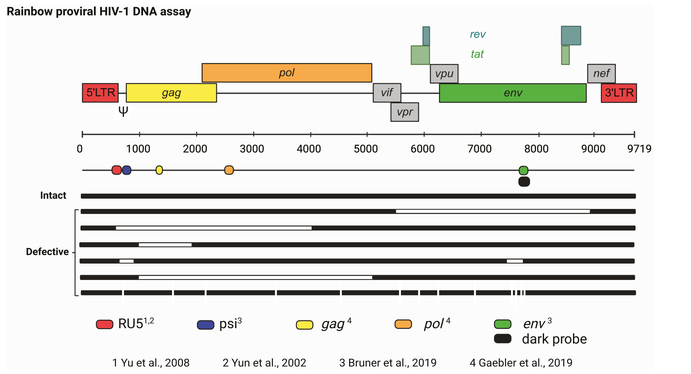
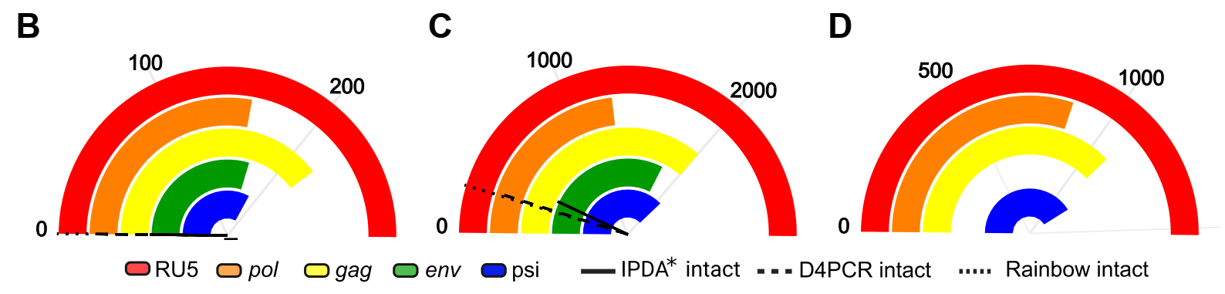
From IPDA to multiple-target detection
Rainbow
﻿Rainbow proviral
HIV-1 DNA dPCR assay
Equally sensitive but more specific than IPDA.
Similar estimation compared to D4PCR.
X Validated for subtype B so far.
Possible failures due to polymorphisms. Might need sequencing information to adjust primers/probes.
5 targets
Delporte et al. Clin. Med. 2025.

Slide 33
Measuring HIV reservoirs:
the optimal or the feasible?
Current challenges

Slide 34
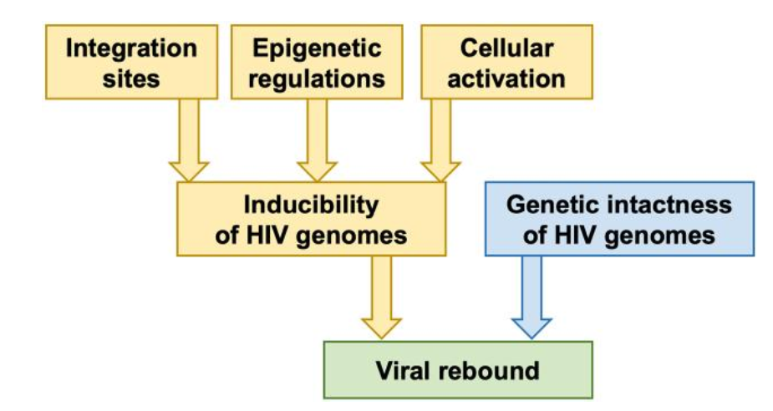

Measuring HIV reservoirs:
the optimal or the feasible?
Sensitivity/Specificity, Cost-effectiveness and Reproducibility.
Broadly applicable across HIV subtypes.
How can impactful changes in HIV reservoir be measured?
→ measure efficacy of therapeutic strategies.
Is there going to be an “ideal” technique that could be a practical alternative to an ATI?
Roux & Chomont. J Infect Dis. 2024.
Kulpa & Chomont. J Virus Erad. 2015.

Slide 35
Summary for community
Measuring HIV reservoirs:
the optimal or the feasible?
There are many techniques combining different approaches for HIV reservoir measurement and characterization in research.
Most are not yet scalable or validated for use in clinical trials.
So far, there is no single “ideal” validated and feasible technique for reservoir measurement, but this remains an area of intense research aimed at evaluating the impact of cure interventions.
We need feasible, scalable and accessible assays that can
be implemented across low- and middle-income countries.

Slide 36
Thank you so much
Thanks to N. Laufer, G. Turk, L. Cruces, M. Armani-Tourret, M. Lancien, M. Bellefroid, L. Osorio and Y. Ghiglione, for their input and feedback.
Lucía Baquero
lbaquero@fmed.uba.ar

