Slide 1

Using mRNA and lipid nanoparticles to reveal and reduce the HIV reservoir
Paula Cevaal | Research Fellow, Lewin lab
  AIDS2026

Slide 2
Conflicts of interest
Paula Cevaal and Sharon Lewin are named inventors on patents associated with the work presented
Sharon Lewin receives honoraria paid to her personally for participation in scientific advisory boards for Gilead, Merck, Abbvie and Immunocore; and for scientific events for Gilead

Slide 3


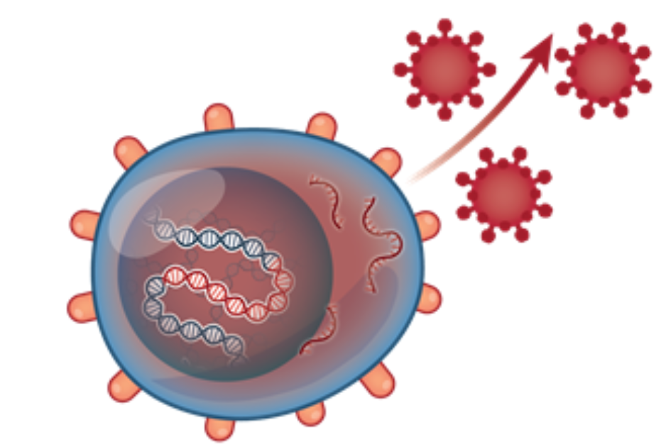


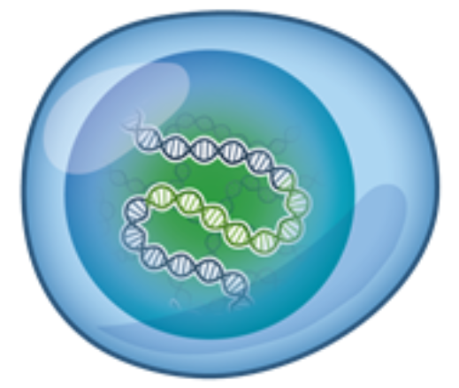


Latency reversal is required to reveal the reservoir
LRA = latency reversing agent
LRA
HIV DNA
Latent infection
Reveal
Reduce
Most LRAs that have been identified to date are repurposed drugs and lack potency and specificity
Shehu-Xhilaga M AIDS 2009; Elliott Plos Path 2014; Rasmussen Lancet HIV 2014; Elliott Lancet HIV 2016; Rasmussen Clin Infect Dis 2021; McMahon AIDS 2022; Uldrick Sci Transl Med 2022; Gunst Nature Med 2023

Slide 4
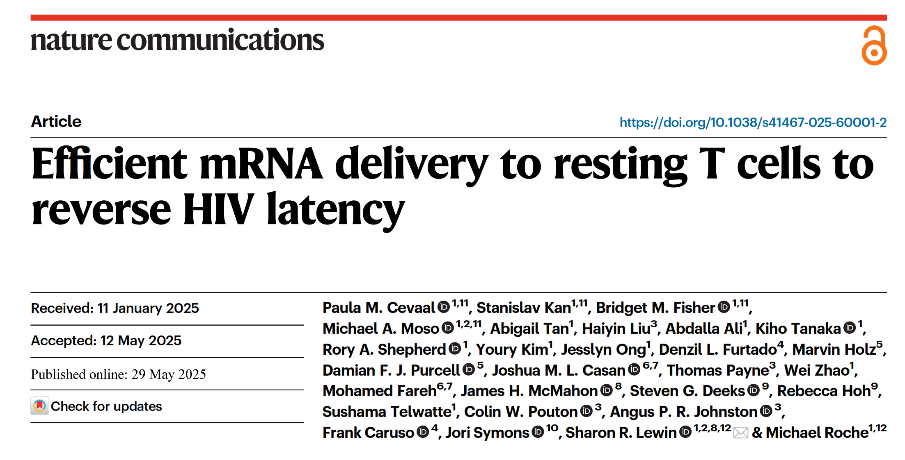

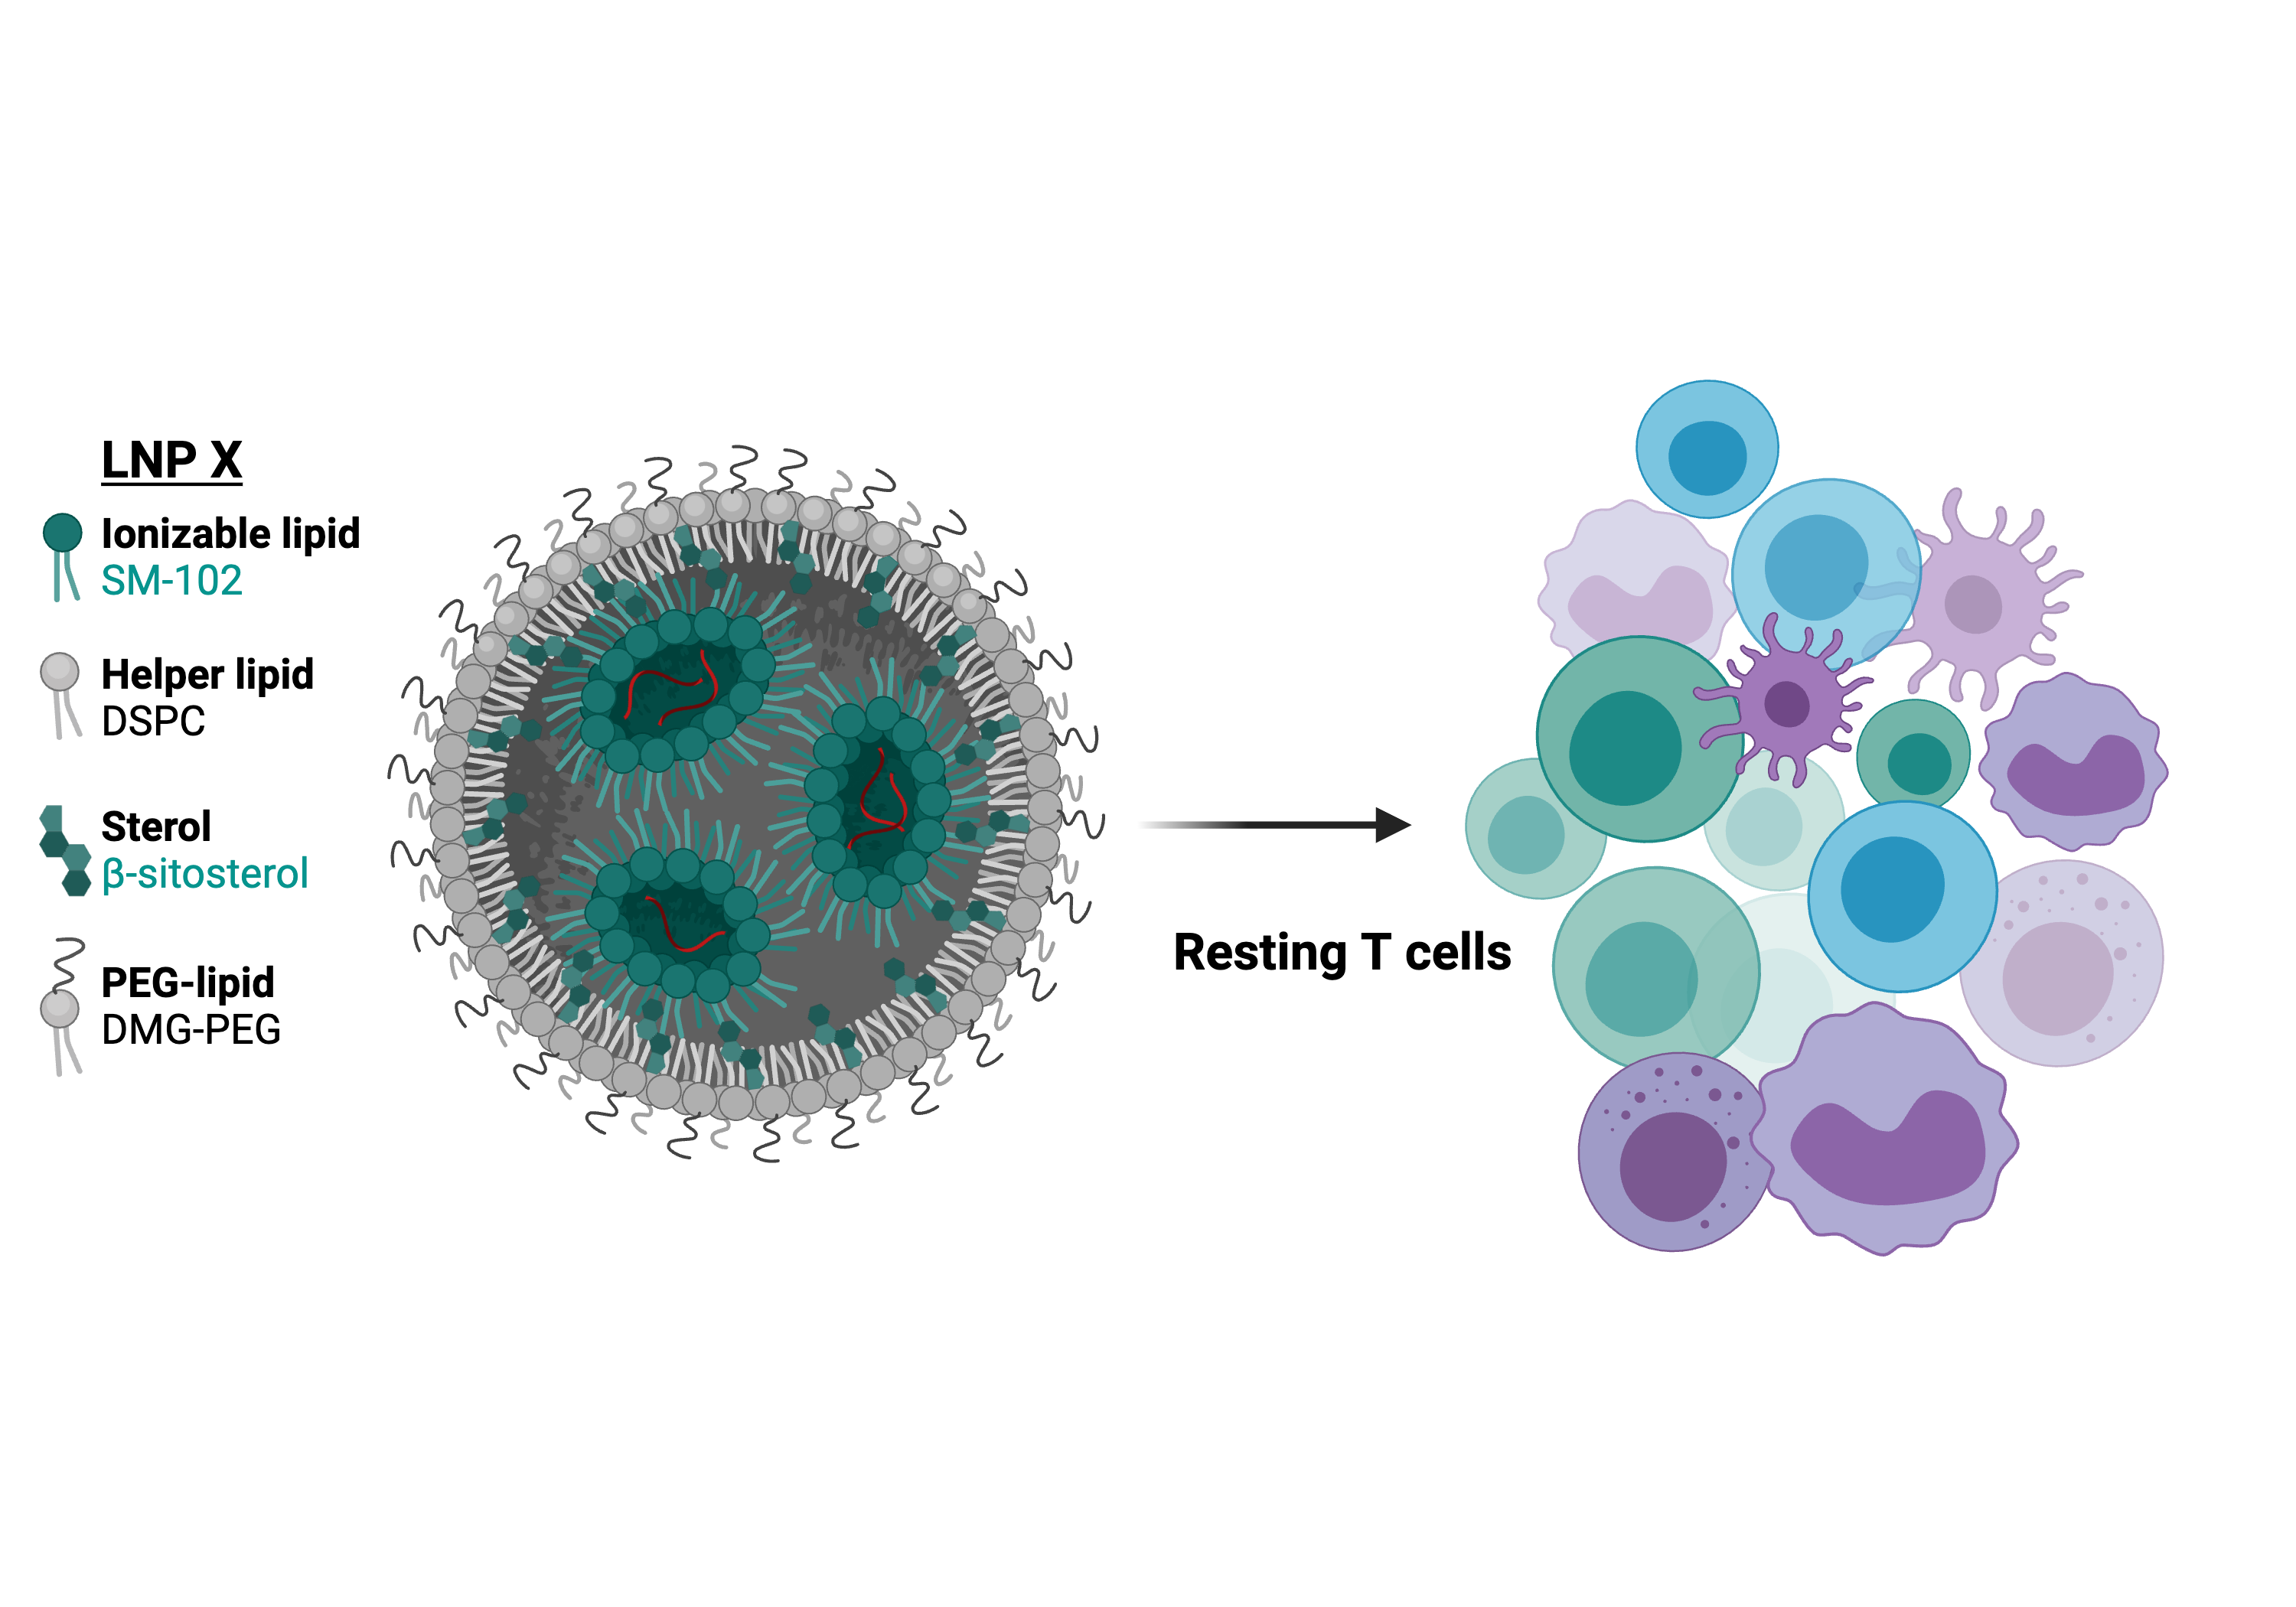



mRNA can deliver HIV-specific latency reversal agents
LNP-X
Ionizable lipid
SM-102
Helper lipid
DSPC
Sterol
β-sitosterol
PEG lipid
DMG-PEG

Slide 5
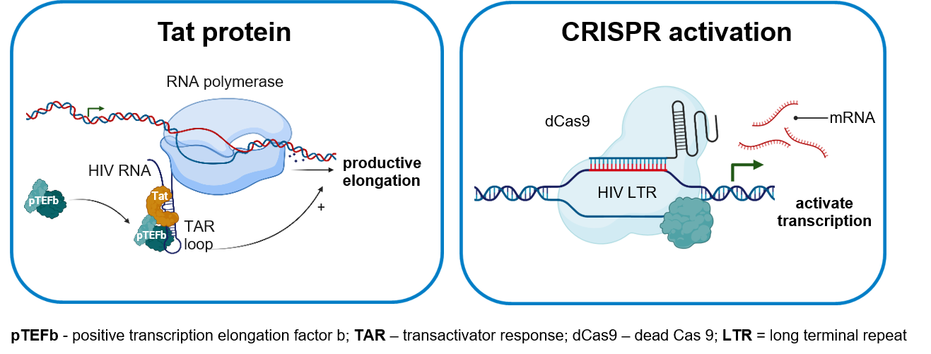
Next generation HIV-specific latency reversing agents
Both approaches are highly HIV-specific and potently reverse latency ex vivo in primary cells
Cevaal, Kan, Fisher, Moso et al., Nat Commun 2025
Notes:
We have identified two strategies.
First, using the well-established properties of HIV Tat to promote transcription elongation. Being HIV’s own protein, the potency of Tat is high, as should be it’s specificity towards HIV. This was shown recently in a study using Tat protein. However, systemic delivery of Tat protein is undesirable due to the high dose that would need to be administered in vivo, to achieve sufficient intracellular concentration. So far, one group has published attempts to use Tat-encoding mRNA, but their results indicate sub-optimal delivery, requiring co-treatment with a non-HIV-specific LRA to observe the desired effect.

Slide 6
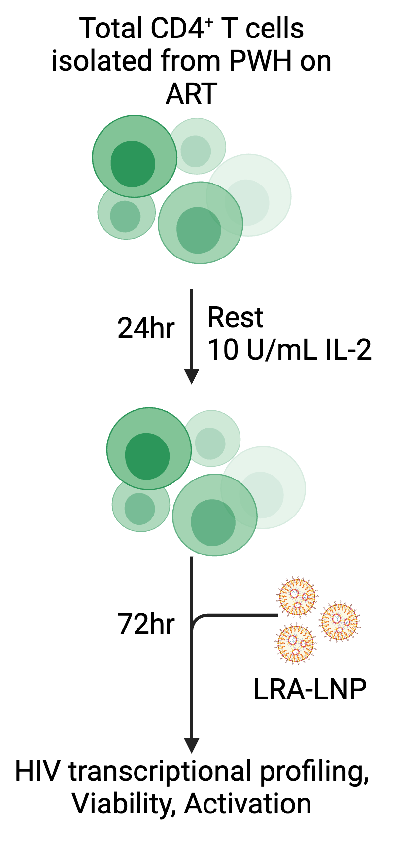
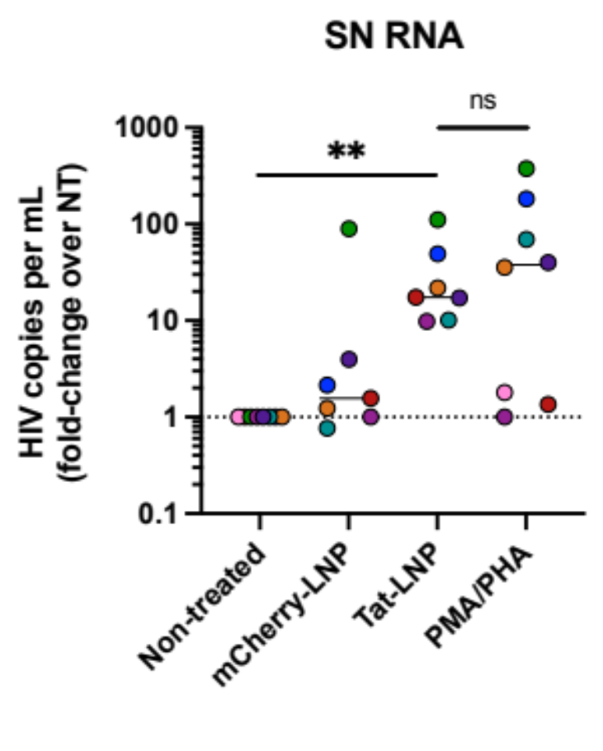
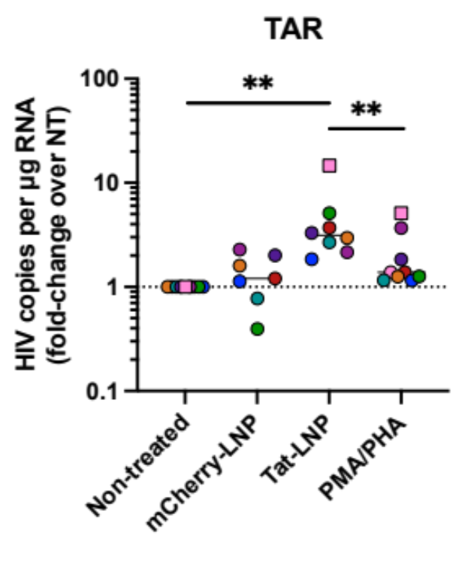
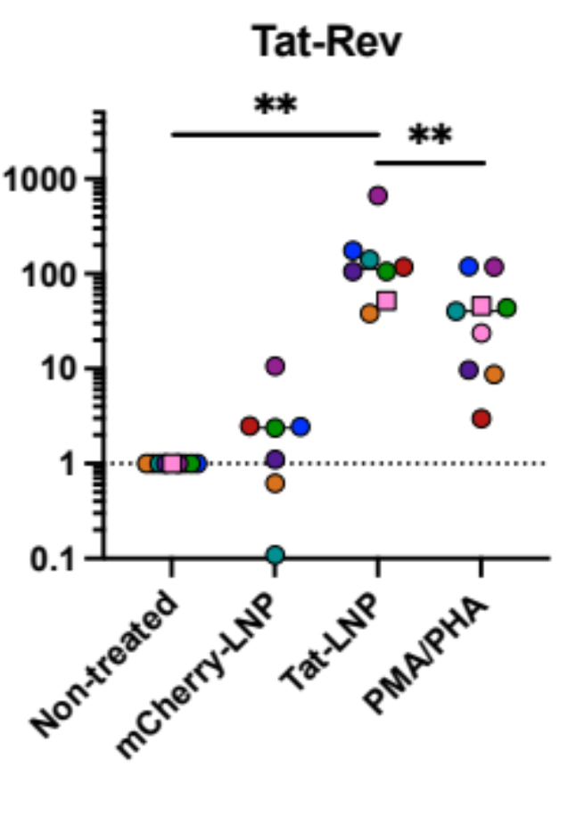
Tat mRNA LNP potently reverses latency ex vivo
Tat-Rev
HIV transcripts
Supernatant HIV RNA
n=8; lines represent median, one-tailed Wilcoxon signed-rank test; all participants infected with subtype B
Cevaal, Kan, Fisher, Moso et al., Nat Commun 2025

Slide 7
What about non-subtype B HIV?

Slide 8
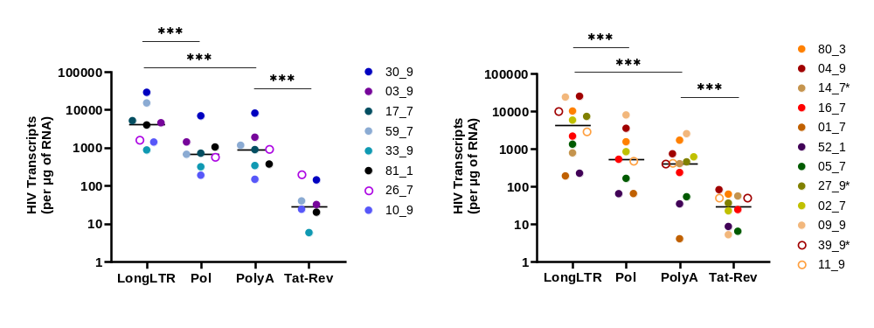
HIV subtypes A1 and D reveal transcriptional blocks analogous to subtype B
HIV subtype A1
HIV subtype D
Participants recruited from the Rakai HIV Latency Cohort (Uganda)
Moso M, Howard N, Redd A, Kanaka E et al; Ferreira AC eBiomedicine 2024

Slide 9
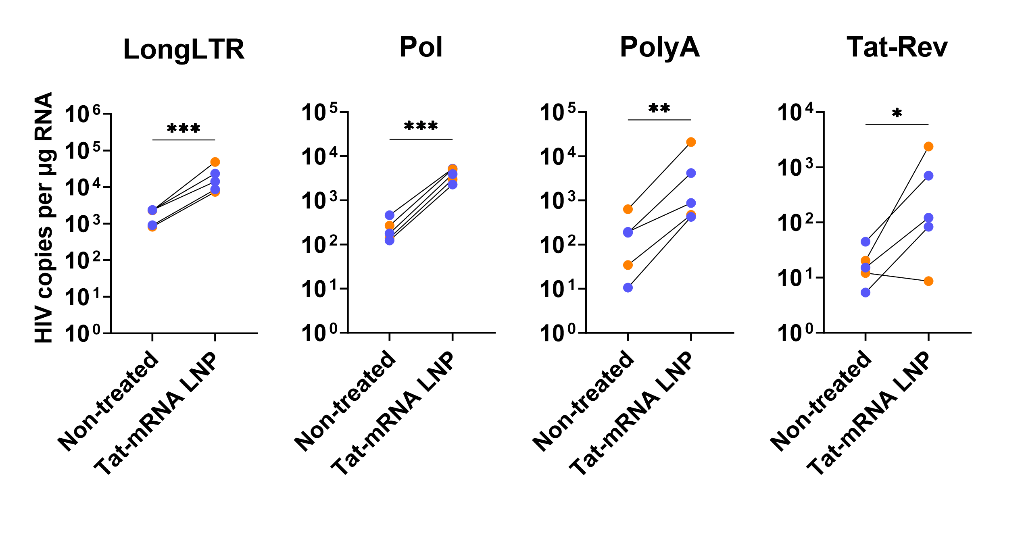
Tat mRNA LNPs also reverse latency in HIV subtypes A1 and D
HIV subtype D
HIV subtype A1
Magnitude of response lower than observed in HIV subtype B
(median increase Tat-Rev mRNA 11-fold vs 112-fold)
Moso M, Howard N, Redd A, Kanaka E et al

Slide 10
What about in vivo delivery?

Slide 11
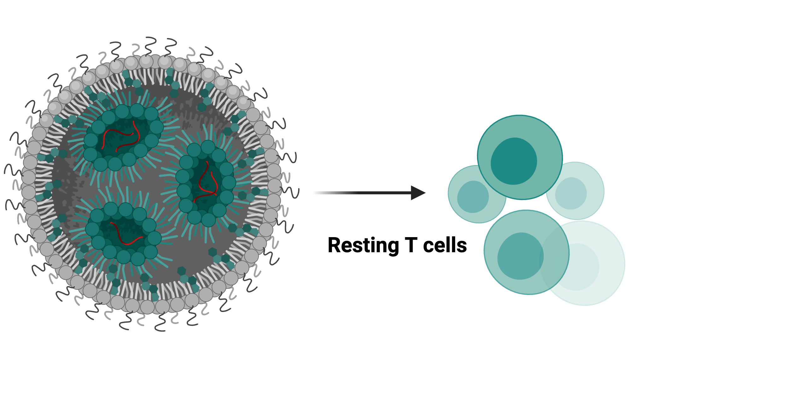
LNP X potently transfects isolated CD4+ T cells, but what about in vivo delivery?
T cells are surrounded by phagocytes that scavenge nanoparticles,
limiting the nanoparticle dose that reaches T cells in vivo

Slide 12
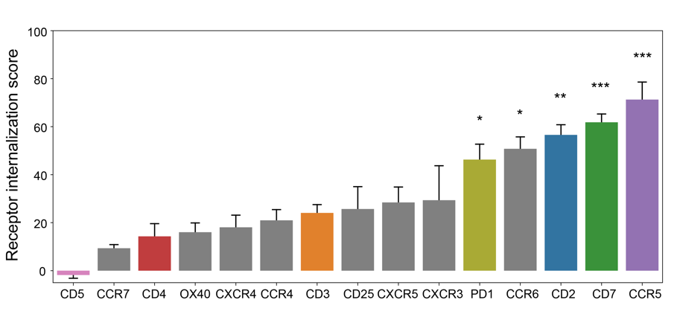
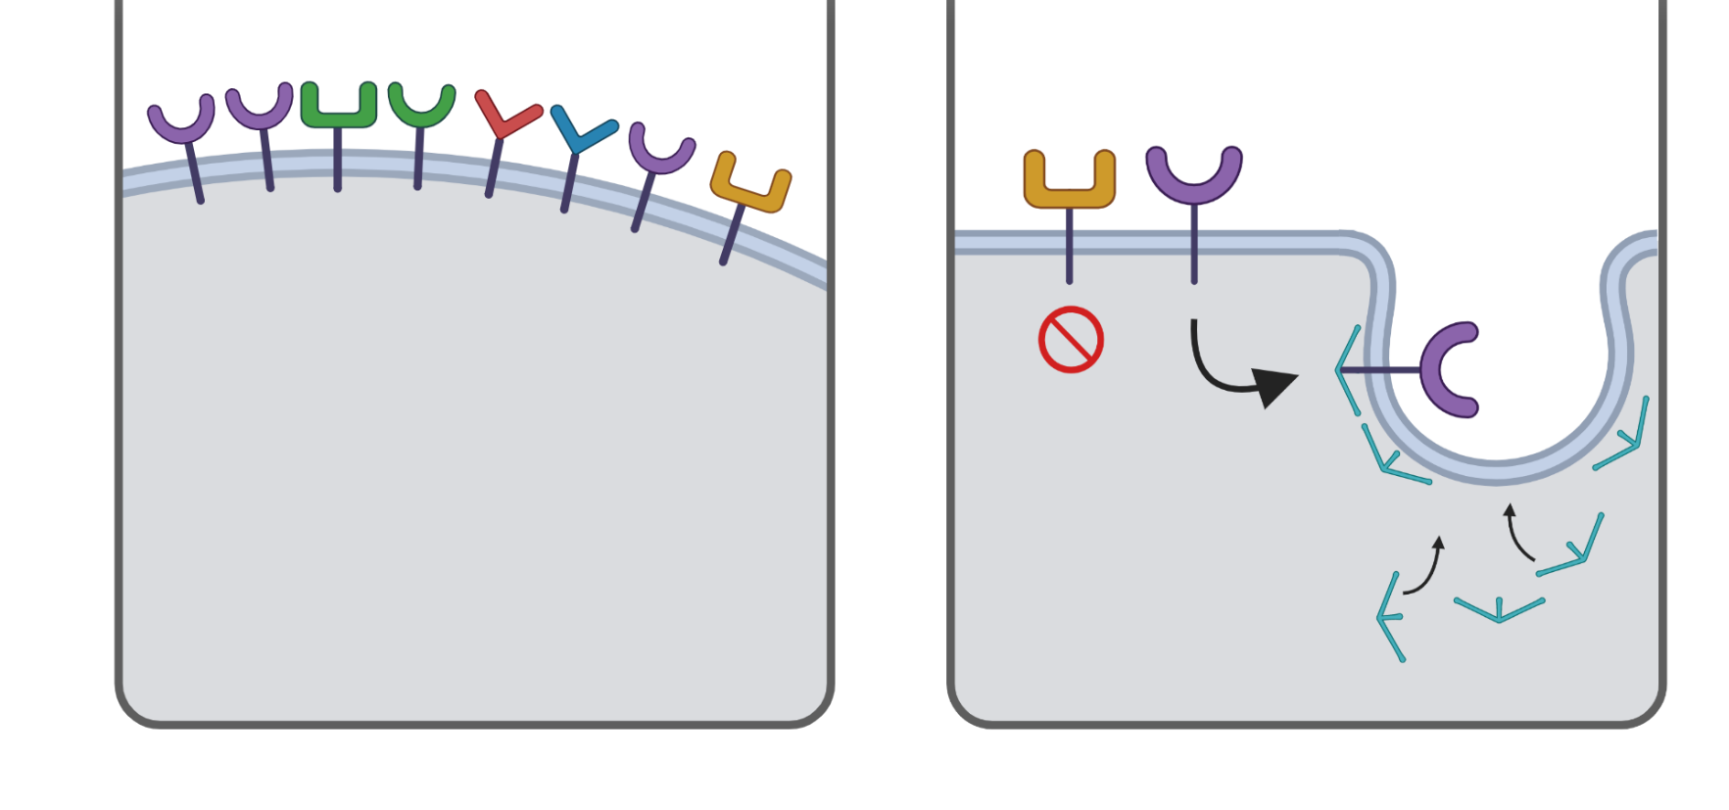
Cell-specific targeting enhanced by receptor internalization
Receptors with high or selective expression on
T cells
Receptors exhibiting high receptor-mediated endocytosis
Receptor internalisation
Library screening of potential target receptors
Target validation using different nanoparticle platforms
Identified CD2 and CD7 as promising receptor targets
Cevaal,et al., Nat Commun 2026
Notes:
Question is; which receptor to target? Or, how do we make fussy T cells eat more of our nanoparticles?
Measure receptor cycling kinetics
We hypothesized that rapidly cycling receptors would enhance nanoparticle uptake most strongly,
Which we subsequently measured using a nanoparticle internalization assay

Slide 13
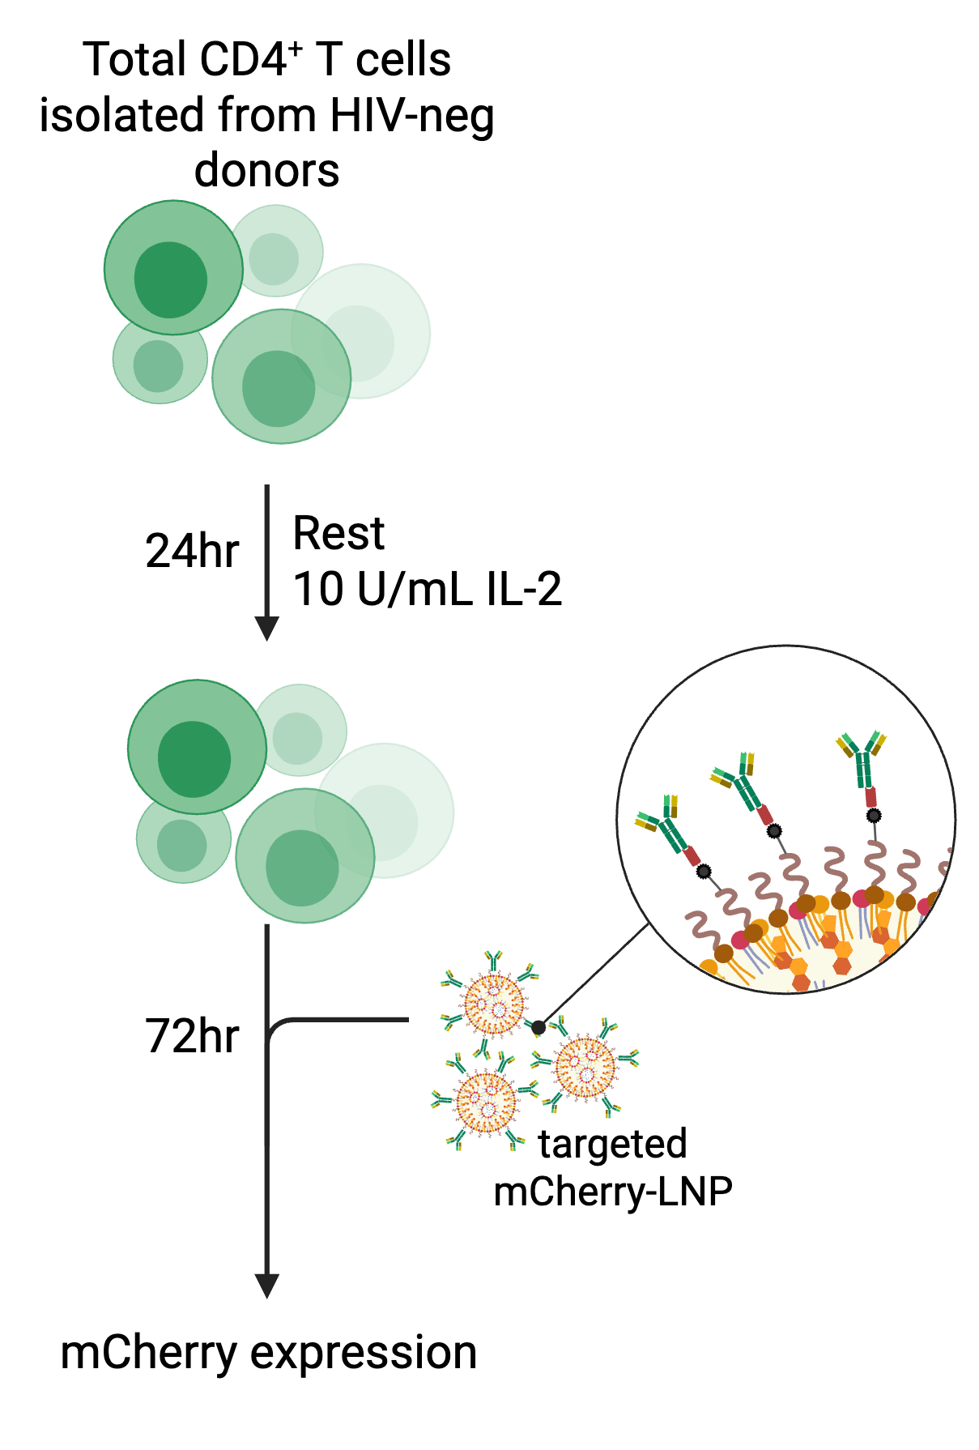
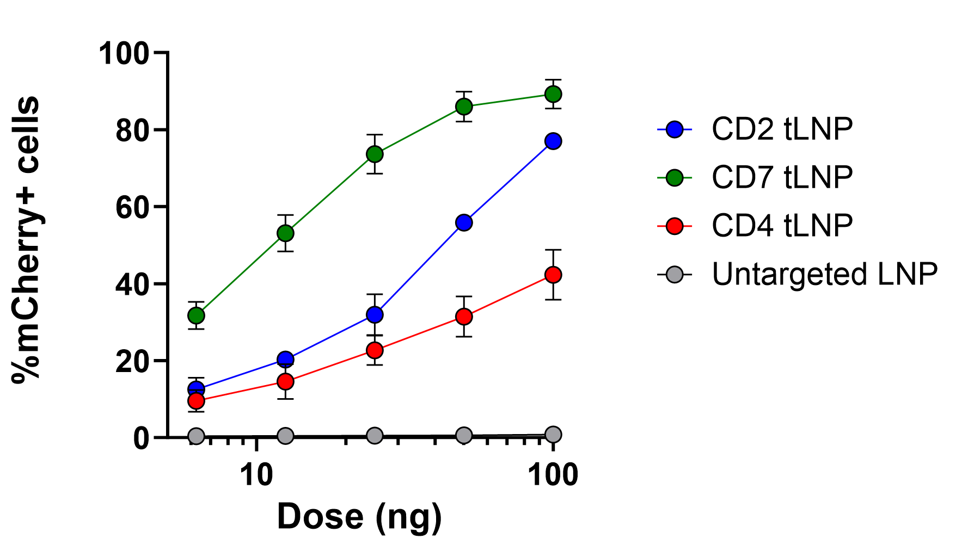
Targeting rapidly cycling receptors induces more potent mRNA delivery to resting CD4+ T cells
Transfection efficiency
1 hour
mean±SEM of n=4 donors. 1E5 cells per condition.
LNP = SM-102, DSPC, cholesterol, nanobody -DSPE-Peg 2000; Chen Nanotech 2025
Cevaal,et al., Nat Commun 2026
Notes:
Similarly, when aiming to deliver mRNA to T cells in the presence of PBMC, we see that in the absence of targeting, no transfection of T cells is observed. In contrast, functionalized LNPs show an increased association to and transfection of CD4 T cells in the presence of bystander cells.

Slide 14
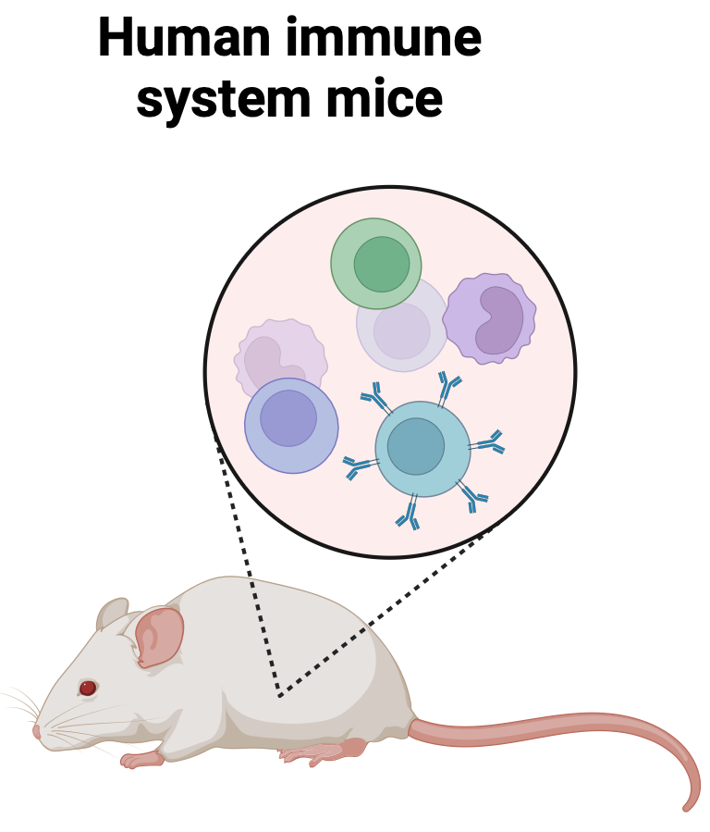
mRNA expression in in vivo in blood and spleen
Naked
isotype
CD2
CD7
%mScarlet
Blood
%mScarlet
i.v. administration
16 hr treatment
0.5 mg/kg
Spleen
n=3-4 mice per group
Cevaal,et al., Nat Commun 2026

Slide 15
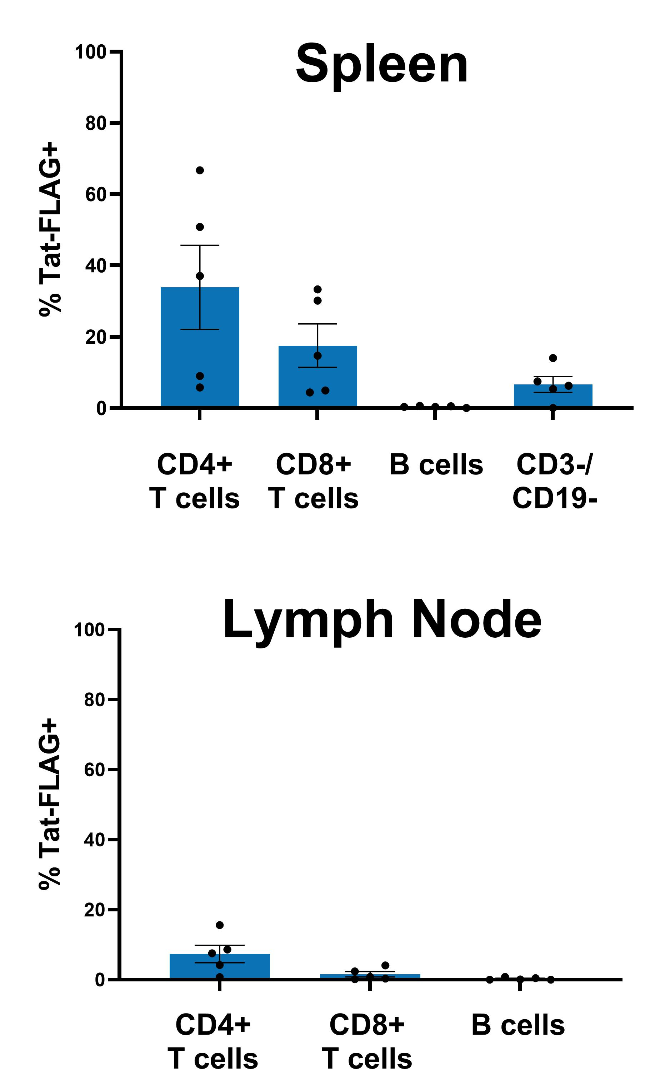
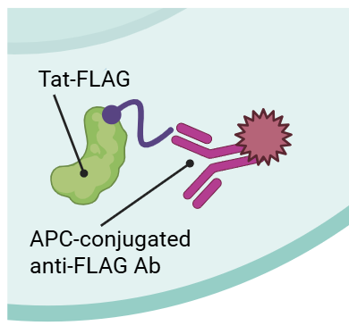
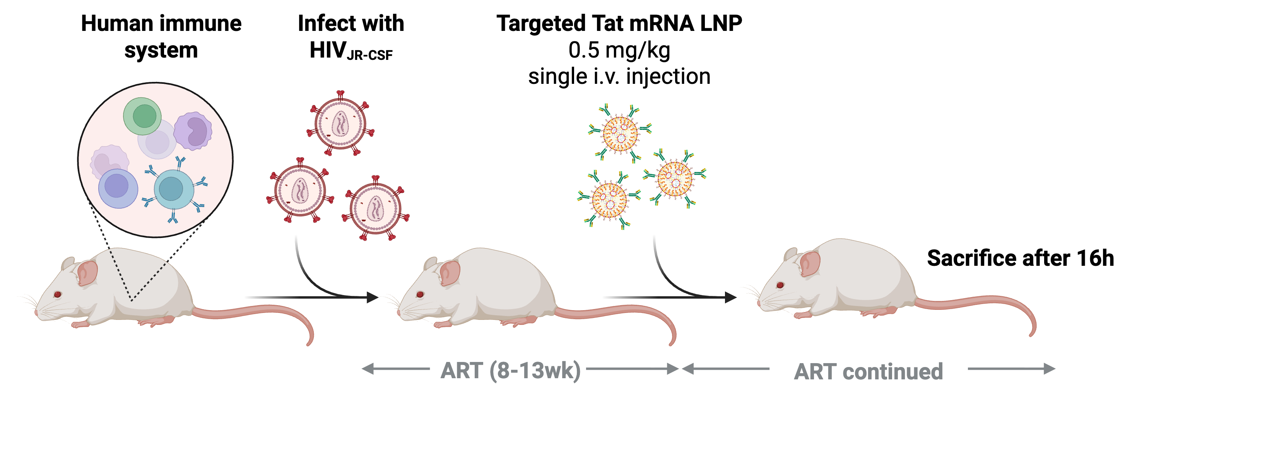
Targeted LNP induces viral reactivation in HIV-infected hu mice
CD2-targeted LNP
Tat-FLAG mRNA
0.5mg/kg IV
No clinical signs of toxicity observed from single i.v. dose
Tat-FLAG expression clearly detectable after 16h but variable between mice

Slide 16
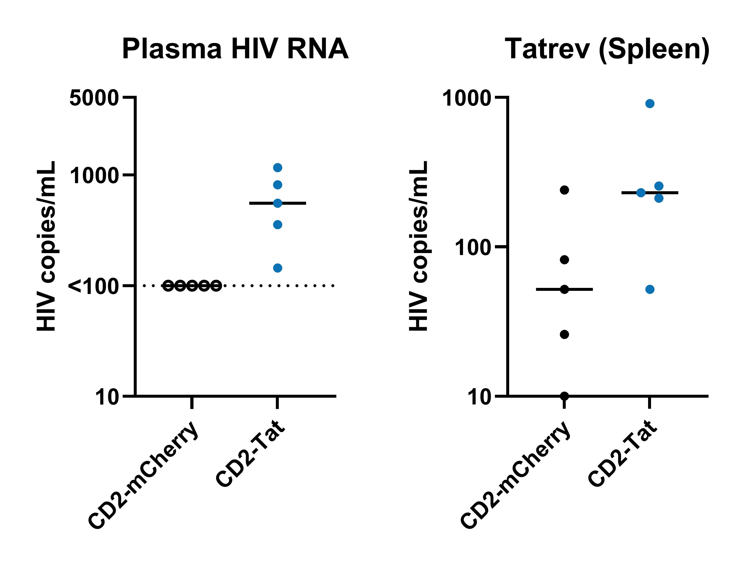
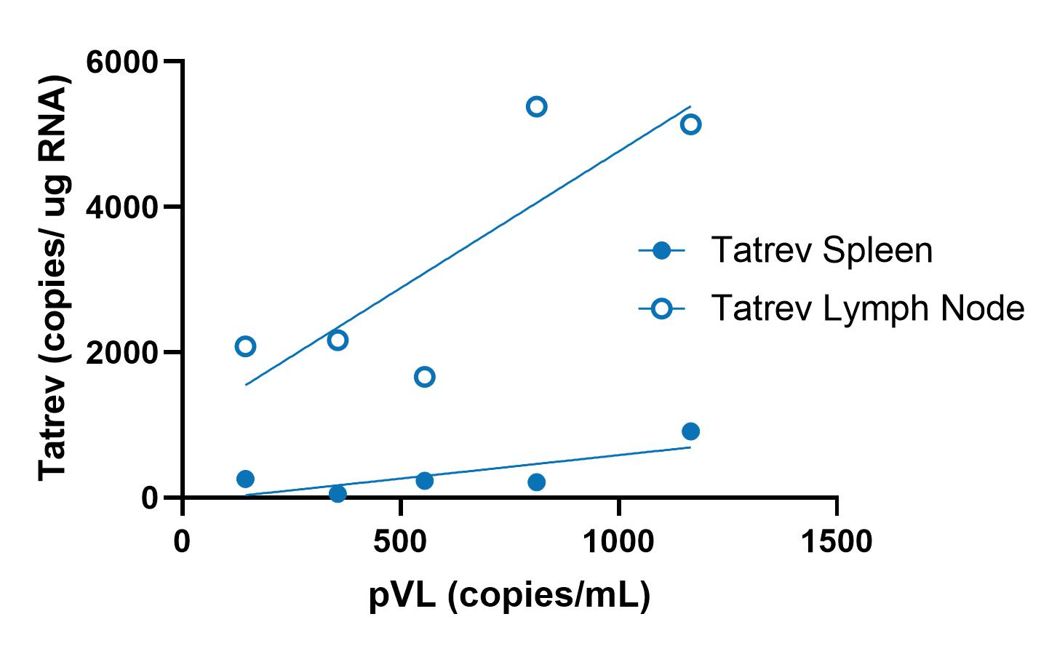
Targeted LNP with Tat mRNA induces viral reactivation in HIV-infected humanised mice

Slide 17
Summary and implications
Tat mRNA LNP is a potent latency reversing agent, and can reactivate HIV subtype B and non-subtype B ex vivo and in a humanized mouse model in vivo
Further work needed to understand the breadth of reactivation, whether Tat mRNA can target truly latently infected cells and whether there are off target effects from Tat secretion
The impact of repeated doses will be assessed in vivo to determine safety, impact on potency and if anti-drug antibodies develop
Ultimately this approach will need to be combined with an elimination agent such as immunotherapy or a pro-apoptotic drug to reduce the reservoir

Slide 18





Acknowledgements
Peter Doherty Institute
Paula Cevaal
Michael Roche
Bridget Fisher
Michael Moso
Abigail Tan
Abdalla Ali
Stan Kan
Rob De Rose
Rory Shepherd
Wei Zhao
Youry Kim
Jesslyn Ong
Sushama Telwatte
Damian Purcell
Alfred Hospital
James McMahon
Peter MacCallum Cancer Centre
Joe Trapani
Mohamed Fareh
Utrecht University
Jori Symons
WEHI
Marcel Doerflinger
Marc Pellegrini
Jan Schäfer
Le Wang
Monash University
Colin Pouton
Angus Johnston
Thomas Payne
Moore Chen
Haiyin Liu
Serena Tao
UCSF
Steven Deeks
Becky Ho
NIH / Johns Hopkins Andrew Redd
Natalie Howard
AHRI
Thumbi Ndung’u
University of Melbourne
Frank Caruso
Christina Cortez-Jugo
Denzil Furtado
Matt McKay
Ahmed Quadeer
Rakai Health Services
Edward Kankaka
Ronald Galiwango
Western University
Jessica Prodger
And the generous support from the J and M Wright Foundation

Slide 19




























CRISPR technologies and HIV cure
CRISPR-Cas 9
CRISPR-Cas 13
dCas9
Cas9
CRISPR-Cas13
HIV LTR
HIV DNA
Target mRNA
CRISPR activation
'Shock and kill'
CRISPR knock-out
Proviral excision
HIV LTR
CCR5
dCas9
Cas9
Cas13
CRISPR interference
'Block and lock'
CRISPR knock-out
Host gene excision
Moso et al. Curr Op HIV AIDS 2025

