Slide 1
CARD8 and TACKs: Implications for treatment and cure
Peter W. Hunt, MD: University of California San Francisco
Basic science and translational clinical studies on HIV cure

Slide 2
Summary FOR COMMUNITY
Key question(s): What role may TACK drugs play in HIV treatment and cure?
Key finding(s): The older drug Efavirenz (EFV) not only blocked HIV from infecting new cells, but also triggered a “self destruct” mechanism in virus-expressing cells (Targeted Activation of Cell Killing).
  Newer TACKs on horizon have the potential not just to reduce the “active HIV reservoir”, but also inflammation and aging complications in people with HIV.
Why is this important?: Reducing the active reservoir size might help make immune-based cure strategies work better, and if they reduce inflammation, they might also reduce risk of infections, cancer, and other aging-related diseases.
How is this related to cure? TACK drugs directly kill cells that make HIV proteins, potentially giving the immune system a fighting chance of controlling it.
Why should we be excited (or not) about this?: Since EFV has modest TACK activity, we may be able to learn about this mechanism even before new drugs are developed.

Slide 3
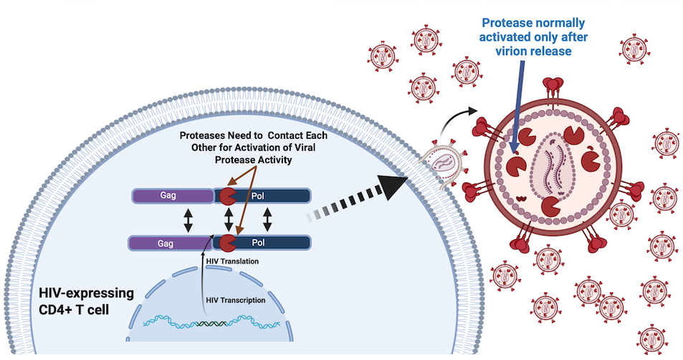
HIV Protease Normally Gets Activated After HIV Virion is Released from the Cell

Slide 4
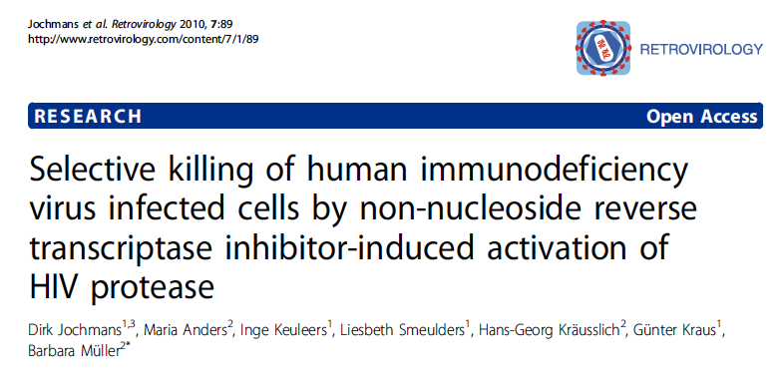
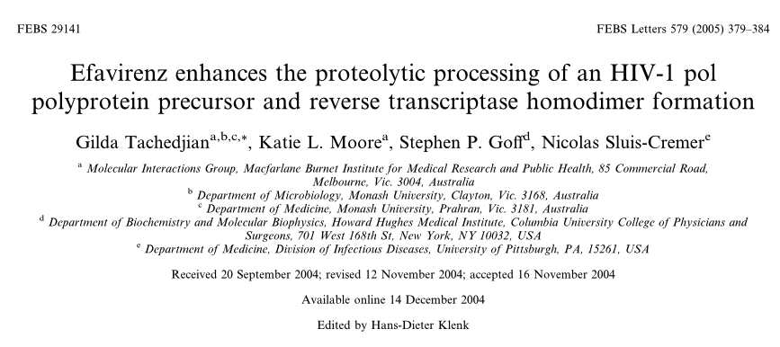
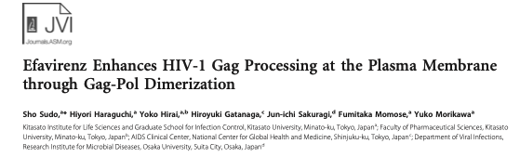
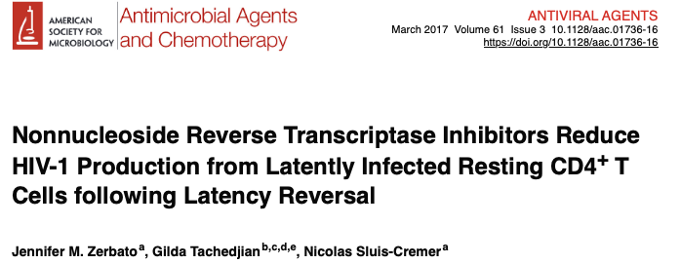
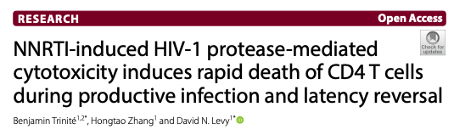
Early Important Observations that Flew Beneath the Radar…
2010: EFV-induced PR activation leads to cell death
2005-13: EFV induces premature
HIV protease activation
2017-19: EFV+RPV reduce virus expression from cells after latency reversal

Slide 5
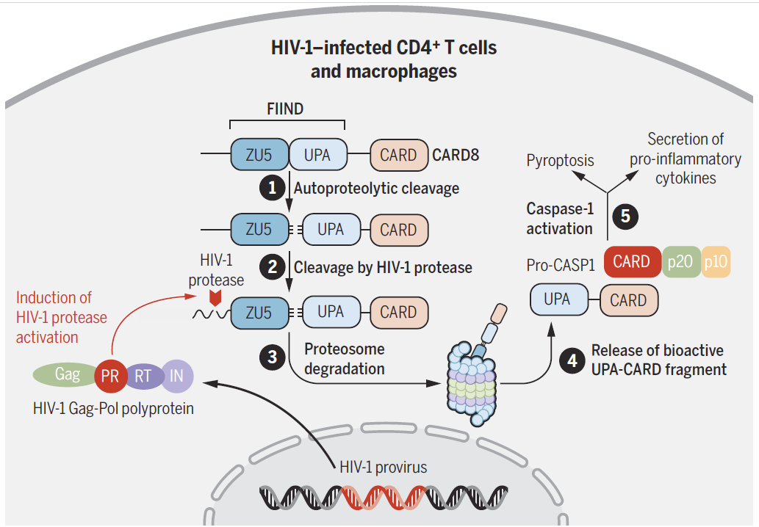
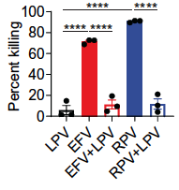
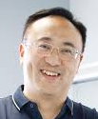
Targeted Activation of Cell Killing (TACKs): New Tools to Kill HIV-expressing Cells
Wang/Shan, Science 2021
Liang Shan, PhD
LPV: Lopinavir; EFV: efavirenz; RPV: rilpivirine
See also: Tachedjian, FEBS Lett, 2005; Jochmans, Retrovirol, 2010; Sudo, J Virol, 2013; Zerbato, AAC 2017 ; Trinite, Retrovirol, 2019

Slide 6
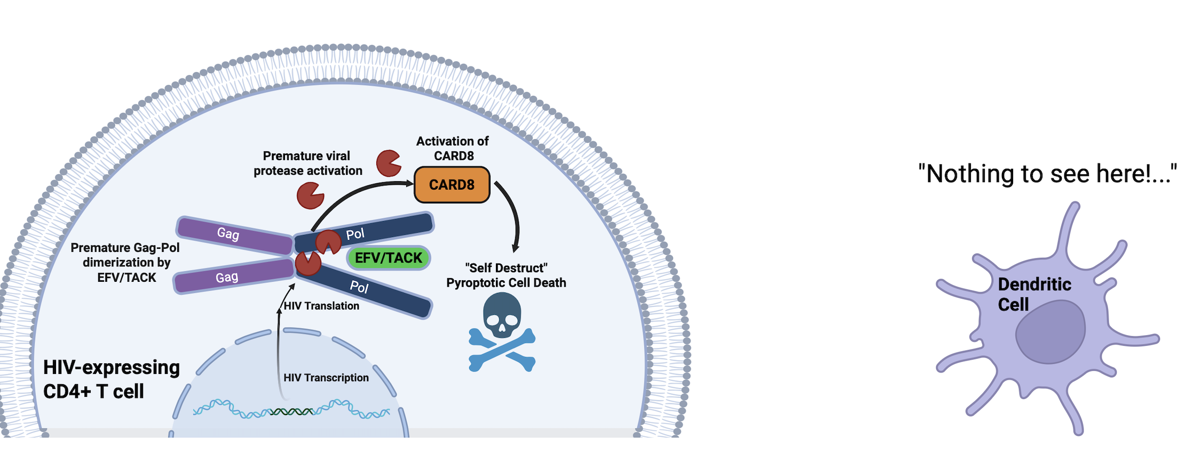
EFV and Other TACK Drugs Induce Premature Dimerization of Gag-Pol, Activating Protease and CARD8 “Self Destruct” Mechanism
Targeted Activation of
Cell
Killing
Based on: Wang/Shan, Science 2021
(see also: Balibar, Sci Transl Med, 2023)

Slide 7
EFV and RPV Are the Only Currently Approved NNRTI’s with TACK Activity
(but more are on the way!)
NNRTI | TACK Activity?
Efavirenz (EFV) | ✓
Rilpivirine (RPV) | ✓
Nevirapine (NVP) | X
Etravirine (ETR) | X
Doravirine (DOR) | X
NNRTI’s in development have >10-fold greater TACK activity…
Based on: Wang/Shan, Science 2021
(see also: Balibar, Sci Transl Med, 2023)

Slide 8
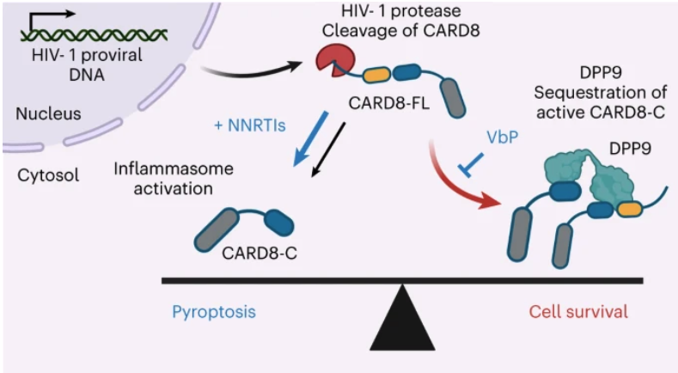
DPP9 Counteracts CARD8-mediated Killing
DPP9 sequesters CARD8, preventing pyroptosis, and allowing for HIV-expressing cell survival
DPP9 is upregulated in proliferating cells
Take Home: DPP9 inhibitors (e.g., ValboroPro, VbP, talabostat) may need to be added to TACKs to kill proliferating cells making HIV
VbP in cancer trials causes cytokine release syndrome…
Clark/Shan, Nature Chem Biol, 2023

Slide 9
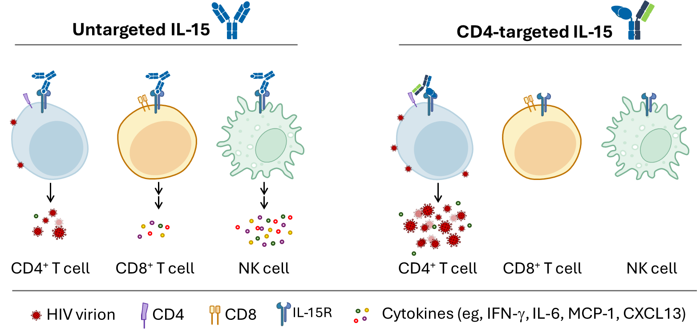
Cure Approach: Combine Latency Reversal + TACK
Maximize “Kick and Kill” for Reservoir Reduction
Caveats:
Unlikely that this approach will clear ALL replication-competent viruses from the reservoir
Will likely need to be paired with an immunologic intervention to “mop up” what is left.
Important: IL-15 induces CD4 proliferation, which would also be expected to upregulate DPP9, decreasing “the kill.”
  May need a DPP9 antagonist to overcome this problem (toxicity concerns)
Potent Latency Reversal with Less Inflammation when
Targeting IL-15 Agonist to CD4+ T cells
Randhawa/Murry #137; Ho et al, #405, CROI 2026

Slide 10
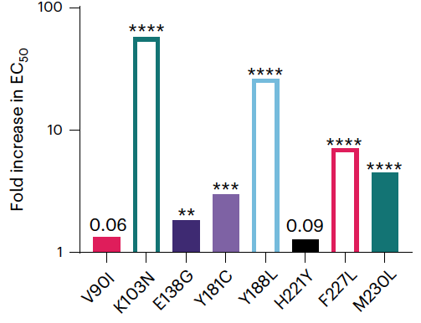
NNRTI Resistance Mutations
Compromise EFV TACK Activity
Open rectangles indicate insufficient killing to even estimate an EC50 reliably.
Bottom Line: Most major NNRTI resistance mutations also compromise TACK activity.
Clark/Shan, Nature Chem Biol, 2023

Slide 11
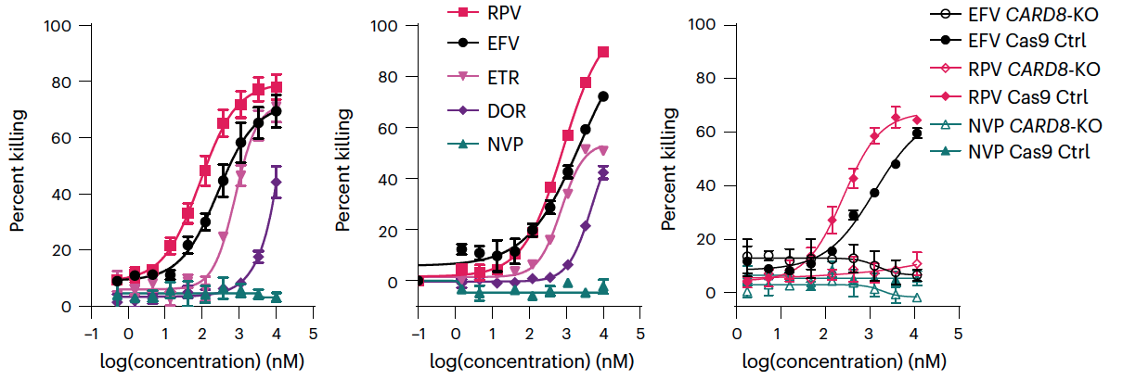
EFV and RPV Have Moderate TACK Activity in Vitro
But not DOR, or NVP
Primary CD4 T cells
Seems unlikely that EFV or RPV concentrations would be high enough in vivo to observe substantial TACK activity…
*RPV
pbmc
*EFV
pbmc
*EFV
But BOTH these drugs concentrate in cells over time…
  After 14d of EFV, PBMC concentrations are ~6,300 nM (3.8 on log₁₀ scale) [Burhenne, AAC, 2010]
  With chronic RPV use, median PBMC concentration is ~3,060 nM (3.5 log₁₀) [Ferrara, J Clin Pharm Thera, 2022]
*RPV
*RPV: Typical free plasma concentration of rilpivirine in vivo (1nM = 0 on log₁₀ scale)
*EFV: Typical free plasma concentration of efavirenz in vivo (30nM = 1.5 on log₁₀ scale)
Clark/Shan, Nature Chem Biol, 2023
RPV: rilpivirine; EFV: efavirenz; ETR: etravirine; DOR: doravirine; NVP: nevirapine

Slide 12
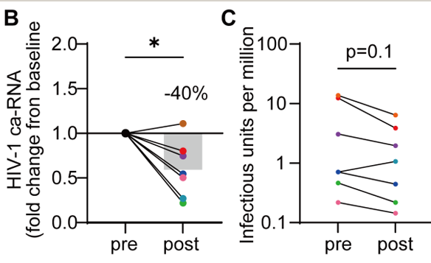
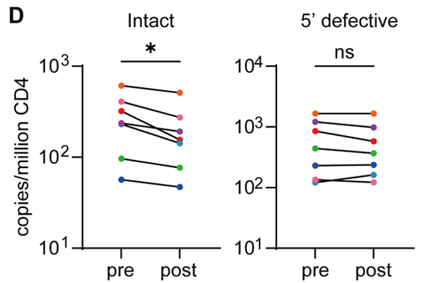
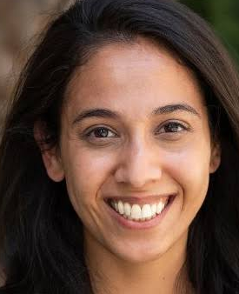
Efavirenz Intensification Appears to Reduce the Active HIV Reservoir in Vivo
EFV 600mg added to suppressive ART in 7 participants for 4 months…
Priya Pal, MD PhD
Pal, CROI 2026, Abstract 383
Notes:
CARD8 Activation by Efavirenz Intensification for Reservoir Reduction
Priya Pal1, Gregory Laird2, Michael J. Peluso3, Steven Deeks3, Leyao Wang4
,
Rachel Presti1, Liang Shan4
1Washington University in St Louis, St Louis, MO, USA, 2The Johns Hopkins University School of
Medicine, Baltimore, MD, USA, 3University of California San Francisco, San Francisco, CA, USA,
4Shenzhen Medical Academy of Research and Translation, Shenzhen, China
Background: HIV-1 persists primarily in memory CD4+ T cells. The CARD8
inflammasome is an innate immune sensor which can be activated by viral
protease activity to induce pyroptosis in HIV-1-infected cells. Our recent studies
demonstrate that some NNRTIs including Efavirenz (EFV) drive intracellular
Gag-Pol dimerization, which then forces premature viral protease activation.
Induction of this pathway in people living with HIV-1 (PLWH) offers an attractive
solution for targeted HIV-1 reservoir reduction.
Methods: To assess the feasibility of this approach, we conducted a prospective
open-label single arm trial of EFV intensification of a baseline HIV antiretroviral
therapy regimen for HIV-1 reservoir reduction. Participants with no documented
EFV resistance were enrolled and maintained on their baseline antiretroviral
regimen with the addition of EFV for 4-5months. No latency reversal agents
were used in this study. Primary safety end points included unsolicited
systemic adverse events, lab abnormalities and mood as measured by PHQ9
measurements. Blood samples were analyzed pre and post intensification by
orthogonal measures of HIV reservoir including the quantitative viral outgrowth
assay (QVOA), the intact proviral DNA assay (IPDA), and cell associated RNA
(ca-RNA).
Results: EFV intensification did not drive immune activation or perturbation
of T cell homeostasis. When analyzing blood CD4+ T cells before and after EFV
intensification, we observed a unified reduction in IUPM quantified by QVOA,
in unspliced cell-associated viral RNA by qPCR, and in intact proviral DNA by
IPDA. Observed decay rates of intact proviruses during EFV intensification were
compared to those reported from longitudinal observational studies, and
accelerated viral reservoir decay was observed with EFV intensification.
Conclusions: Over the course of four months of EFV intensification, we
observed a rapid reduction in the size of HIV-1 latent reservoir in all study
participants. The impact on the viral reservoir in this study is dependent on
intermittent and spontaneous production of HIV-1 proteins from a fraction of
viral reservoirs and could be further improved when co-administered with viral
latency reversal agents. This work underscores the importance of developing
more potent, tolerable therapeutics that harness the CARD8 inflammasome for
HIV reservoir reduction.

Slide 13
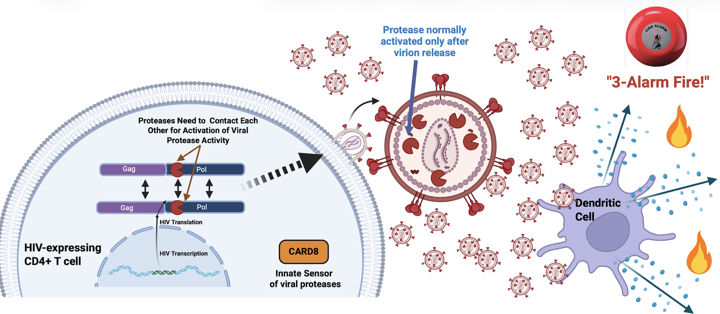
Virus Release into the Tissue Environment is Quite Inflammatory…

Slide 14
And When There Is No Virus in the Neighborhood, No Fire Alarms are Rung!
TACKs kill the HIV-expressing cell even before the
immune system can “see” it!

Slide 15
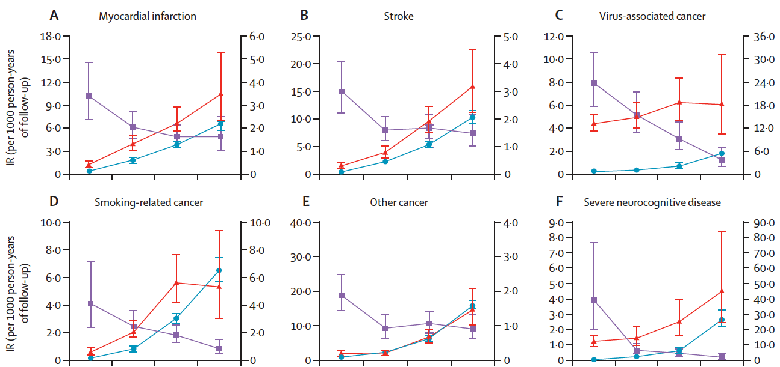
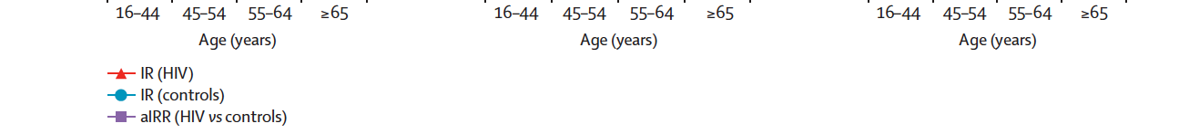
Virus-Associated Cancer Increased to a Far Greater Degree than Other Comorbidities in Treated HIV
(Population-based study in Denmark)
Myocardial Infarction
*Virus-associated Cancer
50% to 3-fold
higher in HIV
3- to 24-fold
higher in HIV
aIRR (HIV vs controls)
aIRR (HIV vs controls)
No increase in breast, colon, prostate cancer: “cold tumors,” unresponsive to anti-PD1, etc.
aIRR= adjusted incidence rate ratio in HIV+ vs HIV- (adj for sex, calendar year, and national origin)
*HPV: cervical, anal, head and neck cancer; HBV/HCV: liver cancer; EBV: lymphoma; KSHV: Kaposi’s sarcoma
Rasmussen et al, Lancet HIV 2015

Slide 16
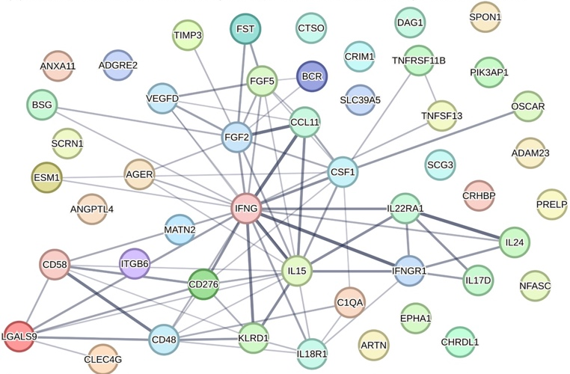
Immunoregulatory pathways more predictive of mortality in PWH than in general population
48 proteins either uniquely predictive of mortality in PWH or had an aHR ≥50% in PWH vs. UKB
The largest cluster comprised immunoregulatory proteins linked to suppressing T, NK, and myeloid cell activation or pro-fibrotic and endothelial cell/ECM regulatory processes
Schnittman CROI 2024, #143

Slide 17

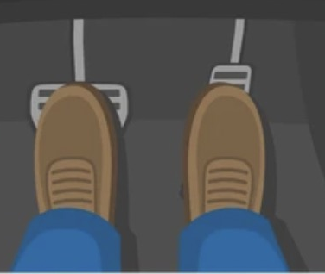
Immunoregulatory pathways appear key in treated HIV
Maybe the ”brake” is key to understanding disease risk in HIV.
  May explain why infection-related cancers and other “hot” tumors are increased?
  Intervening directly on the brake is likely to be harmful (whack a mole)…
  But understanding the underlying drivers of these immunoregulatory pathways would help identify interventional targets.
  Is the active HIV reservoir driving this?
Immune Regulation
Inflammation
Schnittman CROI 2024, #143
Notes:
The current paradigm is that inflammation (the accelerator in this car analogy) is increased and predicts mortality in people with HIV. We identified numerous pro-inflammatory proteins associated with mortality not only in HIV, but also in the general population. However, when directly comparing these populations, we observed that immunoregulatory proteins (the brake pedal) rather than pro-inflammatory ones were preferentially associated with mortality risk in the context of HIV.
CLICK
The excess mortality risk in HIV may not be simply about stomping on the accelerator, but rather by also slamming on the brakes. We have previously published that even in those who start ART very early and remain suppressed, immunoregulatory rather than inflammatory pathways remain persistently elevated compared to HIV-negative controls. These findings taken together may be especially relevant for cancer or infections, for which people with HIV are known to be at an even greater risk for compared to other diseases.
CLICK
And ultimately, we are planning mendelian randomization in CNICS to distinguish if these pathways are truly causal.

Slide 18
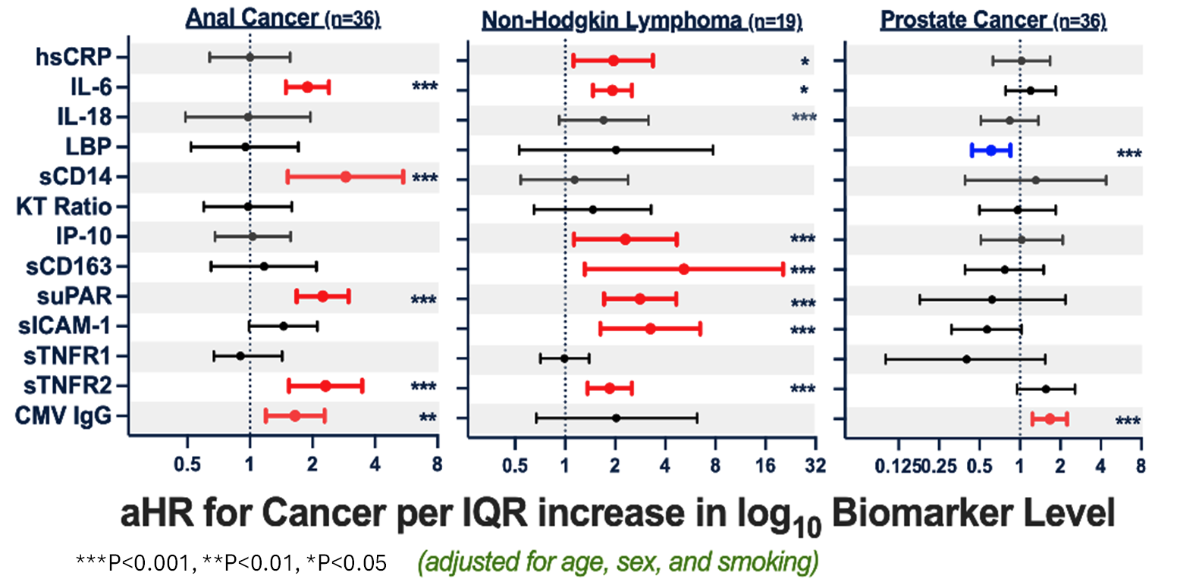
Common Inflammatory Signature for
Virus-associated Cancers
Virus-associated Cancers
“Cold Tumor”
Schnittman CROI 2022, #552

Slide 19
EFV Use Associated with Lower Biomarker Levels Linked to Anal CA and NHL Risk
*
*Castilho, NA-ACCORD, JNCI, 2022

Slide 20
Conclusions
TACKs kill HIV-expressing cells, potentially before the immune system recognizes virus release.
This may help reduce the HIV reservoir, particularly with potent latency reversal.
DPP9 inhibition may be required to get full TACK killing in proliferating cells.
TACKs have potential to also reduce inflammation and morbidity
EFV (and possibly RPV?) might have some activity in vivo
Newer drugs with even more potency are in development.

Slide 21
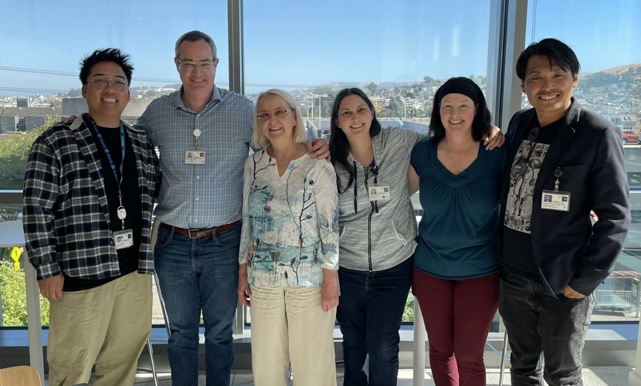


Acknowledgements
JHU
Francesco Simonetti
Richard Moore
U Toronto
Colin Kovacs
Mario Ostrowski
WUSTL:
Priya Pal
Marilia Pinzone
Rachel Presti
Liang Shan
Hunt Lab
Gabby Ambayec
Noah Aquino
Gaby Beck-Engeser
Sam Schnittman
Rebecca Abelman
Louise Swainson
Vanessa York
Alex Mooney
Yoshi Fukazawa
UCSF
Steven Deeks
Jeffrey Martin
Rebecca Hoh
Priscilla Hsue
Carl Grunfeld
Judy Shigenaga
Fran Aweeka
Amelia Deitchman
David Glidden
Case Western Reserve
Mike Freeman
Michael Lederman
Harvard
Ken Mayer
Ahmed Tawakol
UAB
Mike Saag
UCSD
Edward Lalo Cachay
Sara Gianella
Scott Letendre
UNC
Joe Eron
Sonia Napravonik
U. Washington
Heidi Crane
Robin Nance
Susan Heckbert
David Tirschwell
Mari Kitahata
R01 AI155680 R01HL152957
R56HL160457 R01AI110271
R01DK112304 K24AI145806
UM1 1AI126611 Roche, Inc.

