Slide 1

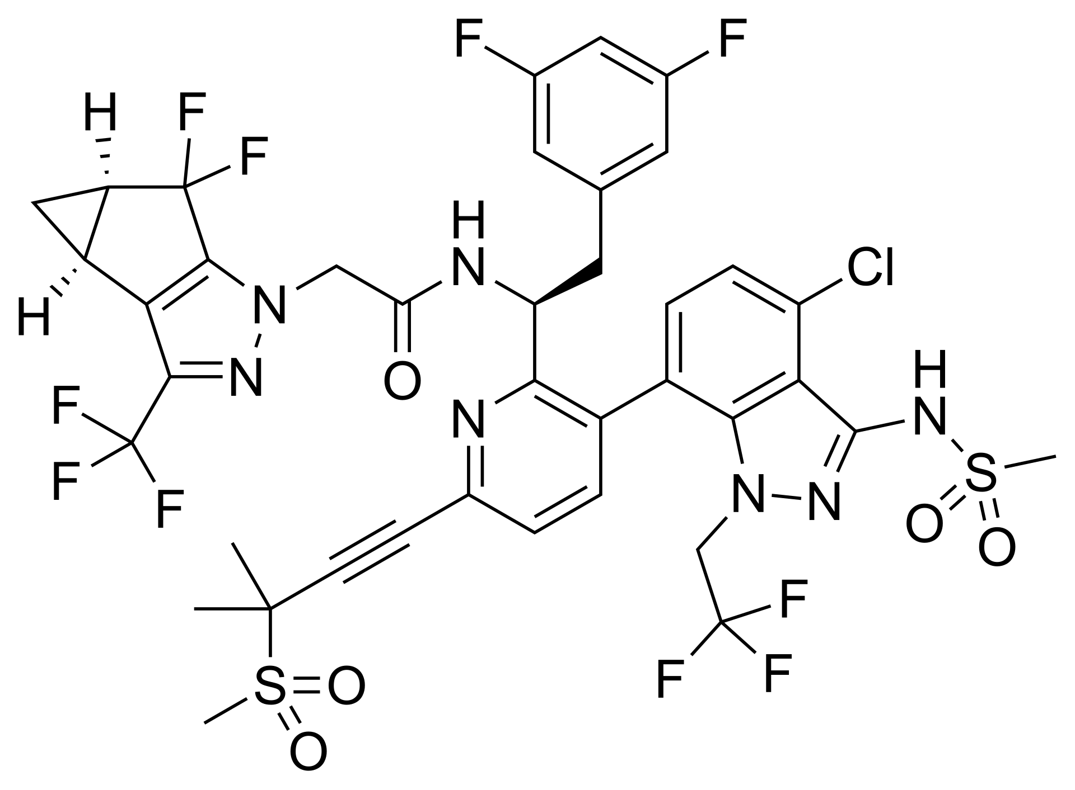

Capsid inhibitor Lenacapavir accelerates degradation of HIV-1 Gag and increases diversity of antigen presentation following latency reversal
Daan Roovers MSc.
Team Goffinet, Dept. of Tropical Disease Biology, LSTM
26.07.2026
daan.roovers@lstmed.ac.uk
Notes:
Present my project about new HIV drug LEN and the effect it may have on immune-mediated killing

Slide 2
Problem
HIV-infected cells are not killed by the immune system
Objective
Study the effect of Lenacapavir on immune killing of HIV+ cells
Finding
Lenacapavir accelerates breakdown of viral protein and improves presentation to ‘killer’ cells

Slide 3
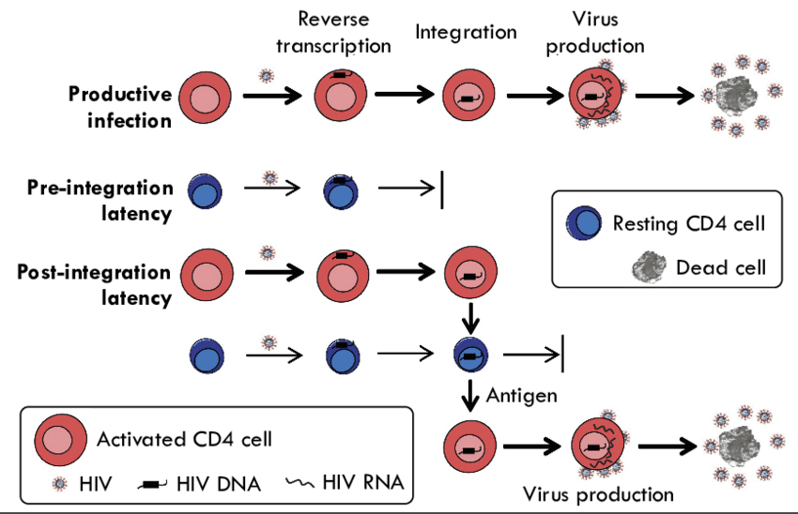
HIV-1 evades immune-clearance during latent infection
reverse transcription
virus production
integration
productive infection
latent infection
latency reversal
adapted from Shan, BioEssays 2013
Notes:
During natural infection, HIV integrates into host genome
Most cells die due to immune clearance/cytopathic effect
Some infected cells survive long enough to revert to resting state (latency/no viral transcription)
Latency: allows HIV to avoid immune detection > obstacle for achieving a cure
Effort into latency reversal + making cells susceptible to immune clearance:
(for example: increasing surface presentation of viral protein + MHC-I antigen during latency reversal)

Slide 4
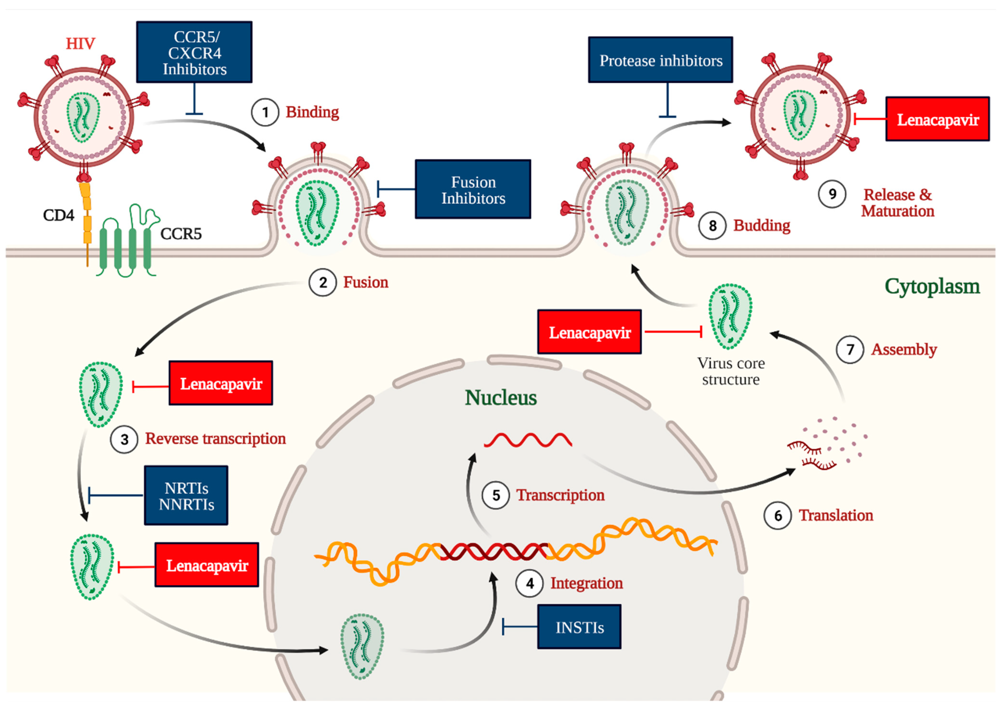
Capsid inhibitor Lenacapavir inhibits HIV-1 infection
Lenacapavir
adapted from
Dzinamarira et al., MDPI 2023
Notes:
LEN = capsid inhibitor (approved 2024)
Sub-nM dose: efficiently blocks nuclear import and integration and formation of infectious particles
Notably: p24 lowers capsid levels in cell
> We wanted to know whether LEN affects immune visibility of latent cells

Slide 5
Objective
Study the effect of LEN on immune-mediated killing
Approach
Assess the effect of LEN on the dynamics of latency reversal
Quantify the effect of LEN on antigen presentation
Perform CTL killing assays +-LEN
Notes:
Because: If LEN increases presentation of viral antigen, may have consequence for cure strategies for HIV

Slide 6
Objective
Study the effect of LEN on immune-mediated killing
Approach
Assess the effect of LEN on the dynamics of latency reversal
Quantify the effect of LEN on antigen presentation
Perform CTL killing assays +-LEN
Notes:
First: study effect of LEN on latent infection/latency reversal...

Slide 7
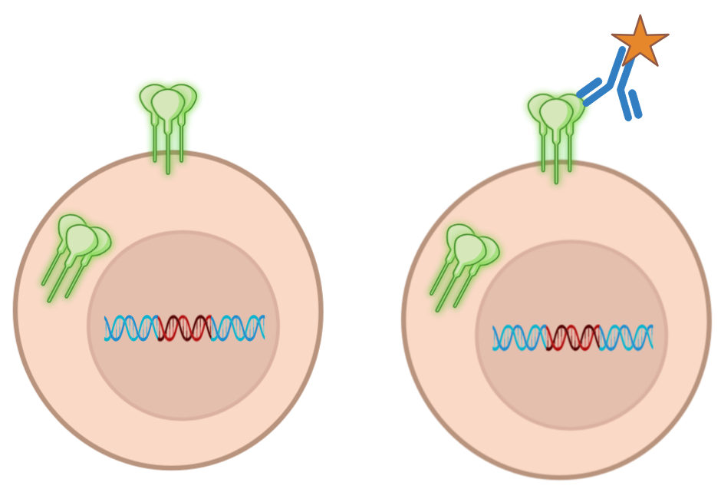
Latent HIV-1-infected Jurkat reporter T-cell line (JLEG2)
EnvGFP
JLEG2 T-cell line
Notes:
3:00
... using latent Jurkat/T-cell based cell line with GFP in Env
Each cell full length provirus
>> Env reflected by GFP

Slide 8
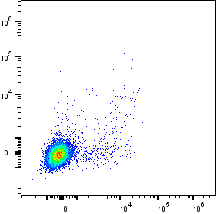
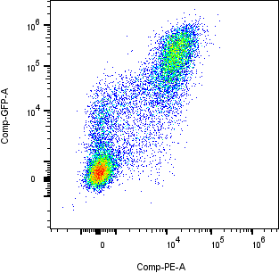
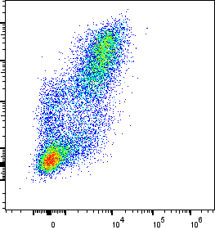
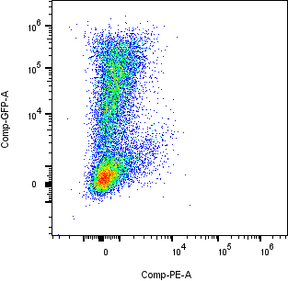
LEN specifically reduces p24CA levels upon latency reversal
50nM pano
mock
DMSO
5nM LEN
50nM LEN
50nM pano
10⁶
3.0%
50.1%
55.3%
15.2%
EnvGFP
10³
0
10⁻³
10⁻³
10⁶
10⁶
10⁶
10⁶
0
10³
10⁻³
0
10³
10⁻³
0
10³
10⁻³
0
10³
p24 (PE)
p24 (PE)
Notes:
Reversed latency with LRA, HDACi pano: express p24+Env
pretreat LEN: lower p24 levels upon latency reversal

Slide 9
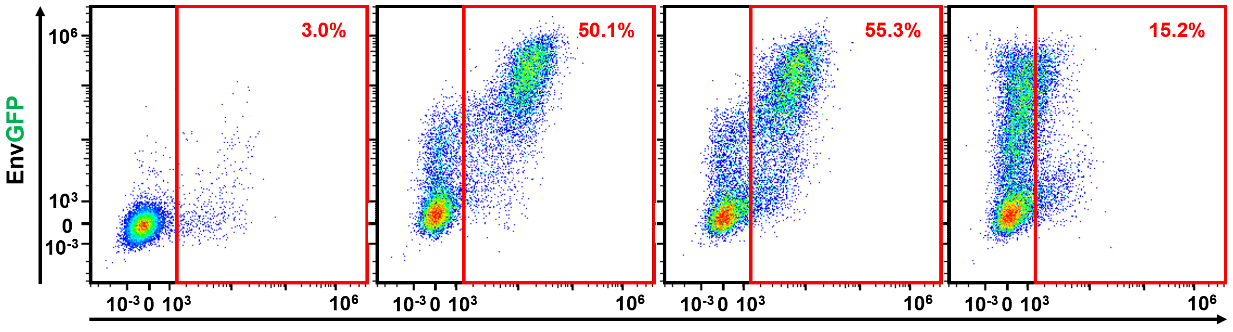
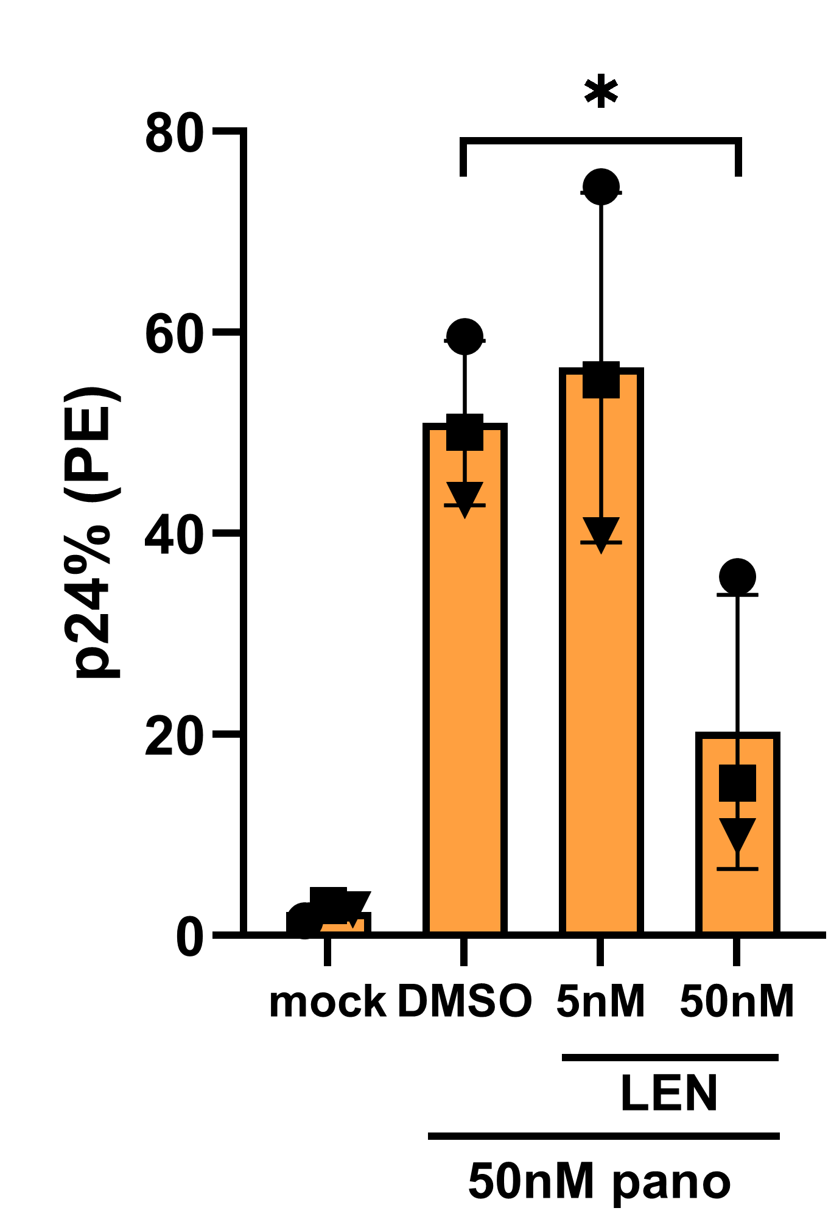
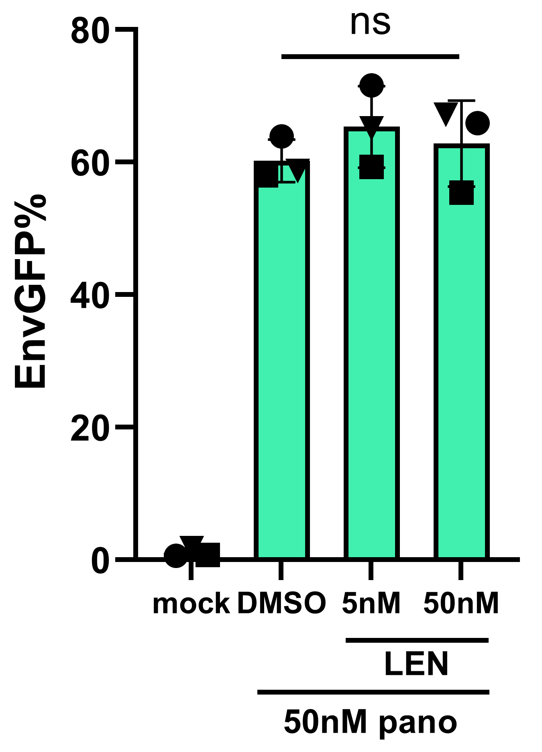
LEN specifically reduces p24CA levels upon latency reversal
mock
pano
5nM LEN + pano
50nM LEN + pano
p24 (PE)
Notes:
Found that effect is specific to p24
not latency reversal in general (as evidenced by Env)

Slide 10
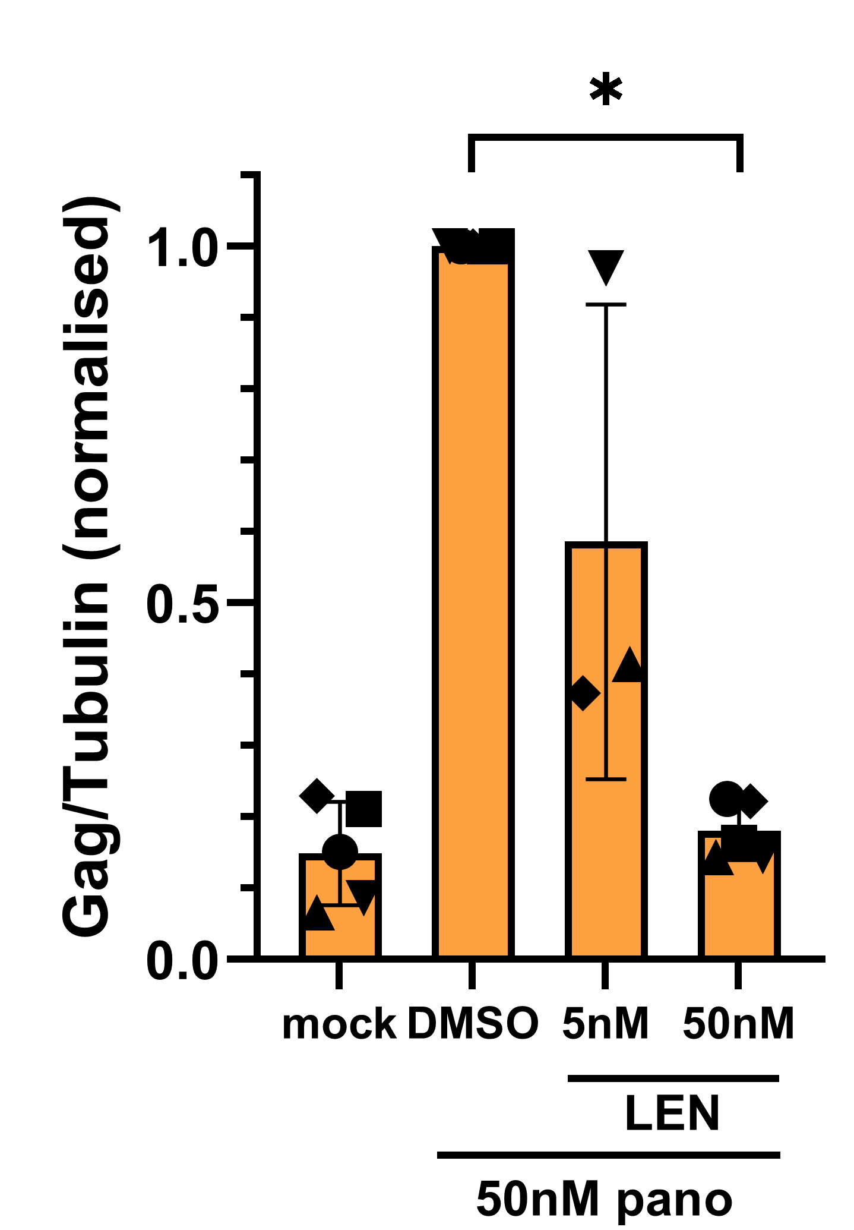
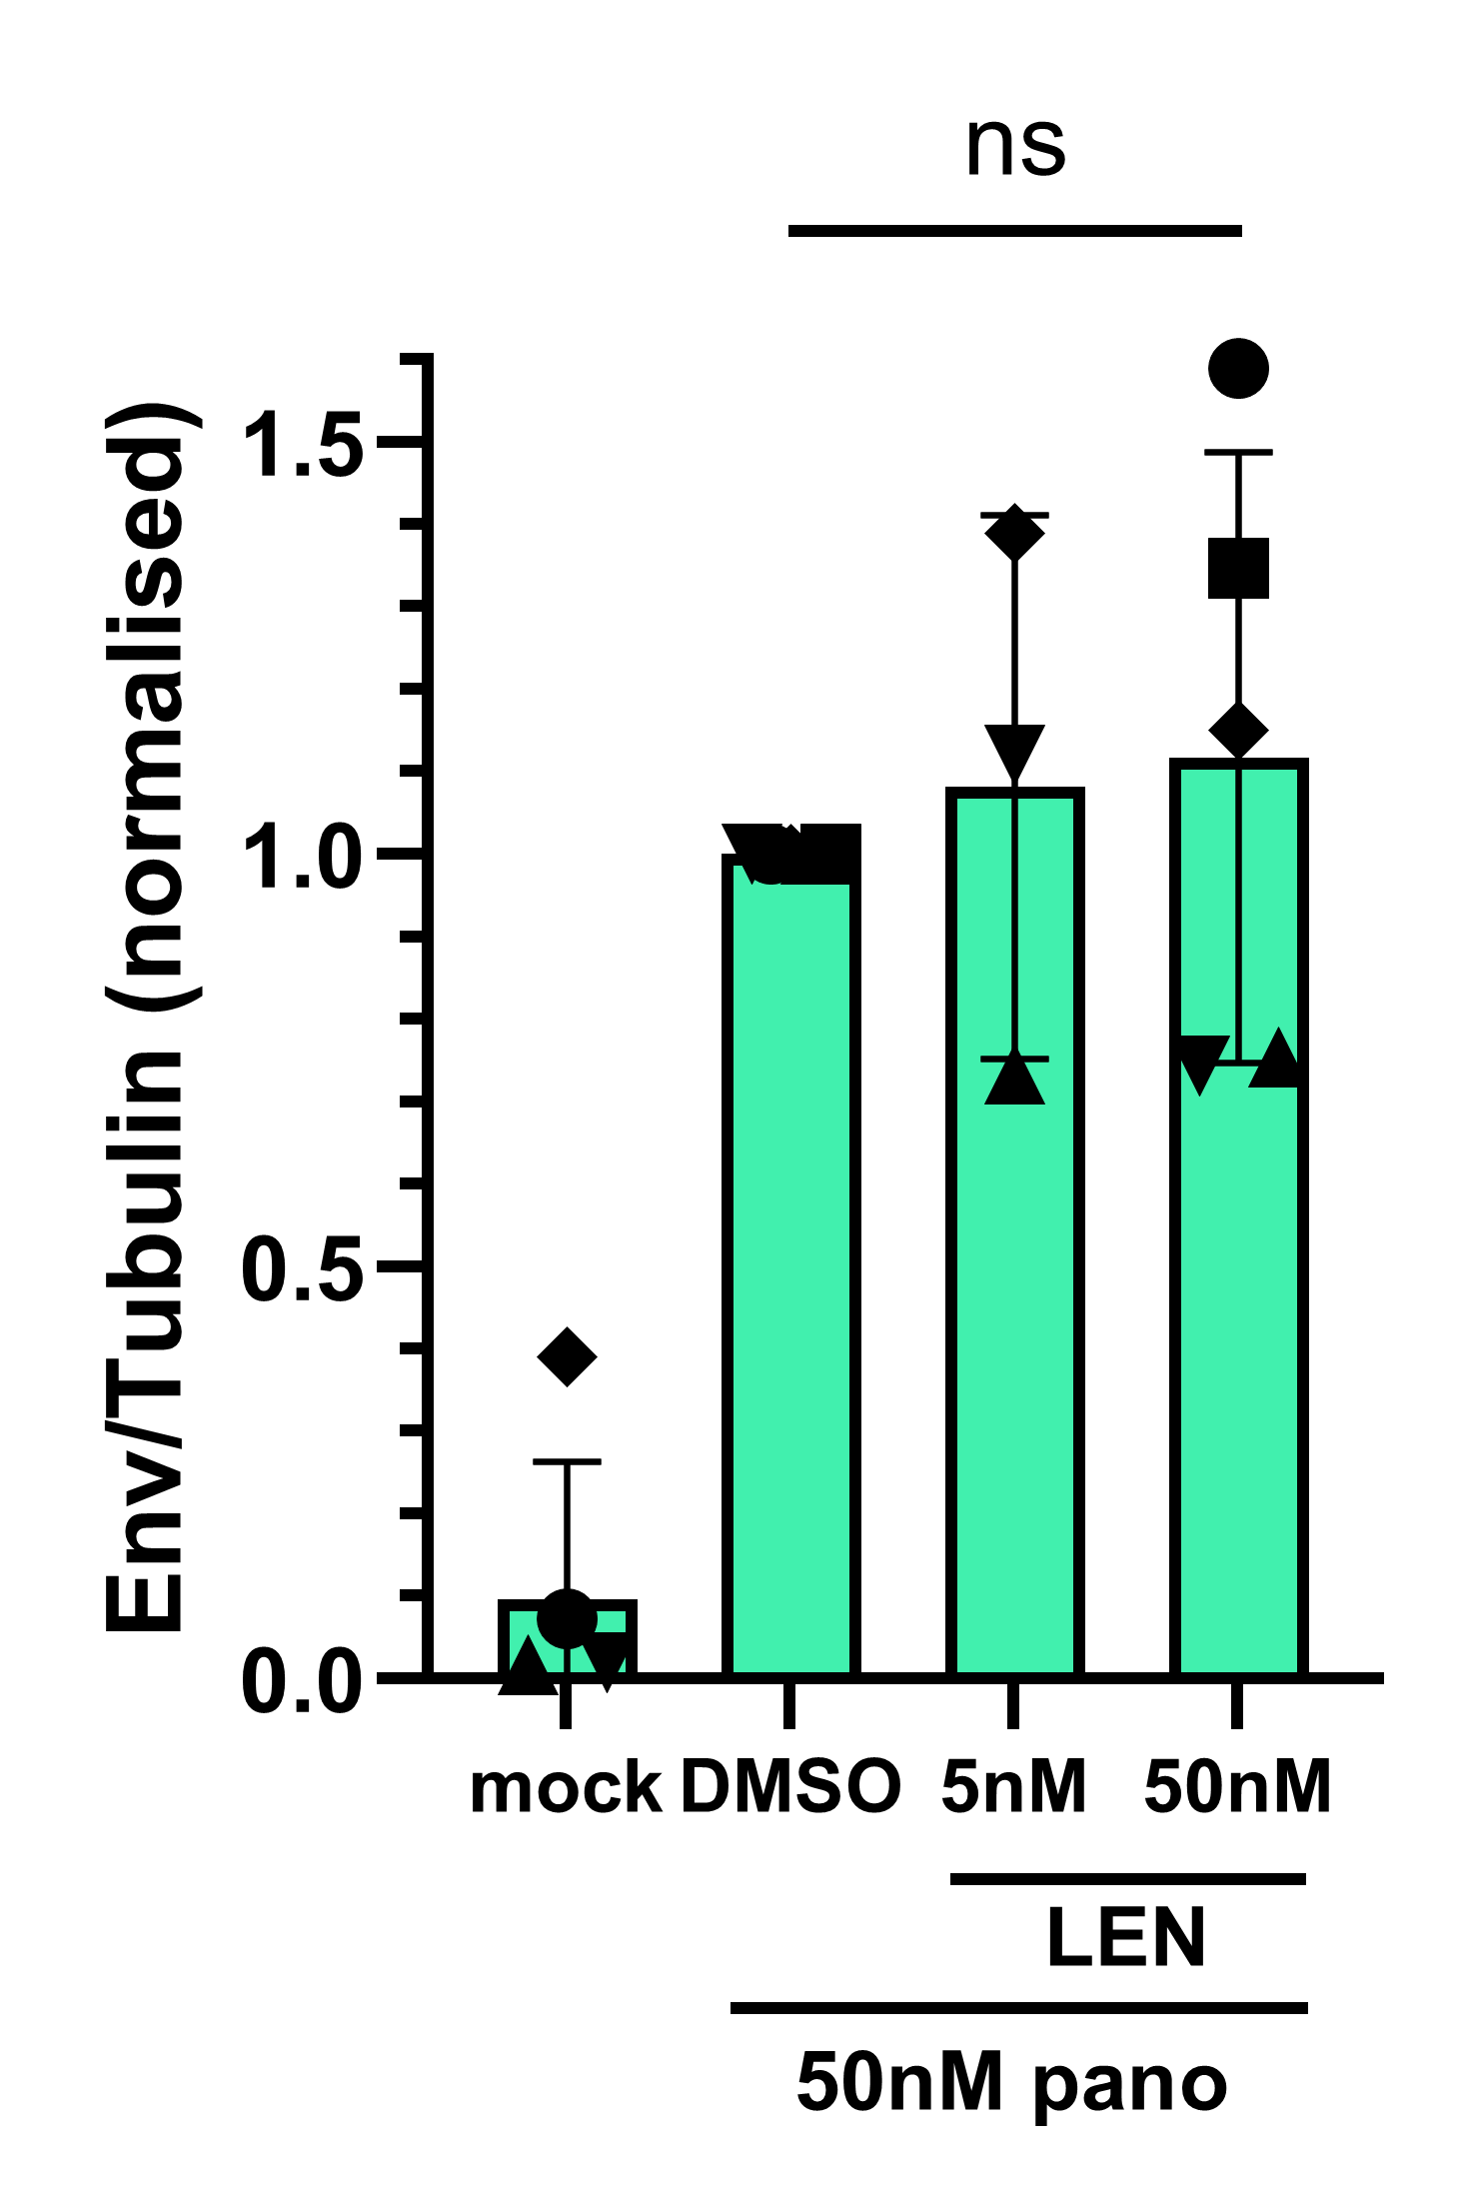
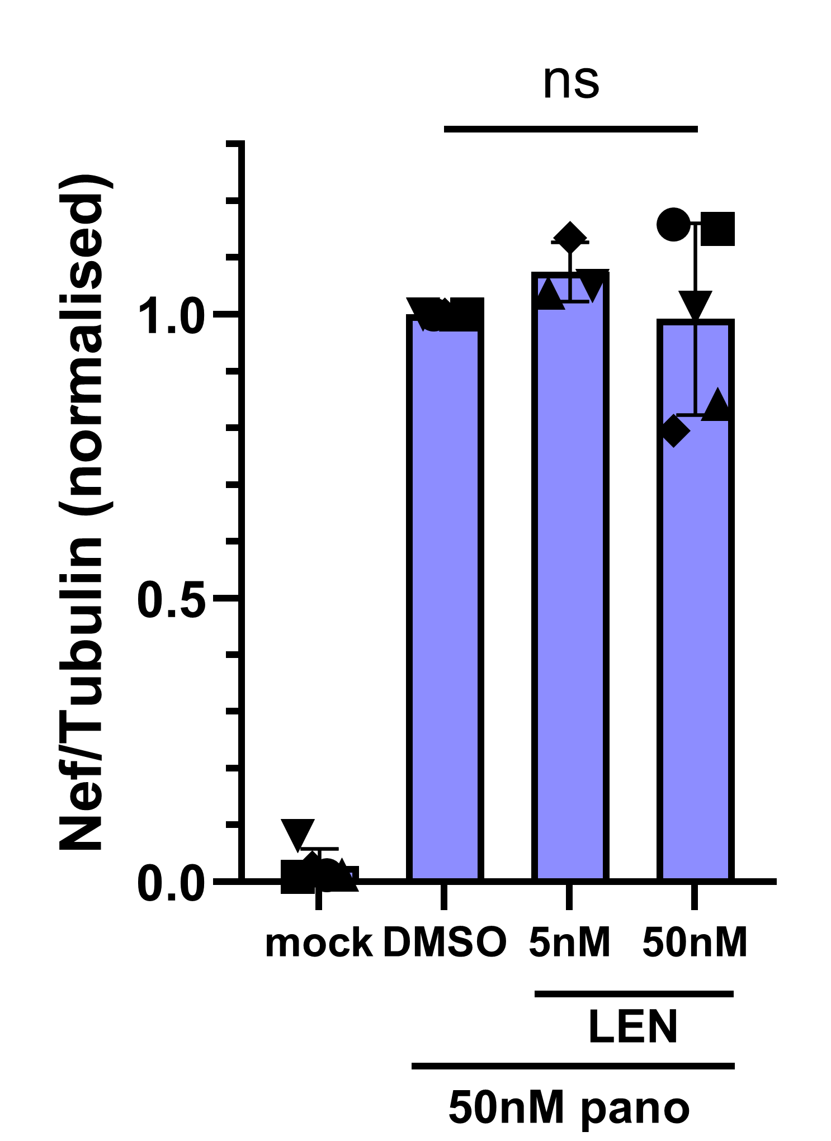
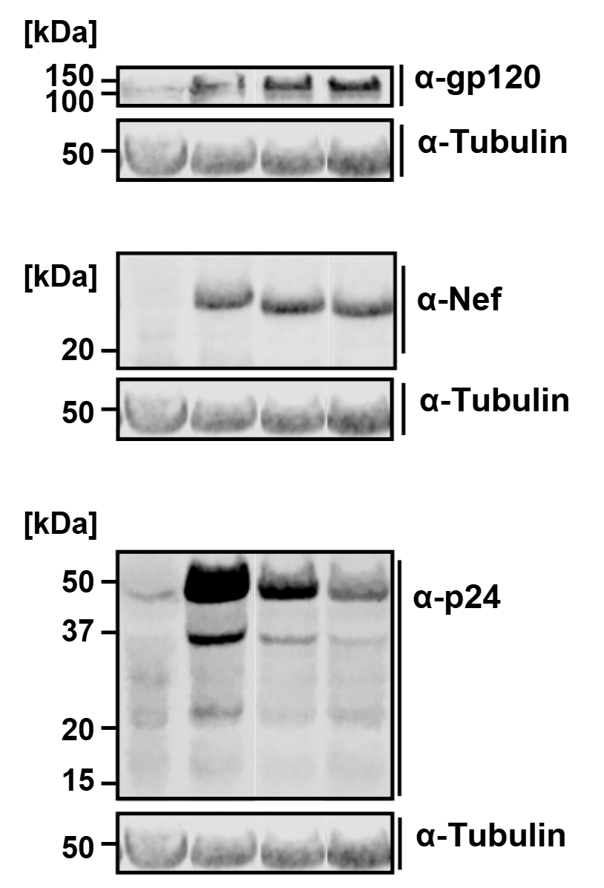
LEN specifically reduces p24CA levels upon latency reversal
Gag
Env
Nef
Notes:
Further validated by WB
Again specific effect of LEN on p24

Slide 11
JLEG2 T-cell line distinguishes total/surface Env
anti-GFP stain
= surface Env
GFP = total Env
JLEG2 T-cell line
Notes:
4:00
Cell line distinguishes total Env (GFP), surface Env (stain non-permeabilised cells)
Relevant: Env = only surface-presenting viral protein > immune detection infected cells

Slide 12
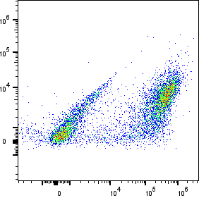
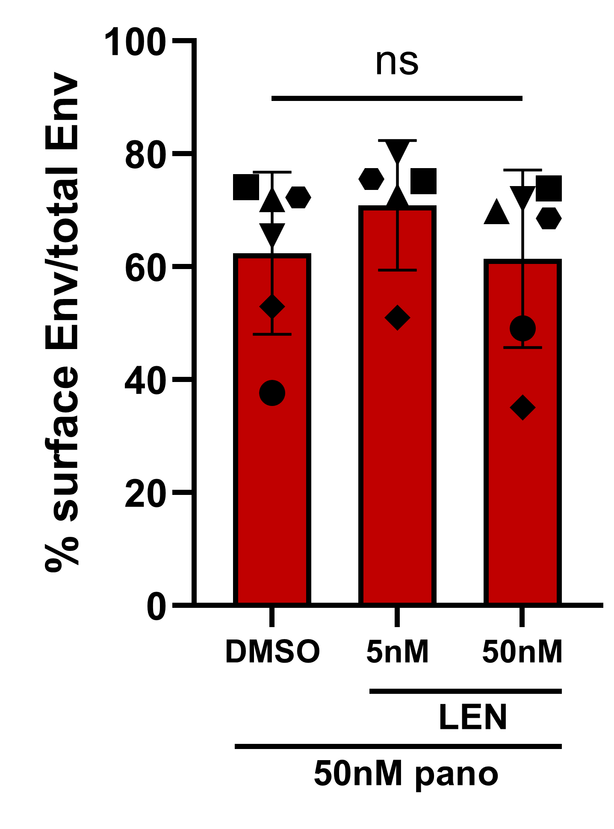
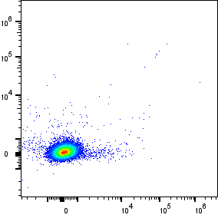
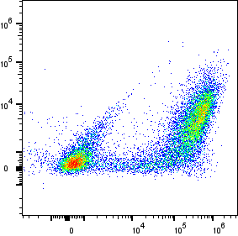
LEN treatment preserves surface Env presentation
50nM pano
mock
DMSO
50nM LEN
10⁶
65.4%
72.0%
surface EnvGFP (eF660)
10³
0
10⁻³
10⁻³
10⁶
10⁶
10⁶
0
10³
10⁻³
0
10³
10⁻³
0
10³
total EnvGFP
Notes:
Found effect on surface Env
Confirms expectation: suggests that antibody dependent immune mechanisms are not negatively affected

Slide 13
Objective
Study the effect of LEN on immune-mediated killing
Approach
Assess the effect of LEN on the dynamics of latency reversal
Quantify the effect of LEN on antigen presentation
Perform CTL killing assays +-LEN
Notes:
5:00
Leads to next part of project...

Slide 14
Objective
Study the effect of LEN on immune-mediated killing
Approach
Assess the effect of LEN on the dynamics of latency reversal
Quantify the effect of LEN on antigen presentation
Perform CTL killing assays +-LEN
Notes:
... study effect on antigen presentation by MHC-I
LEN leads to lower p24 levels > literature: effect at protein level

Slide 15
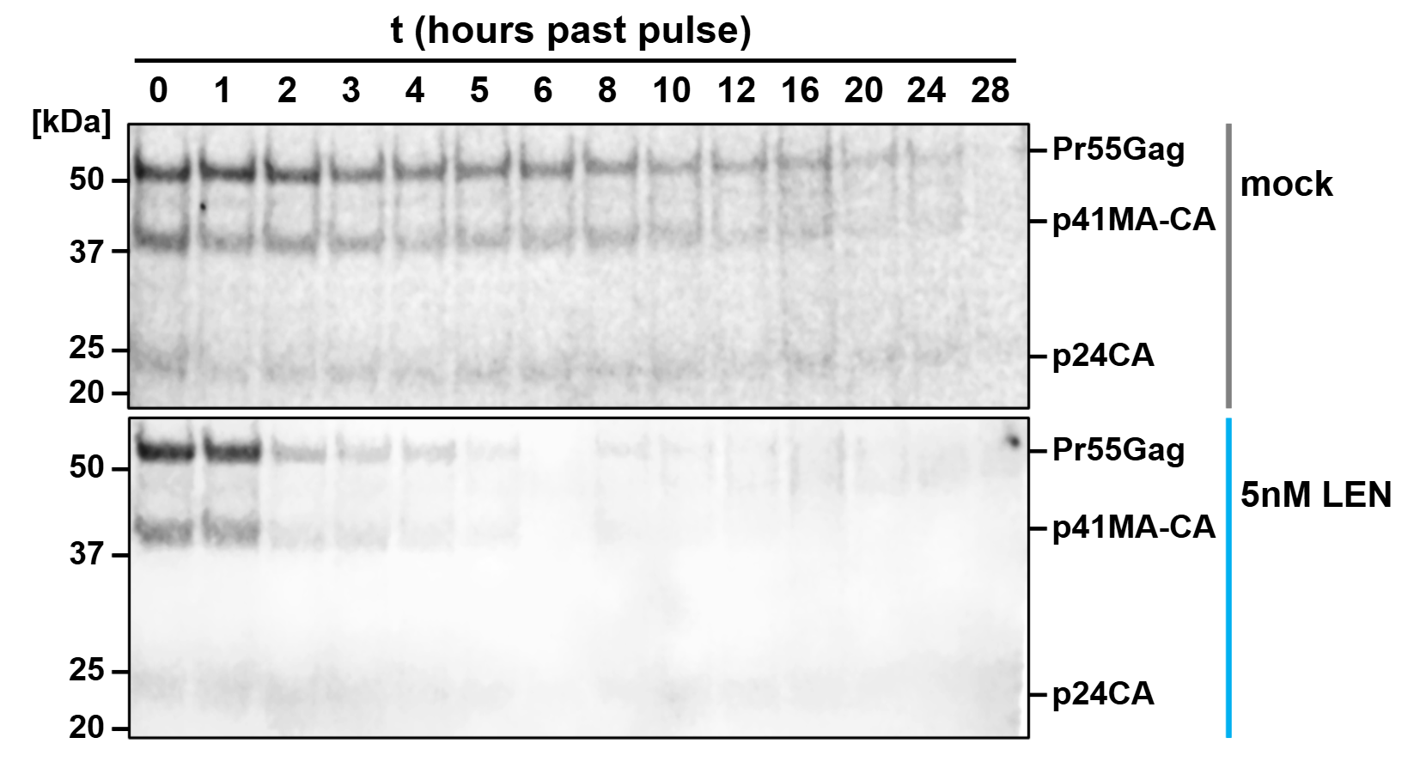
LEN accelerates degradation of HIV-1 Gag
Notes:
Gag stability affected?
Pulsed with WB detectable Met analogue
Track decay of Gag over time
Gag + cleavage products (incl p24)
LEN: faster degradation
Half-life reduced ~3-fold
> Degradation leads to antigen presentation?

Slide 16
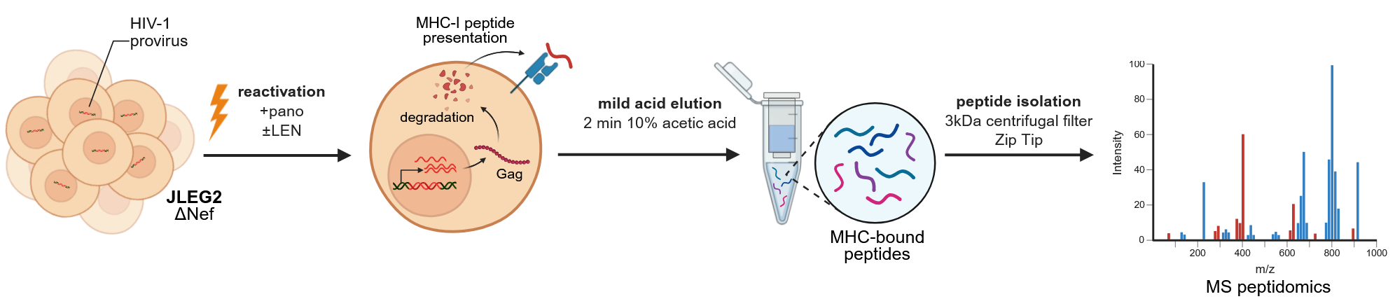
MHC-bound peptide isolation + MS peptidomics
Notes:
6:00
To answer this question, characterises peptide presentation using mass spectrometry.
Isolated peptides from reactivating cells using MAE (intact cells)
Importantly, viral protein Nef downregulates MHC-I during natural infection (hides HIV)
KO Nef to restore MHC-I expression and increase the sensitivity of our assay

Slide 17
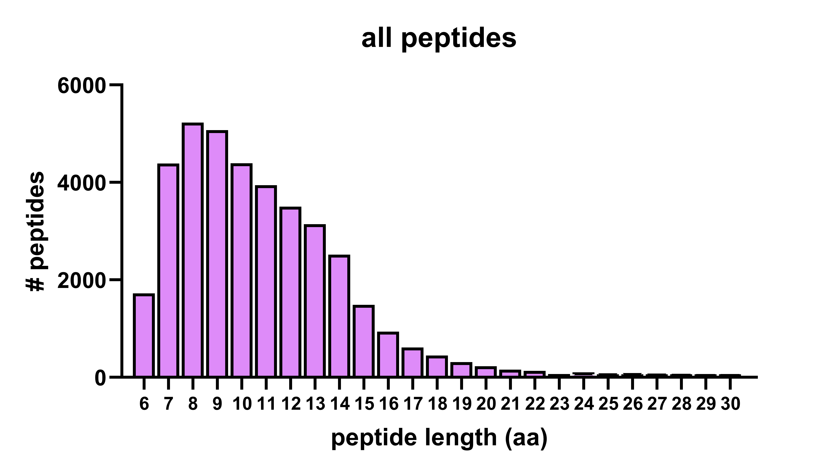
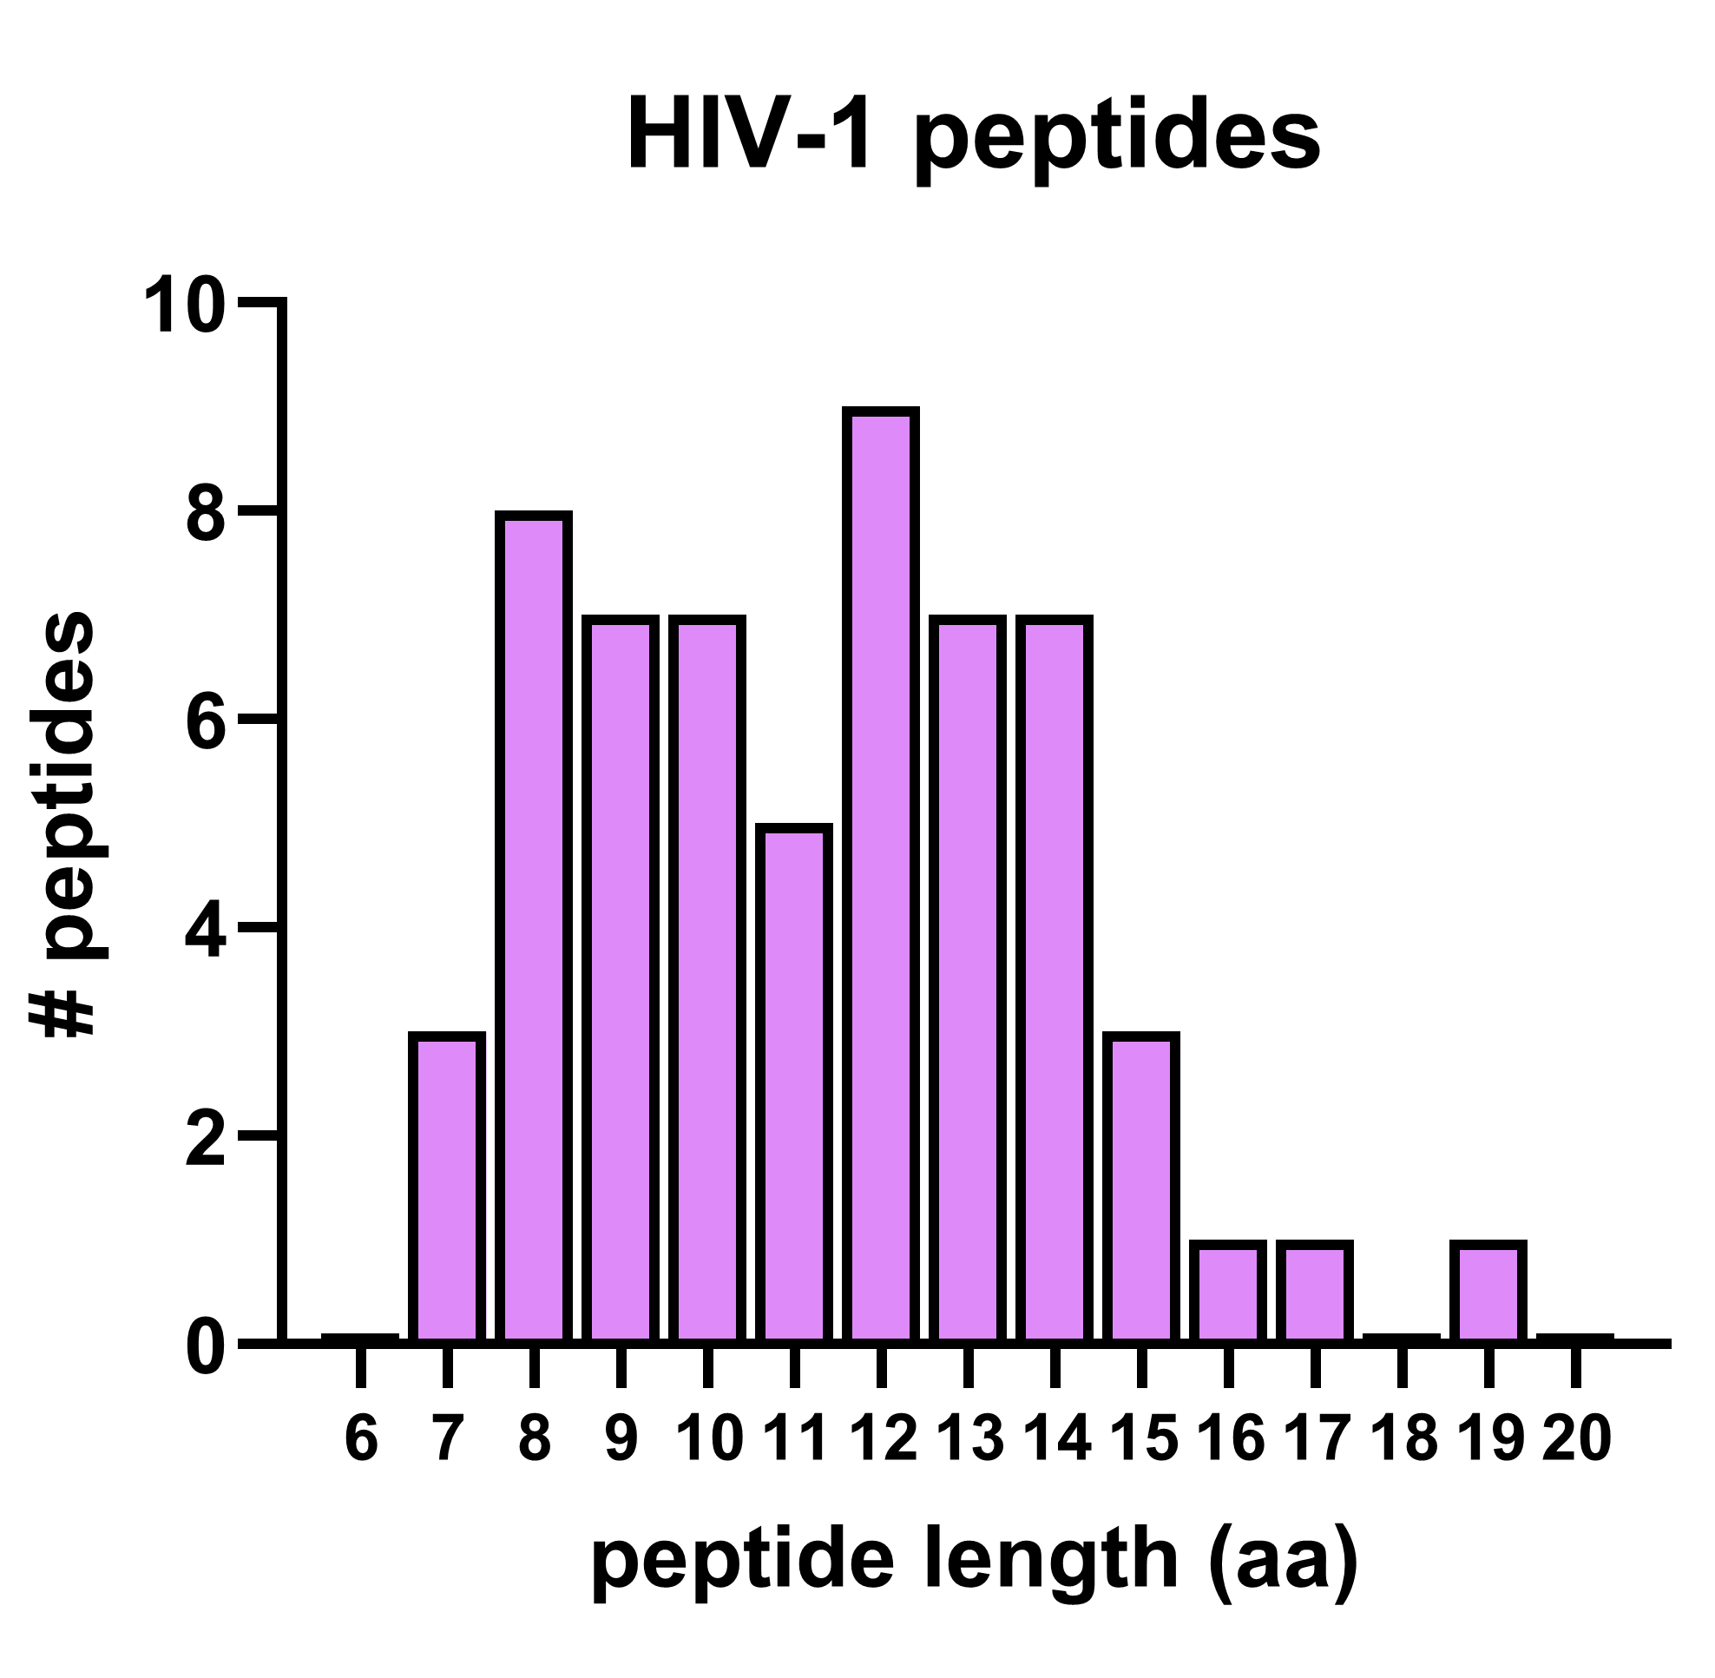
Identified ~25k unique peptides, 41 HIV-1 derived
Notes:
25k unique peptides, 41 HIV-1 derived
Ideal peptide length for MHC-I bound peptides = 8-12
One HLA allele present on cell line (B35) known to present peptides up to 16aa, matches our data

Slide 18
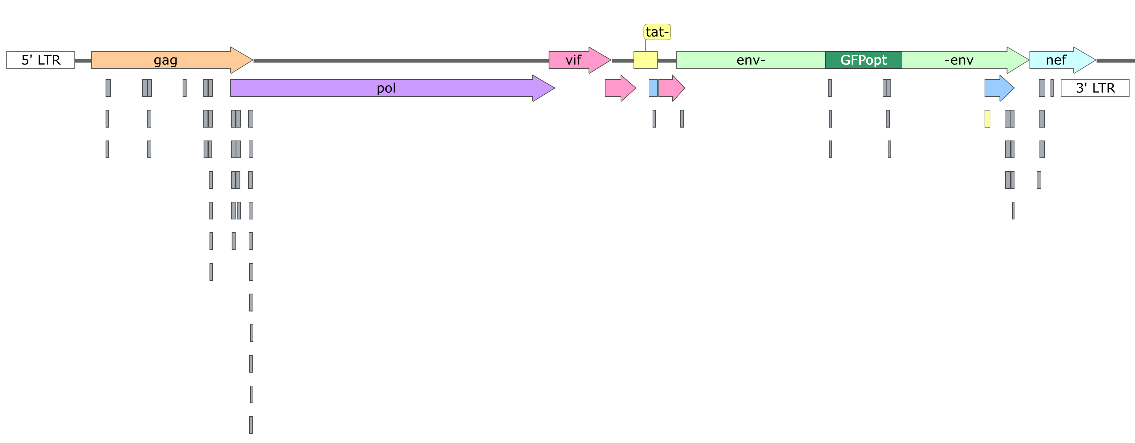
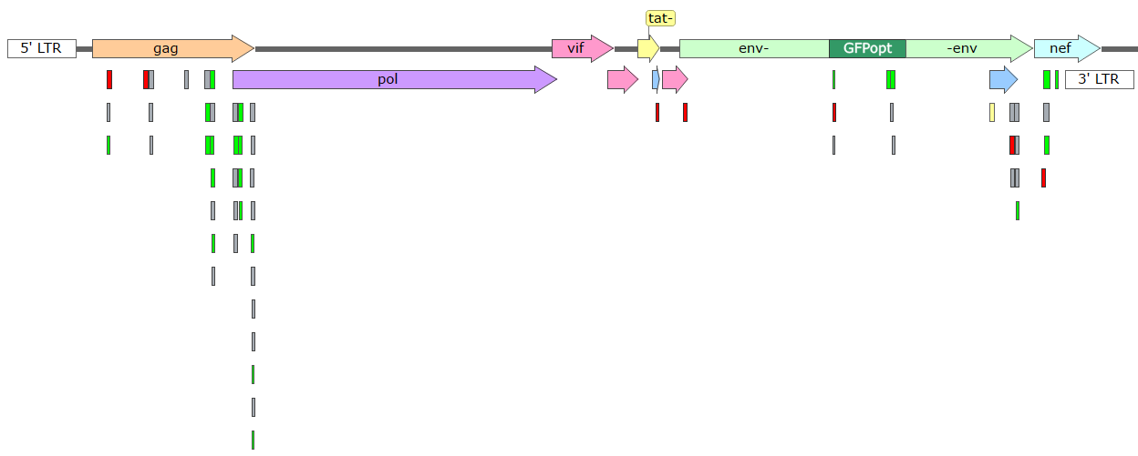
Most viral peptides derived from 8 epitopes on HIV-1 Gag
tat
vpr
vpu
rev
nef sgRNA
Notes:
7? Mapped peptides to HIV genome
Overlapping peptides: same epitope
Majority of peptides derived from Gag (aligns other studies)

Slide 19
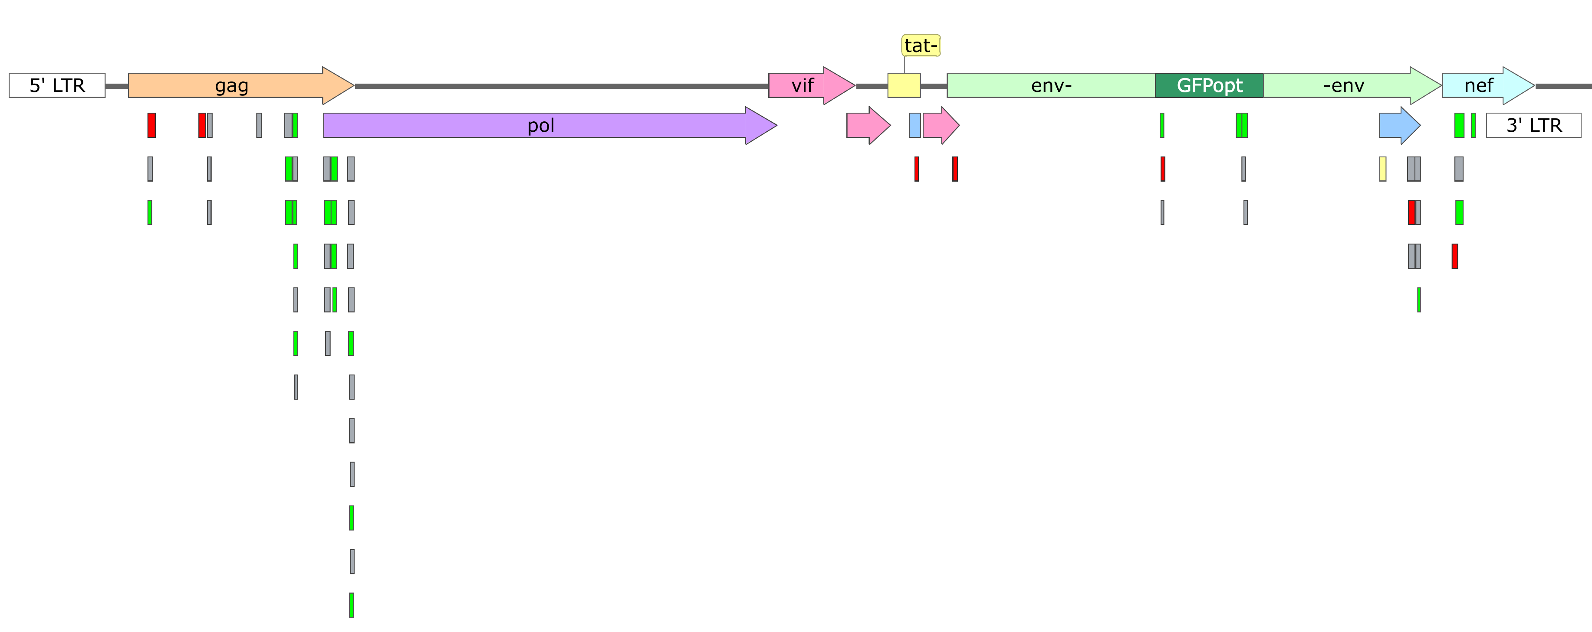
LEN increases diversity of antigen presentation
tat
vpr
vpu
rev
nef sgRNA
Gag peptides
LEN+
LEN-
15
22
2
Notes:
8:00
Parse peptides by treatment condition
Treat w/ LEN leads to more unique peptides from more unique epitopes
Could mean that LEN affects Gag degradation patterns > forms new peptides
Or increased abundance > peptides above detection limit
Overall LEN diversifies viral antigen presentation

Slide 20
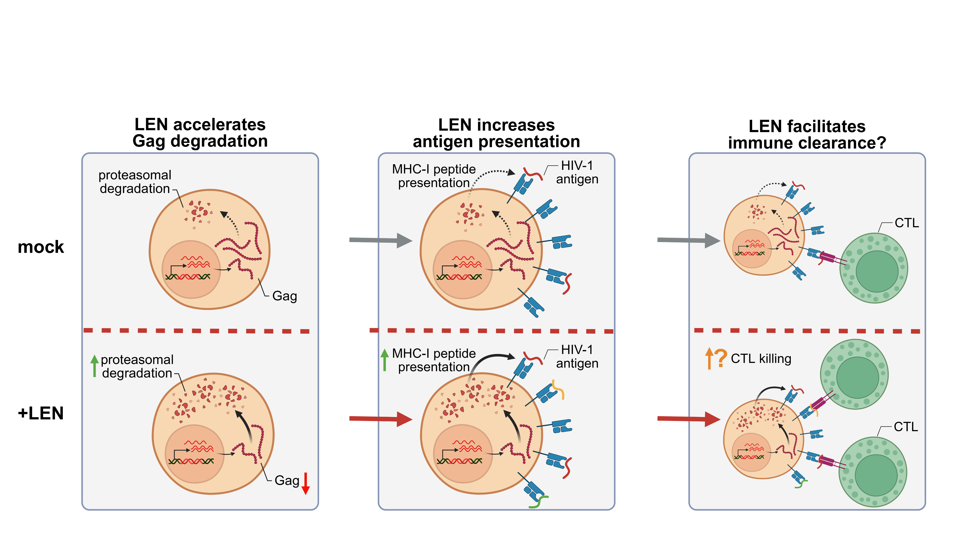
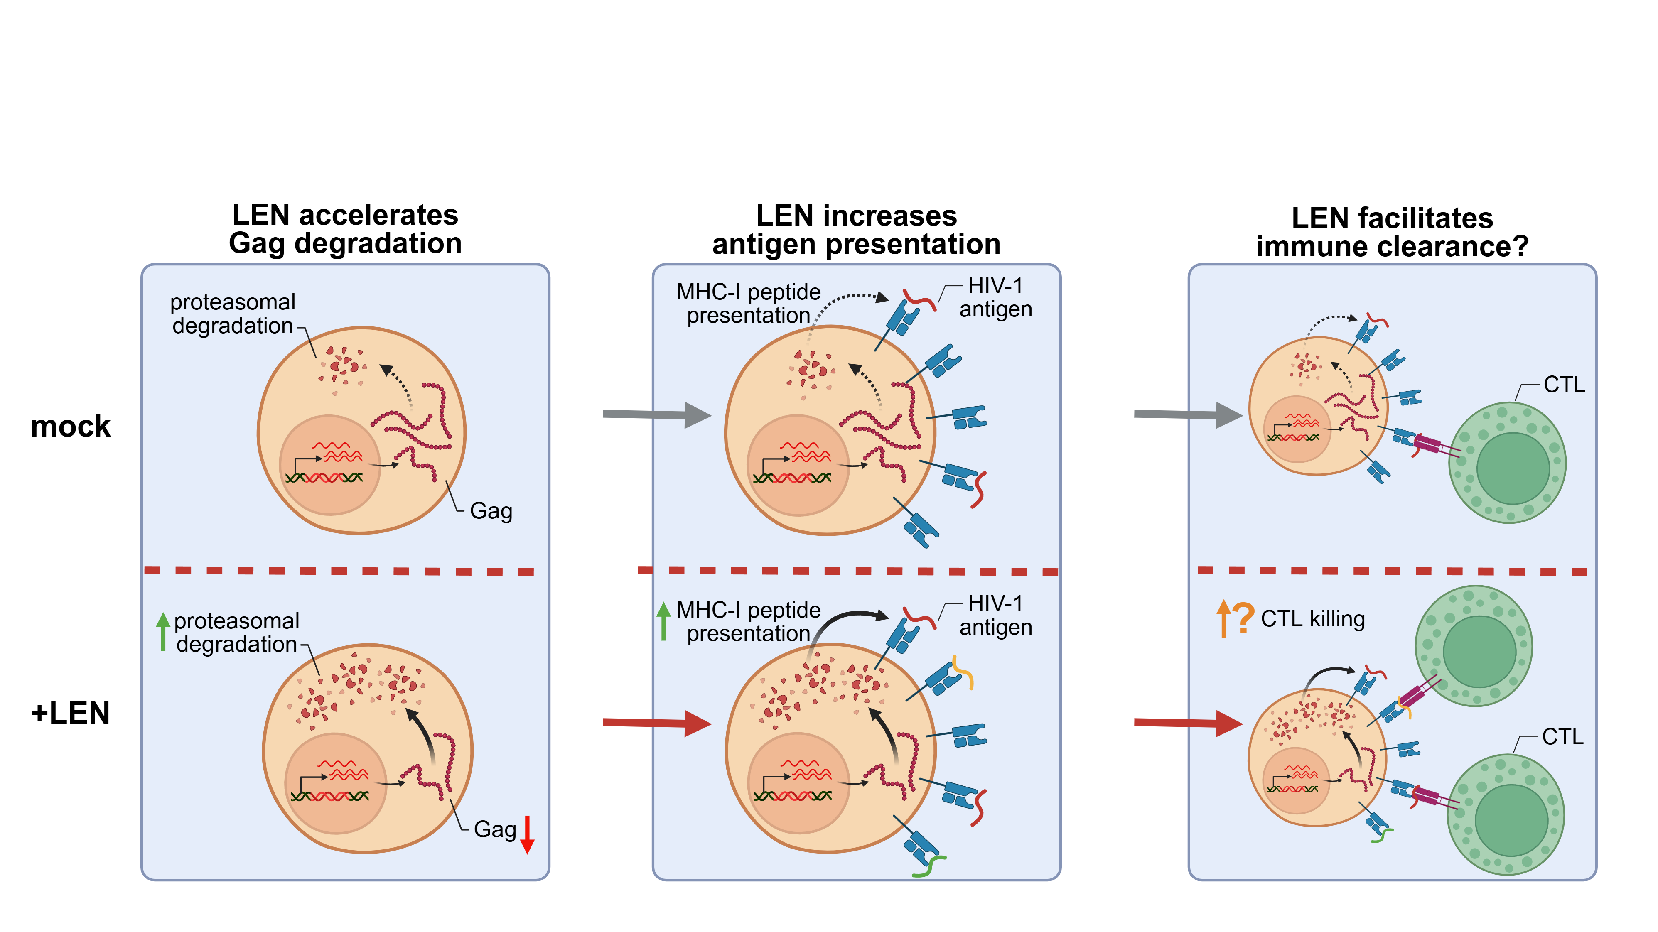
> Computational binding prediction
> HLA-peptide binding assay
> Analyse human peptides?
Notes:
9:00
Next step: confirm effect on immune clearance
killing co-culture with primary CTLs

Slide 21
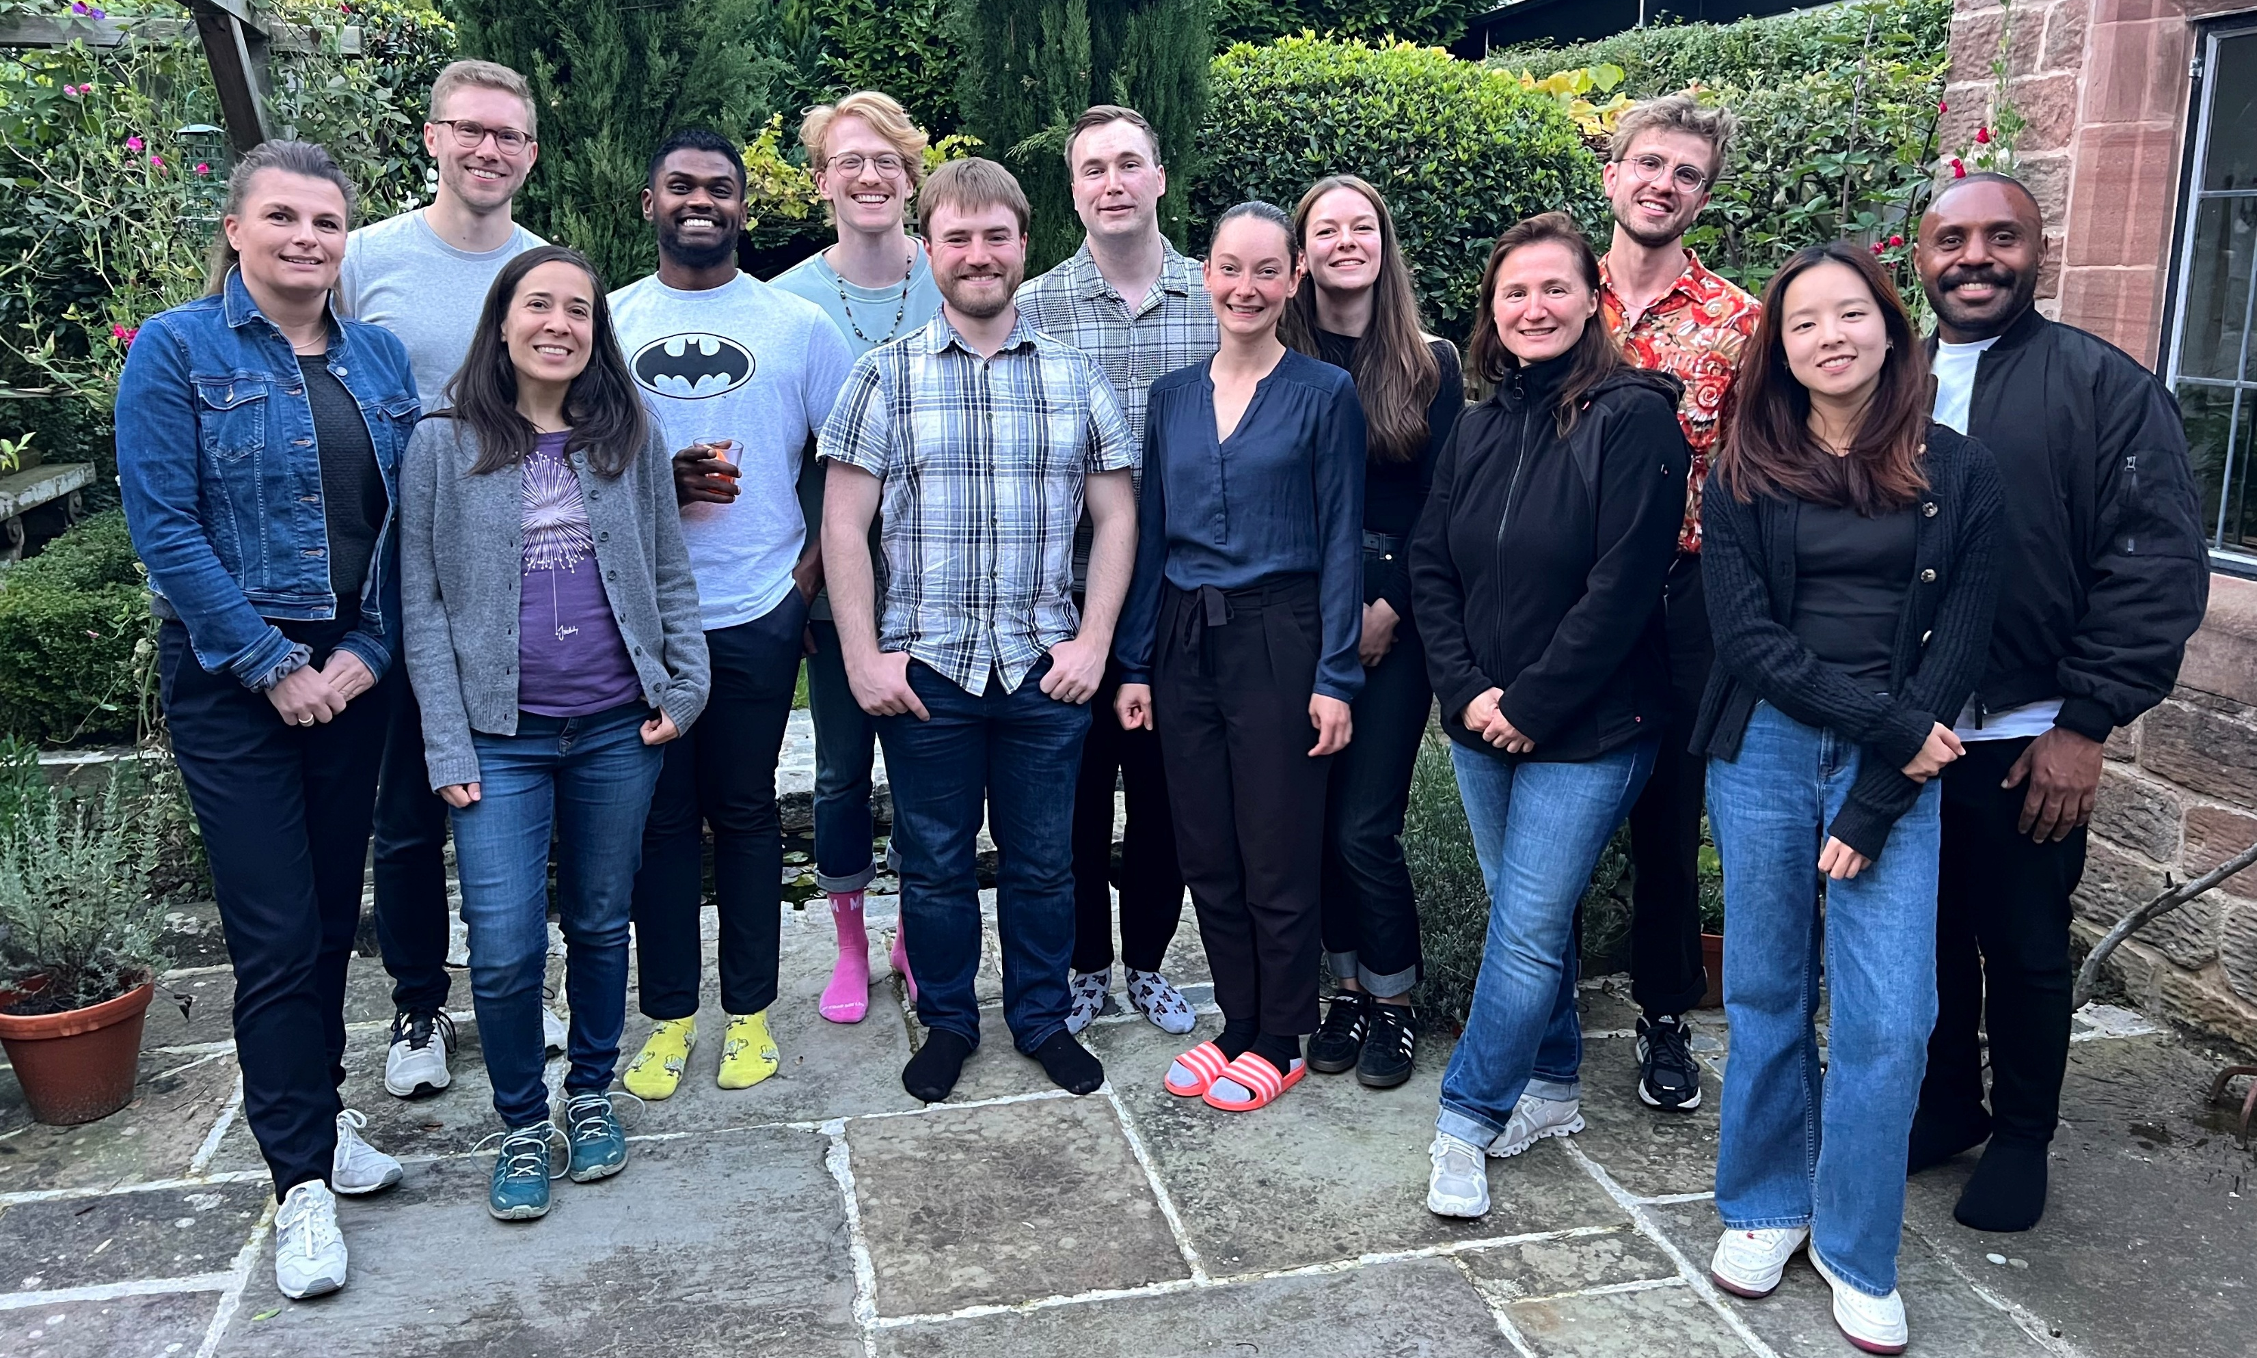




Acknowledgements
Goffinet Group, LSTM
Christine Goffinet
Chloe Hui
Christida Wastika
Dylan Postmus
Dom Wooding
Jid Purohoo
Laure Bosquillon de Jarcy
Nick Heavey
Saskia Stenzel
Toby Ross
Valerie Price
Centre for Proteome Research, UoL
Richard Scheltema
Kareena Adair
Funding bodies
Academy of Medical Sciences (AMS)
daan.roovers@lstmed.ac.uk
Daan Roovers
@goffinetlab.bsky.social

Slide 22
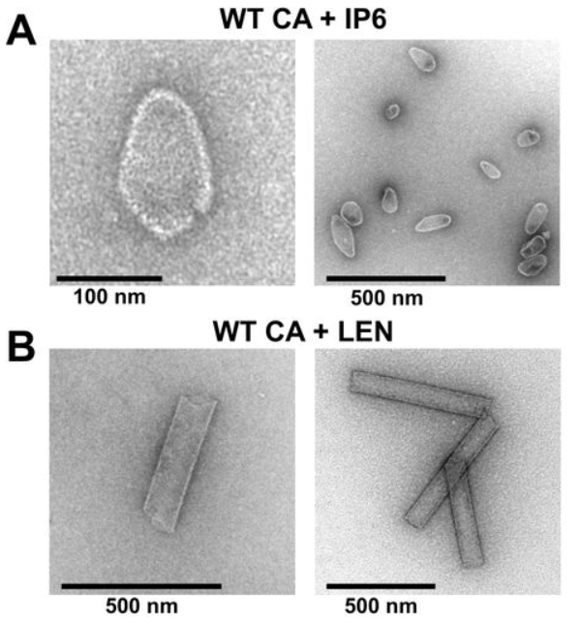
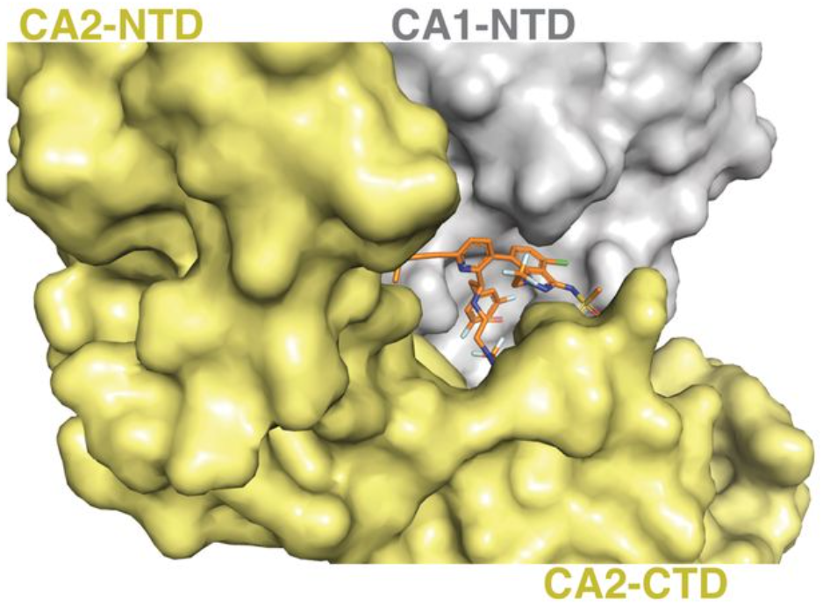
Lenacapavir hyperstabilises the HIV-1 capsid
LEN rigidifies the HIV-1 capsid by binding between two subunits
Rigidification leads to aberrant/atypical capsid formation
Bester et al., Science 2020
Huang et al., BioRxiv 2024
Notes:
Small molecule drug
Binds groove between Capsid subunits, rigidifies capsid
Aberrant/atypical capsid formation

Slide 23
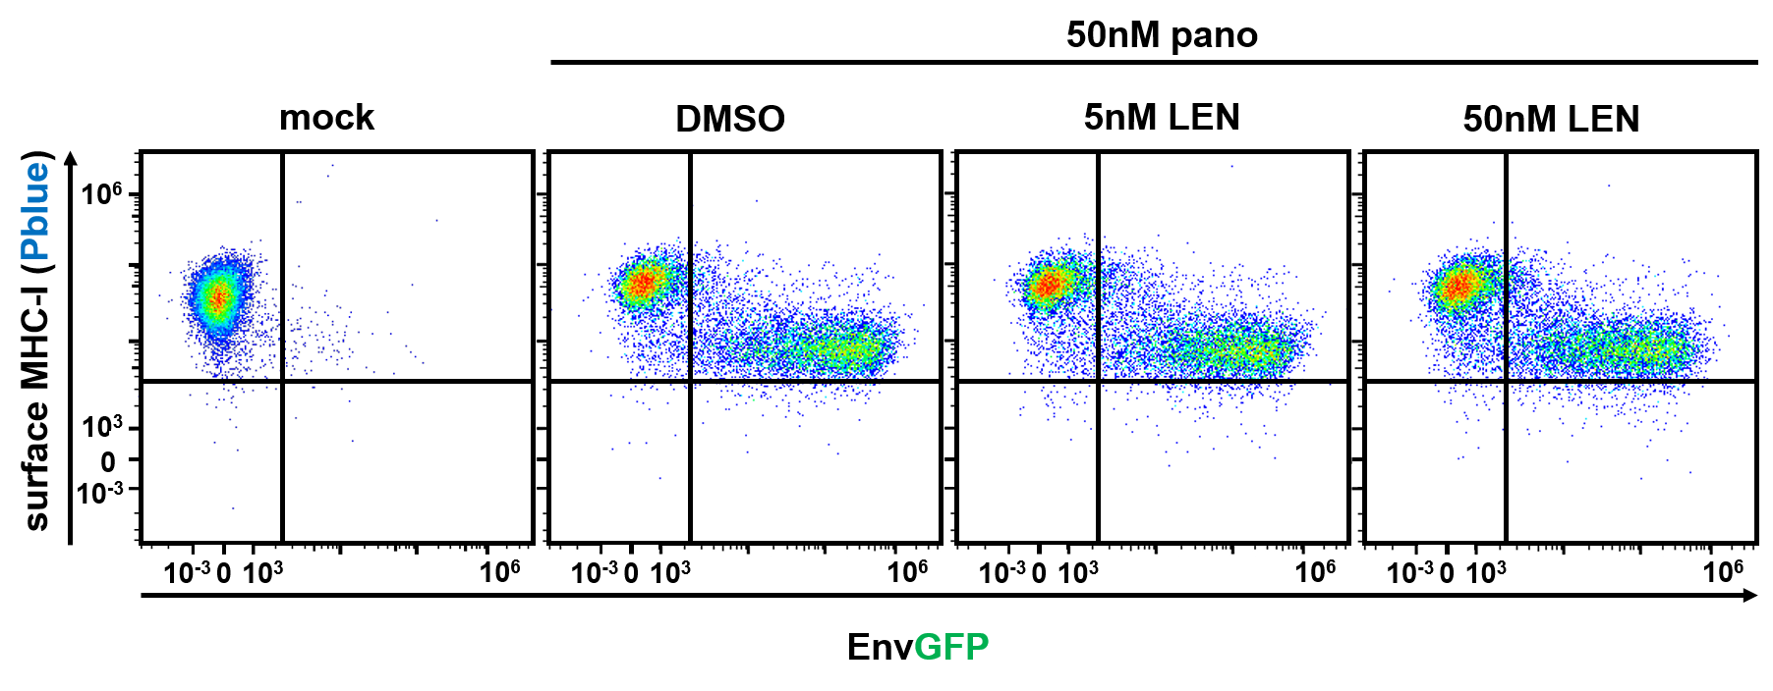
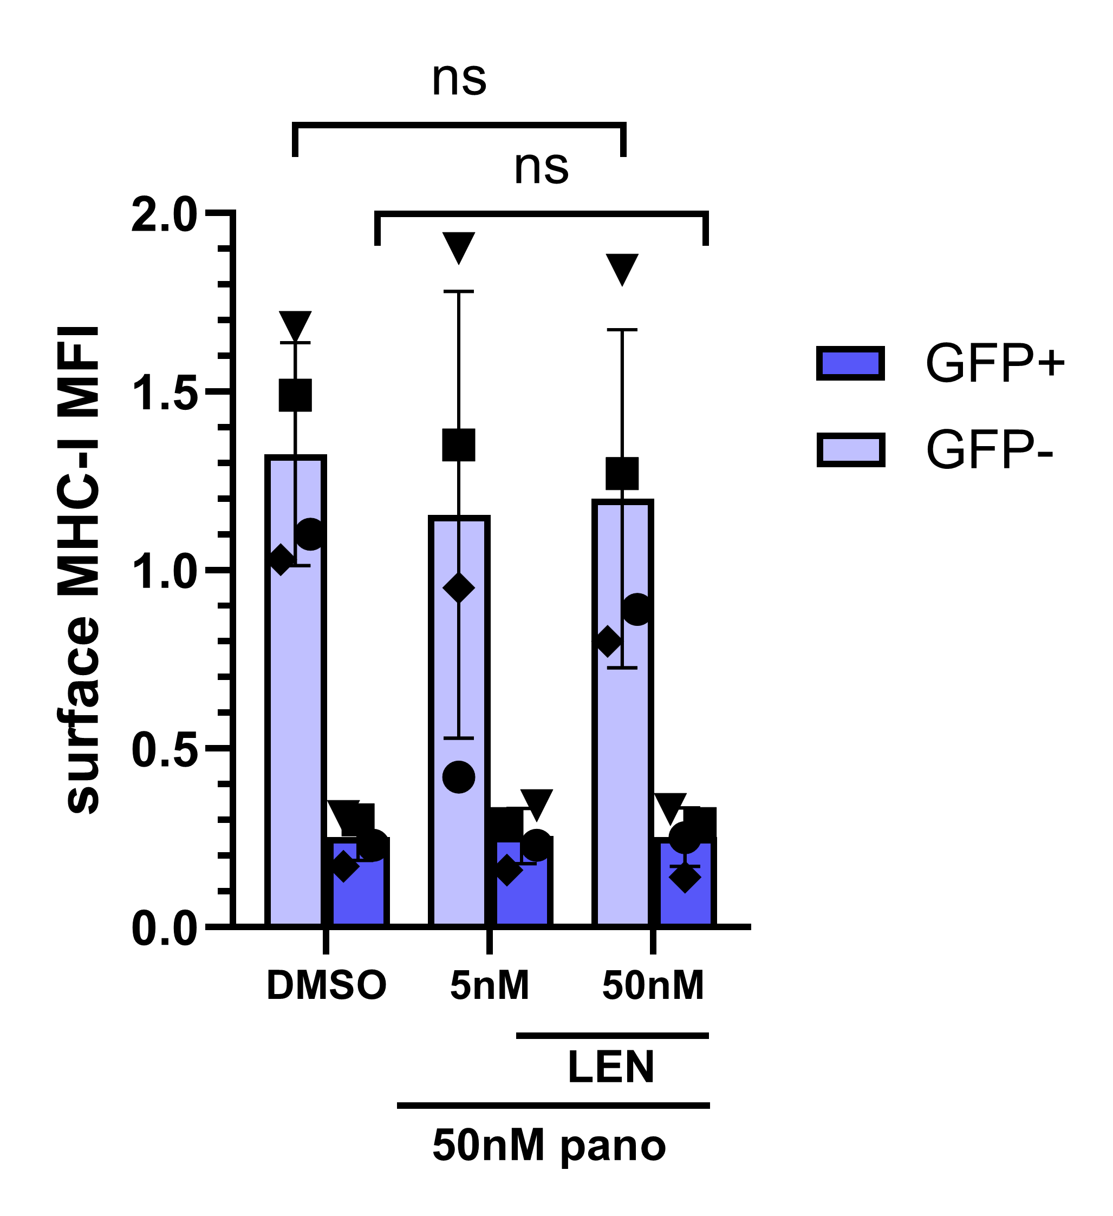
LEN does not affect MHC-I surface presentation
Notes:
Important: viral protein Nef downregulates MHC (hides infected cells)
Reactivation: less MHC-I in reactivating (GFP+) cells
LEN has no effect on MHC-I

Slide 24
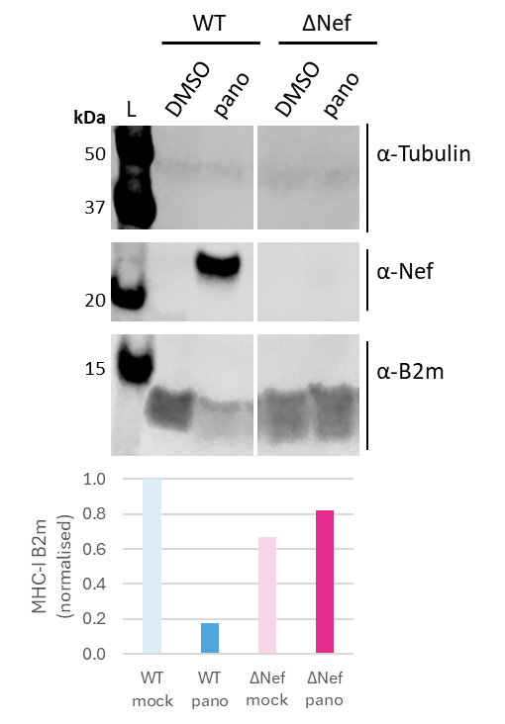
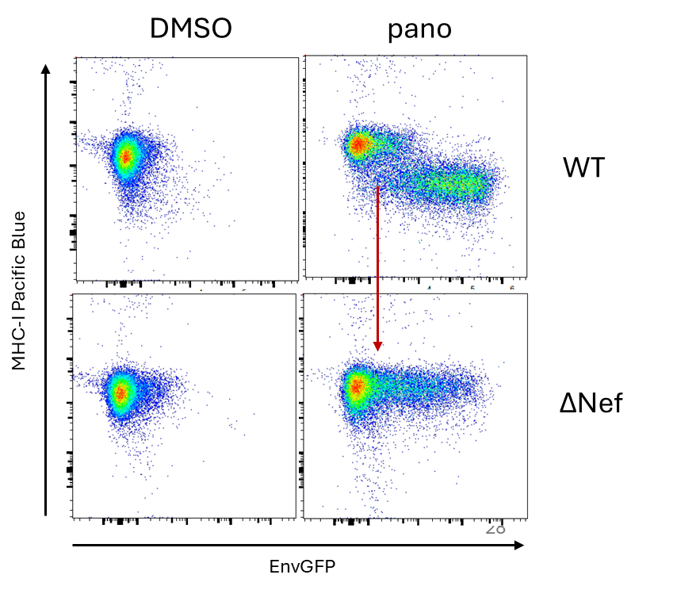
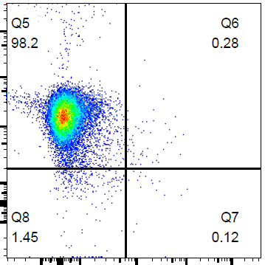
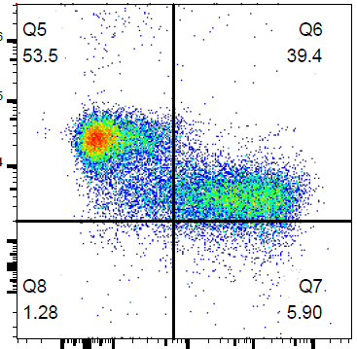
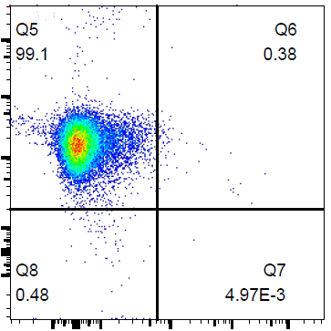
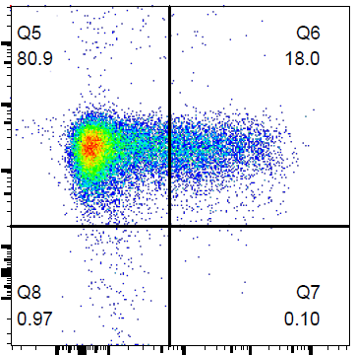
Nef KO restores MHC-I expression upon latency reversal
Notes:
Nef KO restores MHC-I surface expression

Slide 25
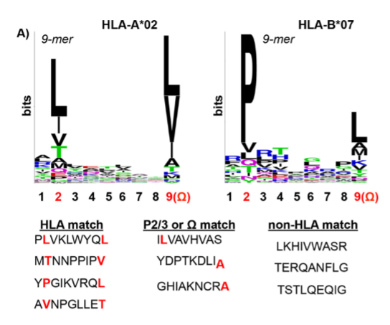


Validation of HLA-peptide binding
Computational:
  NetMHCpan 4.1
  Gibbs Clustering
(Rucevic et al., Jvirol 2016)
Wet-lab: MHC-I peptide stabilisation assay

Slide 26
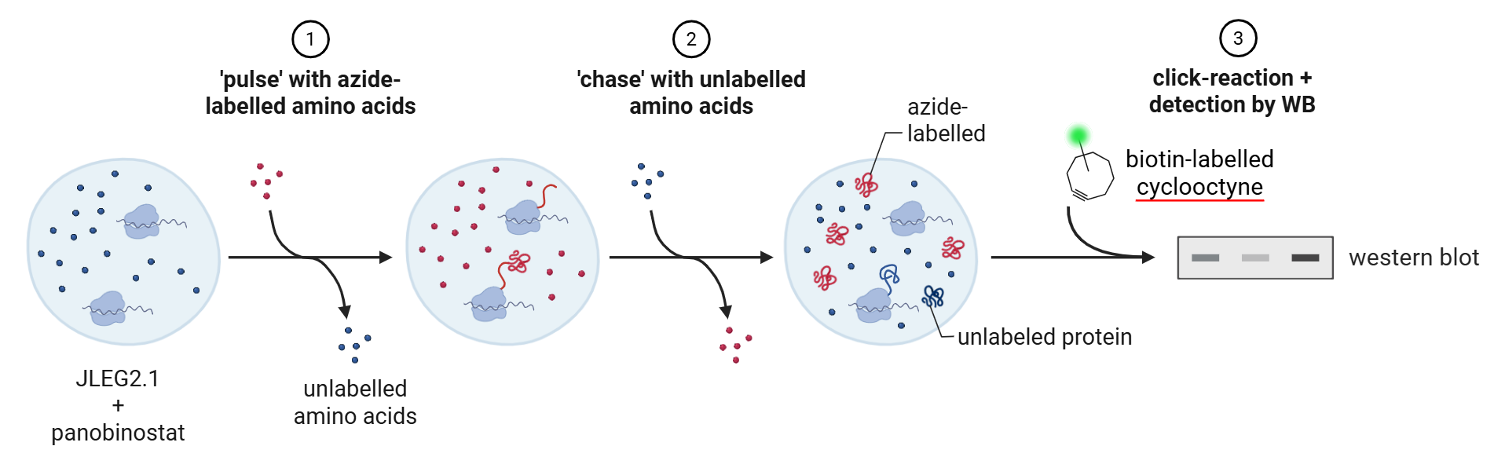
Assess Gag half life: click pulse-chase + p24-IP
Notes:
Reactivate cells
Pulse chase using click chemistry (avoids radioactive amino acids)
Pulse with azide labelled Met, chase with unlabelled
React with biotin-cyclooctyne (click reaction// spontaneous+irreversible reaction)
Pulsed protein visible through biotin

Slide 27
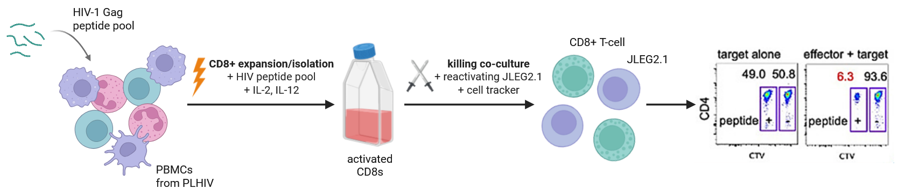
CD8+ killing assay ±LEN
Notes:
Isolate CD8 > killing co-culture +-LEN
Expand specific CD8 with peptide pool

