Slide 1

Mind the Gap
(and Destroy it)
Inclusion of Transgender People in HIV Cure-Related Research
25.07.2026, AIDS 2026 HIV cure pre-conference, Rio de Janeiro
Tomer Einav (he/him)
tomer.einav@charite.de
Painting by Navot Miller
Notes:
Thank to Amanita and all the local leaders

Slide 2
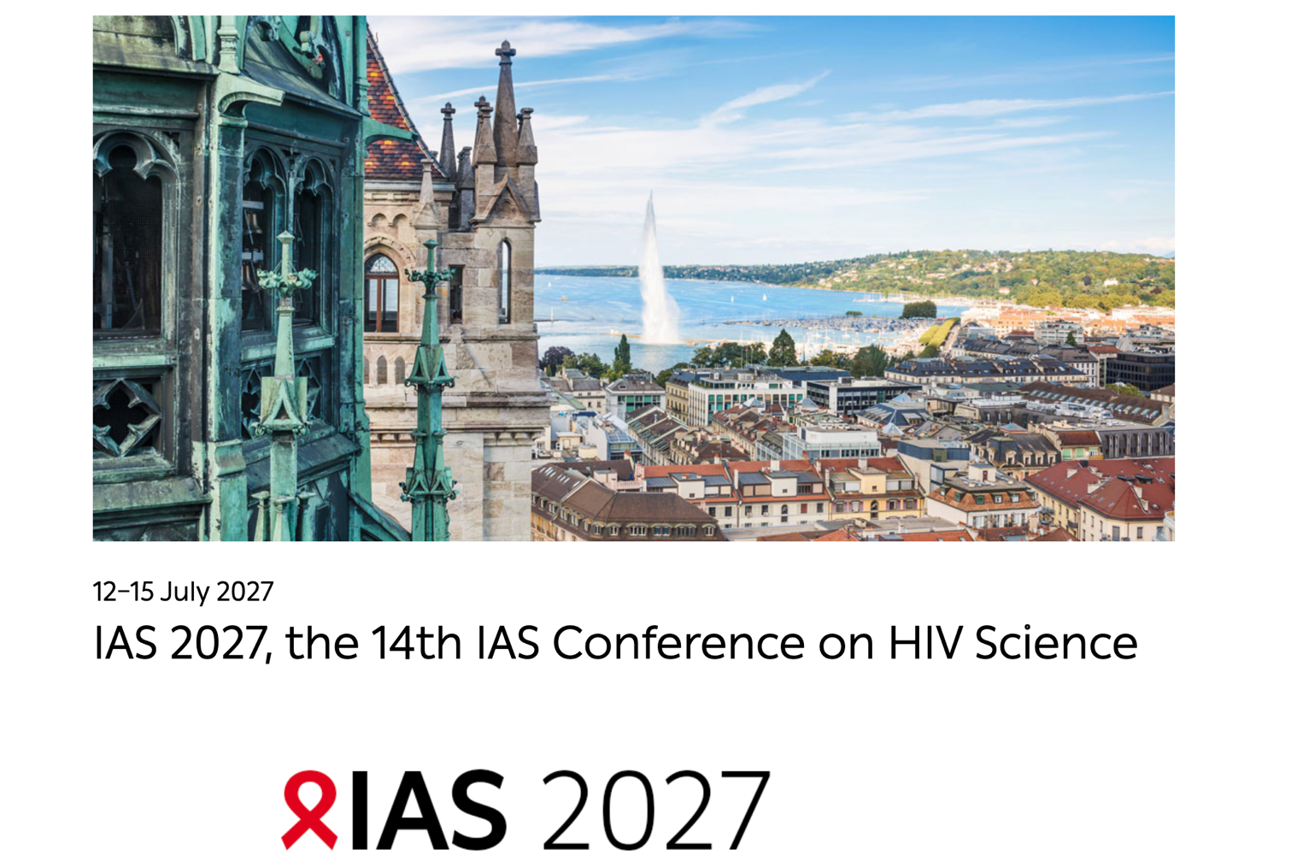
Notes:
.

Slide 3
High Participation of Trans* People in HIV Cure Research
How did we get here?
11.07.2027, AIDS 2027 HIV cure pre-conference, Geneva
Tomer Einav (he/him)
tomer.einav@charite.de
Notes:
Thank to Amanita and all the local leaders

Slide 4
1 year ago…
Notes:
.

Slide 5
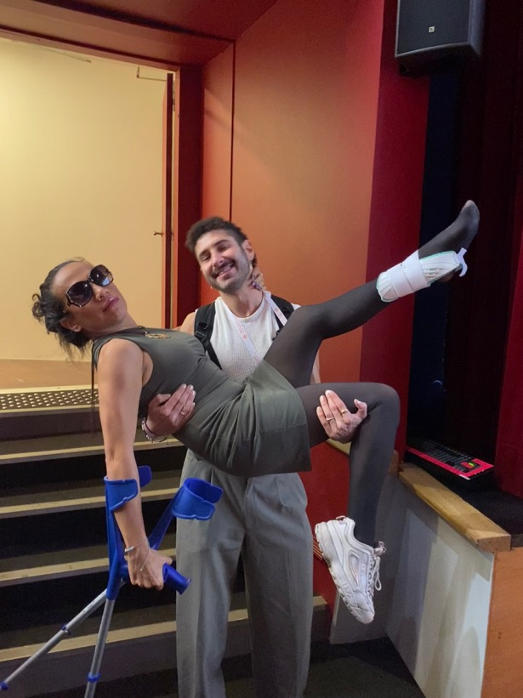
Community co-lead
Collaboration with Amanita Calderon Cifuentes, TGEU
Colombian scientist and trans-activist
HIV research and advocacy
Problem analysis
Change metrics
Program

Slide 6
Community co-lead
Collaboration with Amanita Calderon Cifuentes, TGEU
Colombian scientist and trans-activist
HIV research and advocacy
How to increase participation?
Problem analysis
Change metrics
Program

Slide 7
66x
Trans women
Trans men
7x
more likely to have HIV than the general population
Stutterheim SE, van Dijk M, Wang H, Jonas KJ (2021) The worldwide burden of HIV in transgender individuals: An updated systematic review and meta-analysis. PLoS ONE 16(12): e0260063. https://doi.org/10.1371/journal.pone.0260063
Notes:
.

Slide 8
<1%
of HIV cure research participants are trans*
TAG - HIV Cure-Related Clinical Research Participant Demographics Table, April 8, 2026 https://www.treatmentactiongroup.org/wp-content/uploads/2026/04/HIV-Cure-Research-Demographics-Table-040826-2.pdf
Notes:
.

Slide 9
Therapies not tested
Lack of representative data
Exclusion, mistrust
Low
participation
health risk
Notes:
And scientific gap!

Slide 10
Therapies not tested
Lack of representative data
Exclusion, mistrust
Low
participation
health risk
Key population left out of scientific advances
Notes:
. HIV pathogenesis, persistence, and treatment response¹HIV reservoir and immune response to therapeutic approaches being investigated as cure strategies

Slide 11
Therapies not tested
Lack of representative data
Exclusion, mistrust
Real-world implementation of a cure?
Low
participation
health risk
Key population left out of scientific advances
Notes:
. HIV pathogenesis, persistence, and treatment response¹HIV reservoir and immune response to therapeutic approaches being investigated as cure strategies

Slide 12
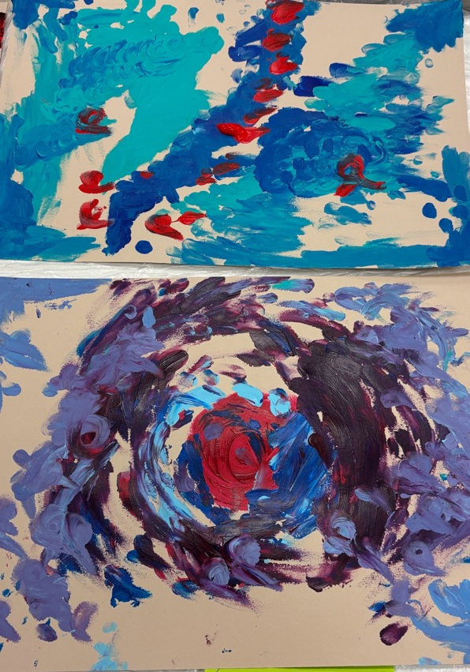
Focus groups
Latin America and Europe
12 community experts: Brazil · Colombia · Mexico · Germany · Netherlands · Sweden · Spain · Ireland
Representing diversity of gender and intersectional identities
Familia+migra

Slide 13
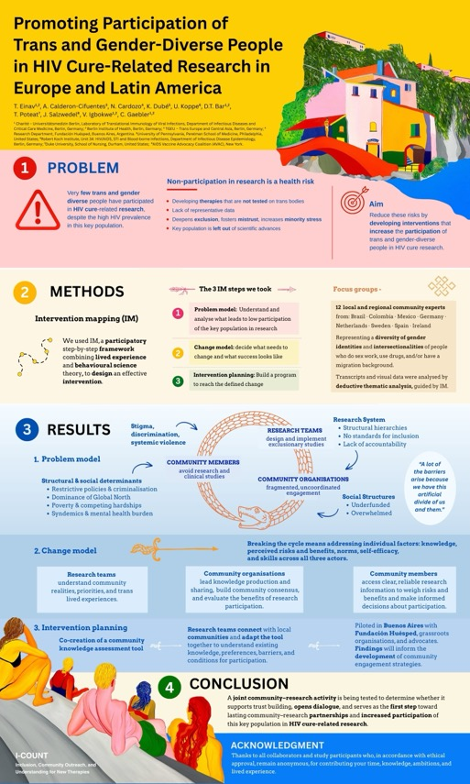
Intervention planning
WEPED428
Increasing participation
Problem analysis
Define ideal situation
Choose the change needed

Slide 14
Intervention planning
WEPED428
Increasing participation
Problem analysis
Define ideal situation
Choose the change needed
Plan a program

Slide 15
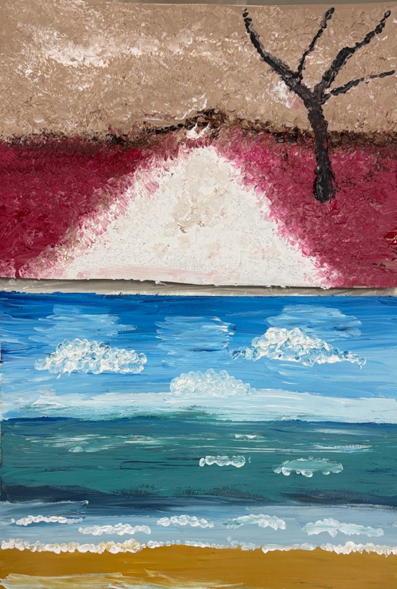
“A lot of the barriers arise because we have this artificial divide of us and them.”
Familia+migra
Notes:
.

Slide 16
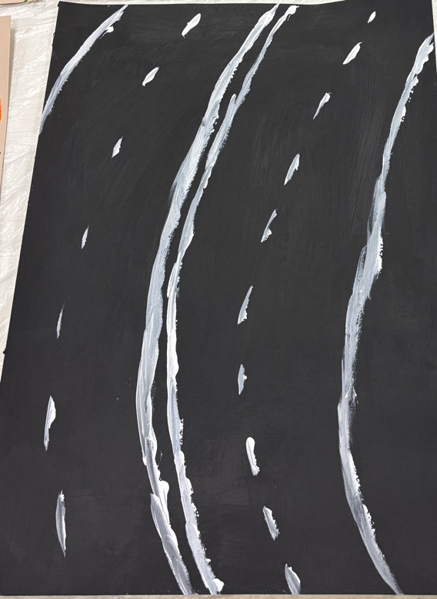
Co-created assessment tool
Promote bilateral learning
Community expresses needs, research knowledge, preferences, barriers, and conditions for participation
Research introduces itself, connect with communities
Community organisations involved
Familia+migra

Slide 17

Buenos Aires & Berlin
Gender identity laws
Political challenges
Fundación Huésped - LAC-CURA, BeCURE - EU2CURE
Esperanza patient, Berlin patient
Notes:
3 nature articles form world wids day

Slide 18
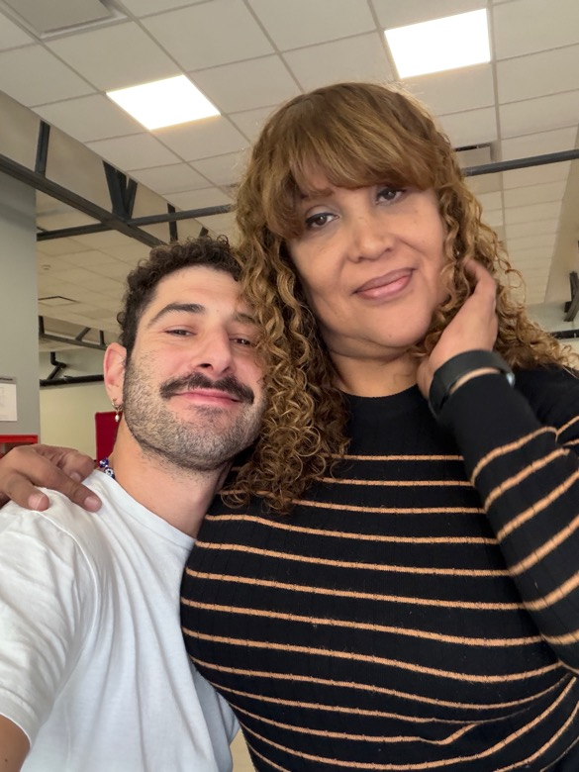
Implementation in Buenos Aires
Nadir Cardozo, Fundación Huésped
Connection with community advocates and organisations
Adoption, implementation, setting mutual priorities, and assessing interest

Slide 19
Preliminary findings from Buenos Aires
Notes:
.

Slide 20
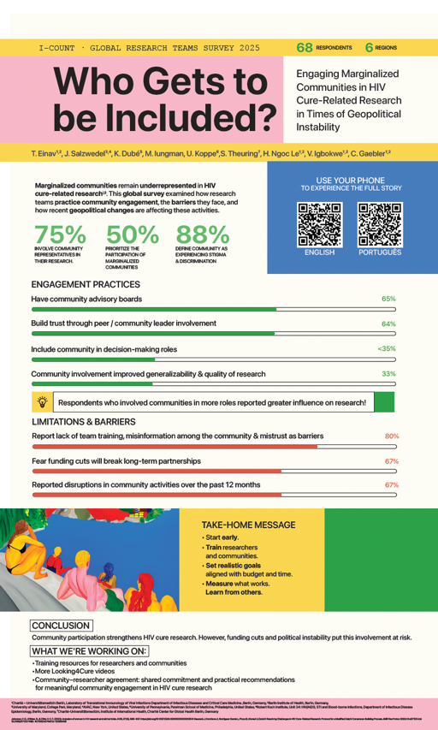
Recommendations
TUPED371
What can you do when you are back from Rio?
Reflect on your current practices
Reach out to community organisations and peers
Offer community training and education: build your own, or use existing (AVAC, Looking4cure, CanCURA, BEAT-HIV)
Invite community members to train your team and join it.

Slide 21
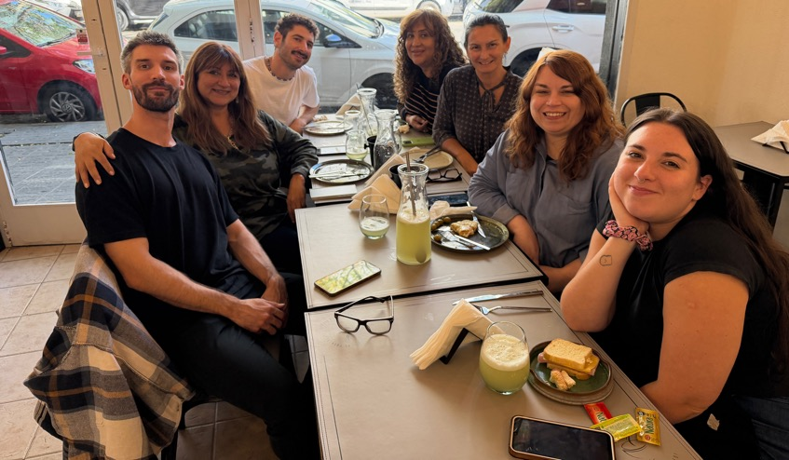
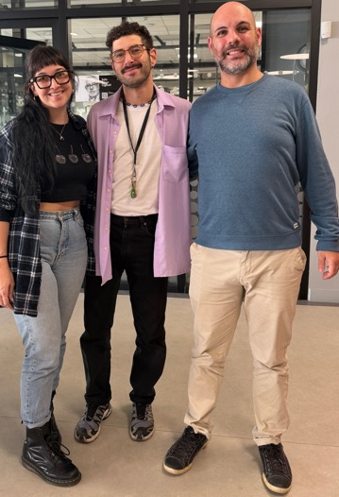
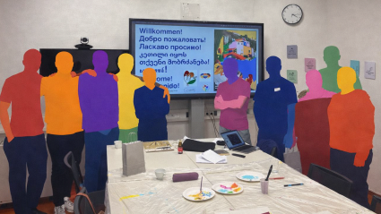
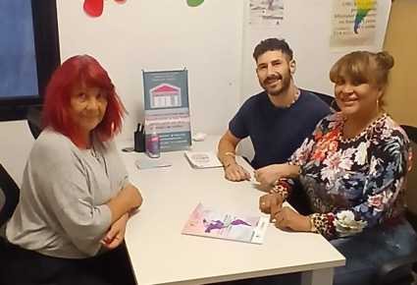
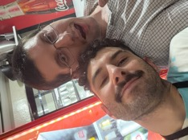
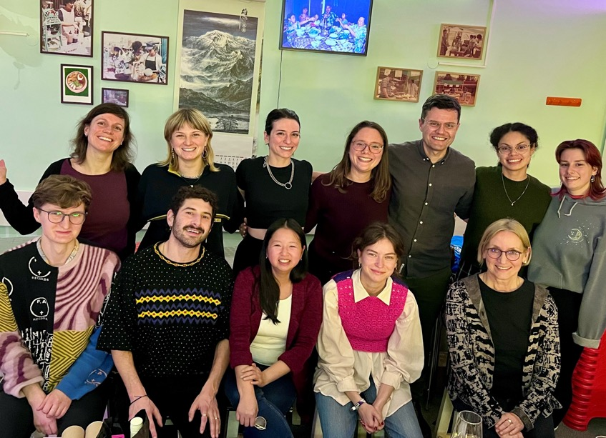
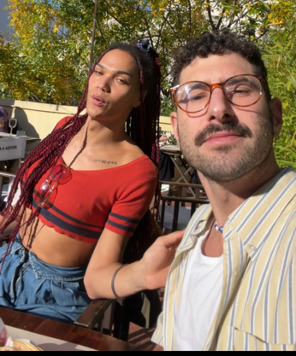

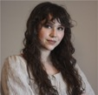

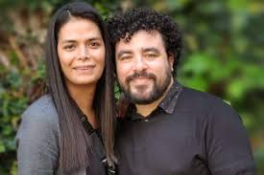
Thank you
Collaborators
Participants
Teams
Navot Miller and Familia+Migra for the paintings

Slide 22

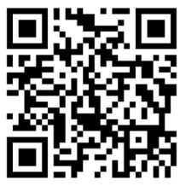

Invitation: screening of animation project
Youth Innovation Showcase: 30.7 10 am
Website
Instagram

