Slide 1
Cancer immunotherapy
Andreia C. de Melo – MD, PhD, MBA
Division of Clinical Research and Technological Development – Brazilian National Cancer Institute (INCA)

Slide 2
Disclosures
Research Support: BMS, Roche, Novartis, AMGEN, MSD, Lilly, Clovis Oncology, Pierre Fabre, Sanofi, Pfizer, GSK, Regeneron, AstraZeneca
Speaker Bureau: BMS, Roche, Novartis, MSD, Lilly, Pierre Fabre, Sanofi, Pfizer, Libbs, GSK, AstraZeneca, Adium, Medison, Daiichi, Abbvie
Advisory board: MSD, BMS, GSK, AstraZeneca, Abbvie

Slide 3
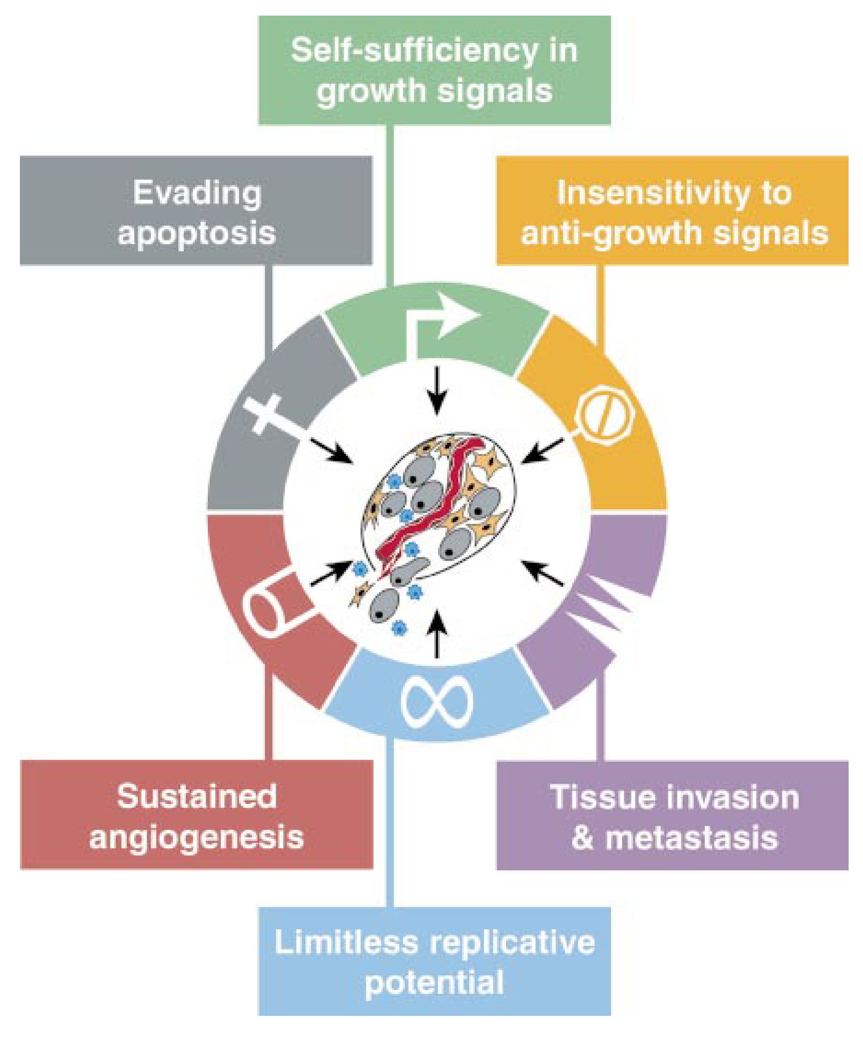
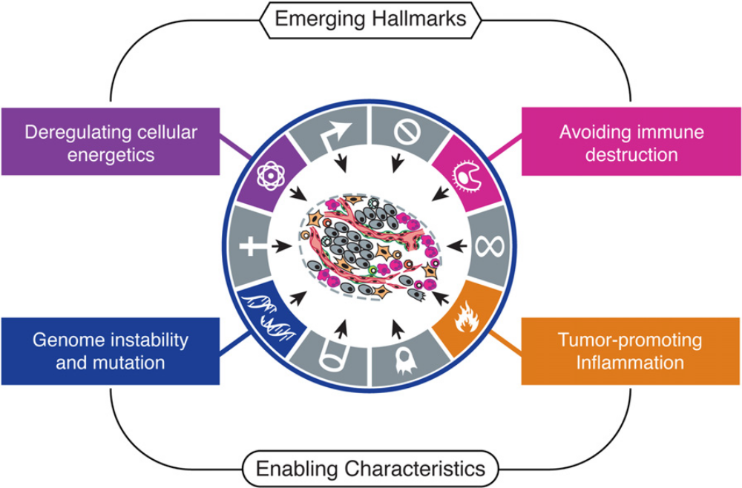
The Hallmarks of Cancer
Six biological capabilities acquired during the multistep development of human tumors
Conceptual progress has added emerging hallmarks
Hanahan & Weinberg, Cell 2000
Hanahan & Weinberg, Cell 2011

Slide 4
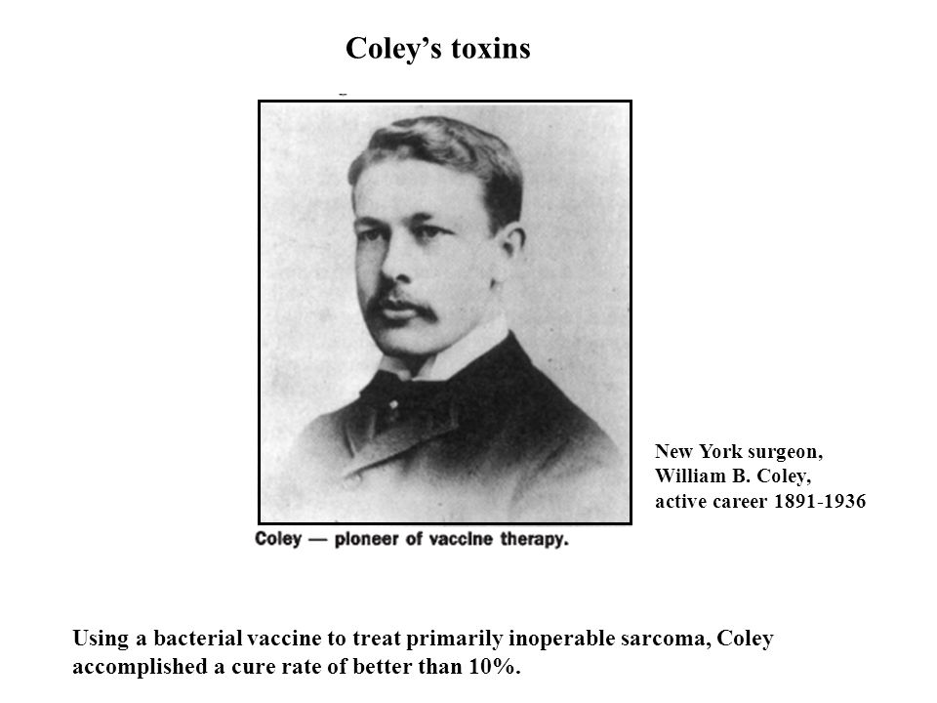
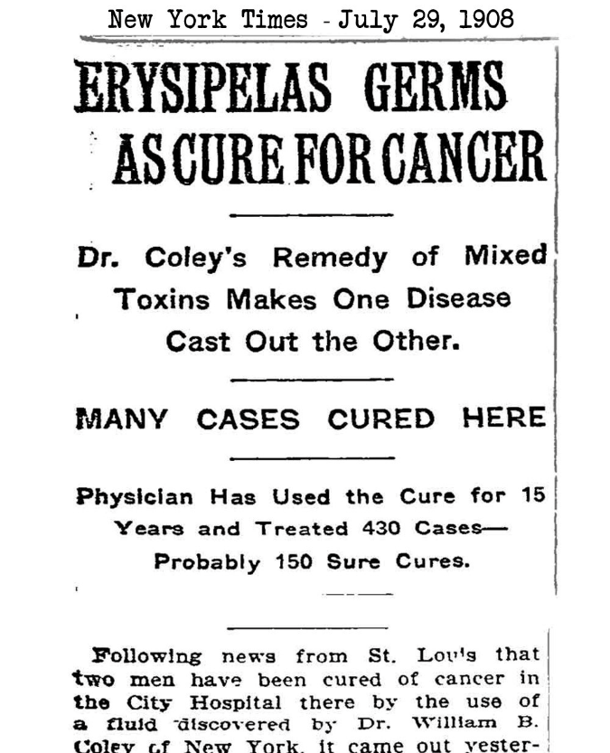
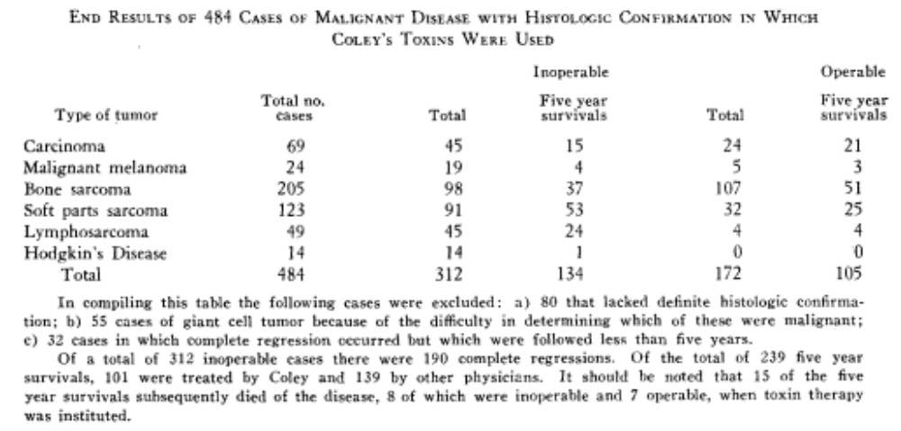
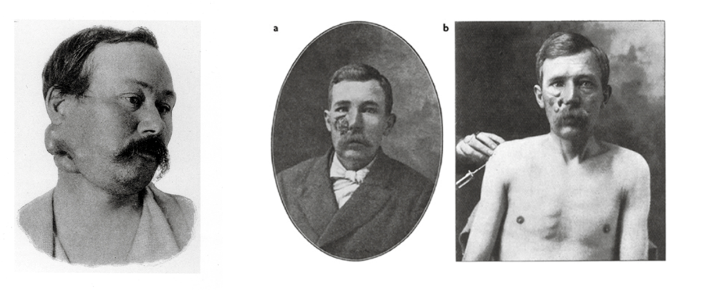
Coley’s toxins
William B. Coley injected streptococcal organisms into patients with inoperable cancer. He thought that the infection he produced would have the side effect of tumor regression.
Cancer Res 1946;6:205-216

Slide 5
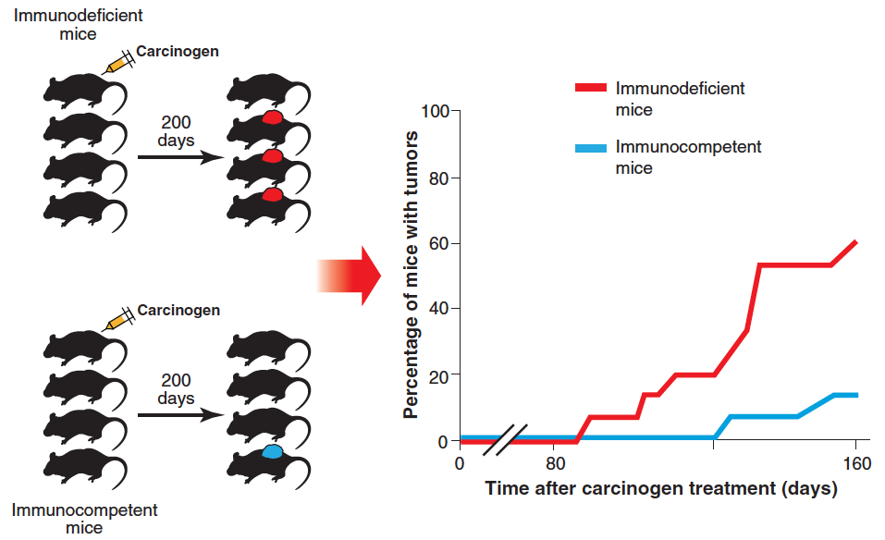
Cancer immunosurveillance
The immune response is essential to prevent the development of carcinogen-induced sarcomas and spontaneous epithelial tumours.
Shankaran et al., 2001

Slide 6
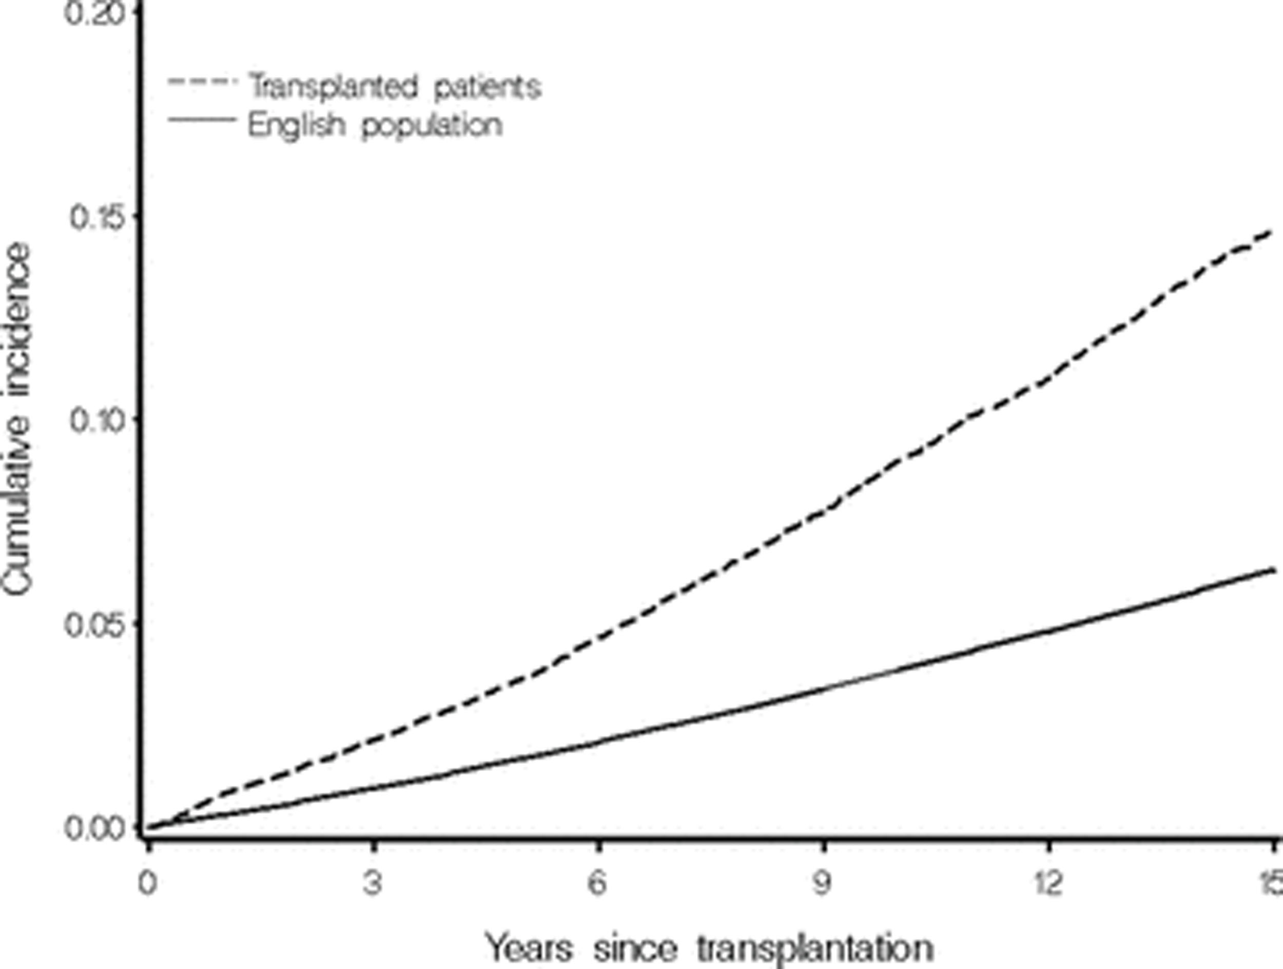
Incidence of malignancy following organ transplantation
An increased incidence of malignancy is an established complication of organ transplantation and the associated immunosuppression
Collett D et al. Am J Transplant. 2010;10(8):1889-1896

Slide 7
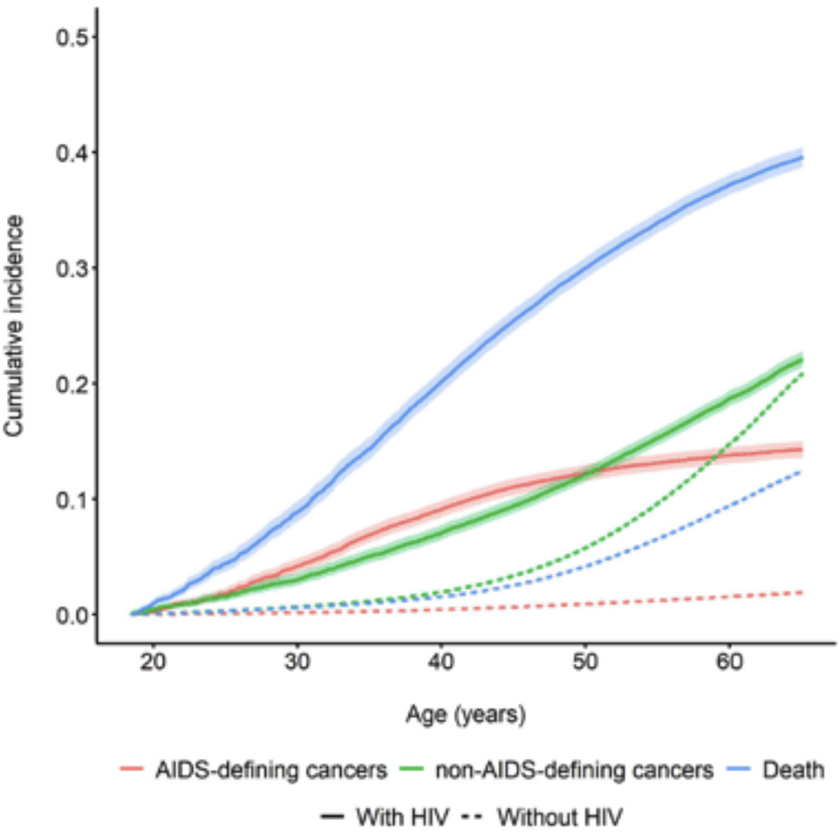
Incidence of malignancy in people living with HIV
Rudolph JE et al. Incidence of cancer among Medicaid beneficiaries with and without HIV: 2001-2015.

Slide 8
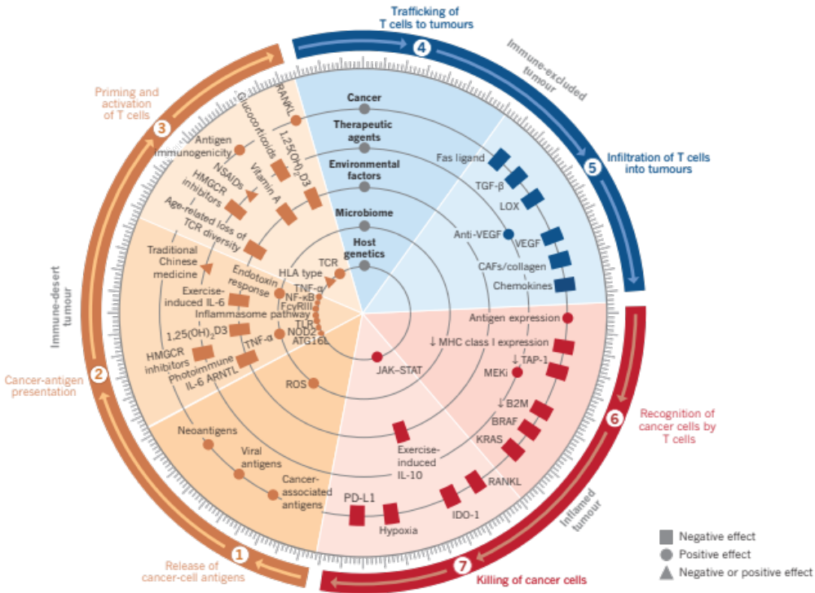
Elements of cancer immunity
Nature volume 541, pages321–330 (2017)

Slide 9
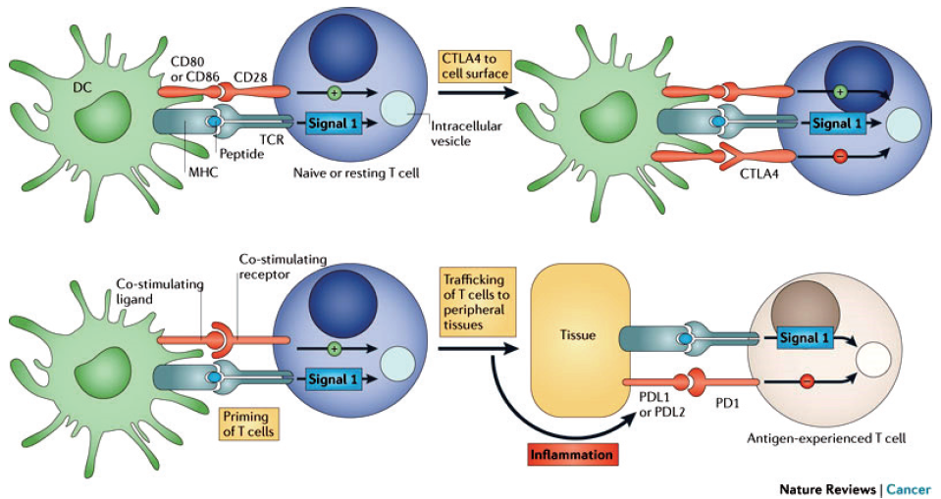
The blockade of immune checkpoints in cancer immunotherapy
Nature Reviews Cancer volume 12, pages252–264 (2012)

Slide 10
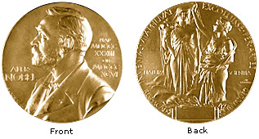
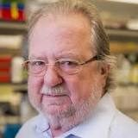
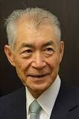
Nobel Prize
The 2018 Nobel Prize in Physiology or Medicine
1 October 2018
The Nobel Assembly at Karolinska Institutet has today decided to award The Nobel Prize in Physiology or Medicine for 2018 jointly to
James P. Allison and Tasuku Honjo
"for their discovery of cancer therapy by inhibition of
negative immune regulation"

Slide 11
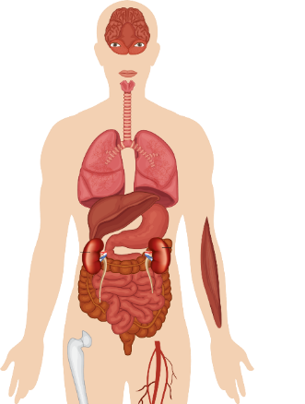
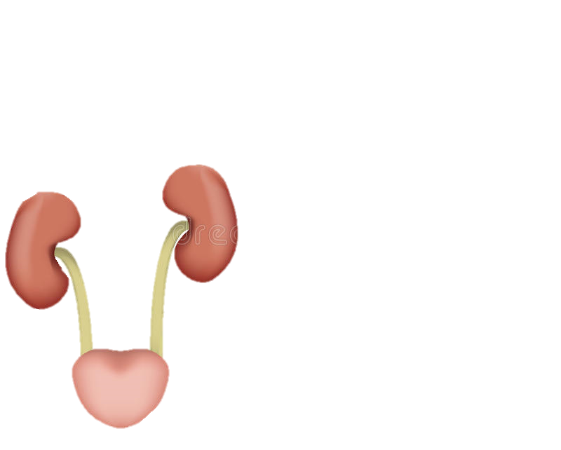
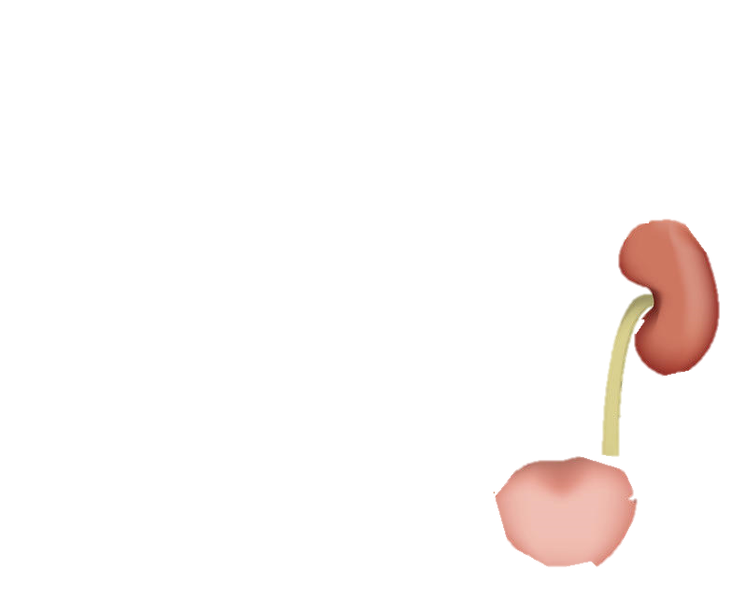
FDA-Approved Immune Checkpoint Inhibitor Indications in Solid Tumors
SCLC
1L, extensive stage: atezo + carboplatin/etoposide, durva + platinum/etoposide
2L+ after platinum chemo: nivo, pembro
HNSCC
1L: pembro + platinum chemo
1L if PD-L1 CPS ≥ 1: pembro
2L+ after platinum chemo: nivo or pembro
NSCLC
Unresectable stage III after CRT: durva
Metastatic/unresectable stage III if PD-L1 TPS ≥ 1%: pembro
1L if PD-L1 TC ≥ 50% or IC ≥ 10%: atezo
1L nonsqNSCLC: pembro + pemetrexed/platinum; atezo + carboplatin/paclitaxel/bevacizumab or carboplatin/nab-paclitaxel
1L sqNSCLC: pembro + carboplatin/(nab)paclitaxel
1L: nivo + ipi + platinum-doublet chemo
1L if PD-L1 TC ≥ 1%: nivo + ipi
2L+ if PD-L1 TPS ≥ 1%: pembro
2L+: nivo, atezo
Malignant Melanoma
Adj: ipi, nivo, or pembro
1L+: ipi, nivo ± ipi, or pembro
Merkel Cell Carcinoma
1L+: avelumab
2L+: pembro
Cutaneous SCC
1L: cemiplimab-rwlc
1L+: pembro
TNBC
1L if PD-L1 IC ≥ 1%: atezo + nab-paclitaxel
HCC
2L+ after sorafenib: nivo ± ipi, pembro
1L: atezo + bevacizumab
Gastric, Esophageal, and GEJ Adenocarcinoma
2L+ squamous esophageal if PD-L1 CPS ≥ 10: pembro
2L+ squamous esophageal: nivo
3L+ gastric or GEJ if PD-L1 CPS ≥ 1: pembro
Advanced RCC
1L: nivo + ipi, pembro + axitinib, avelumab + axitinib
2L+ after antiangiogenic therapy: nivo
Locally Advanced or Metastatic Urothelial Cancer
1L if ineligible for any platinum: pembro or atezo
1L if PD-L1 CPS ≥ 10 and ineligible for cisplatin chemo: pembro
1L if PD-L1 IC ≥ 5% and ineligible for cisplatin chemo: atezo
Maintenance after 1L platinum chemo: avelumab
After platinum chemo: pembro, atezo, avelumab, durva, or nivo
BCG-unresponsive NMIBC: pembro
MSI-H or dMMR Cancers
1L in CRC: pembro
2L+ in CRC: nivo ± ipi
2L+ in CRC: pembro
2L+ tumor agnostic: pembro
TMB-H Cancers
2L+ tumor agnostic: pembro
Cervical Cancer 2L+ if PD-L1 CPS ≥ 1: pembro
Endometrial 2L+ if NOT MSI-H or dMMR:
pembro + Lenvatinib
Endometrial 1L, Ovarian PROC
Atezolizumab PI. Avelumab PI. Cemiplimab-rwlc PI. Durvalumab PI. Ipilimumab PI. Nivolumab PI. Pembrolizumab PI. PD-L1 IHC 28-8 PharmDx PMA.

Slide 12
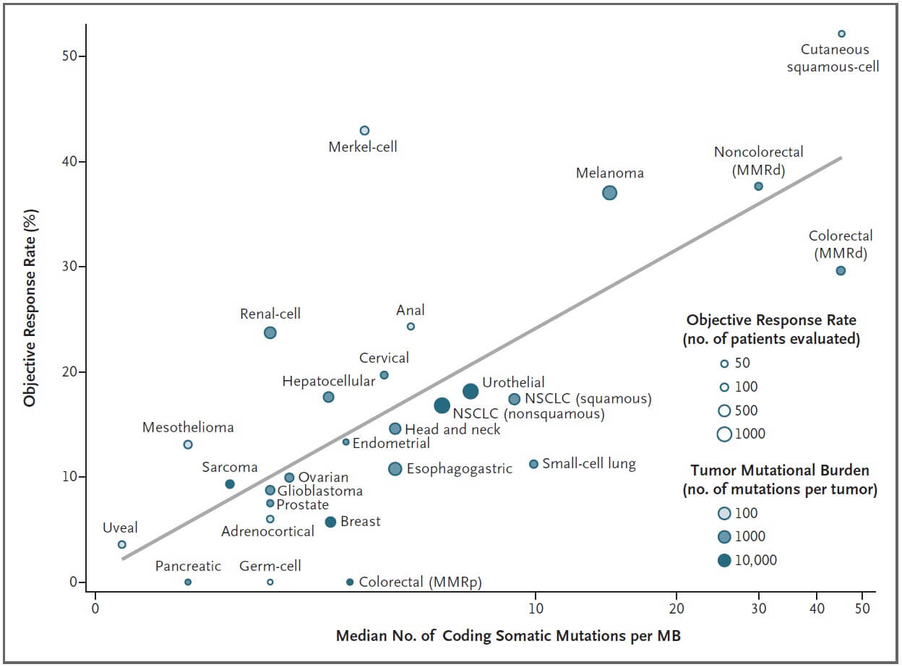
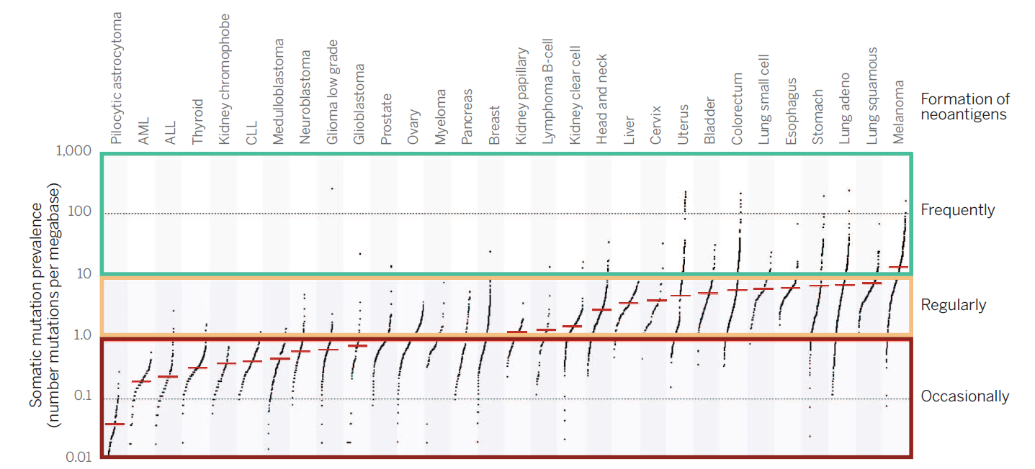
Melanoma
Yarchoan M, Hopkins A, Jaffee EM. N Engl J Med, 2017

Slide 13
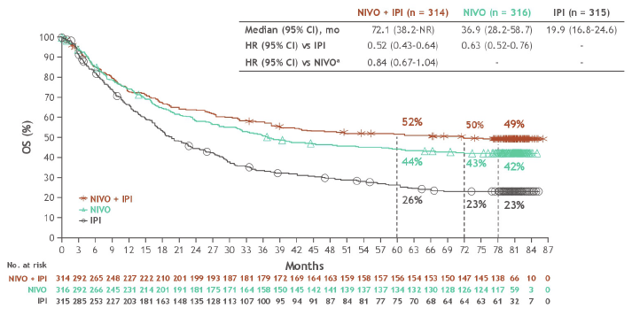
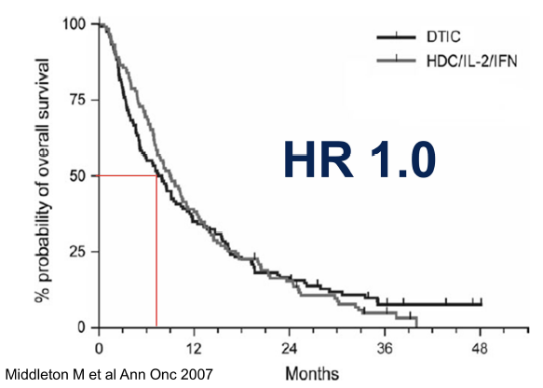
Metastatic Melanoma
N Engl J Med 2025;392:11-22

Slide 14
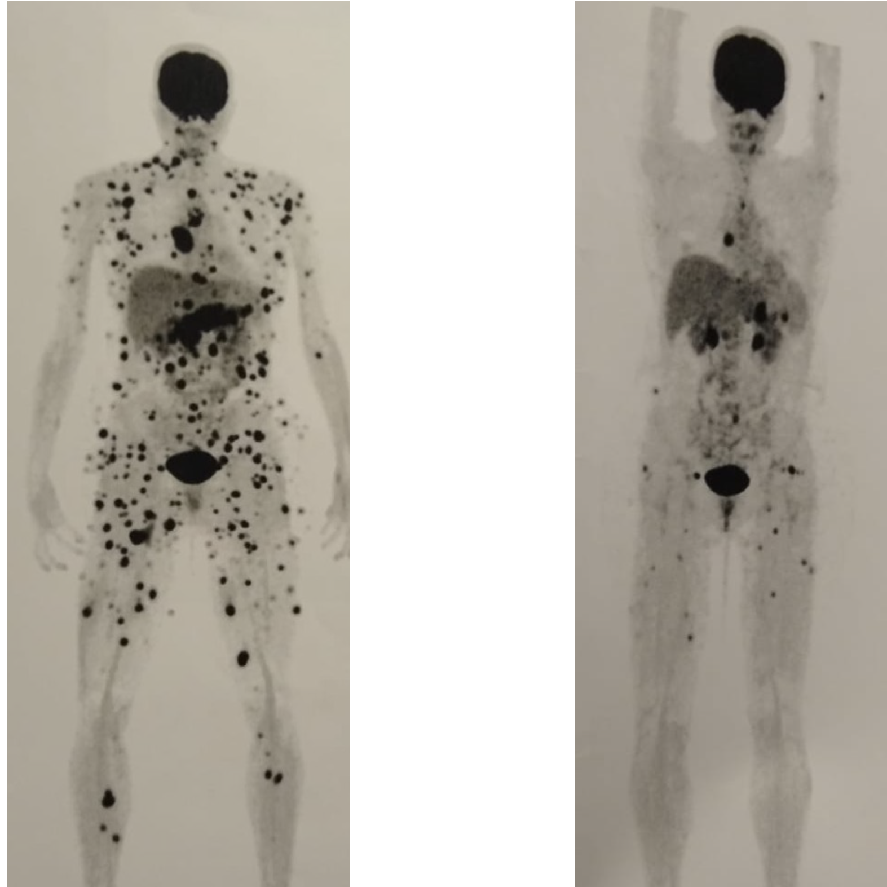
Metastatic Melanoma
Anti-CTLA-4 + Anti-PD1
Setember/2020
December/2020
Written informed consent was obtained from the patient for the use of clinical data and images for educational purposes

Slide 15
Metastatic Melanoma
Anti-PD1
Written informed consent was obtained from the patient for the use of clinical data and images for educational purposes

Slide 16
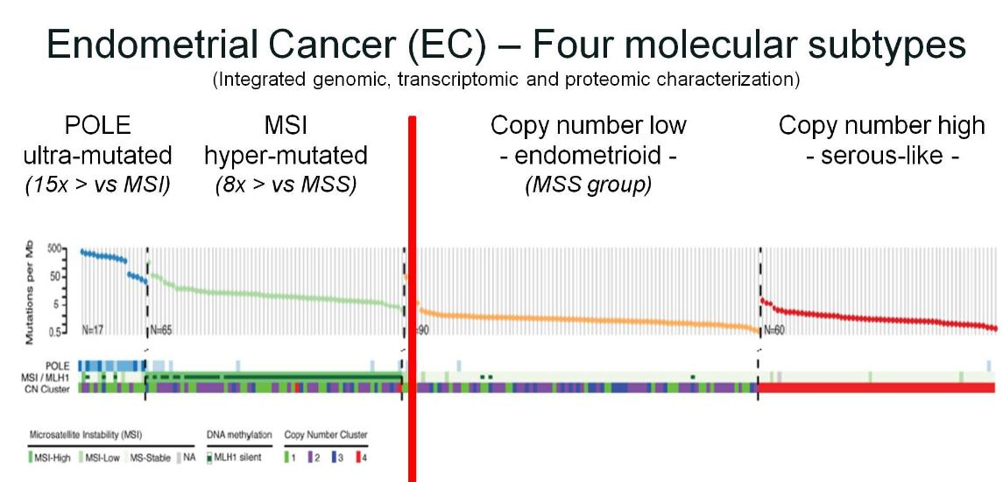
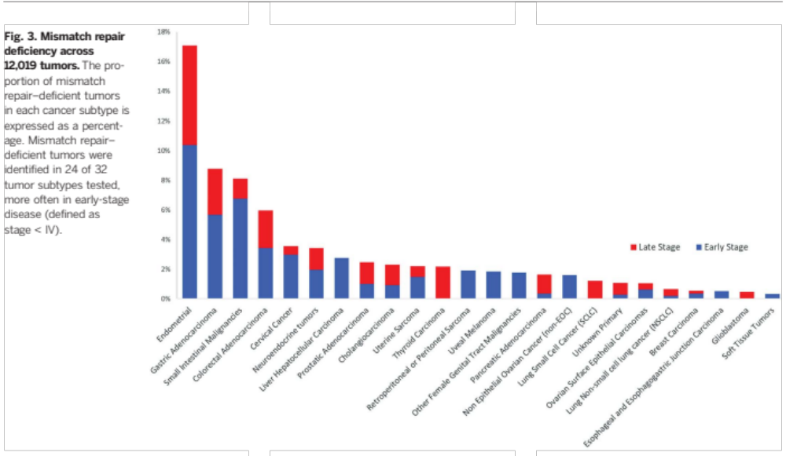
Endometrial cancer
TCGA Nature. 2013 22;500:415-21
Le DT, Durham JN, Smith KN, Wang H, Bartlett BR, Aulakh LK, et al.. Science. 2017 Jul 28;357(6349):409-13.

Slide 17
Endometrial cancer - dMMR
1.0
HR, 0.34
(95% CI, 0.19–0.63)
82.8%
(95% CI, 69.5%–90.7%)
76.9%
(95% CI, 62.9%–86.2%)
Median follow-up, 55.6 moª
0.8
72.8%
(95% CI, 58.5%–82.9%)
Dostarlimab + CP
mOS, NE
(95% CI, NE–NE)
0.6
Probability of survival, %
58.2%
(95% CI, 45.3%–69.2%)
0.4
45.3%
(95% CI, 32.8%–57.0%)
mOS, 32.8 mo
(95% CI, 21.6 mo to NE)
40.3%
(95% CI, 28.2%–52.1%)
Placebo + CP
~71% of patients in the placebo arm that had FUACT received IO
0.2
 | Events, n/N (%)
Dost + CP | 15/53 (28.3)
PBO + CP | 38/65 (58.5)
OS maturity | 53/118 (44.9)
0.0
Censored
0
4
8
12
16
20
24
28
32
36
40
44
48
52
56
60
Months from randomization
No. at risk (no. events)
Dost + CP
53(0)
50(3)
46(6)
45(7)
44(7)
44(7)
42(9)
42(9)
41(10)
38(12)
36(14)
35(14)
34(14)
24(15)
15(15)
5(15)
PBO + CP
65(0)
62(3)
56(9)
52(13)
45(20)
41(23)
36(27)
34(29)
31(32)
28(35)
27(36)
26(37)
23(38)
16(38)
10(38)
6(38)
Society of Gynecologic Oncology (SGO) 2026 Annual Meeting on Women’s Cancer, April 10–13, 2026

Slide 18
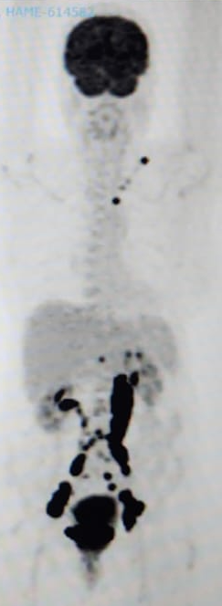
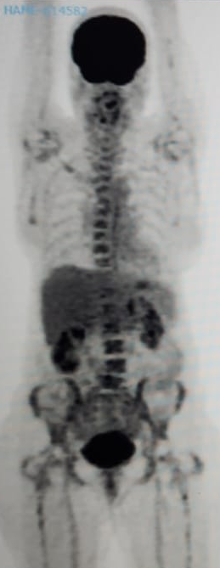
Endometrial Cancer - dMMR
Anti-PD1 + chemotherapy
Written informed consent was obtained from the patient for the use of clinical data and images for educational purposes

Slide 19
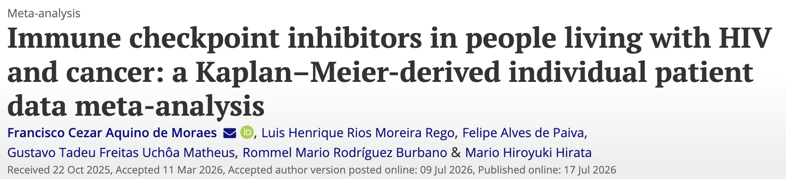
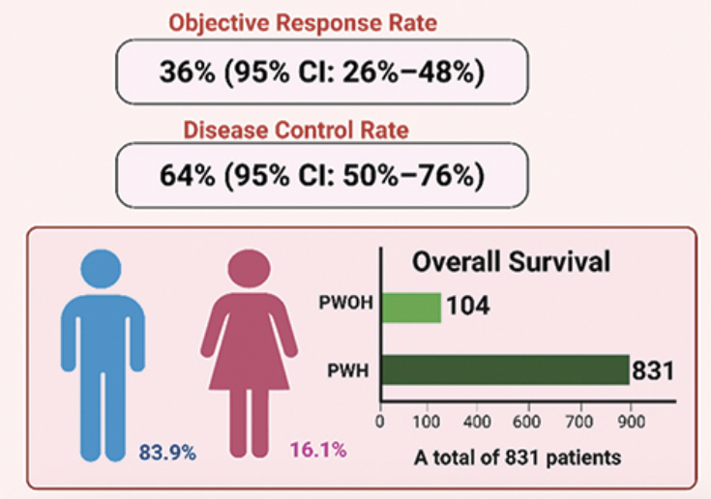
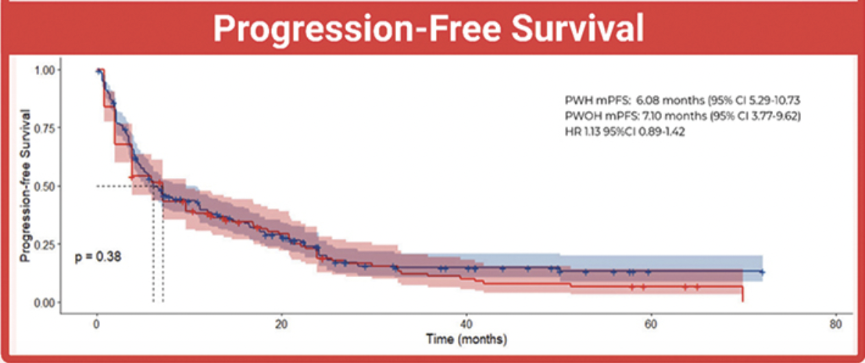
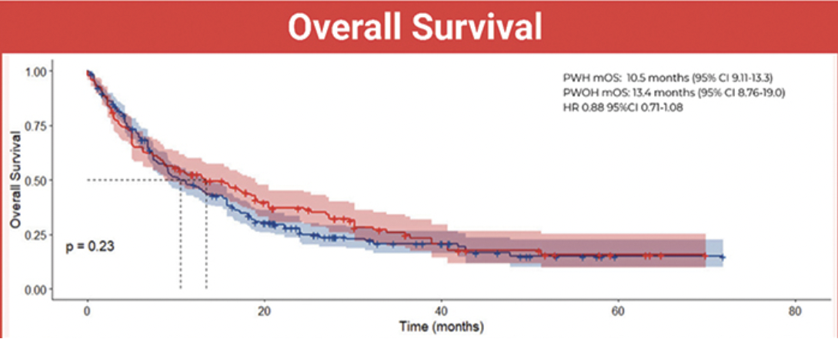
Immunotherapy in people living with HIV
Fourteen studies including 935 patients were analyzed.
Compared with people living without HIV, PLWH showed no significant differences in overall survival (HR, 0.88; 95% CI, 0.71–1.08; p = 0.23), progression-free survival (HR, 1.13; 95% CI, 0.89–1.42; p = 0.38), any adverse events (OR, 0.90; 95% CI, 0.52–1.58; p = 0.71), or severe adverse events (OR, 1.04; 95% CI, 0.51–2.10; p = 0.91).
Moraes, F. C. A. et al. (2026). Expert Review of Anticancer Therapy,

Slide 20
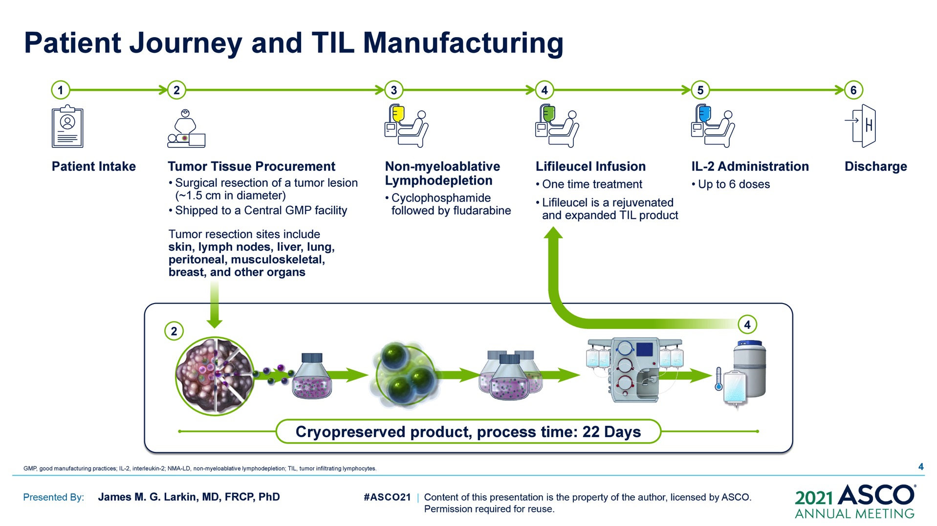
TILs
ASCO 2021

Slide 21
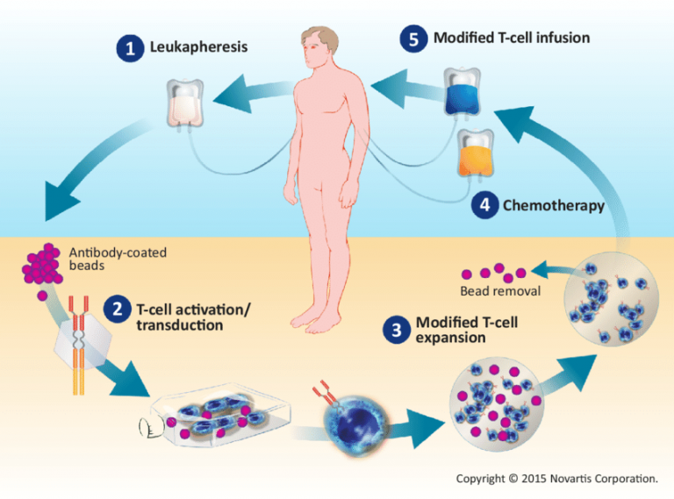
CAR-T

Slide 22

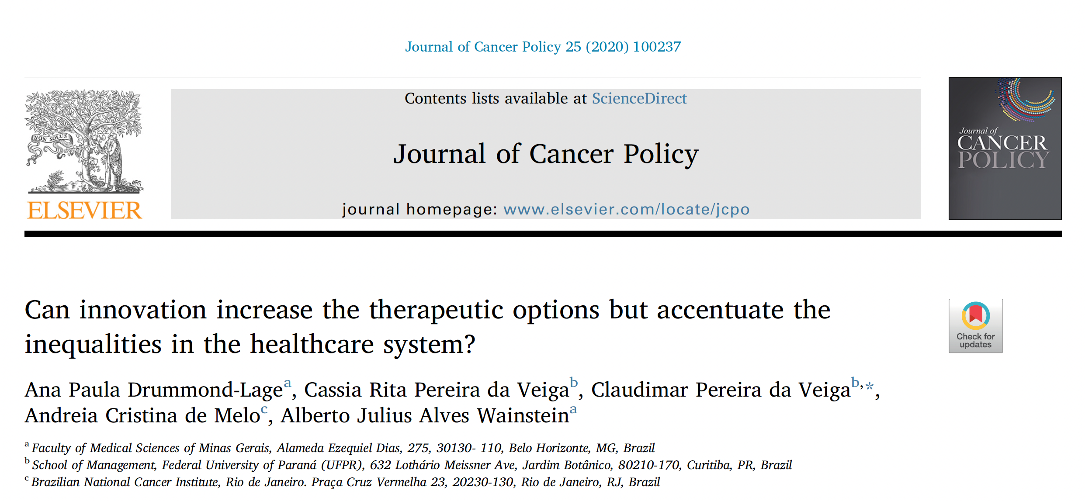
Inequalities in LMICs
The introduction of innovations can accentuate the existing inequalities
in the delivery of healthcare in Brazil

Slide 23
Access to immunotherapy
The challenge is how to incorporate the immunotherapy into the toolbox of health professionals, given the
complexity and inequities of the Brazilian healthcare system, limiting financial resources and numerous health needs.

Slide 24
Summary for community
Key question
How has immunotherapy transformed cancer treatment?
Key findings and take-home message
Immune checkpoint inhibitors have transformed the treatment of multiple cancers by restoring the patient's own anti-tumor immune response.
Current evidence shows that people living with HIV have similar efficacy and safety compared with people living without HIV.
How is this related to cure?
Although immunotherapy is not a cure for most patients, it can induce durable disease control, and in some cancers, a subset of patients achieve complete responses and improve overall survival.
Why should we be excited?
Patients diagnosed with cancer are living more and with quality of life. The next challenge is ensuring that these therapies become accessible, inclusive, and equitable worldwide.

Slide 25
Thank you! andreia.melo@inca.gov.br
Andreia C. de Melo – MD, PhD, MBA
Division of Clinical Research and Technological Development – Brazilian National Cancer Institute (INCA)
@andreiacdemelo
Andreia Melo

