Slide 1

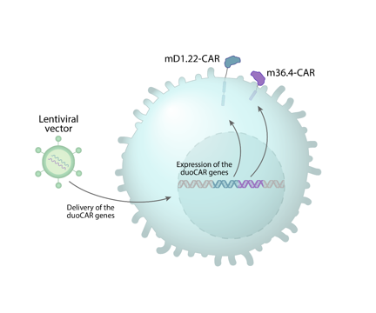





Safety and anti-HIV activity of anti-HIV duoCAR-T cells in people living with HIV (NCT04648046)
Steven Deeks, MD
Mehrdad Abedi, MD
Kim Anthony-Gonda, PhD
Jane Reese, MBA
Boro Dropulić, PhD, MBA

Slide 2
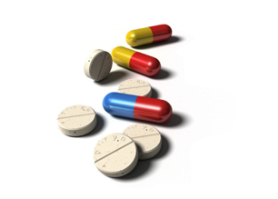

Antiretroviral therapy (ART) prevents active HIV replication but is not curative
Treatment must be given for life, which is challenging for many
ART
Viral Load
50 copies HIV RNA/mL
Years to Decades

Slide 3
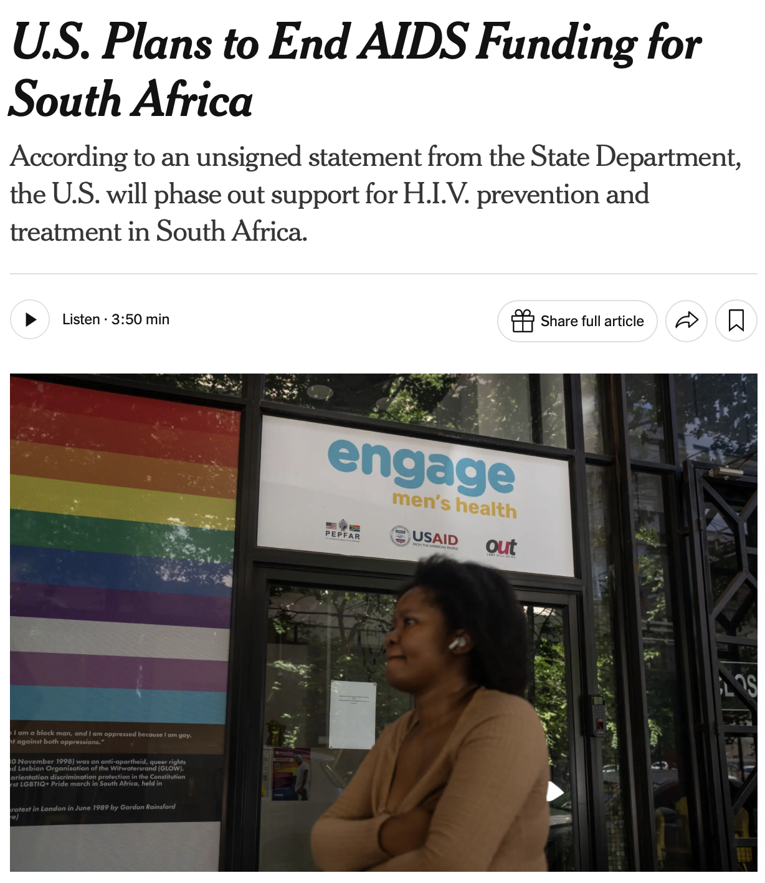
Why do we need a cure in an era of effective antiretroviral therapy?
Individual challenges
  Adherence challenges
  Stigma/discrimination of taking daily treatment
  Long-term health: Obesity, polypharmacy
  Multi-drug resistance
Public health challenges
  ART is lifelong and expensive: Total spent on HIV/AIDS: ~ $50 billion/year
  Social, political, and economic disruptions can interrupt sustained access to ART, including pandemics (COVID-19), reductions in PEPFAR funding, armed conflict, humanitarian crises, and supply chain disruptions.
  Despite massive investments, many (~30% of world’s population) are not on effective ART
  ~1.2 million new HIV cases yearly worldwide
June 19, 2026

Slide 4
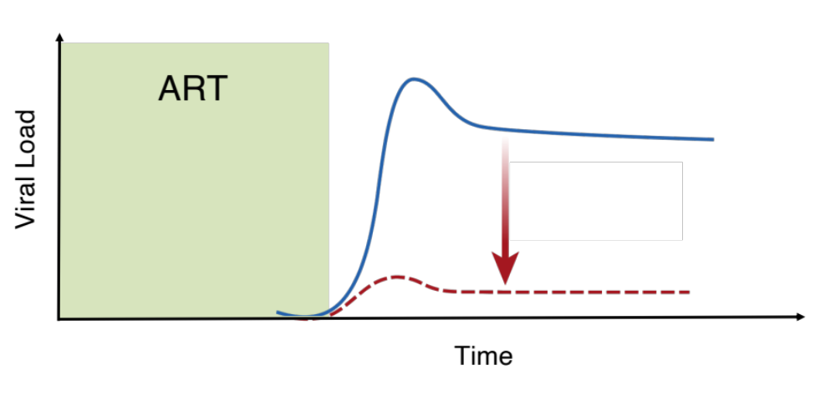
Immunotherapy: Enhancing the capacity of the immune system to control HIV Similar to the effects of “elite” control
HIV control is consistently associated with CD8+ T cells that target conserved epitopes and have strong proliferative capacity ("stemness")

Slide 5
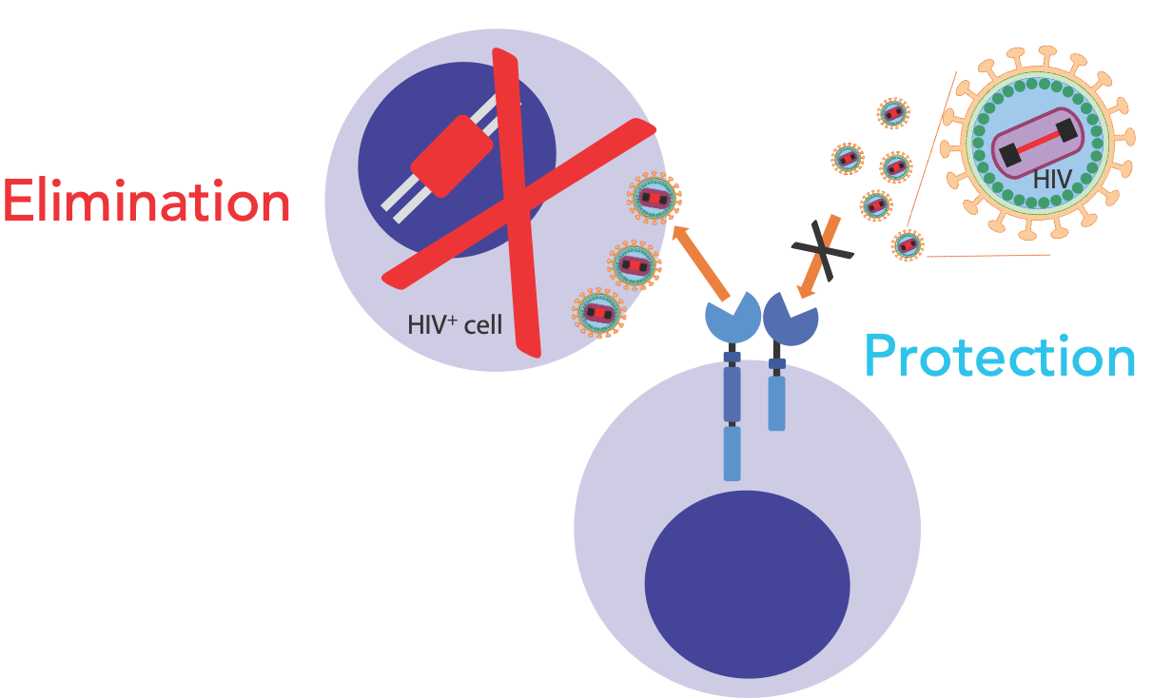
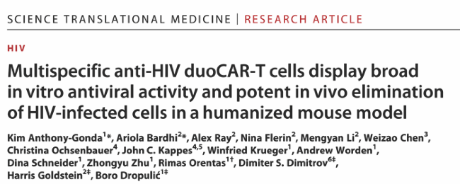
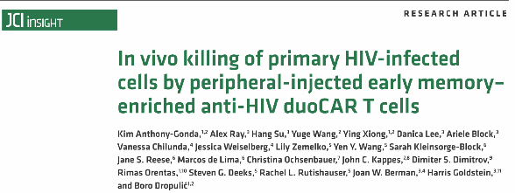
Anti-HIV duoCAR-T cells eliminate productively HIV infected cells and are protected from HIV infection
DuoCAR
T cell

Slide 6
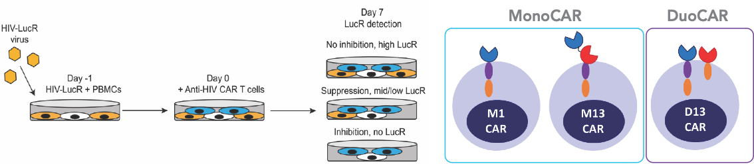
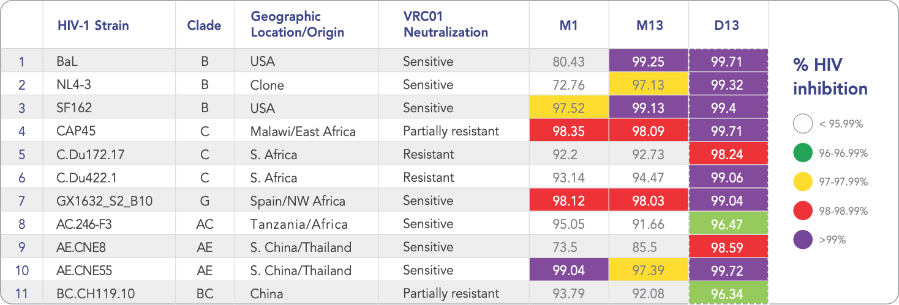
Anti-HIV duoCAR-T cells are highly effective against global HIV-1 subtypes and superior to monoCAR-T cells

Slide 7
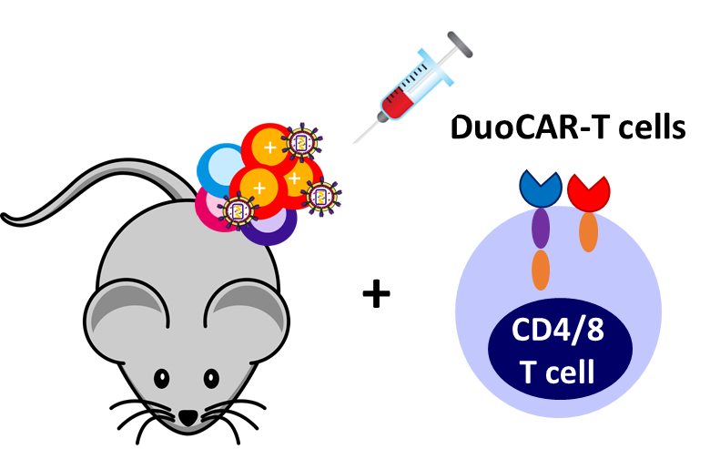
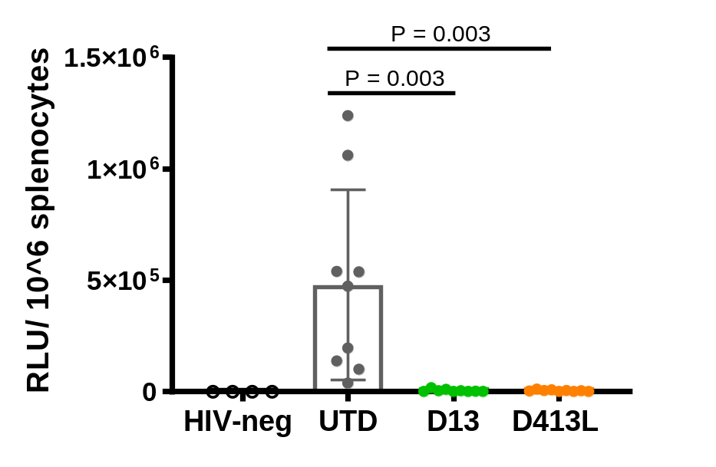
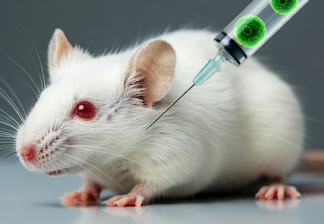

Anti-HIV duoCAR-T cells potently inhibit HIV replication and protects CD4 T cells from HIV infection in humanized mice
Human CD4⁺ T cells
30 days of
HIV-1 infection
Subtype C
CD4⁺ T cell
protection
CD4⁺ T cell
depletion
Anti-HIV efficacy
Bi-duoCAR vs. Tri-duoCAR
DuoCAR
30 days

Slide 8
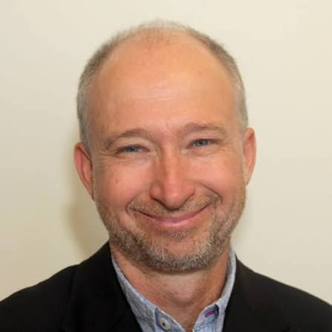
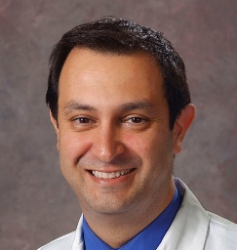

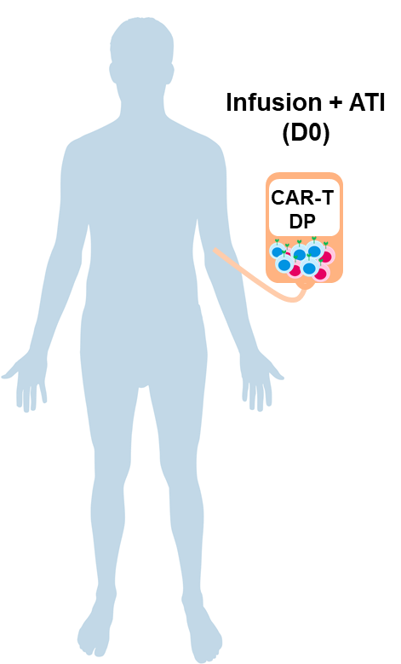
First-in-human, dose-escalation study (3+3 design)
ART interrupted at the same time as the CAR-T cells are infused
Steve Deeks
Clinical PI
UCSF
Mehrdad Abedi
Co-Clinical PI
UCD
Clinical site
(UC Davis)
Study Design
9 participants enrolled
2 in cohort 1 re-enrolled in later cohorts (11 total infusions)
9 interrupted ART and are the focus of the efficacy outcomes
2 remained on ART
CAR-T cell therapy is known to require transient conditioning for activity/efficacy
ATI
ATI
ATI
No Conditioning 3 x 10⁵ cells/kg
ATI
ATI
ATI
Non Myeloablative Conditioning
3 x 10⁵ cells/kg
Non Myeloablative Conditioning
1 x 10⁶ cells/kg
ATI
ATI
ATI
LTFU plan
Conditioning regimen: cyclophosphamide (1 gm/m²)
NCT04648046

Slide 9
Typical post-treatment rebound dynamics
ART
ATI
ART

Slide 10
Study Design: CAR-T cells infused on the day ART is interrupted
Conditioning regimen given Day -3 (cohorts 2 and 3)
ART
ATI
ART

Slide 11
CAR-T cells infused at the virus-host intercept may allow the immune system to get ahead of the virus, leading to control
ART
ATI

Slide 12

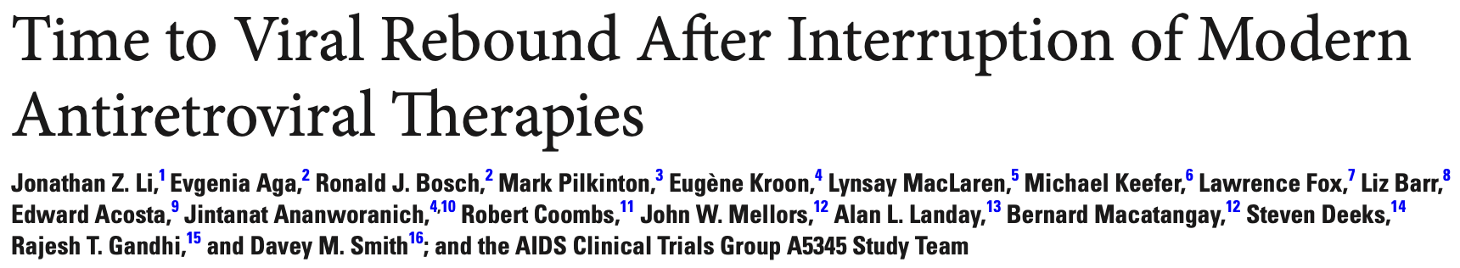
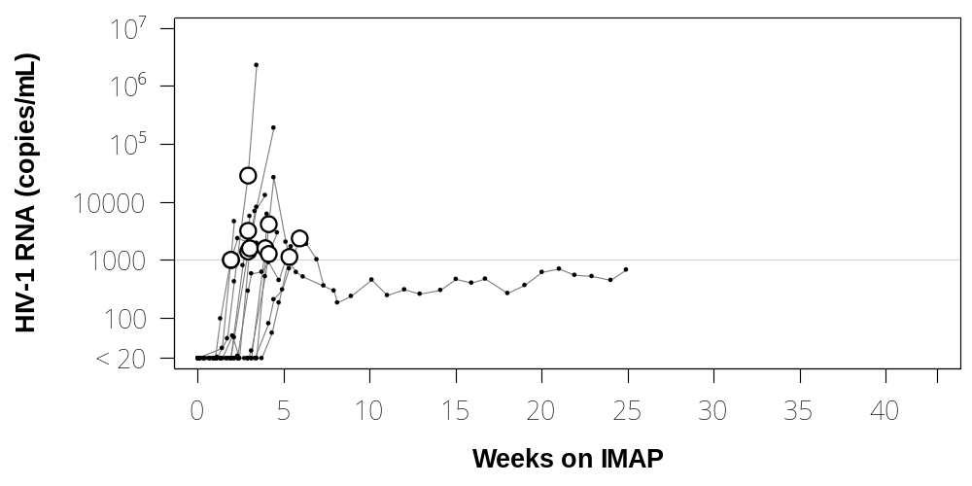
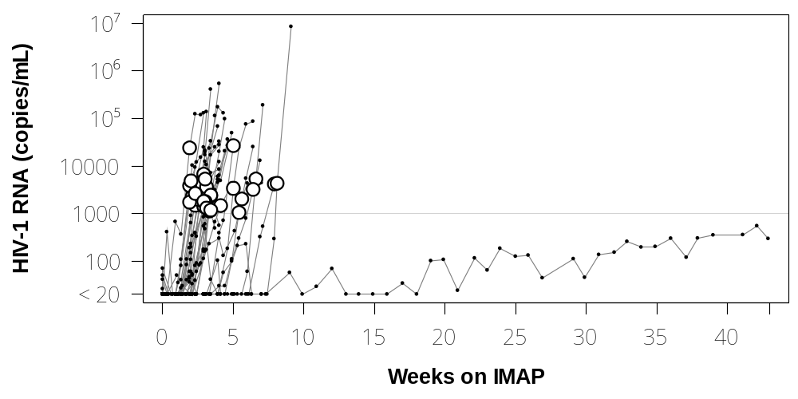
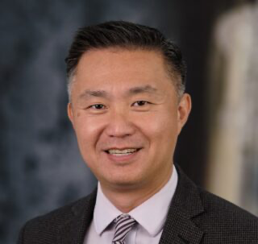
ACTG 5345: Prospective ATI study to define post-ART viral dynamics in the modern era
Early ART (Fiebig 3-5)
n = 12
Late ART
n = 33
Weeks of ATI
Weeks of ATI
Rebound is typically rapid (14-21 days) and exponential
Partial control (~ 1000 cpm) is uncommon
Complete or near-complete control (< 50 cpm) is rare
Jonathan Li
ART resumed for VL > 1000 confirmed

Slide 13
Eligibility Criteria
Age ≥ 18 and ≤ 70 years
Continuous ART > 12 months without any interruptions of > 14 days
Stable regimen that does not include an NNRTI or long-acting ART
HIV RNA levels < 30 cpm (isolated blips allowed)
Screening CD4+ T-cell count ≥ 350 cells/mm³
Capacity to construct an effective antiretroviral treatment regimen
Not pregnant/breastfeeding
No history of an HIV-associated malignancy
No history of or current active hepatitis B; active HCV
No active and poorly controlled atherosclerotic cardiovascular disease
No history of potential immune-mediated medical conditions
We enrolled people who started ART early or late

Slide 14
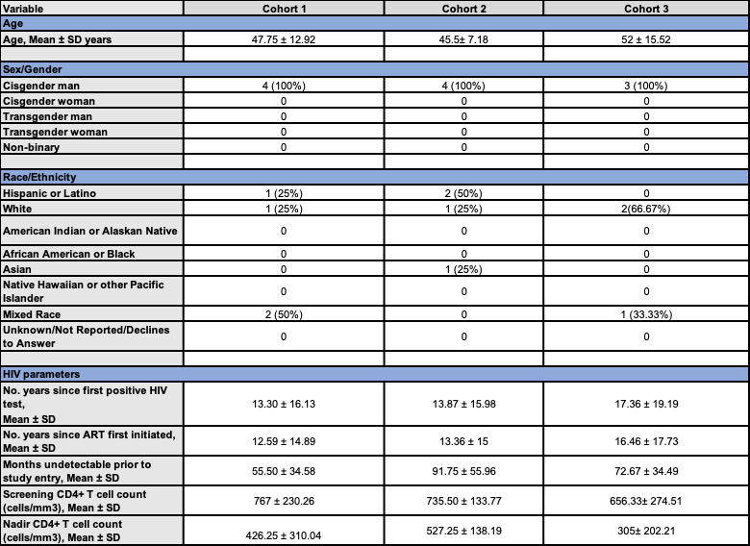
Baseline participant characteristics

Slide 15
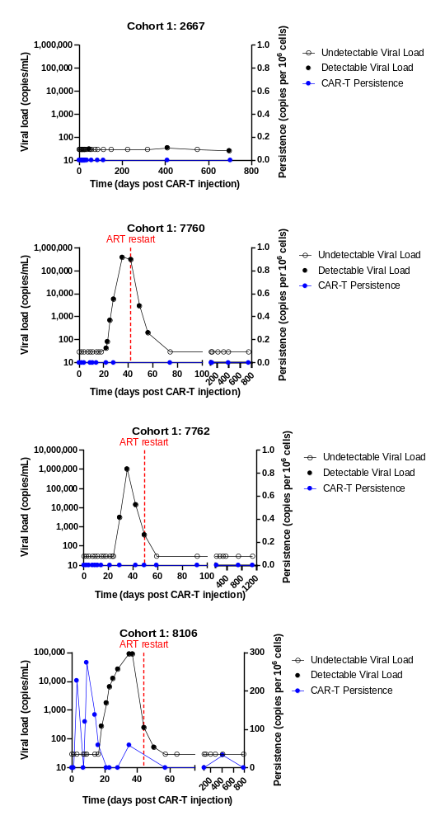
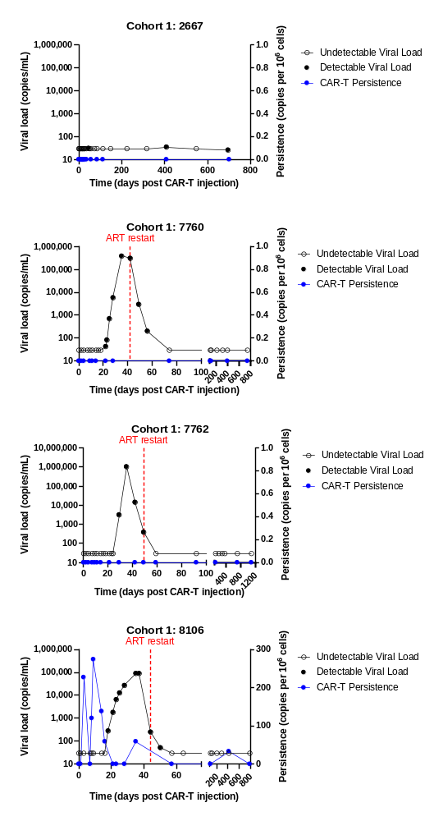
Cohort 1
No conditioning, ATI at dosing with 3 x 10⁵ CAR-T cell per kg
CONFIDENTIAL

Slide 16
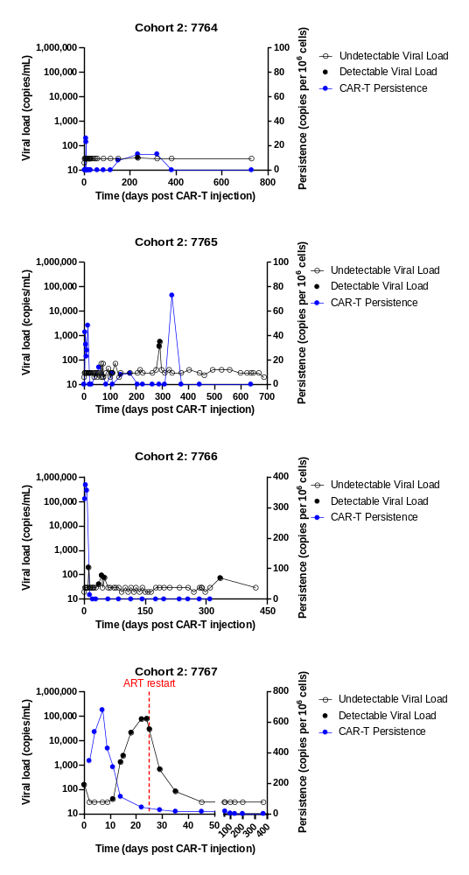
Cohort 2
Cytoxan conditioning, ATI at dosing with 3 x 10⁵ CAR-T cell per kg
Acute/early infection (Fiebig 4)
HLA-B5701 Neg
Control > 60 weeks
Acute/early infection (Fiebig 4)
HLA-B5791 Neg
Control > 100 weeks
Chronic Infection
CONFIDENTIAL

Slide 17
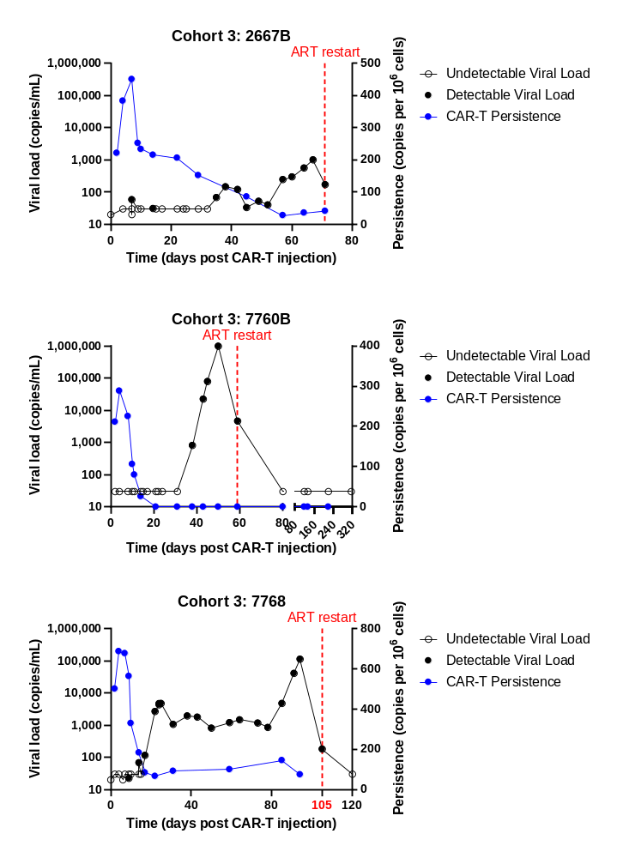
Cohort 3
Cytoxan conditioning, ATI at dosing with 1 x 10⁶ CAR-T cell per kg
Acute/early infection (Fiebig 4-5)
HLA-B5701 Neg
Partial control ~ 15 weeks
Chronic infection
HLA-B5701 Neg
Partial Control ~ 10 weeks
Transient G4 Neutropenia
Chronic infection
CONFIDENTIAL

Slide 18
Safety Profile
Product (LVgp120duoCAR-T cells)
  No episodes of cytokine release syndrome
  No episodes of neurotoxicity (ICANS)
  No gradable toxicities related to the LVgp120duoCAR product
Conditioning regimen (cyclophosphamide 1 gram/m²)
  Transient non-gradable lymphopenia common (expected)
  Grade 4 neutropenia (day 10) and lymphopenia (day 14) in one individual; cell counts improved over time
Analytic treatment interruption (ATI)
  Multiple expected grade 1 and 2 adverse events related to ATI
  Transient drops in CD4+ T cells counts
  No episodes of acute retroviral syndrome

Slide 19
Conclusions
LVgp120duoCAR-T product was safe
  No classic CAR-T cell toxicities observed (CRS, ICANS)
  Conditioning regimen caused a significant cytopenia in one person
Post-ART control observed in those who started ART early
  3/3 Acutely infected participants that started ART early, controlled VL completely or partially
  1/3 Chronically infected participants partially controlled VL
  All who started ART (n=3) early and may have achieved control in absence of an intervention, although complete and partial control in all three participants is very rare
  Transient low-level CAR levels observed in the blood for those with conditioning
Data provide encouraging evidence that a one-time treatment could offer a viable strategy for sustained, long-term HIV control
  Randomized studies will be needed to prove effectiveness of this approach

Slide 20
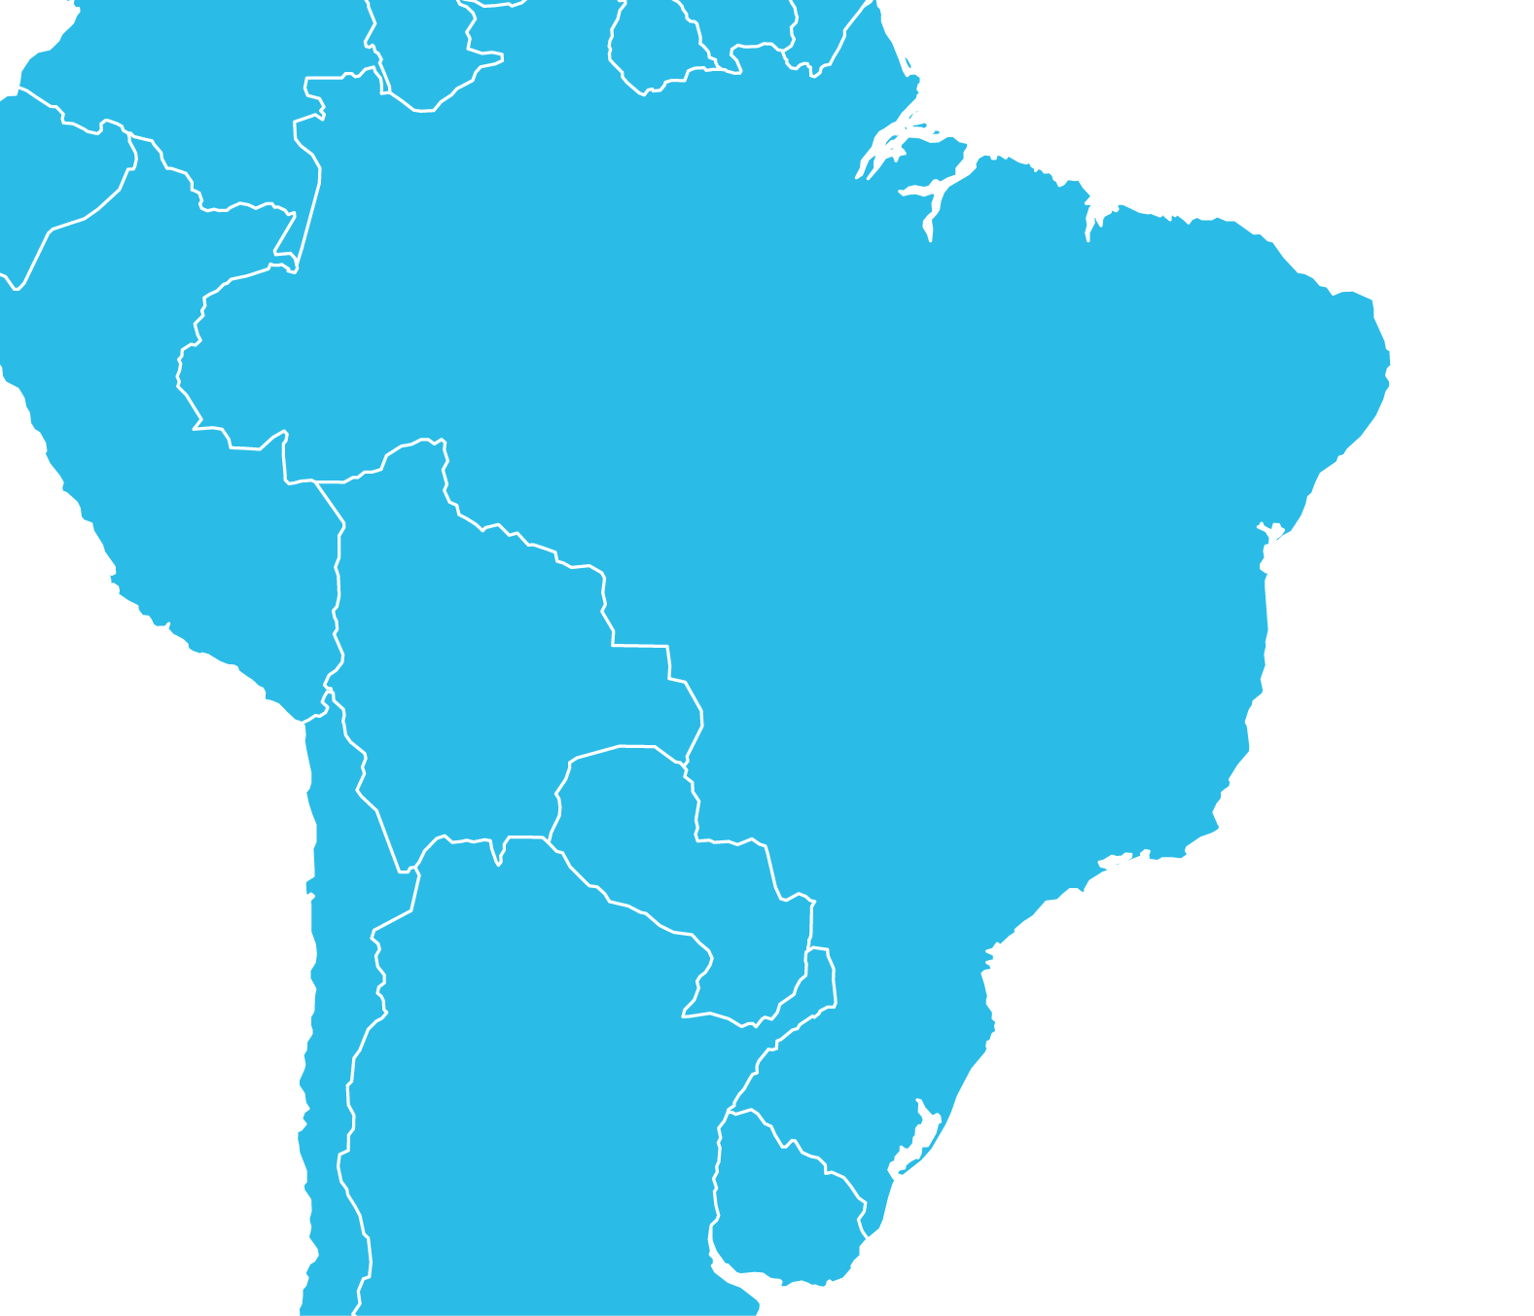
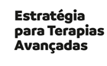

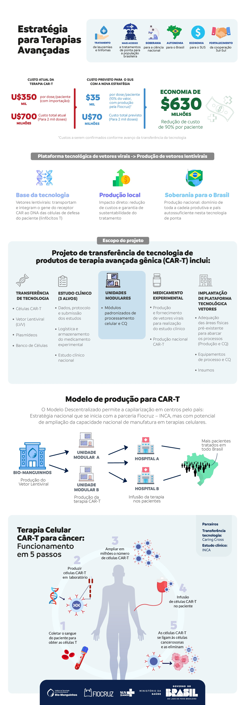


Making CAR-T cell therapies affordable by technology transfer to local organizations
A price of US$350K+ for CAR-T cell therapy is not sustainable anywhere, and not feasible in countries like Brazil
Caring Cross technology transfer to Fiocruz & Bio-Manguinhos, supported by the Brazilian Ministry of Health
Transfer of advanced CAR-T cell manufacturing and Lentiviral vector manufacturing technology
CAR-T for Oncology, HIV, other ATMPs
CAR-T cell therapy will have an all-inclusive cost of about US$35,000 per dose, a 90% reduction in cost
Fiocruz & Bio-Manguinhos Cell and Vector Manufacturing Facilities
Medical Center CAR-T Manufacturing Facility

Slide 21
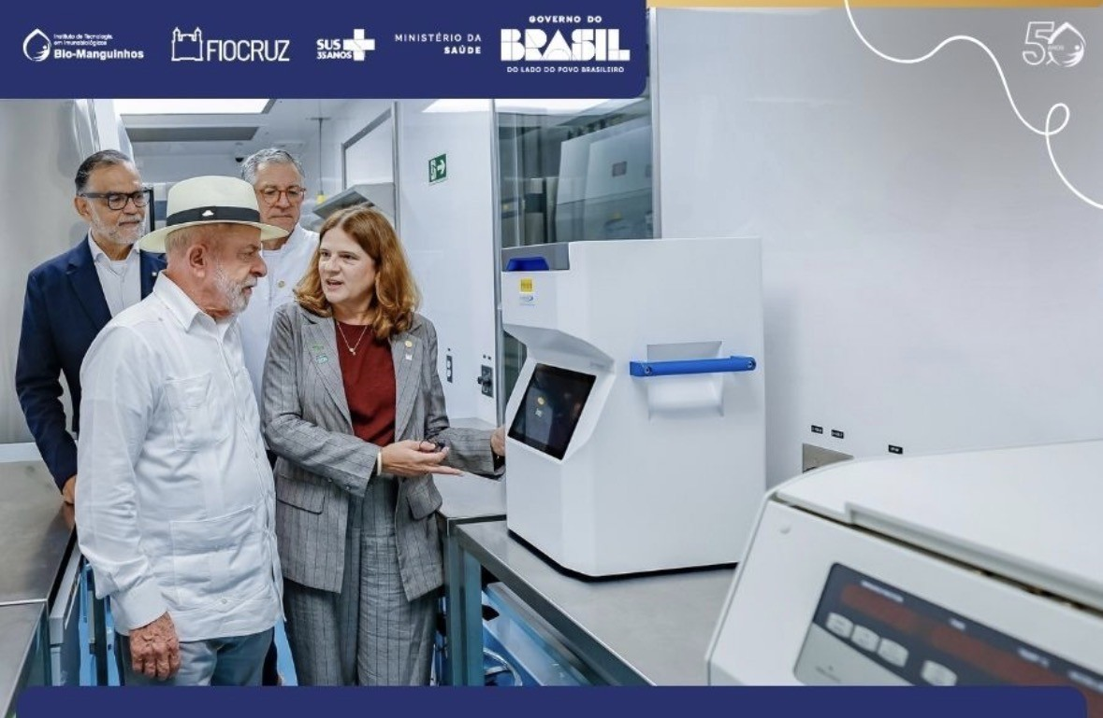
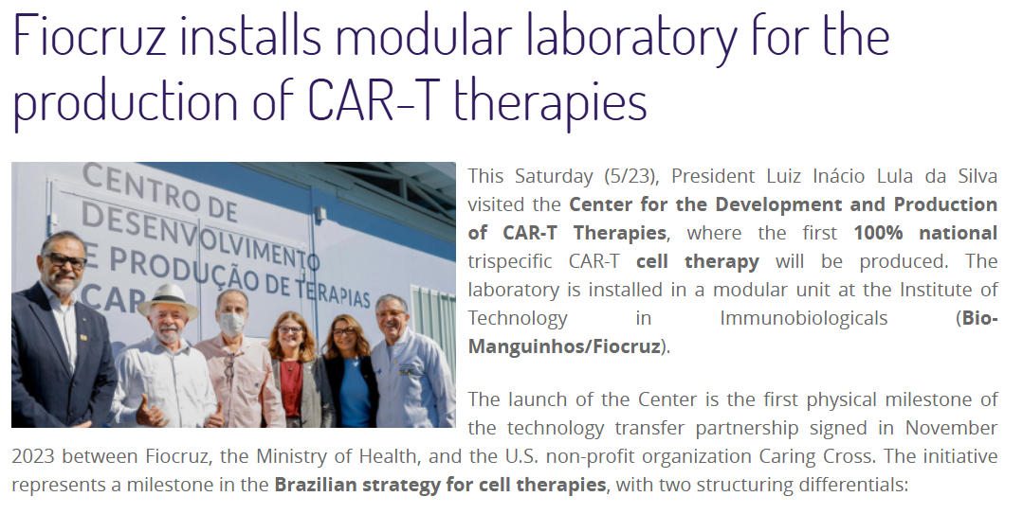

Brazilian President Luiz Inácio Lula da Silva visits the first Biomodular CAR-T GMP Manufacturing facility in Rio de Janeiro.

Slide 22







Acknowledgements
Steven Deeks
Becky Hoh
Meghann Williams
Monika Deswal
Elinaz Eilkhani
Michael Peluso
Urmila Vudali
Brian LaFranchi
Gina Borgo
Gabbriella Kimmerly
Amelia Deitchman
Rachel Rutishauser
Tim Henrich
Mehrdad Abedi
Chistina Dyer
Paolo Troia-Cancio
Karen O’Donnell
Boro Dropulić
Kim Anthony-Gonda
Megan Forrest
Kara Analuf
Erin Kostik
Oxana Slessareva
Victor Bass
Rodrigo Borrega
Ibeawuchi Oparaocha
Beatrix Ferencz
Ying Xiong
Greg Sword
Zhongyu Zhu
Mike Kadan
Andrew Worden
Kathy Schonley
Jon Li
Evgina Aga
Ron Bosch
Jane Reese
Sarah Kleinsorge-Block
Ashley Lawrence
Maria Chiuchiolo
Sohel Talib
Marcos de Lima
Funded by the California Institute of Regenerative Medicine (CLIN2-12090)

