Slide 1
HIV Cure Without Borders
Lessons from the HTLV-1 Field and Perspectives for Latin America and the Caribbean
Jorge Casseb, MD, PhD
Associate Professor - School of Medicine - USP

Slide 2
I have no conflicts of interest to disclose. The views presented are based on independent scientific research and are not influenced by any commercial entity.
Disclosure

Slide 3
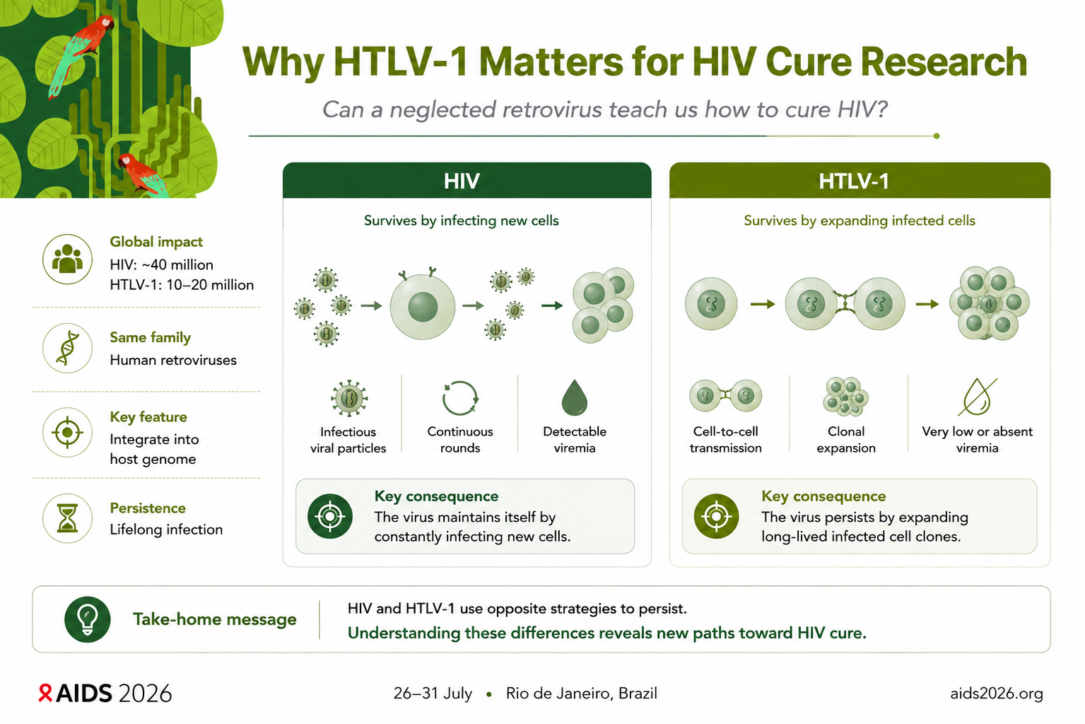

Slide 4
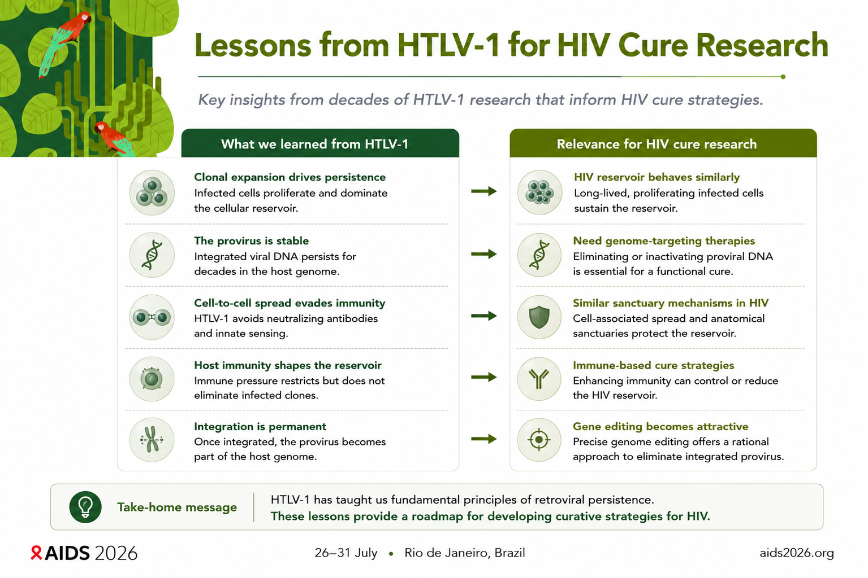

Slide 5
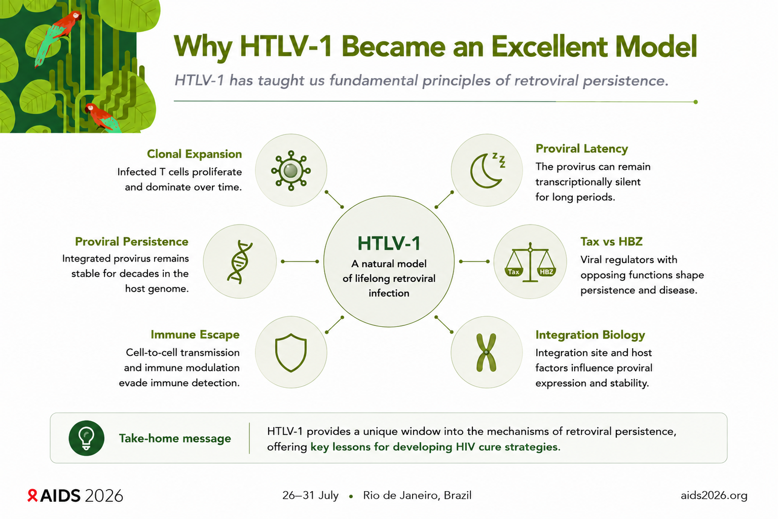

Slide 6
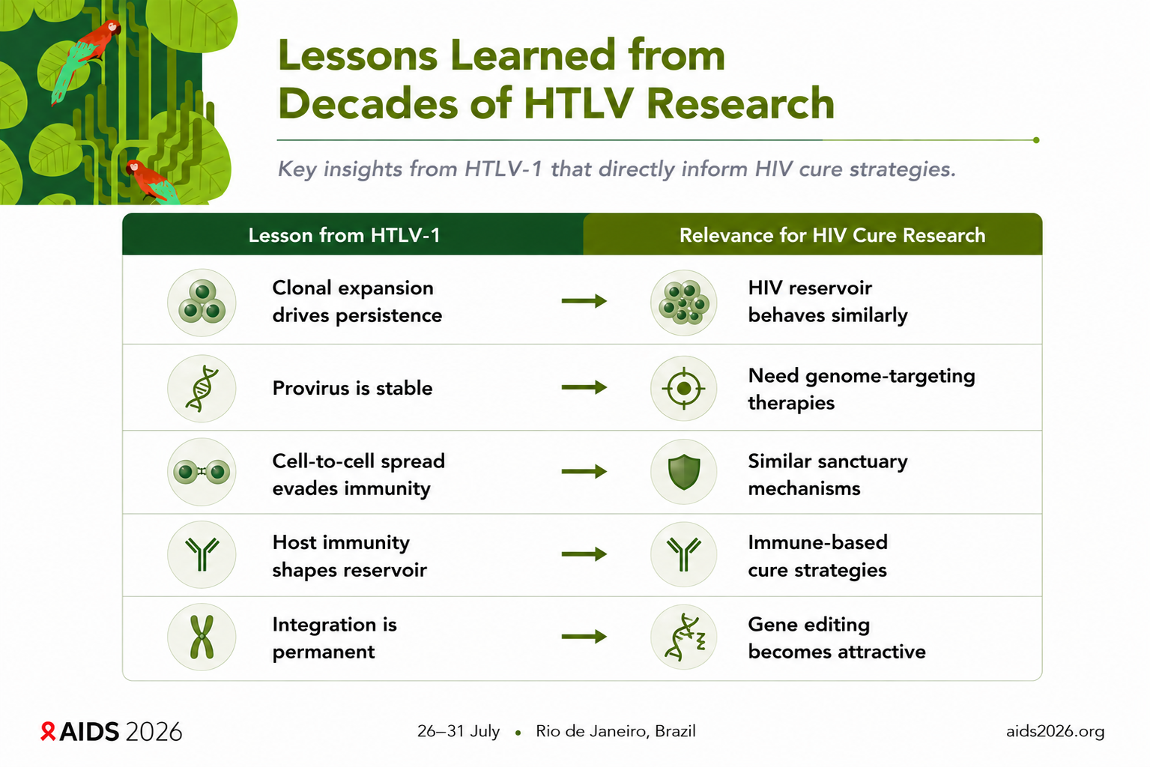

Slide 7
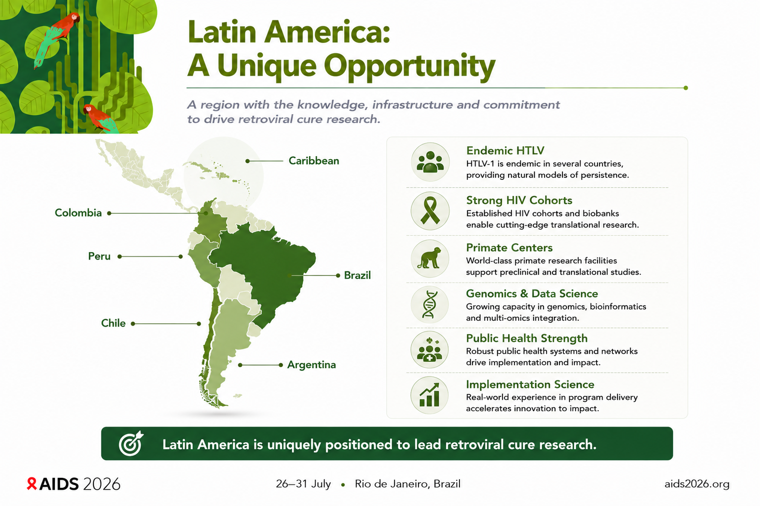

Slide 8


Slide 9
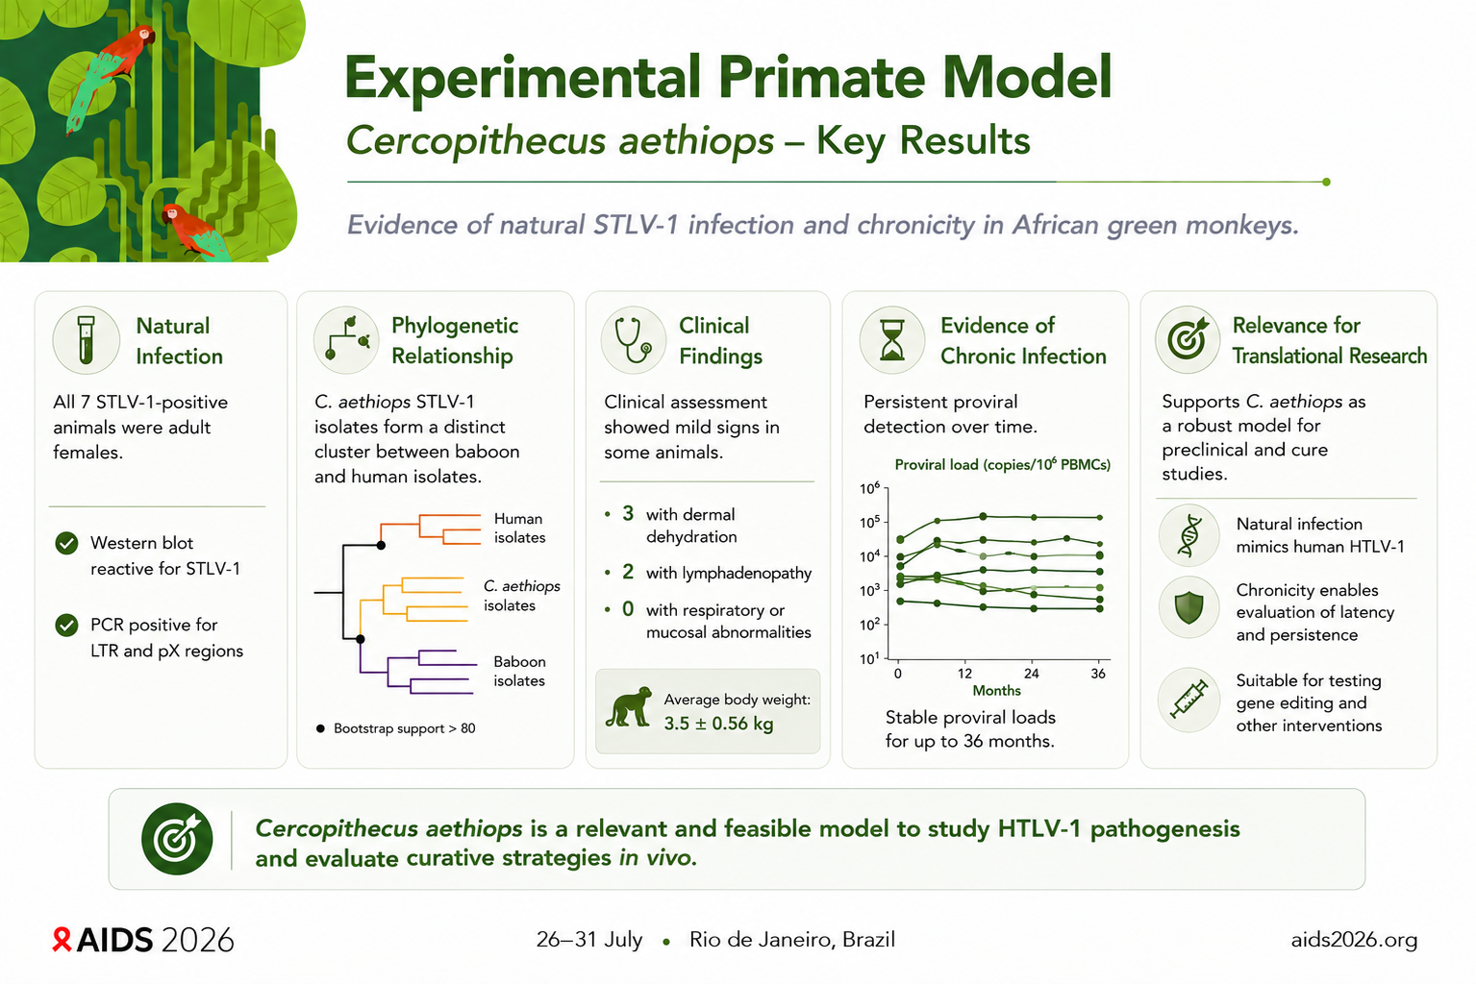

Slide 10
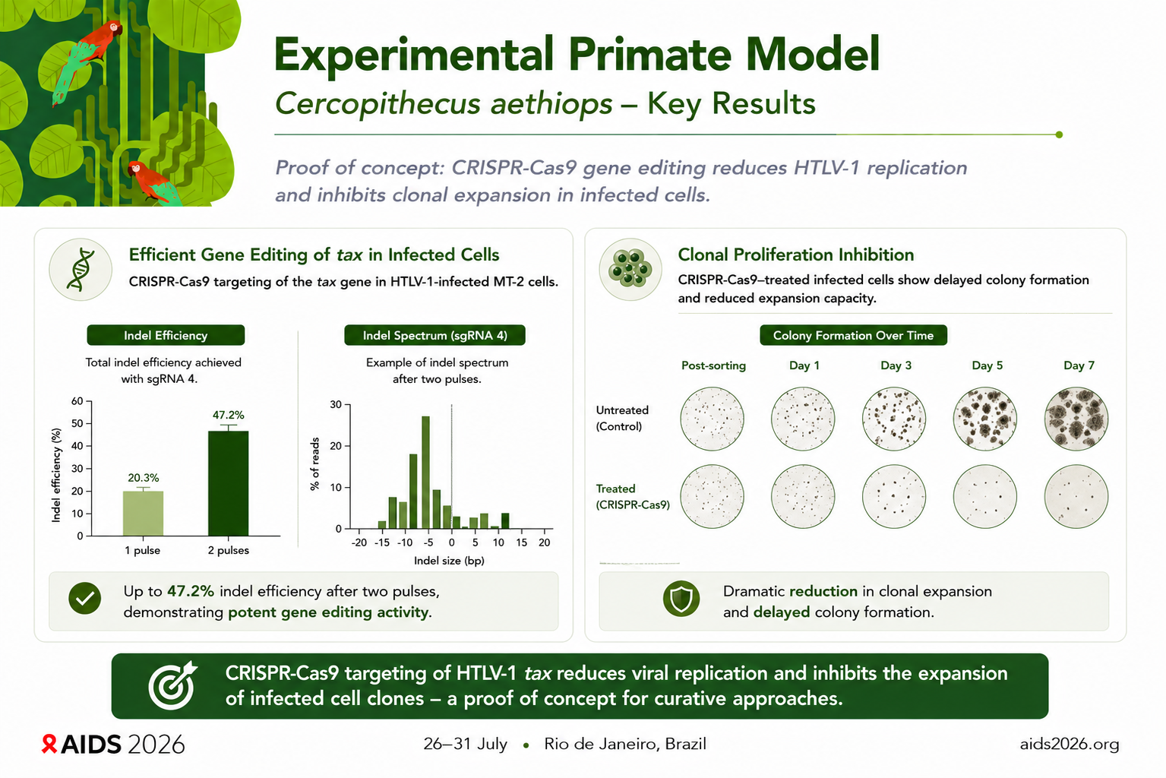

Slide 11
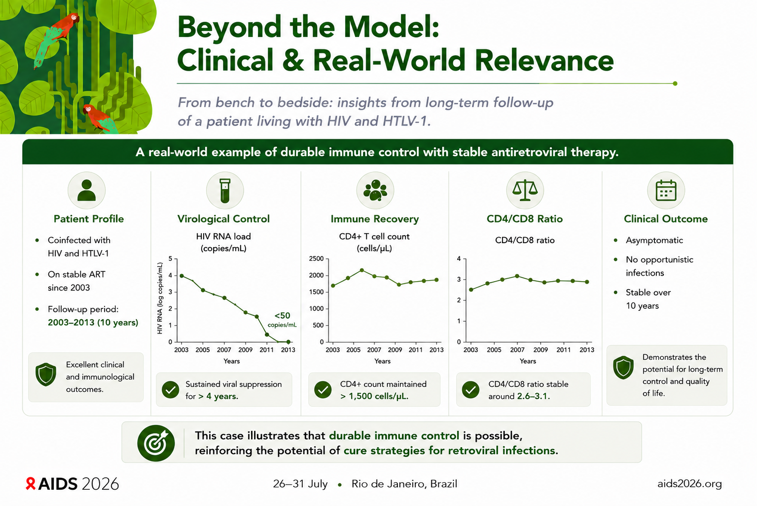

Slide 12
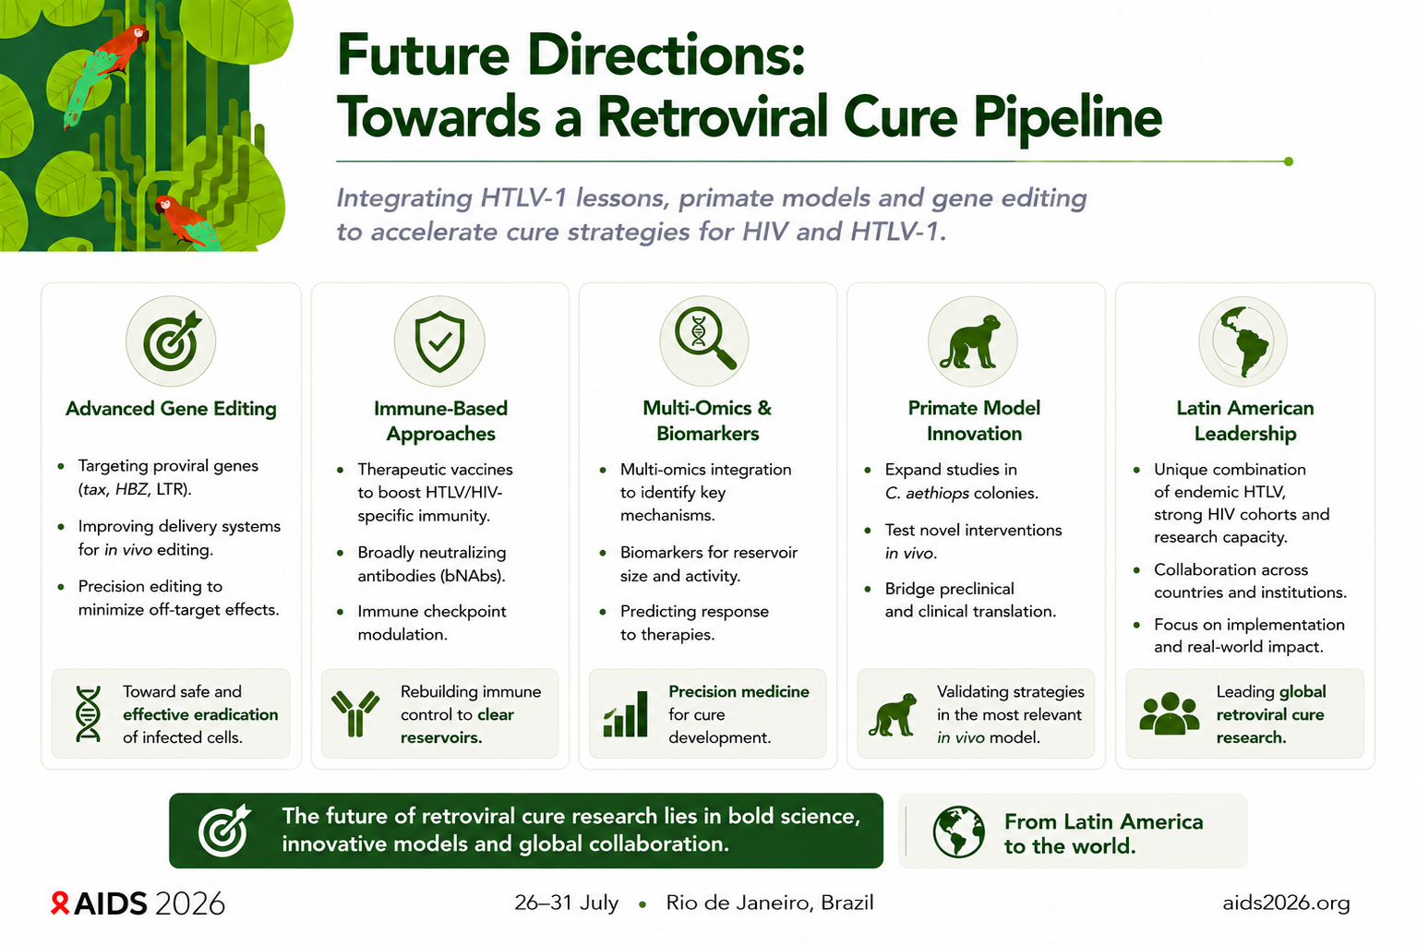

Slide 13
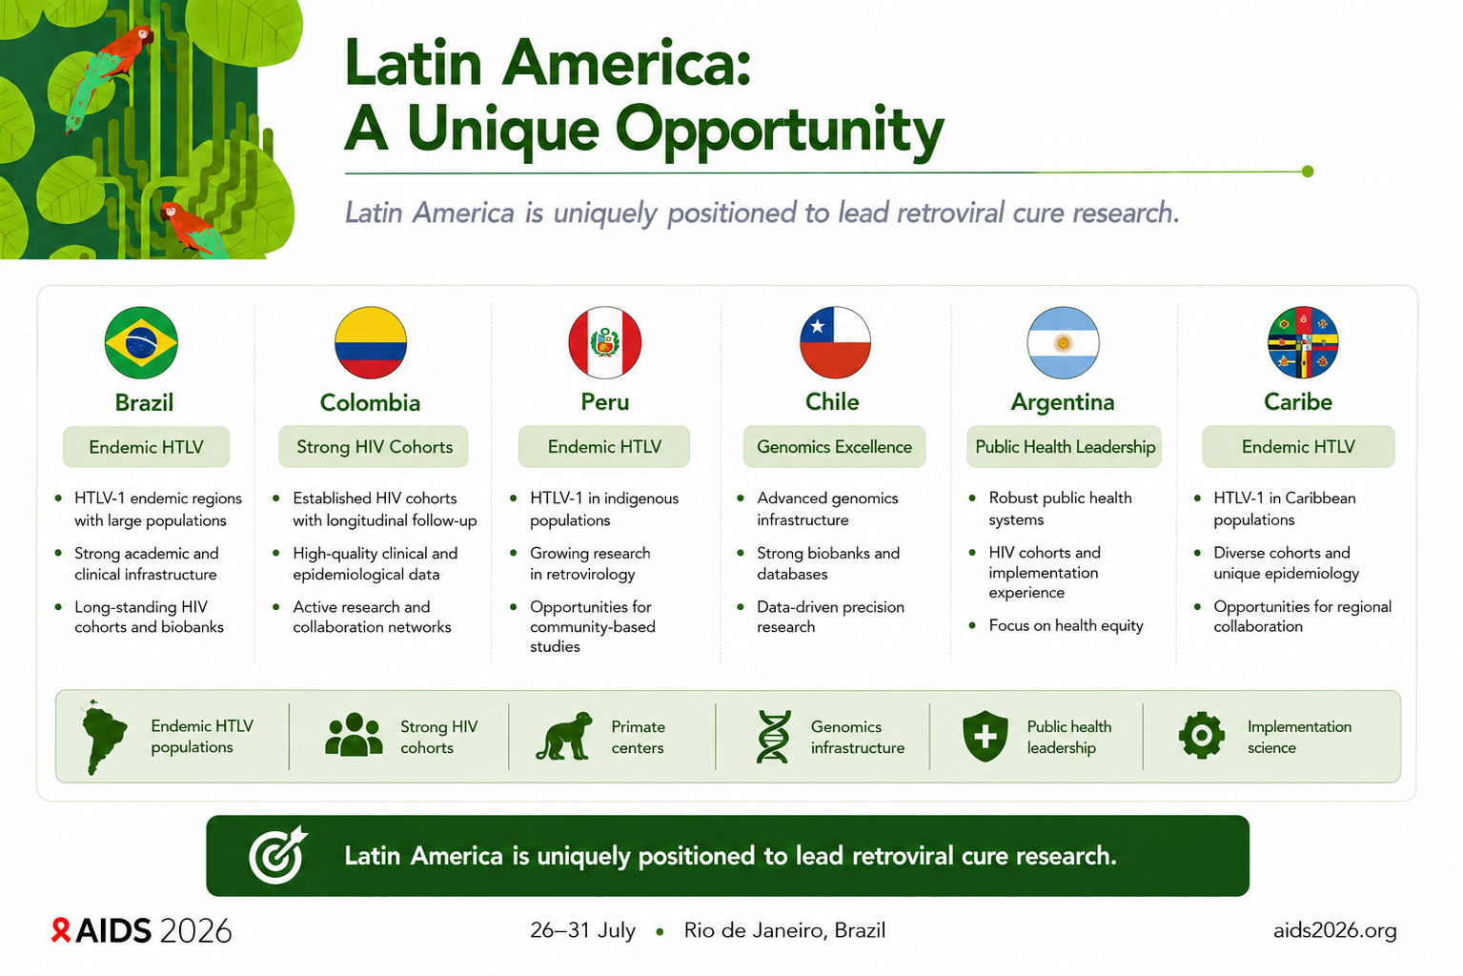

Slide 14
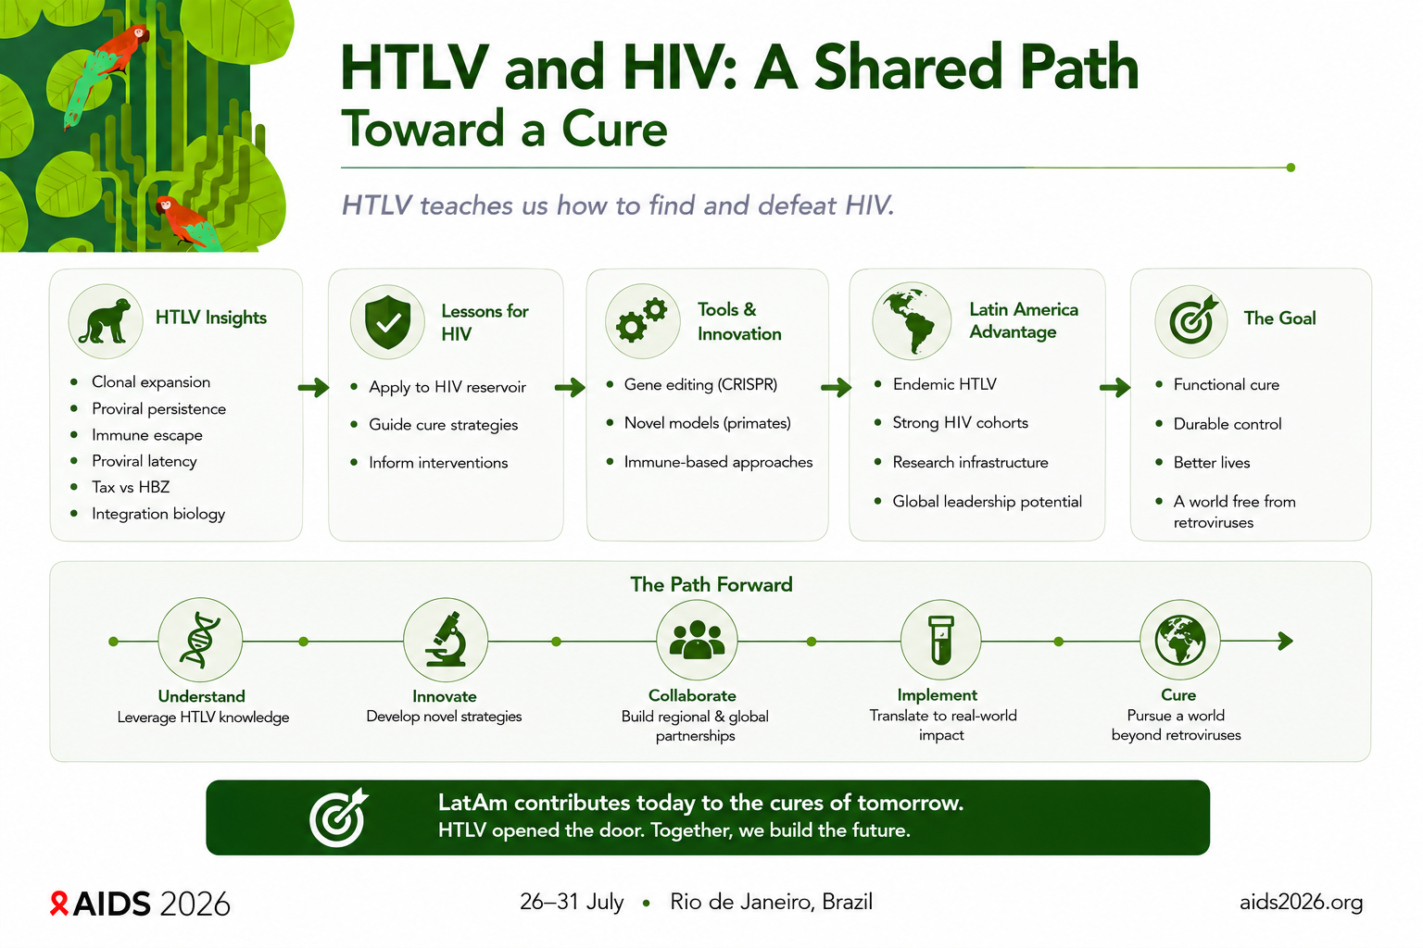

Slide 15
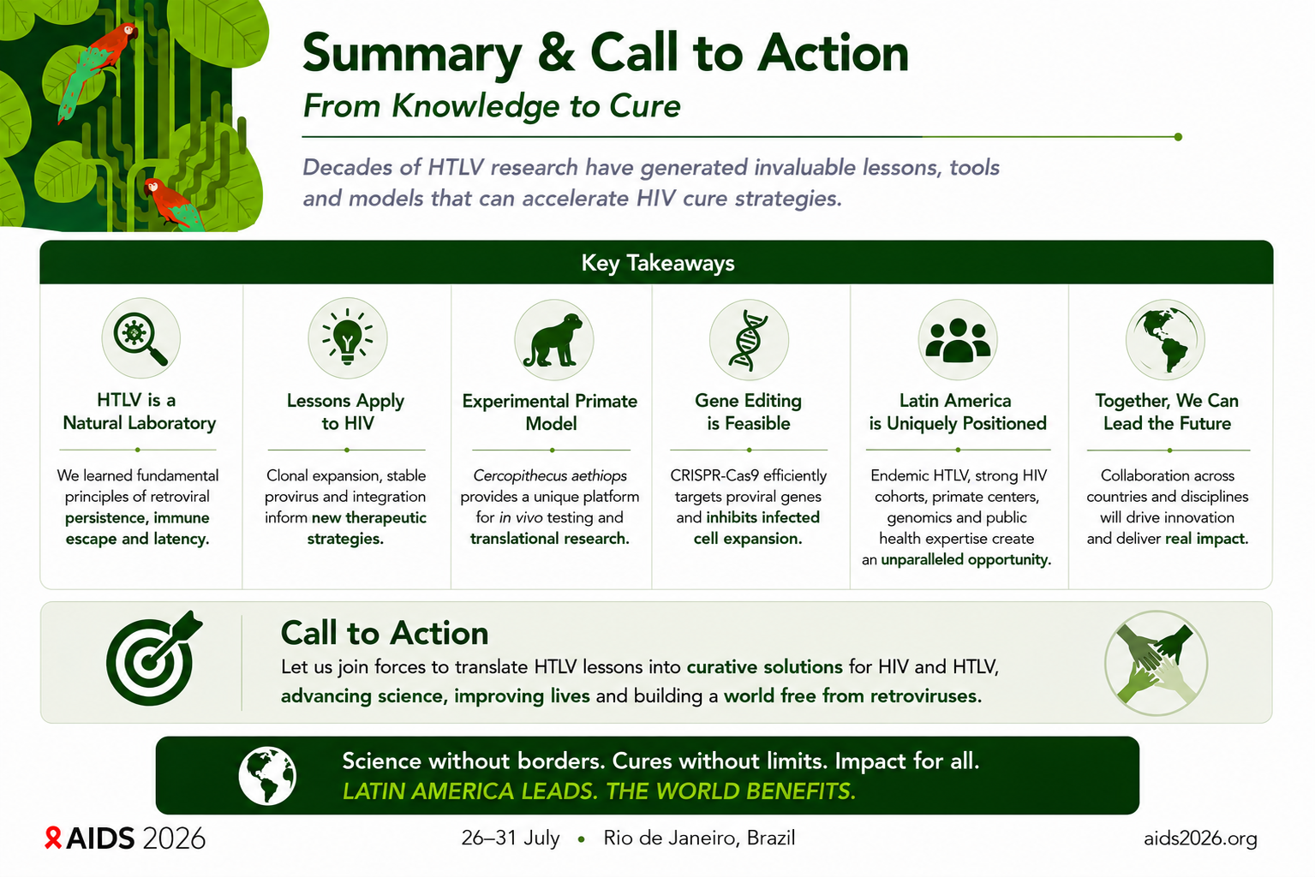

Slide 16
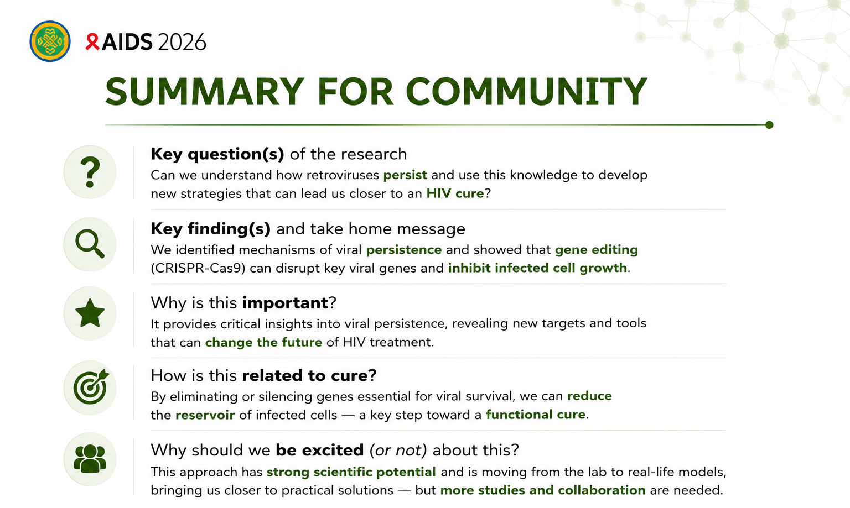

Slide 17


Slide 18
Thank You!
jcasseb@usp.br

