Slide 1






Elizabeth Zahabu, Team Lead
WeCare Initiative
Practice and pathways: Integrated testing and screening as entry points to HIV care.
Integrating STI self-testing as a scalable entry point to HIV prevention among adolescent girls and young women in Dar es Salaam: evidence from a community-led advocacy initiative.
26–31 July • Rio de Janeiro, Brazil
aids2026.org

Slide 2

Summary
Main Question:
Can STI self-testing serve as an entry point to HIV prevention for adolescent girls and young women (AGYW) in Dar es Salaam, Tanzania?
Key findings?
  STI self-testing successfully engaged AGYW in HIV prevention services.
  72% of AGYW who sought follow-up care also completed HIV testing.
  41% received PrEP counseling through referral pathways.
  Community education reduced stigma, improved STI-HIV knowledge, and strengthened trust between AGYW and healthcare providers.
  Facility assessments identified gaps in STI-HIV service integration and PrEP availability.
Why is it important:
Integrating STI self-testing into community-based HIV prevention strategies can help reduce barriers, address stigma, and expand access to HIV testing and PrEP among AGYW.
26–31 July • Rio de Janeiro, Brazil
aids2026.org

Slide 3
Background
Adolescent Girls and Young Women (AGYW) in Tanzania continue to bear a disproportionate burden of STIs and HIV. Untreated STIs increase the biological risk of HIV acquisition by up to three times.
Despite this intersection, uptake of STI screening and HIV prevention services remains low due to:
  Stigma surrounding STI testing
  Fragmented STI–HIV services
  Limited youth-friendly service delivery
Recognizing these barriers, this community-led project explored whether STI self-testing could serve as an accessible entry point to HIV testing and PrEP uptake among AGYW.
26–31 July • Rio de Janeiro, Brazil
aids2026.org

Slide 4

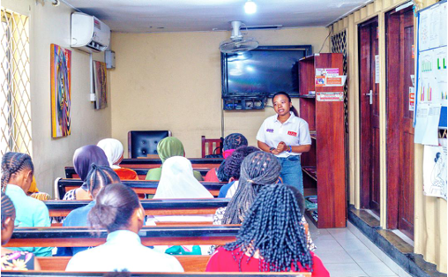
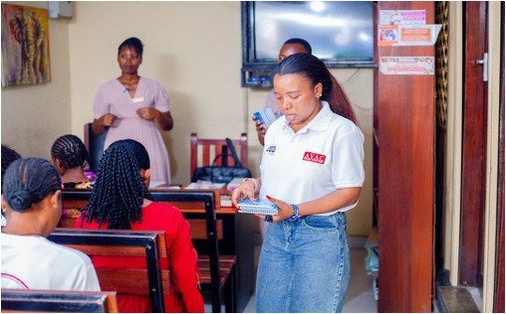
METHODOLOGY
A multi-component community-led intervention was implemented between October and December 2024.
The intervention included:
  Facility mapping and health facility assessments
  Community sensitization
  Targeted peer education sessions for AGYW, caregivers and healthcare providers
  Pilot distribution of 250 syphilis self-testing kits
  On-site testing and structured referral pathways to youth-friendly HIV services
Facility assessments examined:
  STI–HIV service integration
  PrEP availability
  Adolescent readiness
Quantitative service uptake data and qualitative feedback from community dialogues and facility visits informed the analysis.
26–31 July • Rio de Janeiro, Brazil
aids2026.org

Slide 5
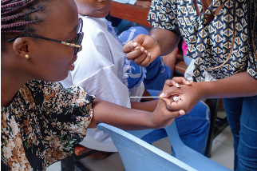
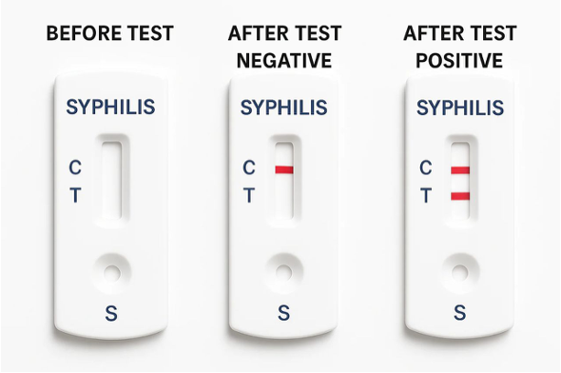
RESULTS/ FINDINGS
250 syphilis self-testing kits distributed:
  72% of AGYW who engaged with follow-up services also completed HIV testing
  41% received PrEP counselling
Facility mapping revealed:
  Limited integration of STI–HIV services
  limited PrEP access
  cost of STI treatment emerged as a significant barrier.
Community dialogues:
  Improved knowledge of STI–HIV interactions
  Reduced stigma around STI testing
  strengthened AGYW-provider trust
26–31 July • Rio de Janeiro, Brazil
aids2026.org
Notes:
STI self-testing not only improved early syphilis detection but also created an accessible and non-judgmental entry point into HIV testing and prevention.

Slide 6
CONCLUSION
This community-led intervention demonstrated that STI self-testing can successfully increase engagement with HIV prevention.
By providing an accessible and non-judgmental entry point into HIV testing and PrEP counselling, STI self-testing has the potential to strengthen HIV prevention efforts.
However, persistent gaps in STI–HIV service integration, affordability, and PrEP availability continue to limit access to comprehensive prevention services.
26–31 July • Rio de Janeiro, Brazil
aids2026.org

Slide 7

RECOMMENDATION
To maximize impact:
  Integrate STI self-testing into community health strategies.
  Strengthen integration of STI and HIV prevention services.
  Expand access to youth-friendly PrEP services.
  Reduce affordability barriers to STI services.
  Scale community-led HIV prevention interventions targeting AGYW.
26–31 July • Rio de Janeiro, Brazil
aids2026.org

Slide 8

ACKNOWLEDGEMENT
Funders:
Implementation Partners:
Kinondoni District
Tandale Health Center
Magomeni Health Center
DARE Organization
Tanzania Youth Health and Development
Community Contributors:
Peer educators from Kinondoni, Kigamboni, and Ubungo, Community members
26–31 July • Rio de Janeiro, Brazil
aids2026.org

Slide 9
Thank You!
Asanteni Sana.

