Slide 1
Unfinished business: Ending preventable deaths from advanced HIV disease in a changing HIV response
AIDS 2026 satellite
29 July 2026

Slide 2
Purpose of the session
Provoke honest discussion about difficult trade-offs
Identify urgent actions needed to ensure AHD prevention and treatment remain central to the HIV agenda
Identify a small set of priority actions for national programmes, implementers and funders to safeguard AHD services during the next phase of the HIV response.

Slide 3
Run of show
Time | Title | Speaker/co-chair name(s)
18:00-18:03 | Opening framing – Setting the challenge | Tendai Nyagura (Gates Foundation, South Africa) Nathan Ford (WHO, Switzerland)
18:03-18:15 | What we know vs what is happening | Graeme Meintjes (University of Cape Town and Queen Mary University London, South Africa / UK)
18:15-18:17 | Reality check: what the clinical data misses – lived experiences and structural barriers | Florence Riako Anam (GNP+, Kenya)
18:17-18:27 | National programme reality check – AHD services in Zambia | Sivile Suilanji (Ministry of Health, Zambia)
18:27-18:29 | Response – National programme reality check – AHD in Mozambique | Irenio Gaspar (Ministry of Health, Mozambique)
18:29-18:39 | The true cost of delivering effective AHD screening and prevention packages | Ana Moore (CHAI, the Netherlands)
18:41-18:43 | Response – Cost of AHD | Izukanji Sikazwe (The Global Fund, Switzerland)
18:43-18-48 | M&E for AHD | Maureen Syowai (ICAP, Kenya)
18:48-18:50 | Response – In-patient data | Sivile Suilanji (Ministry of Health, Zambia)
18:50-19:00 | Facilitated Q&A | By the co-chairs
19:00-19:30 | Panel discussion Facilitated by session co-chairs | Florence Anam, Irenio Gaspar, Graeme Meintjes, Yogan Pillay, Izukanji Sikazwe

Slide 4




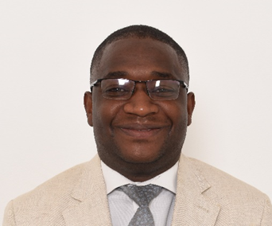
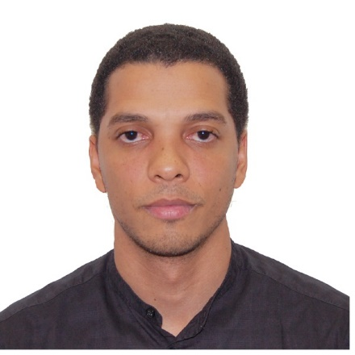




Unfinished business: Ending preventable deaths from advanced HIV disease in a changing HIV response
Tendai Nyagura
Gates Foundation
South Africa
Nathan Ford
WHO
Switzerland
Graeme Meintjes
University of Cape Town/
Queen Mary University London
South Africa / UK
Florence Riako Anam
GNP+
Kenya
Suilanji Sivile
Ministry of Health
Zambia
Irenio Gaspar
Ministry of Health
Mozambique
Izukanji Sikazwe
Global Fund
Switzerland
Yogan Pillay
Gates Foundation
South Africa
Ana Moore
CHAI
The Netherlands
Maureen Syowai
ICAP
Kenya

Slide 5
Unfinished business: Ending preventable deaths from advanced HIV disease in a changing HIV response
Moderated discussion
Tendai Nyagura
Gates Foundation
South Africa
Nathan Ford
WHO
Switzerland
Graeme Meintjes
University of Cape Town/
Queen Mary University London
South Africa / UK
Florence Riako Anam
GNP+
Kenya
Irenio Gaspar
Ministry of Health
Mozambique
Izukanji Sikazwe
Global Fund
Switzerland
Yogan Pillay
Gates Foundation
South Africa

Slide 6
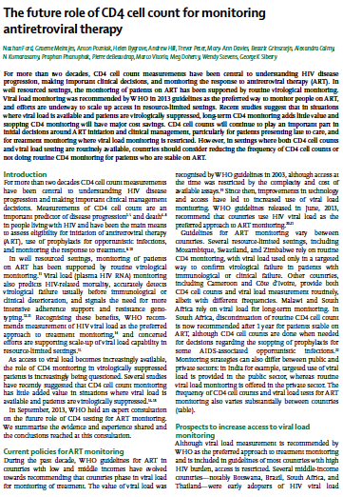
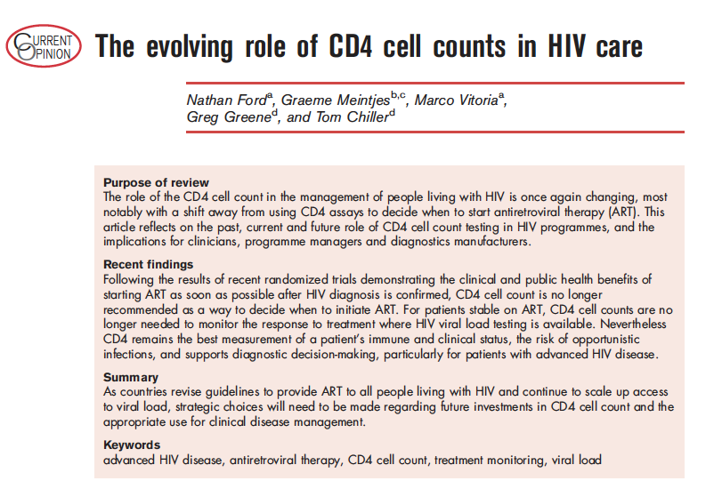
The role of CD4 testing
“Retain capacity for CD4 to support risk stratification for provision of a package of care, including prophylaxis and cryptococcal antigen screening
Ensure access to CD4 for individuals who develop clinical problems or evidence of virological failure while on ART”
“CD4 remains the best measurement of immune and clinical status, risk of opportunistic infections and diagnostic decision-making, particularly for patients with advanced HIV disease.”
Lancet Infectious Diseases, 2015
Current Opinions HIV/AIDS, 2017

Slide 7

WHO CD4 Recommendation
CD4 testing is recommended as the preferred method to identify advanced HIV disease in people living with HIV.
Strong recommendation
In settings where CD4 testing is not yet available, WHO clinical staging can be used to identify advanced HIV disease in people living with HIV
Conditional recommendation

