Slide 1
What we know vs what is happening
Graeme Meintjes, University of Cape Town & Queen Mary University London
Unfinished business: Ending preventable deaths from advanced HIV disease in a changing HIV response
Notes:
Re-read brief
Check slide 13

Slide 2
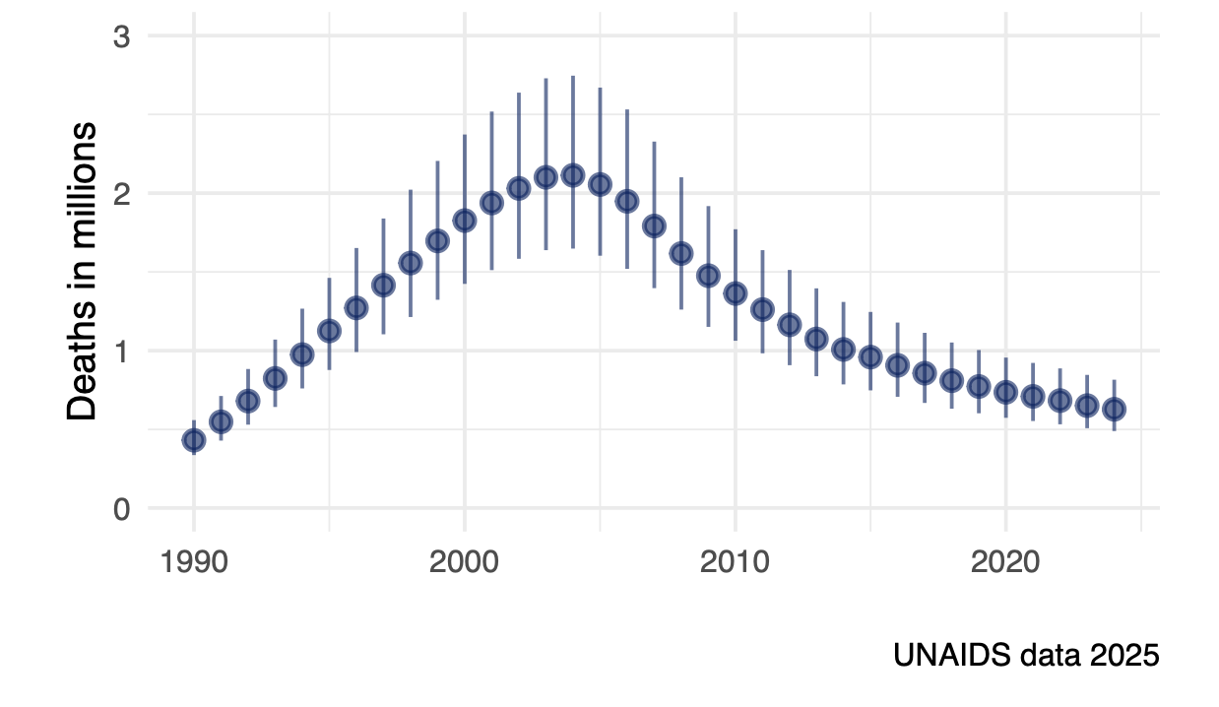
Rate of decline in HIV-related deaths has slowed
Deaths consistently
~ 600,000 / year
since 2020
Estimated 1.9 million
people living with AHD
in sub-Saharan Africa
Stelzle
Lancet Glob Health 2025;13:e437

Slide 3
Drivers of AHD and settings it is encountered
Late HIV diagnosis
(Re)enter care as outpatient
~12% mortality over 1-year
Enter or return
to care
Failure to start ART
Require hospitalisation
~16% inpatient mortality
~14% in year after discharge
Disengagement from care
Scheier, AIDS 2026;40:967
Burke, JIAS 2026;29:e70134
Ford, Lancet HIV 2022;9:e150
Not in care

Slide 4
Drivers of AHD and settings it is encountered
Late HIV diagnosis
Testing strategies
(Re)enter care as outpatient
~12% mortality over 1-year
Enter or return
to care
AHD package of care
Failure to start ART
Linkage strategies
Require hospitalisation
~16% inpatient mortality
~14% in year after discharge
Disengagement from care
Improved hospital management
& linkage to outpatient care
Retention & early return strategies
Not in care
Notes:
Return to these in final slide
Upstream
Hopsitals – health systems often outrside of vertical hiv programs – cf integration
Package doesn’t reach those not in care and often too late for those hpsitalised
Multifaceted strategy

Slide 5
Issues to be covered
Disengagement as a driver of AHD
Implementation of AHD package of care and role of CD4 testing
Management of those hospitalized with AHD

Slide 6
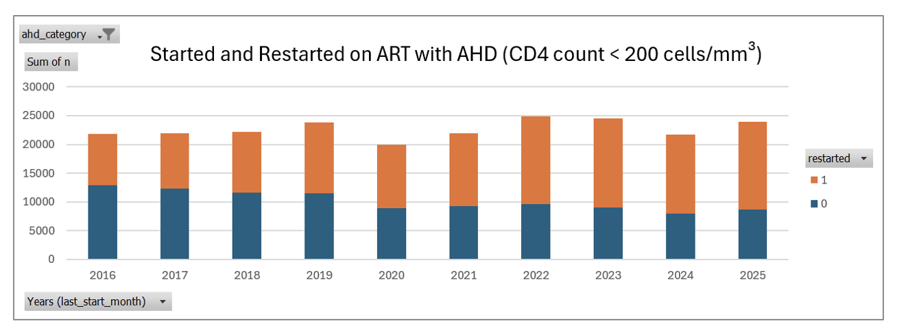
Western Cape, South Africa: Return to care with AHD
2025: 65% of those with CD4 < 200 are re-entering care (rather than entering for first time)
Euvrard et al, Western Cape Data Centre

Slide 7
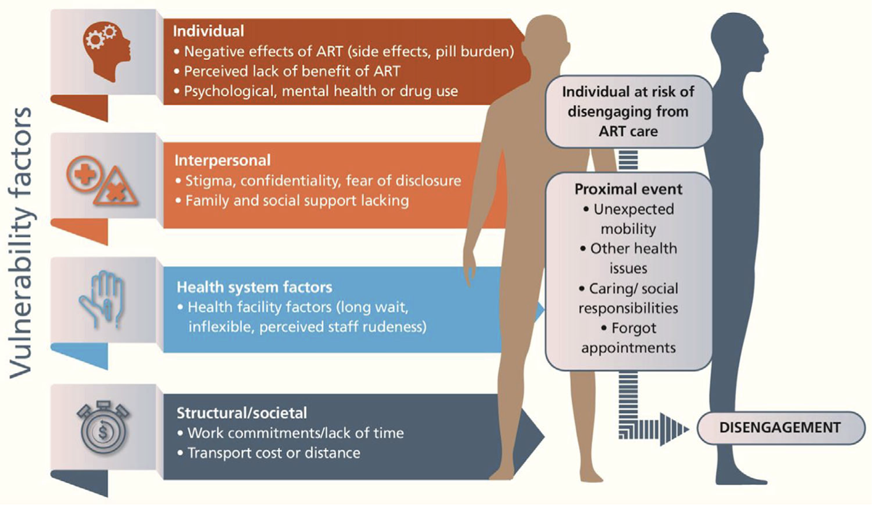
What are the reasons for disengagement?
Systematic review of 21 studies
(LMICs, 2015 -2022):
“The most common reasons for
disengagement were unexpected
events, socio-economic reasons,
ART side effects or lack of
perceived benefit of ART”
Burke, J Int AIDS Soc 2024,27:e26230
Notes:
Conceptually, studies described underlying vulnerability factors (individual, interpersonal,
structural and healthcare) but that often unexpected proximal events (e.g. unanticipated mobility)
acted as the trigger for disengagement to occur”

Slide 8
Disengagement from ART care = key AHD driver
Especially patients who have low CD4 nadir
HIV infection
ART interrupted
CD4 count
600
CD4 recovers on ART
over a few years
Rapid drop in CD4
to approximate nadir
within months
Gradual decline in CD4
over years without ART
200
ART started
Low CD4
nadir
East Africa IeDEA Collaboration: CD4 increases after ART reinitiation
much slower than those before disengagement
Thomadakis
Am J Epidemiol 2023;192(7):1181
Notes:
Interrupting slower CD4 recovery – read paper
Note gradient of decline

Slide 9
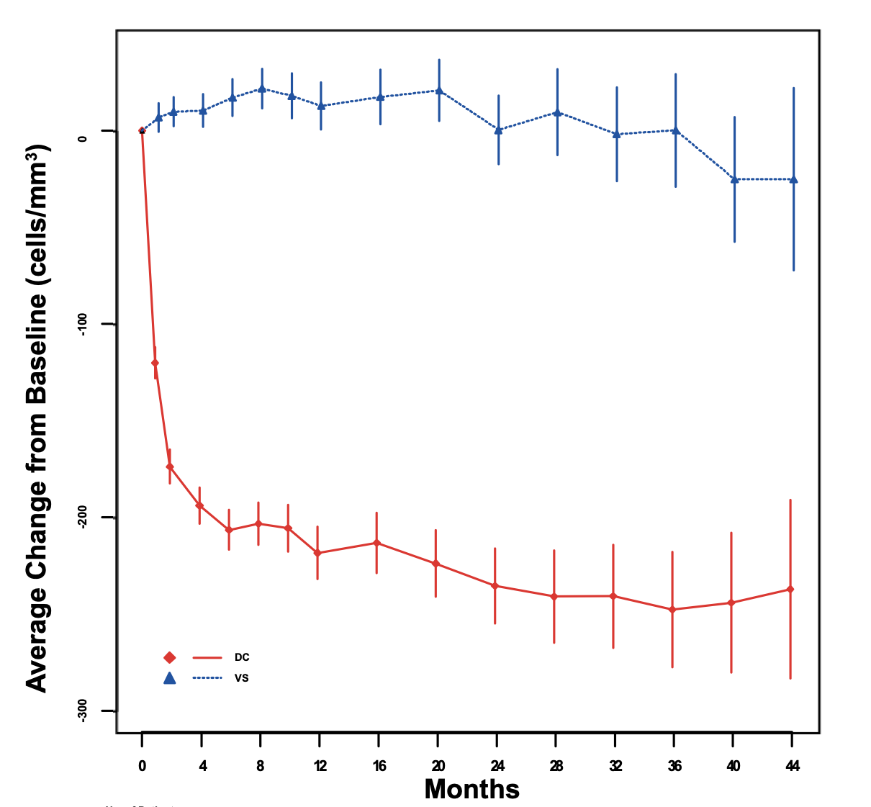
In majority of people with low CD4 count nadir, when stop ART
CD4 count drops in 3-6 months to approximate that CD4 nadir
SMART trial evaluated planned
ART interruption strategy:
CD4 dropped by ~ 200 in 4 months
following ART interruption
SMART Study Group
N Engl J Med 2006;355:2283

Slide 10
Interventions to address disengagement
Funding cuts will negatively impact PEPFAR-funded retention and outreach activities to find patients who have disengaged
Need to intensify strategies for retention/early re-engagement
  Design services to work around life demands of PLHIV and their mobility
  Welcoming, person-centered services
  Including multi-month dispensing and dispensing outside facilities
  Adherence support and education about consequences of disengagement
  Outreach to find those disengaged; including mHealth solutions

Slide 11
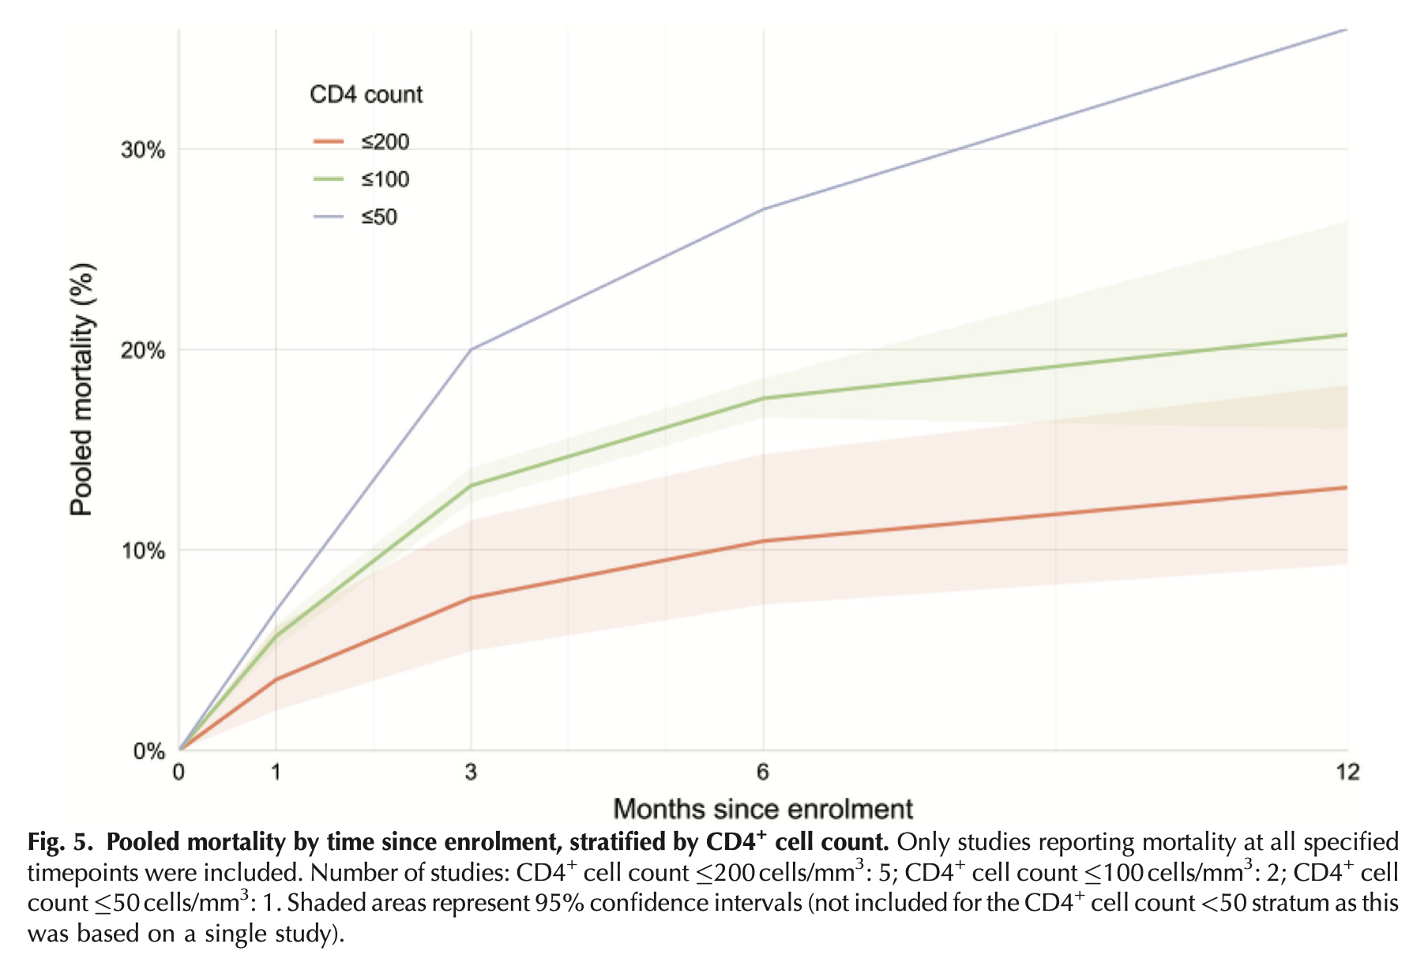
Substantial mortality after entering/re-entering care with CD4 < 200
Meta-analysis of studies
CD4 < 50
CD4 < 100
CD4 < 200
12-month mortality
Scheier, AIDS 2026;40:967–981

Slide 12
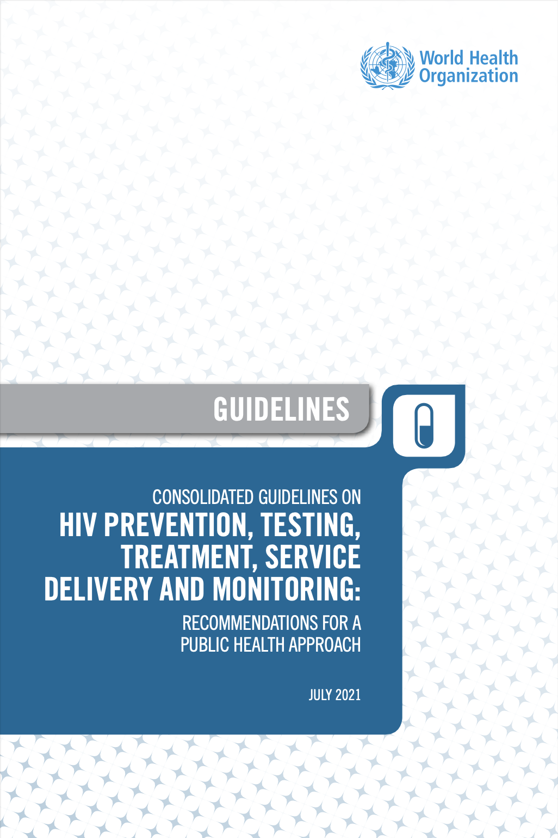
WHO package of care for people with AHD
Screening and diagnostics
TB symptoms screen
Sputum NAAT
Urine LAM
CrAg screening recommended if CD4 <= 100 (consider if CD4 <= 200)
Prophylaxis
Co-trimoxazole if CD4 <=350 or stage 3 or 4
TB preventive therapy
Fluconazole pre-emptive treatment if CrAg+
ART initiation
Rapid, but defer if symptoms of TBM or CM
Adapted adherence support
Include home visits if feasible
Integrated into WHO 2021 Consolidated HIV guidelines
Notes:
Dual testing now advised

Slide 13
Evidence behind AHD package of care
Urine LAM reduces deaths among hospitalised PWH
  TB NEAT LAM trial: 25 to 21%
  STAMP trial: 21 to 18%
CrAg screening / pre-emptive fluconazole + adherence support
  REMSTART trial: reduced deaths by 28% in those with CD4 < 200
Co-trimoxazole prophylaxis with ART
  Meta-analysis: reduced death by 60% when started at CD4 < 350
Isoniazid preventive therapy for TB with ART
  IPT-ART trial: reduced incidence of TB by 37%
  TEMPRANO trial: reduced TB by 56% and death by 37%
  PREVENT TB: 3HP non-inferior to isoniazid preventive therapy
Peter, Lancet 2016;387:1187
Gupta-Wright, Lancet 2018;392:292
Mfinanga, Lancet 2015;385:2173
Suthar, Lancet HIV 2015; 2: e137
Rangaka, Lancet 2014;384:682
TEMPRANO, N Engl J Med 2015;373:808
Badje, Lancet Glob Health 2017;5:e1080
Sterling, N Engl J Med 2011;365:2155
Notes:
Suthar – observational?

Slide 14
CD4 testing: recommendations and coverage
CD4 testing critical for identifying patients for AHD package of care
  WHO recommendation 2026: CD4 testing is recommended as the preferred method to identify AHD among PLHIV
  (Strong recommendation, moderate-certainty evidence)
Funding constraints, national policy, market forces affects provision
Manufacture of new machines stopped
  Abbott stopped production of Pima, but now committed to limited production
  BD no longer produce FACSPresto
Main option now = semi-quantitative VISITECT (AccuBio)
CD4 testing declined 35% from 2024 to 2025 (6 countries in SSA)
WHO Guideline update 2026
Syarif, Lancet Glob Health 2025;13:e26
CHAI HIV Market Impact Memo, June 2026
Notes:
USG funding cuts severely affected provision

Slide 15

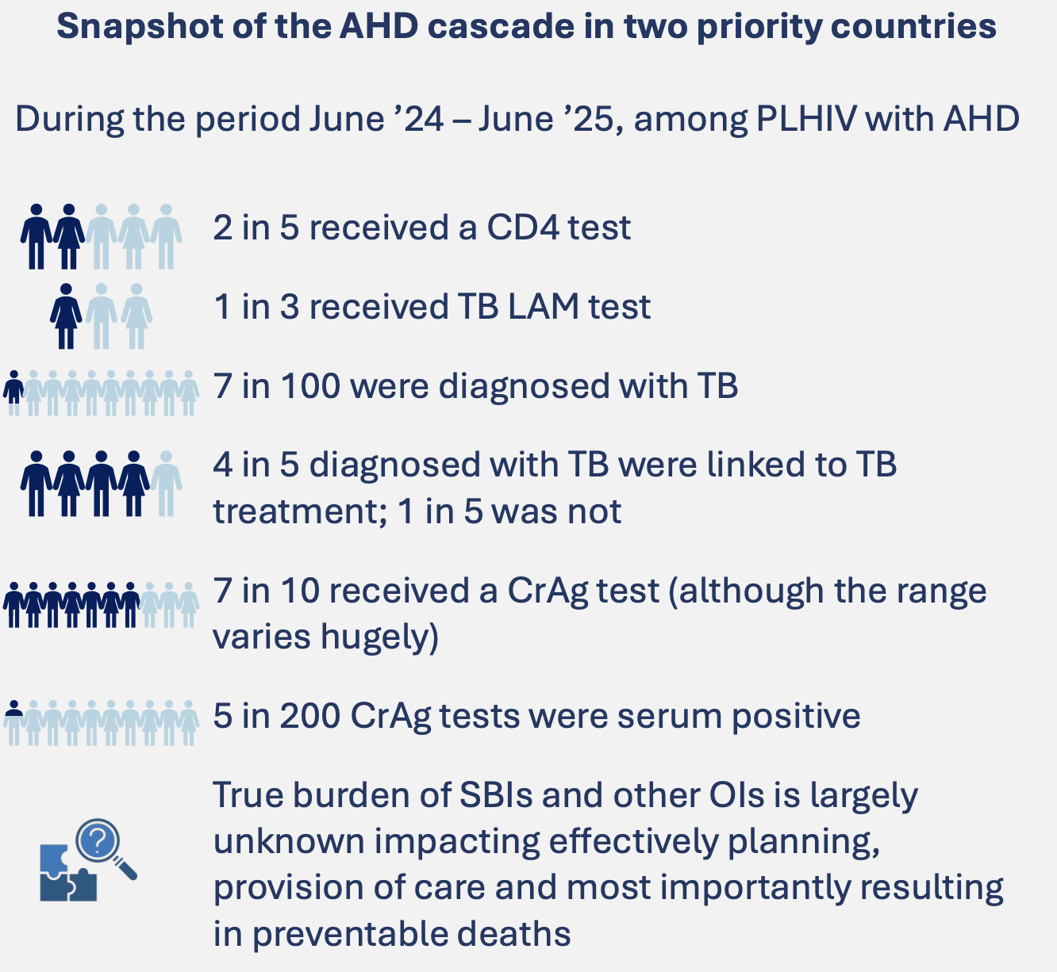
AHD Rapid Landscape Assessment
Survey of 6 countries in southern Africa (2025)
Critical challenges with supply chain and funding
CD4 testing coverage remains inconsistent,
ranging from as low as 16% of new ART initiates
in one country to 80%+ in another
CrAg and TB LAM screening gaps are severe,
with one of the five countries reporting
3% of eligible AHD clients receiving either test,
and highest reporting coverage rates only ~50%
Acknowledgment: Ana Moore (CHAI)
Notes:
AHD commodities

Slide 16

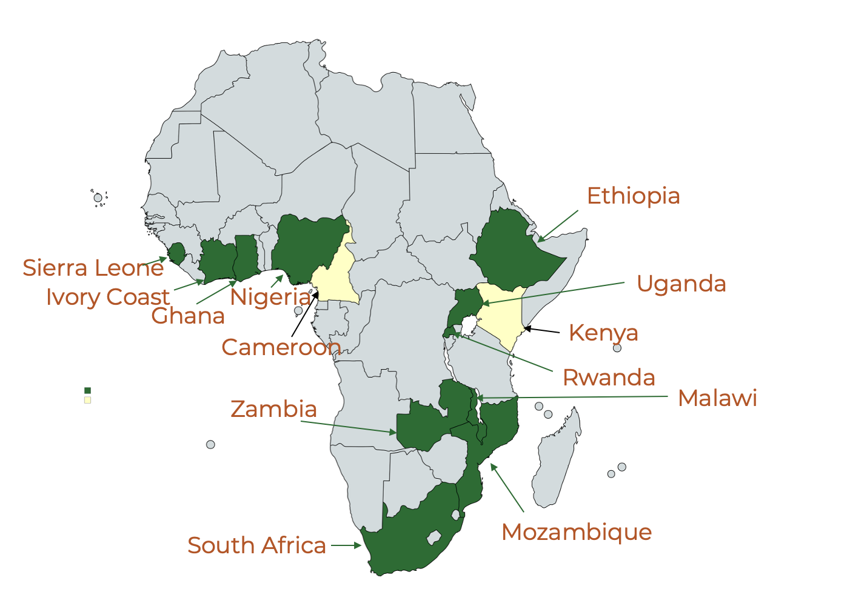


REVIVE trial
RCT evaluating Azithromycin prophylaxis (250mg for 4 weeks)
in patients with CD4 < 100 entering or returning to care to
reduce mortality (related to severe bacterial infections)
Enrolling in 57 sites across 11 countries
6000 of target 8000 participants enrolled
Results anticipated Q4 of 2027

Slide 17
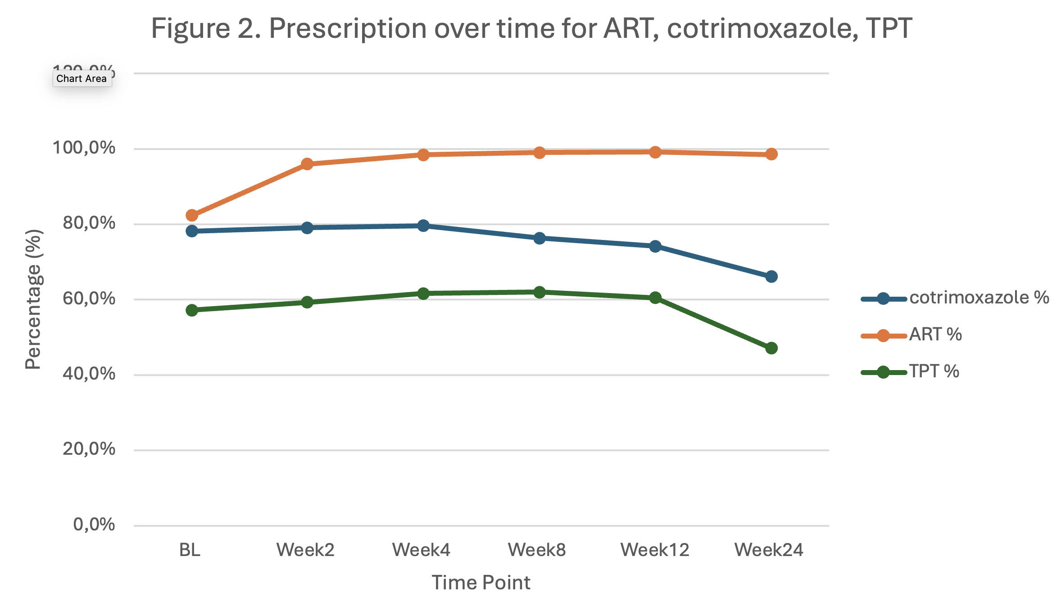
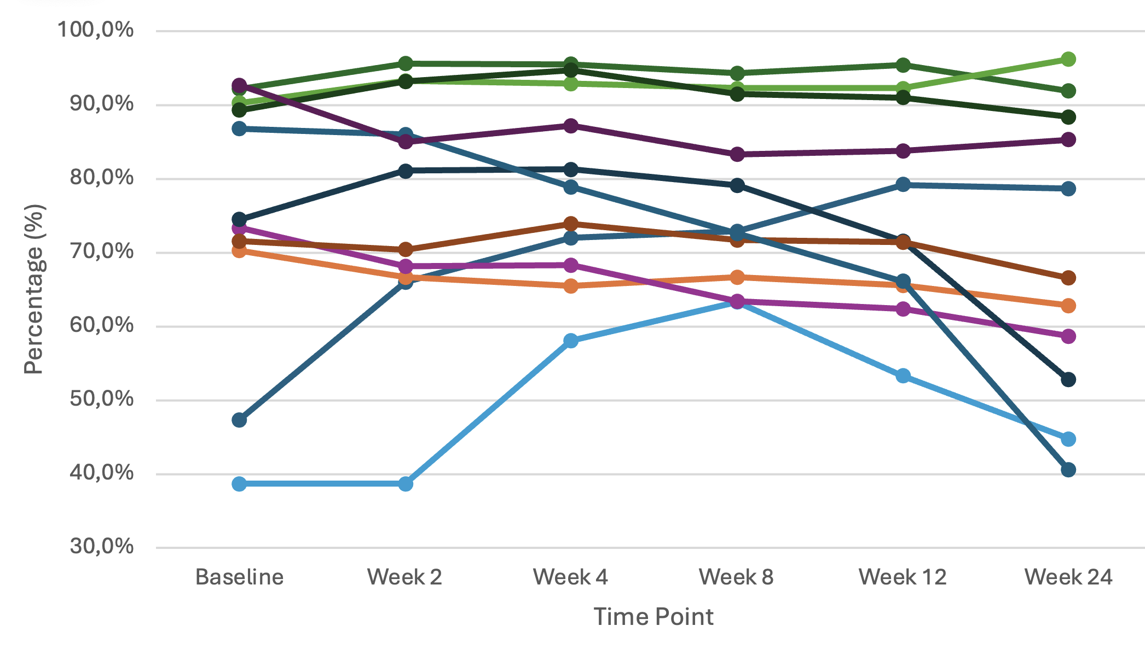
REVIVE: Co-trimoxazole preventive therapy (CPT)
Prescription over time for ART, CPT, and TPT
Prescription of CPT, stratified by country
Reasons for non-prescription of CPT:
Supply issues, funding cuts, out of pocket,
misunderstanding of guidelines
This is clinical trial – worse in routine care?
Data for n=4041
Wasserman, Scheier, REVIVE investigators
Unpublished

Slide 18
Causes of hospitalization and death in AHD
Tuberculosis
Severe bacterial infections
Cryptococcal meningitis
Region specific
infections:
C & S America:
Histoplasmosis
SE Asia & China:
Talaromyces
HIV-related organ disease
esp. renal
Diarrhoeal disease
Other opportunistic infections
eg. PCP, Toxoplasmosis
Malignancies
Kaposi’s sarcoma, lymphoma, cervical
Burke, Lancet HIV 2025;12:e355; Burke, JIAS 2026;29:e70134; Gupta, AIDS 2015, 29:1987–2002;
Meintjes, Medicine 2015;94:e2269; Rajasingham, Lancet Infect Dis 2022;22:1748
Notes:
Rough approximation across studies
Burke 2026 – TB 27%, SBI 25%

Slide 19

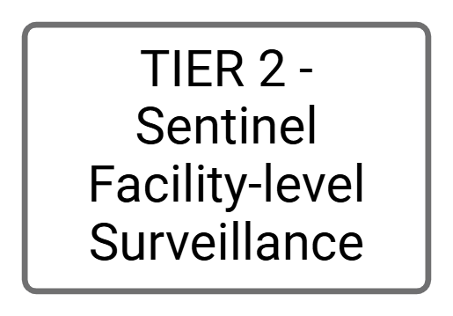

Infection-related admissions are most commonly of unknown cause, followed by TB, bacteria, PCP and crypto
Prophylaxis in last year
CPT 2%
TPT 3%
Notes:
Sentinel facility-level surveillance; one of 4 tiers

Slide 20


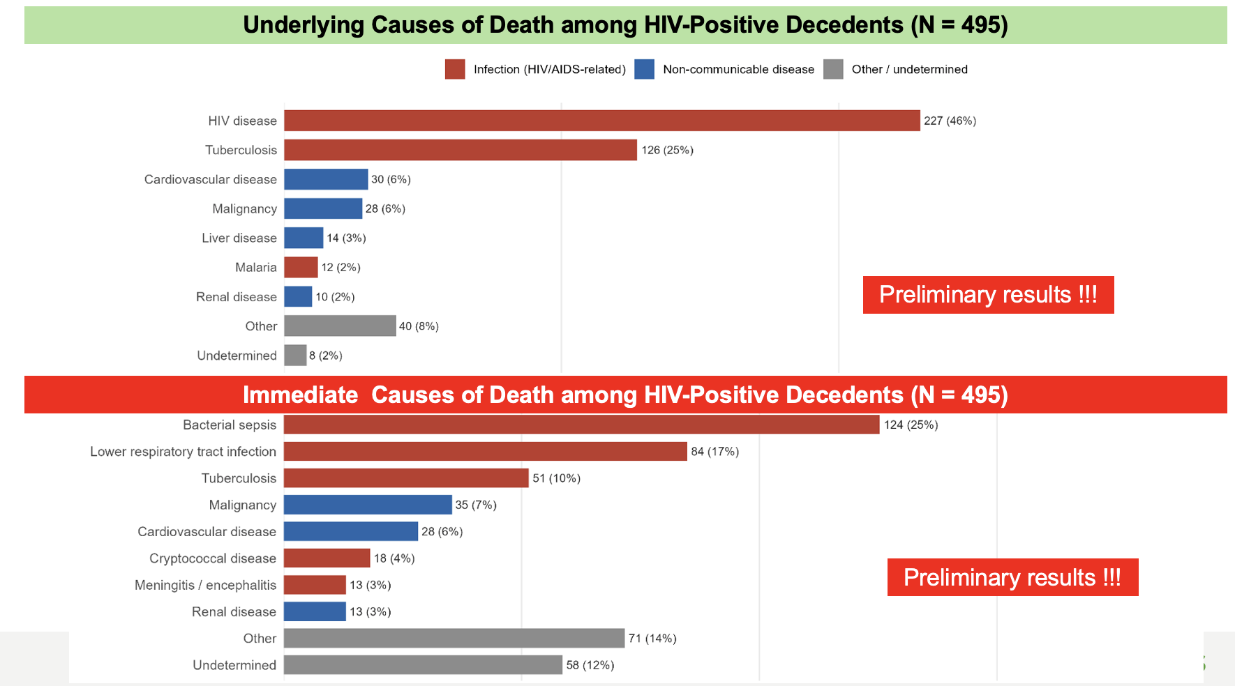
South Africa
Kenya
Mozambique
Sierra Leone

Slide 21
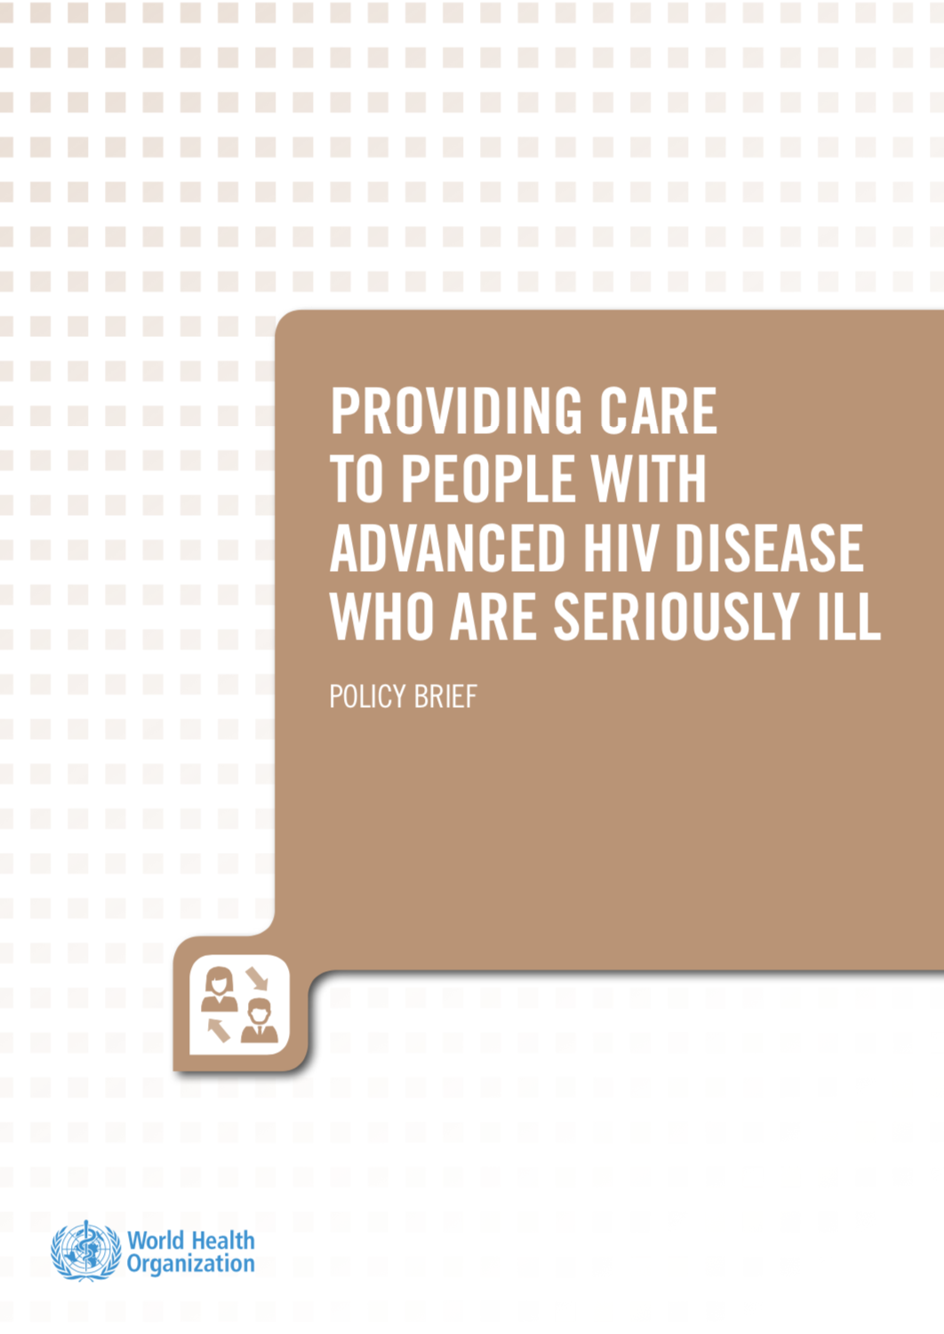
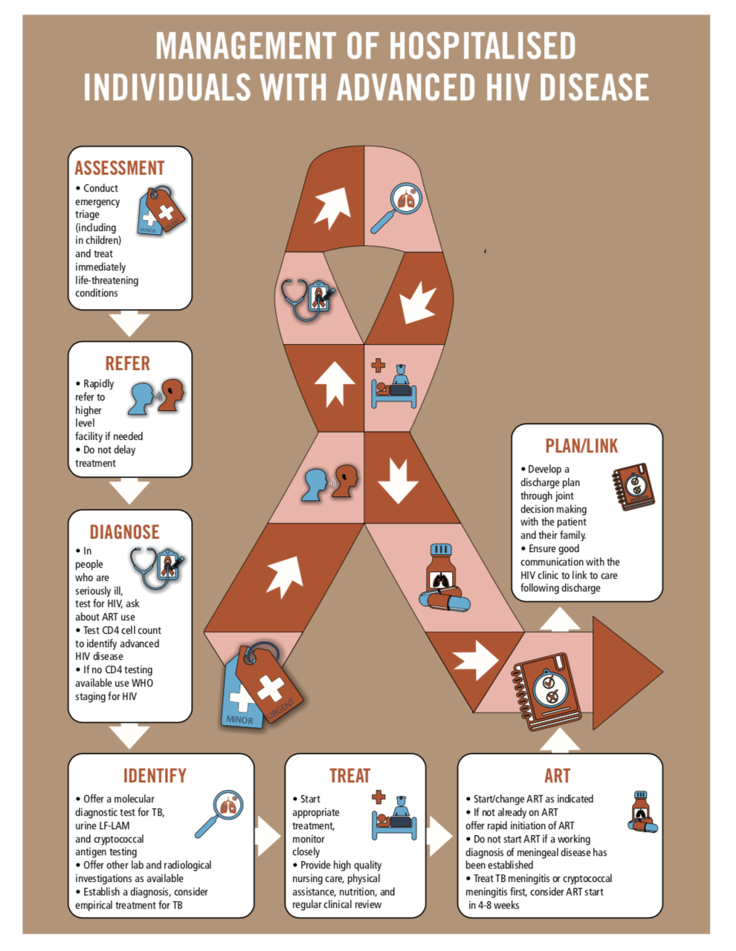

Slide 22
Minimum package for managing AHD in hospitals
DIAGNOSTICS
FBC
Chemistry
CSF analysis
Chest X-ray
Ultrasound
CT scan (at central facility)
NAAT test for TB
Urine LAM
Cryptococcal antigen test
Stool microscopy
SUPPORTIVE MANAGEMENT
Oxygen
IVI fluids
Electrolyte supplementation
Nutritional supplementation
Adherence support (especially for linkage)
MEDICATION
TB treatment (Rifampicin, INH, PZA, Ethambutol)
Broad-spectrum IVI and oral antibiotics
ART
Co-trimoxazole
Ampho B (preferably liposomal), flucytosine, fluconazole
CHAI HIV Market Impact Memo (2026) highlights critical threats to supply chain for CM medication
(short supply and stock outs of ampho B and flucytosine)
Notes:
BC and urine MCS
Sats
Glucose
Due to USG funding cuts

Slide 23
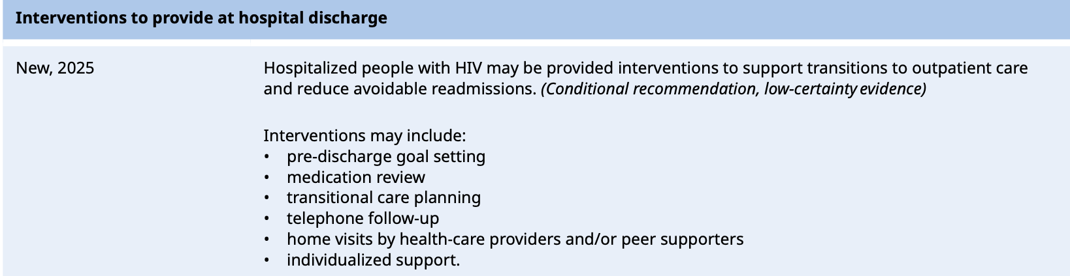
Linkage of PLHIV at hospital discharge
60–65% link to care within 1 month of discharge; 42% in a meta-analysis
Meta-analysis: Interventions (eg. pre-discharge care planning, post-discharge follow-up) may improve linkage to care and reduce readmission, but no mortality benefit
WHO recommendation (2025):
Katuramu, BMC Public Health 2025;25:3571
Ford OFID 2025;12(4):ofaf175

Slide 24

Priorities
Initiatives upstream to prevent AHD
  Improve retention in care and ensure early re-engagement
  Person-centered program innovations, adherence support, patient education,
  community outreach, mHealth solutions
Ensure optimal coverage of CD4 testing and AHD package of care commodities for patients entering/returning to care in clinics
  Especially first 6 months of ART start/restart
Care of people hospitalised with AHD
  Management often outside HIV program
  Educating hospital health care professionals in AHD management
  Commodity supply for OI diagnosis and management
  Interventions at discharge
  Linkage to outpatient care after discharge and follow-up
Notes:
Flexibility
Health system strengthening

Slide 25

Acknowledgements
Nathan Ford
Tendai Nyagura
Anna Grimsrud
Ana Moore and CHAI
ADVANCE-GERMS investigator team
MITS-DeCoDe investigator team
Sean Wasserman and REVIVE investigator team
Andrew Boulle
Jonathan Euvrard

