Slide 1
National programme reality check
Advanced HIV Disease services in Zambia
Dr Suilanji Sivile,
Ministry of Health, Zambia
Unfinished business: Ending preventable deaths from advanced HIV disease in a changing HIV response

Slide 2


AIDS Creeps Back in Parts of Zambia, a Year After U.S. Cuts to H.I.V. Assistance
By Stephanie Nolen
Photographs by Arlette Bashizi
Stephanie Nolen reported this story in Zambia. She has reported on the country’s H.I.V. epidemic for more than 20 years.
Published April 25, 2026Updated April 26, 2026

Slide 3
Presentation Outline
Where are we with AIDS deaths?
How have funding changes affected AHD services and AIDS deaths in Zambia?
What should we be doing about it?
What opportunities exist?

Slide 4
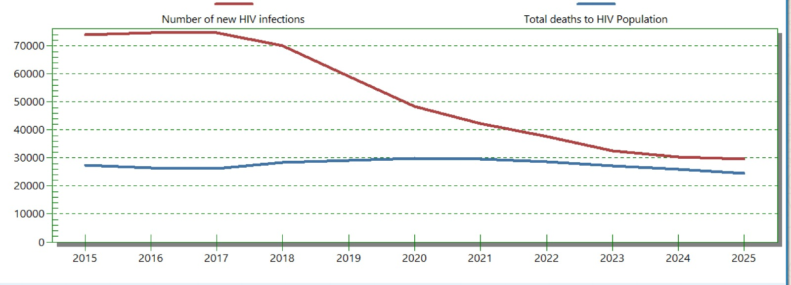
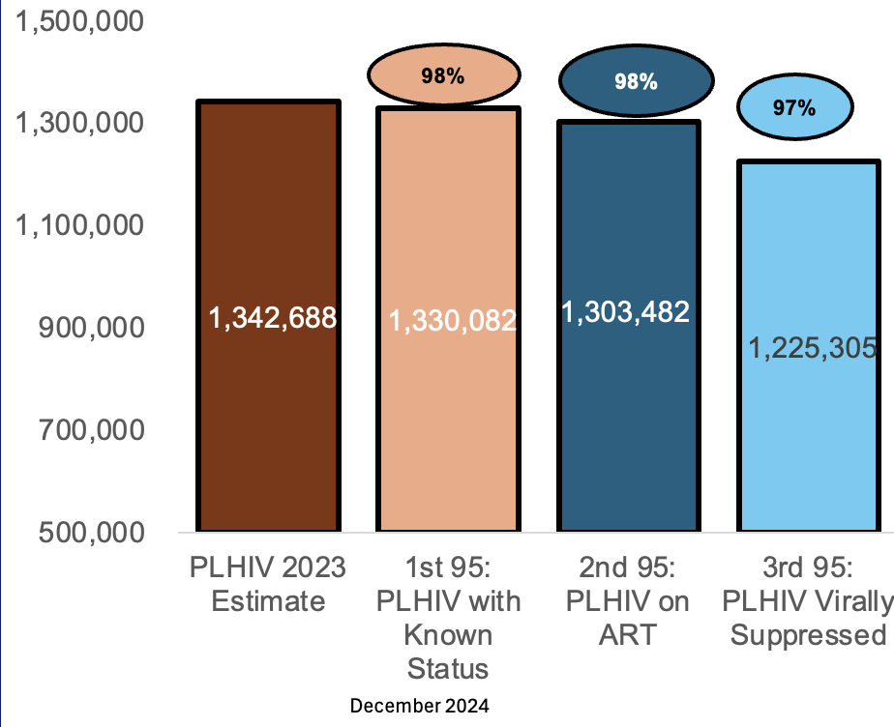
Where are we with AIDS deaths in Zambia ?
Slow reduction in HIV deaths
No epidemic control without reducing mortality
Is the modeling reliable for estimating mortality
(Specturm output 2025)

Slide 5
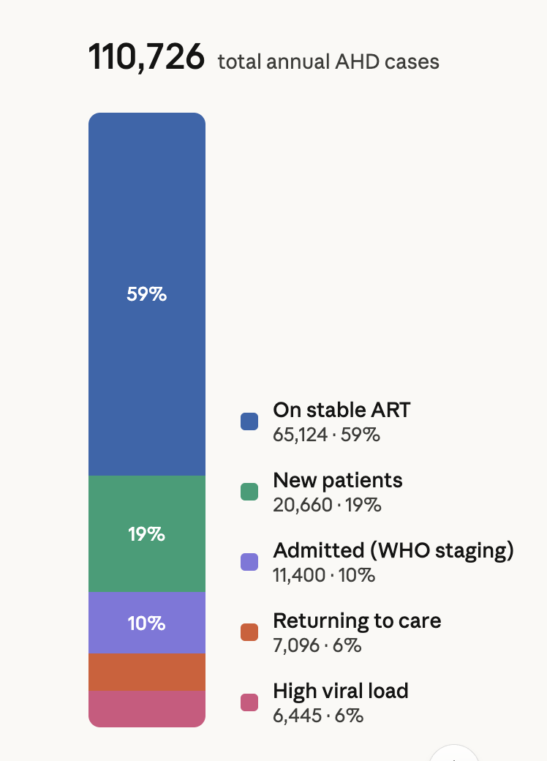
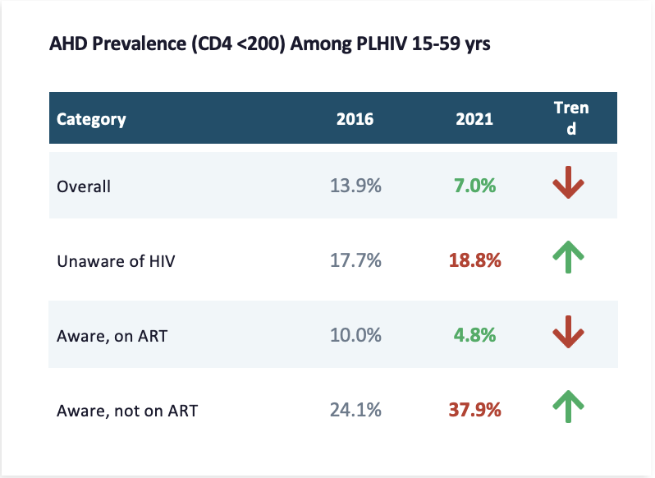
Advanced HIV Disease is still a problem in Zambia
1/4 of AHD cases are those with treatment interruption
Being ill the number one reason for individuals with IIT and AHD for coming back to care
HIV testing the most effective pathways for identifying individuals with AHD and bringing them back to care (40% of new positives are known to care)
NATIONAL DATA
AHD Programme Overview
National forecast and quantification report source routine HMIS/SmartCare-Pro/MO-ZM data
Sources: ZAMPHIA 2016 & 2021
Advanced HIV disease during the first six months on antiretroviral therapy in Zambia (AHD Zambia: RETURN6 preliminary results policy brief

Slide 6
How have funding changes affected AHD services and AIDS deaths in Zambia?

Slide 7
Reduce testing, lose opportunity to identify AHD cases
HTS Monthly Testing Volumes by Year, 2024–2026
HIV Positive Results (HTS) by Year, 2024–2026

Slide 8
Progressive loss in current on ART from 2024-2026
Causes of loss to follow-up
Reduction in community health workers
Closure of drop in centers for key populations
Reduction in Differentiated service delivery models including MMDs, Community Adherence groups, community ART distributions and others
Threatened commodity security
Change in clinicians due to transition to government service points
Data challenges

Slide 9
Events in ART: Lost to Follow-Up, 2024–2026
Notes:
Grouped column chart of clients lost to follow-up in the ART programme by month for 2024, 2025 and 2026, ordered January to December. 2026 values are reported through June only; July to December 2026 are not yet available.

Slide 10
Deaths among PLHIV on ART 2024-2026 seem to be reducing but??
Incomplete data challenges for HIV mortality in routine data systems
Huge fraction of community deaths at 45% in Zambia
Give it time, it will show
Need for formal surveys
Does not include HIV deaths for those not on ART or untraceable
Source: DHIS2/SmartCare

Slide 11
Difficult to interpret the AHD performance data
Recution due to poor testing of AHD cases rather reuction of AHD numbers
Reduced CD4 resting commodity security
Reduced AHD programmatic monitoring
Reduced AHD workforce
Source: DHIS2, 2026

Slide 12
What should we be doing about it?

Slide 13
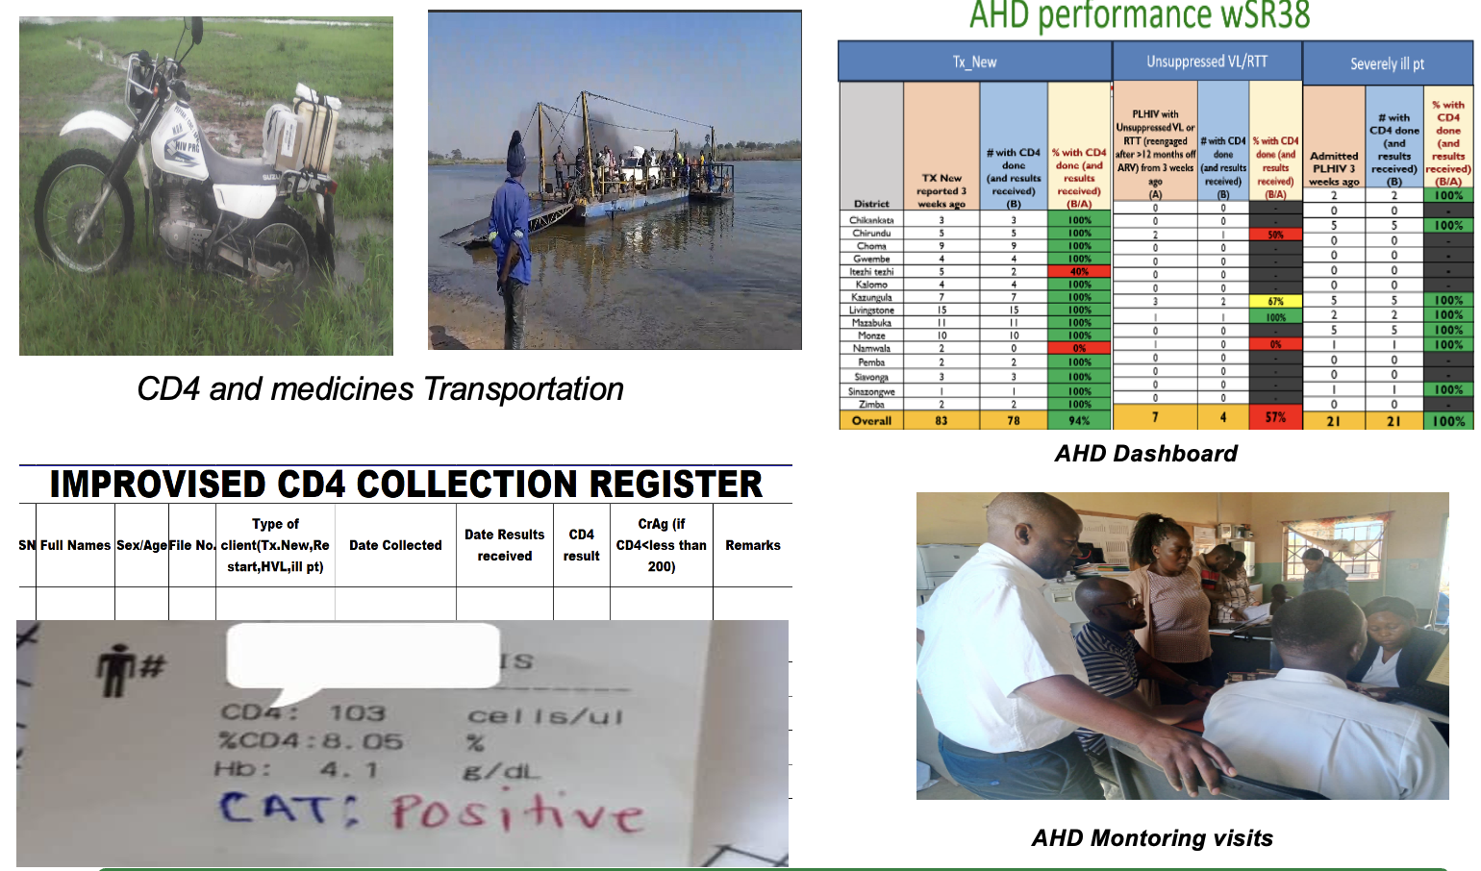
Sustain the difficult work!!!
Keep individuals on treatment
  Community workers for tracking and tracing
  Maintain DSDs
  Person centered Services
Continue testing to find the new cases
  Targeted testing
  Return testing volumes
  Broaden test kits type options
Support Logsitics and Supply chain
Support data systems

Slide 14

Advanced HIV Disease in Minimum Package of Care
Prioritise Advanced HIV Disease Service
  CD4 testing for all new, high VL, ITT>6months and seriously ill
  TB-LAM,CrAg,GeneXpert,CXR for all AHD
Prioritise retention in care, tracking and tracing
Prioritise HTS including self tests
Prioritise quality assurance and improvement services as we transition HIV services into PHC
Caution in introduction of extended DSDs such as 12 monthly MMDS and 24 monthly viral load

Slide 15
Threats on Advanced HIV Disease Services Emerging Funding Changes
SERVICE SCOPE
HUMAN RESOURCES
COMMODITIES
Shift to ARVs-only provision
Workforce losses
Commodity insecurity
Prioritization problem
AHD services are heavy on resources
Reduction in absolute staff numbers
Skill erosion from curtailed training and capacity building and task-shifting to routine workers
CD4 cell count testing challenges
Disrupted distribution of core AHD commodities
M&E / DATA
INPATIENT CARE
COMMUNITY LINKAGE
Stagnation of AHD monitoring
Poor in-patient AHD services
Weak post-discharge follow-up
Deprioritisation of AHD indicators in routine reporting
Weakened accountability for service quality
Inconsistent AHD package of care on admission wards
Limited screening and management of AHD-defining conditions
Gaps in community tracing after hospital discharge
High risk of loss to follow-up and readmission
26–31 July • Rio de Janeiro, Brazil
aids2026.org

Slide 16
What opportunities exist?

Slide 17
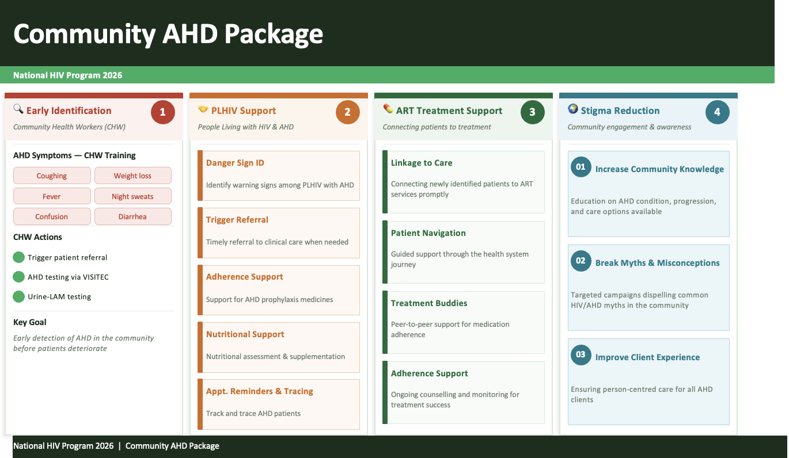
Expanded AHD Community Services
AHD community package included in polyvalent community health workers curriculum
Symptomatic screening for AHD for early identification
Early referral
Post-discharge support navigating pathways of care
Stigma reduction

Slide 18

Is there a role of AI in AHD services?
Risk predictions
Clinical decision support
Recipient of care interface for person-centered model of care

Slide 19
So we call for help!
Hold the Line on Fundamentals
Testing, linkage, and retention are the backbone of everything we've built
Find Them. Hold Them. Save Them.
Screening, Prophylaxis and treatment for AHD with fidelity
Innovate or Fall Behind
The old models won't carry us through this transition.
Help Us!

Slide 20

Acknowledgments
Ministry of Health Zambia
CHAI Zambia
Advanced HIV disease during the first six months on antiretroviral therapy in Zambia AHD Zambia: RETURN6 preliminary results policy brief
SPHO
AIDS2026
Victoria falls Zambia

