Slide 1
The true cost of delivering effective AHD screening and prevention packages
Ana Moore, CHAI
Unfinished business: Ending preventable deaths from advanced HIV disease in a changing HIV response

Slide 2
Goals of this presentation:
  Present the cost-effectiveness of AHD commodities and services
  Emphasize the cost of not providing the package of care and the impact on preventable morbidity and mortality

Slide 3
The WHO-recommended AHD package of care is deliberately simple and appears cost-effective; timely presentation matters
WHO 2022 consolidated guidelines: comprehensive package for all PLHIV with CD4 <200
WHO 2022 consolidated guidelines: comprehensive package for all PLHIV with CD4 <200
CD4 Testing
(AHD Screening)
$4-$16
TB LAM
(TB Screening)
$3.70
CrAg LFA
(CrAg Screening)
Histoplasmosis &
Other OI Screening
$2.40-$3.20
$6-$10
TB LAM
Positive
TB LAM
Negative
CrAg
Positive
CrAg
Negative
Positive Result
$8 - 15
Molecular Confirmation &
DST (GeneXpert)
Initiated
on TPT
Preemptive
Prophylaxis
Linked to Treatment
$14 - 20
$3.35
$1,654
Confirmatory CSF testing
(LP Procedure + CrAg LFA)
GeneXpert
Positive
$37-108
Excludes severe bacterial infections and future costs for expanded screening (toxoplasmosis, talaromycosis, cytomegalovirus). Prices include consumables only and exclude platform investments.
Linked to TB
Treatment
CSF
Positive
CSF
Negative
$35 - $3k+
CM Treatment
Initiated
$271
Preemptive
Prophylaxis
$3.35
Entry point
Result / decision point
Screening test
Treatment / prevention initiated

Slide 4
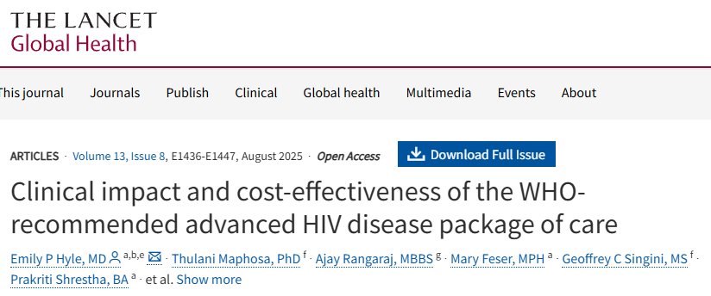





As programs finalize HIV budgets, the clinical impact and cost effectiveness of AHD must be emphasized
Methods:
Simulated adults initiating/reinitiating ART in Malawi (25% with AHD).
Compared 13 strategies, ART-only up to the full WHO AHD package (sputum Xpert + urine-LAM + TB preventive therapy + serum CrAg/pre-emptive fluconazole + co-trimoxazole).
Threshold for cost-effective: <$600/QALY (2023 Malawi GDP per capita).
5-year budget impact modelled for 80,000 people initiating ART.
TB
CM
SBIs
Cost effectiveness
$580/QALY
Budget impact
15% incremental budget requirement (vs ART-only)
In Malawi, the total cost of providing the package of care to 80,000 people over 5 years cost $51M vs $44 for ART only representing 2% of Malawi's 2022–23 external HIV budget
30%
25%
38%
Incremental cost effectiveness ratio (ICER) for the full package — cost-effective vs the $600/QALY threshold
1-year reduction in deaths vs ART-only
Greatest life expectancy of all 13 strategies tested
Bottom line: the package is cost-effective but not cost-saving — it extends life, which itself adds ART/care costs. Authors conclude
WHO package of care “should be made widely available in Malawi and similar settings”
CD4 testing remains essential to identify asymptomatic AHD, even in the Treat-All era.
Source: Hyle EP et al. Lancet Glob Health 2025;13(8):e1436–e1447. doi:10.1016/S2214-109X(25)00190-1

Slide 5
The later a client presents to care, the more costly the intervention; more importantly, the lower the chance of survival
Total cost per patient episode¹
Commodity cost
Hospital costs
Total cost
Probability of survival²
Outpatient (CrAg-)
$8-$21
–
$8 - $21
~91%
6-mo survival, CrAg-negative
CrAg+, titre <1:160 (fluconazole)
$19 - $133
–
$19 - $133
~87%
fluconazole alone adequate at low titre
CrAg+, titre 1:160-639 (fluconazole)
$19 - $133
–
$19 - $133
~65-75%
2.6x risk vs low titre; fluconazole often inadequate
CrAg+, titre ≥1:640 (needs CM-level care)
$335
$1,706
$2,041
<30%
fluconazole fails; effectively converges to CM treatment
Outpatient (TB LAM -ve)
$9.31 - $21.88
–
$9.31 - $21.88
~90-93%
1-yr survival, LAM-negative outpatients
Outpatient (TB LAM +ve)
$17.28 - $29.85
–
$17.28 - $29.85
~65-75%
1-yr survival, LAM-positive outpatients
Inpatient (CM, L-AmB + 5FC)
$335
$1,706
$2,041
~75%
10-wk survival, AMBITION-cm regimen
Inpatient (TB, first-line regimen)
$70 - $419
$348 - $1,503
$418 - $1,922
~70%
2-mo survival, hosp. HIV/TB (range 54-88% by risk)
Inpatient (Severe histoplasmosis)
$988 - $4,038
$1,921
$2,908 - $5,959
~50-65%
survival with treatment, LAC cohorts
¹ Assumptions and sources are provided in the appendix
² Illustrative ranges from AMBITION-cm; CrAg screen-and-treat and titre-stratified cohorts (Uganda, South Africa, Ethiopia); urine-LAM outpatient/ART cohorts (South Africa, Malawi); hospitalized HIV/TB mortality risk-score cohort; Latin American histoplasmosis mortality studies

Slide 6





Data from national programs highlights key gaps between eligible clients who have received the package and what is recommended
Common gaps between recommended and implemented AHD packages
CD4 testing at ART initiation
Inpatient AHD identification
Ideal: 100% of new ART starts
Actual: 16-83% in four assessed countries
Ideal: Systematic CD4 + OI screen on admission
Actual: Rarely protocolised; depends on clinician
TB-LAM testing (CD4 <200)
CrAg reflex testing
Linkage to care is complicated by cost and hesitation of HCWs to perform and of patients to receive a lumbar puncture
Ideal: All patients with CD4 <200
Actual: 5-60% in four assessed countries; stockouts are frequent
Ideal: All LAM-tested or CD4 <200
Actual: 25-100% in four assessed countries
Fluconazole prophylaxis
CM treatment (L-AmB + 5FC)
● Red = critical gap (routine data) ● Amber = significant gap
Ideal: All CrAg+ receive pre-emptive Rx
Actual: Inconsistent; supply chain failures
Ideal: Full course for confirmed CM
Actual: L-AmB/AmB-D often available; 5FC rarely so
Source: CHAI 2025 AHD Landscape Assessment

Slide 7



Ensuring people receive care requires a careful consideration of how commodities and services reach them
Essential AHD diagnostics and therapeutics are available — but reaching patients is hard
Available Diagnostics
CD4 Reagents & QC Materials
AHD diagnosis
TB LAM Urine Test
TB screening
CrAg LFA
CrAg screening
Available Therapeutics
Fluconazole
CM prophylaxis
Amphotericin B
CM treatment
Flucytosine
5FC combination
Barriers between eligible clients and AHD care
Patient- and Service Level
Health System
Structural
Fears of stigma and disclosure
Late recognition/misdiagnosis
Disengagement from care
Cost of seeking care
Distrust of conventional health services
Missed clinical opportunities
Diagnostics access gaps
Fragmented entry points
HCW capacity and training gaps
Weak defaulter tracing
Constrained AHD funding
Weak community-facility linkage
Fragmented integration
Limited M&E visibility

Slide 8
Addressing structural barriers requires market shaping, strengthening referral networks, and improving F&Q and stock management
Key health system and structural gaps between clients and AHD care
Barrier |  | Solution
Diagnostics access gaps |  | Revisit min. package of care at different levels; consider centralizing CrAg/LAM testing & stock management at district hub with satellites batch samples
HCW capacity and training gaps |  | Task-shift AHD screening and point-of-care testing to trained lower-cadre staff; adopting digital tools to ease HCW burden on reporting
Constrained AHD funding |  | Pool & consolidate procurement — Global Fund/ PEPFAR pooled volumes; market-shaping for LAM & 5FC
Weak community-facility linkage |  | Formalize community-facility referral and sample-transport networks
Fragmented integration |  | Embed AHD commodities in existing MoH pharmacy/ART workflows rather than parallel systems
Limited M&E visibility |  | Annual forecasting, real-time reporting and quarterly stock reviews

Slide 9
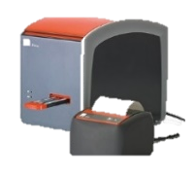
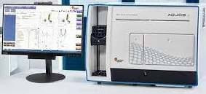
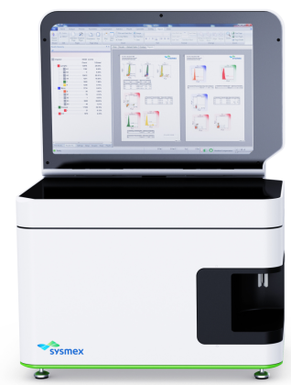


Ensuring access to CD4 remains critical as the gateway to the package of care
CD4 landscape: currently available options and those close to market entry
Manufacturer | Product |  | Sample | Status | Price / Instrument | Price / Test Source
SRA-approved & commercially available
Abbott Rapid Dx Germany | PIMA CD4 — quantitative POC |  | Venous / capillary blood | Instrument discontinued Cartridges & service continue | $6,095 UNICEF SD | $9.29–$15.98 Abbott, July 2026
Beckman Coulter USA | Aquios CL — conventional flow cytometer |  | Venous whole blood | Available | Not publicly available | €7.30¹ Beckman Coulter, 2024
Sysmex Partec Germany | CyFlow — near-POC conventional |  | Venous whole blood | Available | $20,000+ (est.) | $3.00^{1,2} Sysmex, January 2025
AccuBio UK | VISITECT CD4 Advanced Disease (200-cell cutoff) |  | Venous / capillary blood | Available | Not required | $4.18 Global Access Price, June 2026
Not yet SRA-approved
AccessoBio USA | VITA CD4 — quantitative POC |  | Venous / capillary blood | In development WHO PQ targeted EOY '27 | ~$10,000 (est.) | ~$7.00 AccessoBio, January 2026
¹ should be confirmed with supplier and may depend on volume-based agreements;
² rental agreements are available whereby the cost of the platform is included in the test price, and no upfront investment is needed

Slide 10



What needs to happen?
What is achievable within existing budgets? What requires additional investment?
National programs
Funders
Partners, inc. CSOs
Optimize CD4 testing networks and referral pathways especially between inpatient and outpatient care
Explicitly protect/ring-fence AHD commodity allocations during donor transitions
Document and disseminate true AHD service delivery costs to inform national advocacy
Identify highest priority populations, facilities and right size the package of care to maximize reach within available resources
Support country-level AHD costing to baseline true expenditure vs. need
Build AHD M&E into integrated HIV program monitoring systems
Itemize and protect AHD commodities within HIV program budgets; flag urgent gaps
Collaborate and share data to drive market transparency and stabilize the markets for AHD commodities particularly CD4 and 5FC
Adopt standardized F&Q tools and WHO’s minimum data set; run regular review cycles
Support innovative solutions to improve efficiency and effectiveness of M&E and PSM systems
Expand systematic CD4 testing coverage, esp at ART initiation and decentralized sites; scale up supporting solutions for VISITECT (reader & EQA)
Secure volume guarantees and long-term agreements for CD4, TB-LAM, and CM treatment commodities
Scale community-led monitoring and peer support to address stigma and drive demand
Establish stock visibility and emergency redistribution systems to prevent stockouts and expiries
Ensure national HIV financing mechanisms (MOUs, Global Fund grants) explicitly name and fund AHD commodities and services
Expand AHD EMR and digitization tools to reduce health-worker burden
Within reach: achievable with existing resources
Needs funding: requires additional or redirected resources

Slide 11
Appendix

Slide 12
Sources and assumptions used in calculations
Costing of the WHO-recommended AHD package of care
  CD4: Low-end VISITECT ($4.18/test | Global Access Price as of July 2026); high end PIMA ($9.29-$15.98/test | all-inclusive offer, Abbott July 2026
  TB LAM: $3.70/test | Global Access Price, Global Fund July 2026
  CrAg LFA: $120/50 pack, $80/25 pack. IMMY, February 2026
  LP (commodity source alone not reported, however the costs of providing LP is Kenya is reported as $35-105 for public sector (link) while in South Africa is subsidized at R20-60pp
  CM Prophylaxis: each patient needs 67% of a pack of Fluconazole, and a 1000 pack of 200 mg tablets is $5.00
  CM Tx: Taken the average of the four available CM regimens, assuming L-Amb = $23, 5FC = $75, AmB-D = $7.13 per 50mg/vial. Single dose L-AmB = $405 | 7 day short course = $664-710 | AmB-D + 5FC + fluc = $130-166 | Oral regimen = $129
  GeneXpert: $7.97/test | Global Fund
  TPT: $14.25 | MedAccess, Unitaid, CHAI and The Aurum Institute
  TB (DST) STOP TB
  TB first line: $35 Malawi, $56 RSA, $76 Uganda (University of Oxford, WHO)
  XDR treatment $2,922 in RSA (University of Oxford, WHO)
  Histo Dx: $10/test | MiraVista. Histo ELISA is $578.81 for 96 ($6.03)
  Histo Tx: Weighted average of the cost of the severe regimen ($4026.00, 66% of cases) and the moderate ($975.82, 34% of cases). L-AmB = $75 per 50mg vial, AmB-D = $7.13 per 50mg/vial, Itraconazole - $24.00 per 40 pack 100mg capsule
Cost per patient episode
  Outpatient CrAg -: HIV test ($0.80-$8.18)+ CD4 ($4.81-10) + Crag LFA ($2.40-$3.20). Range of $8.01-21.36
  Outpatient CrAg+: HIV test ($0.80-$8.18)+ CD4 ($4.81-10) + Crag LFA ($2.40-$3.20)+ CSF CrAg ($2.40-$3.20) + LP ($5.00-$105) + Fluc ($3.35) = Range between 18.76 -132.93
  Outpatient (TB LAM -ve): HIV test ($0.80-$8.18)+ CD4 ($4.81-10) + TB LAM ($3.70)
  Outpatient (TB LAM +ve): HIV test ($0.80-$8.18)+ CD4 ($4.81-10) + TB LAM ($3.70) + GeneXpert ($7.97)
  Inpatient (CM, L-AMB + 5FC): Hospital costs + HIV test + CD4 + CrAg LFA, CSF CrAg + LP + L-AmB and 5FC regimen | Uganda: $1,349 | Nigeria: $1,467 | South Africa: $2,136 | Botswana: $1873 | Average $1,706
  Cost of 2 week induction period (link)
  Bed-day rates from AMBITION: Uganda $13.85/day, Zimbabwe $15.90/day, Malawi $18.36/day, South Africa $80.66/day, Botswana $88.80/day
  TB first-line inpatient: lower end: Commodity costs – average of HIV test + CD4 + TB LAM + GXP + First line TB from GDF 2021 pricing = ~$70 | Averaged hospitalization cost = ~8-day mean inpatient stay for HIV+ TB patients (Zetola et al x bed-day cost in each of Uganda/Zimbabwe/Malawi/South Africa/Botswana (from AMBITION-cm trial costing paper). Total = $348.11; higher end: Long et al (2016) High Cost of HIV-Positive Inpatient Care at an Urban Hospital in Johannesburg, South Africa (link)
  Histoplasmosis: hospital cost: Rajasingham et al 2023 (link) | Adherence counseling: $20 per 3 months – Phillips et al 2016 (link) | ART: $43.43 in Uganda, Madu et al 2025 (link) | HIVST: $0.80 (CHAI Market Impact Memo 2025) - $8.18 for both testing & counseling (link)

