Slide 1
Monitoring & evaluation for advanced HIV disease
Maureen Syowai, ICAP at Columbia University, Kenya
Unfinished business: Ending preventable deaths from advanced HIV disease in a changing HIV response

Slide 2
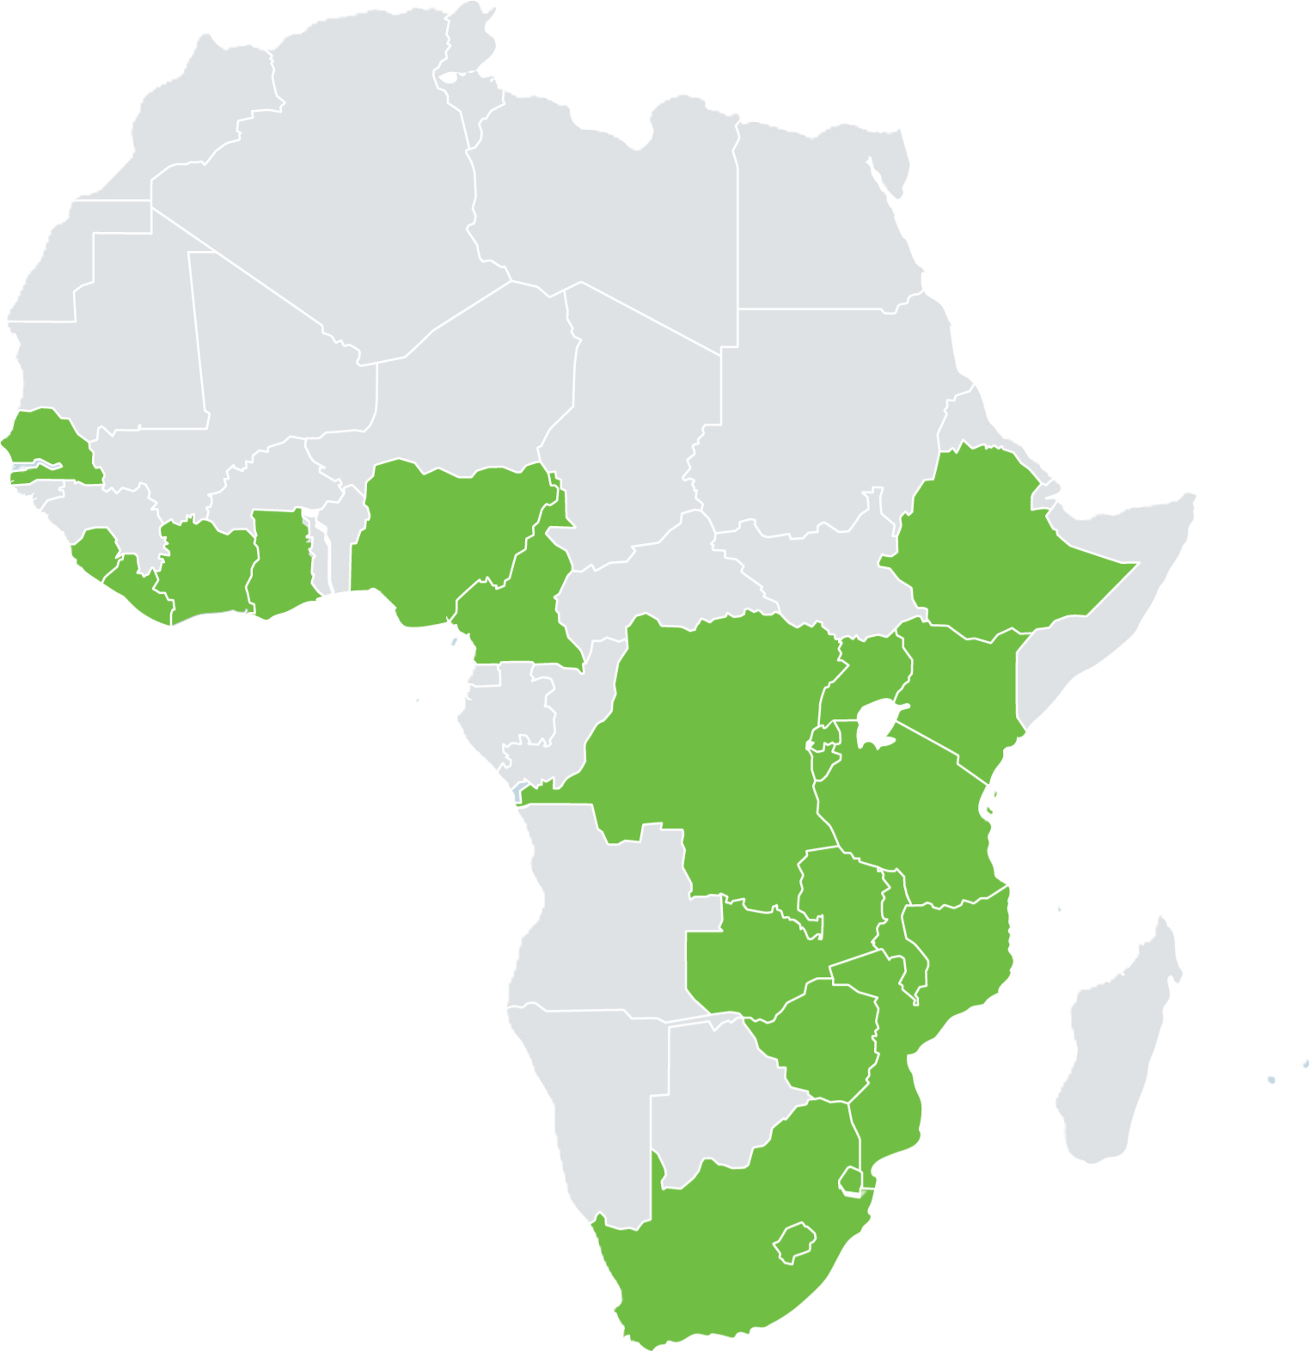

Outline
Shifting M&E Systems: Transitioning to Government‑Led M&E
AHD Metrics: Aligning Indicators to Systems & Epidemics
Data Trends: Signals in the AHD Data from National HMIS: 2024–2026
Call to Action: Protecting AHD M&E in a Time of Transition

Slide 3

CQUIN: HIV Coverage, Quality, and Impact Network
Convening local health system leaders to accelerate the scale-up of high-quality, high-impact person-centered HIV services since 2017.
ICAP provides technical assistance and thought leadership.
AIM: To promote country-to-country learning, knowledge sharing, and the co-creation of practical tools.
GOAL: Increased coverage and quality of person-centered HIV services for enhanced health outcomes.
Burundi
Cameroon
Côte d’Ivoire
DRC
Eswatini
Ethiopia
Ghana
Kenya
Lesotho
Liberia
Malawi
Mozambique
Nigeria
Rwanda
Senegal
Sierra Leone
South Africa
Tanzania
Uganda
Zambia
Zimbabwe
21 COUNTRIES
FUNDED BY
THE BILL & MELINDA GATES FOUNDATION
CONVENED BY ICAP AT COLUMBIA UNIVERSITY
cquin.icap.columbia.edu

Slide 4
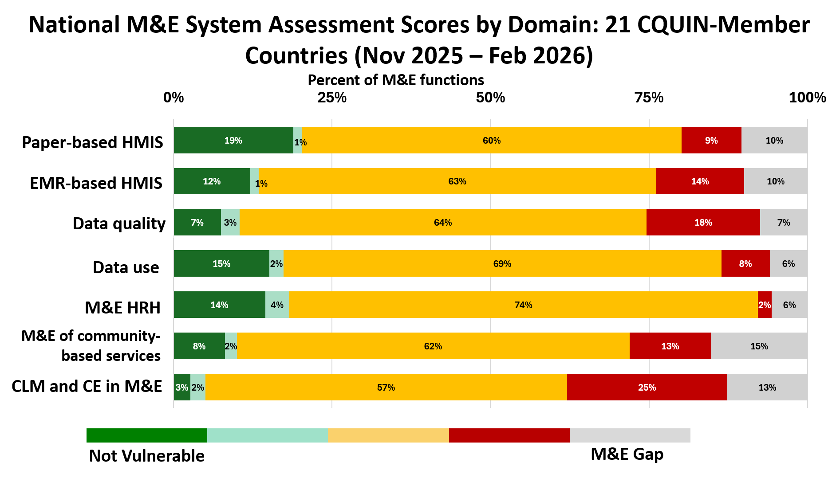
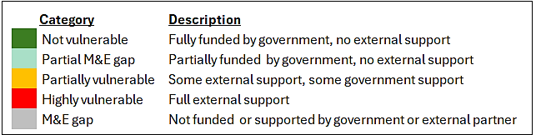
Shifting M&E Systems: Transitioning to Government‑Led M&E
The M&E Landscape Is Shifting
Countries are transitioning from donor‑driven systems to government‑owned, integrated M&E platforms.
AHD monitoring must adapt to national HMIS realities, data flows, and governance structures.
All domains had external support and/or gaps in 80+% of M&E functions
Source: ICAP CQUIN National M&E System Assessment (Nov 2025 – Feb 2026)

Slide 5
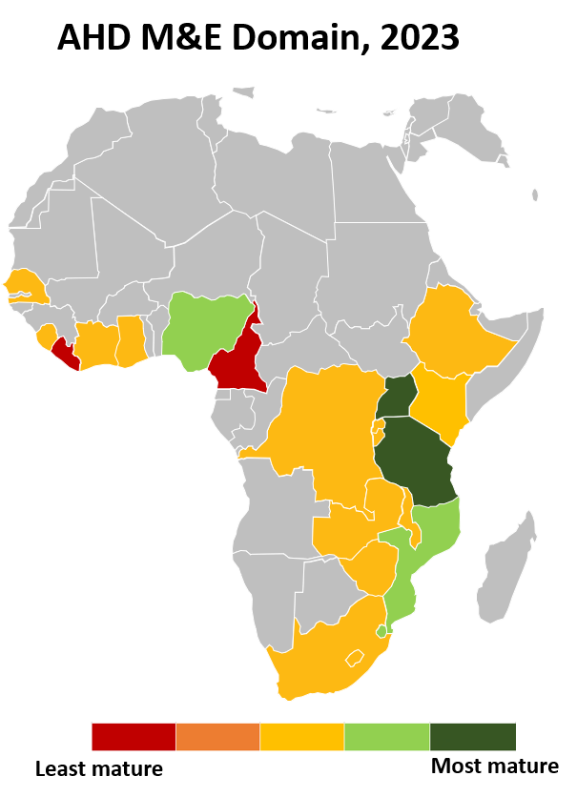
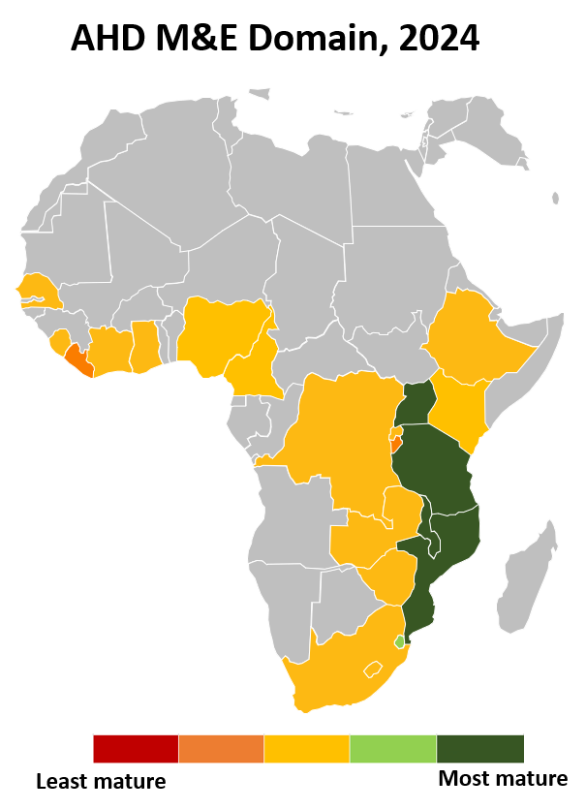
State of AHD M&E Across CQUIN-Member Countries
AHD is Under‑Measured and Under‑Managed
Progress in M&E of AHD
(2023 and 2024)
Limited Visibility into AHD Performance
Most countries cannot produce meaningful AHD cascades: data gaps exist at every step from identification to management.
AHD indicators are inconsistently captured, fragmented across tools, or missing in national HMIS/DHIS2 platforms.
Reporting pathways for AHD are often parallel, manual, or donor‑driven, resulting in poor completeness and weak national ownership.
Significant Gaps in Routine AHD Monitoring
CD4 testing coverage remains uneven, limiting the ability to identify and manage AHD early.
Recognizing and monitoring all populations likely to experience AHD, beyond people newly initiating ART, still falls short.
The In‑Patient Blind Spot
AHD management in inpatient settings, where the sickest patients are seen, is almost entirely invisible to national HIV programs.
Progress on M&E of AHD has been slow over the years even with WHO AHD guidance dating back to 2017
Source: ICAP CQUIN AHD CMM Assessment (2023 and 2024)

Slide 6
AHD Metrics: Aligning Indicators to Systems & Epidemics
Opportunities to Prioritize and Strengthen AHD M&E
Integrate AHD indicators into HMIS/DHIS2 workflows and national dashboards.
Address the inpatient AHD blind spot through sentinel surveillance while hospitals transition to EMRs.
Use M&E system‑shift periods to harmonize definitions, tools, and reporting pathways.
Strengthen data use capacity at facility, subnational, and national levels.
Leverage synergies with TB screening, mortality audits, CD4 testing systems, and community reporting.
AHD M&E Framework & Indicator Rationalization
Rationalize AHD indicators based on:
  Epidemic context (AHD burden, testing coverage, mortality trends).
  System capabilities (lab connectivity, digital maturity, data flow reliability).
  M&E shifts (integration, interoperability).
Aim for a lean, high‑value indicator set that is feasible, actionable, and aligned with national priorities.
Ensure indicators reflect what systems can reliably produce and what programs need to act on.

Slide 7
Data Trends: Signals in the AHD Data from National HMIS: 2024–2026
21 CQUIN-Member Countries
Countries with up-to-date HMIS Submissions
AHD Identification Data Available - 6 Countries
Data completeness:
Partial data set – 3 countries
Complete data set – 3 countries
Source: National HMIS Data Submissions to ICAP CQUIN
Notes:
This data is on AHD Identification among People Initiating ART (n=3 countries)
CD4 Testing among New ART Initiators is fairly stable across periods 44,499 to 41,191 to 45,776. This is despite the sharp decline in people initiating ART from 125,383 (Q1 2024) to 83,820 (Q1 2025), then some recovery to 97,288 (Q1 2026).
AHD Identification - Increased from 10,096 (Q1 2024) to 11,908 (Q1 2025), then slightly decreased 10,477 (Q1 2026) with the proportion of advanced HIV disease cases remaining high, implying persistent late presentation or incomplete early testing.
AHD burden remains significant, and CD4 testing coverage continues to be the main bottleneck for accurate identification.

Slide 8
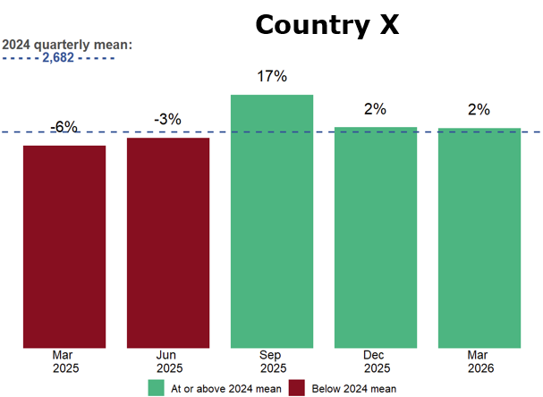
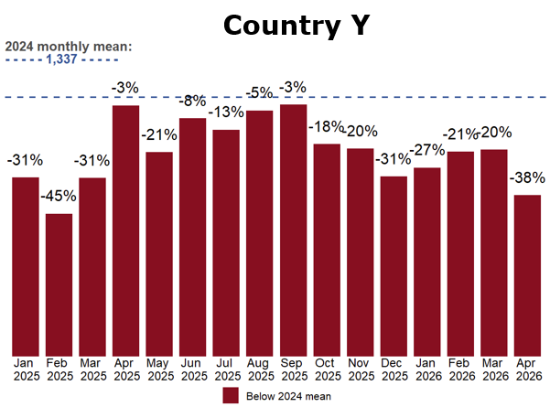
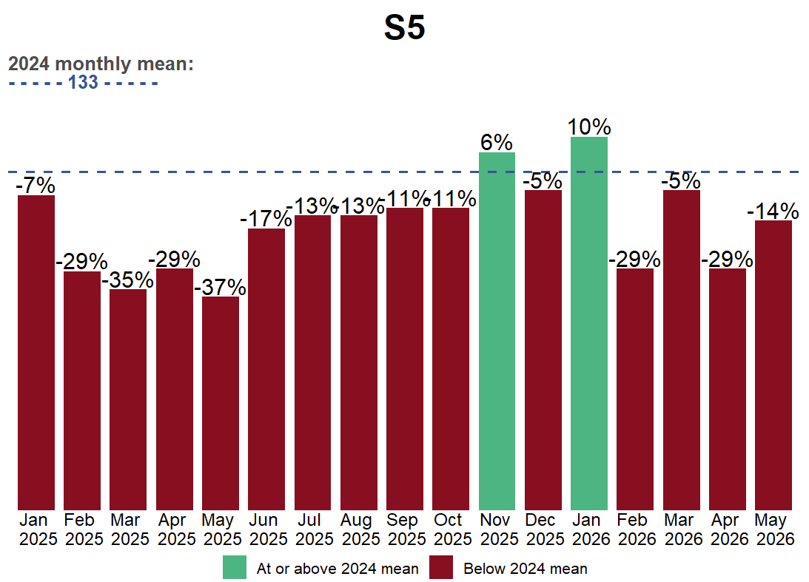
Current State of HIV-Related Deaths Reported Among People Receiving ART
[2025–2026 Trends Relative to the 2024 Baseline (3 Countries)]
Country Z
Deaths are largely captured through passive reporting: most are documented after tracking and tracing reveals that a recipient of care has died, resulting in delayed and incomplete mortality data.
Inpatient deaths remain a major blind spot: hospital wards rarely use EMRs, and paper‑based inpatient mortality is not routinely integrated into national HIV M&E or DHIS2 systems.
National mortality data is fragmented: civil registration systems are inconsistently linked to HIV programs, limiting reliable death ascertainment. Underscores the need for strengthened mortality surveillance, including sentinel platforms.
Observed declines may not reflect improvements in mortality outcomes as reduced death ascertainment and documentation during 2025–2026 cannot be ruled out
Source: National HMIS Data Submissions to ICAP CQUIN
Notes:
Summary of graphs:
Notably, documented deaths remained largely below 2024 mean levels and improved outcomes on mortality should be interpreted cautiously
Country summaries
Country X (Quarterly)
Mortality remained broadly stable around the 2024 baseline (−6% to +17%), with occasional quarterly increases suggesting intermittent spikes rather than a sustained trend.
Country Y (Monthly)
Documented deaths remained consistently below the 2024 mean (−45% to −3%), suggesting a sustained decline, although incomplete death ascertainment cannot be ruled out.
Country Z (Monthly)
Mortality fluctuated around the 2024 baseline (−37% to +10%), indicating variable reporting or localized changes rather than a consistent trend.

Slide 9
Call to Action: Protecting AHD M&E in a Time of Transition
Preserve M&E for AHD During System Transitions
Call for governments to actively safeguard AHD metrics within redesigned national HMIS systems
Prioritize High‑Value, Feasible AHD Indicators
Lean, rationalized indicator set reflecting epidemic realities, aligned with system capacity, and producing actionable insights
Recognize and Monitor Populations likely to Experience AHD
PLHIV newly initiating ART
PLHIV re-engaging in care following disengagement
PLHIV on ART with virologic failure
PLHIV who are hospitalized or seriously ill or are considered clinically unstable
Children < 5 yrs, and not yet established on ART
AHD Indicators Should Reflect the AHD Cascade
Strengthen National M&E Ownership While Maintaining Technical Rigor
AHD Screening & Identification
TB Screening, Prevention, Diagnosis & Treatment
CM Screening, Pre-emptive Therapy, Diagnosis & Treatment
Mortality Data

Slide 10

Acknowledgments
Ministries of Health, recipients of care, communities, donors, implementers, academics, and other key stakeholders in CQUIN countries
The World Health Organization, UNAIDS, Global Fund
United States Government
The International Treatment Preparedness Coalition
The International AIDS Society
The Clinton Health Access Initiative
The South-to-South Learning Network
The CQUIN team and ICAP leadership and staff around the world
The Gates Foundation

Slide 11
Thank You!

